Slide 1
A3i-Accel Frontend v2
Research, design and a working website concierge
Assignment 3
Implementation and evidence as of 19 October 2026
1 / 10
Notes:
Cover. Existing approved company name and logo. This deck reports current evidence rather than claiming all assignment work is complete.

Slide 2
The visitor’s decision
Understand the offering, then find relevant work
A growing portfolio needs a clear explanation.
A concrete task makes AI easier to evaluate.
A demo request needs a dependable next step.
2 / 10
Notes:
Source: assignment document and docs/PRD.md. Explain the business problem before showing animations. No conversion improvement has been measured.

Slide 3
Three visitor perspectives
Provisional personas to validate
SMB owner: reduce repetitive administration.
Operations leader: evaluate workflows and oversight.
Investor: understand the portfolio and business focus.
3 / 10
Notes:
Source: docs/research.md. These are assignment-derived hypotheses, not interview findings. Describe the distinct information each visitor needs.

Slide 4
Five benchmarks
Activities and examples make products easier to explore
LangChain: organize discovery around work stages.
Intercom and Notion: explain recognizable capabilities.
Linear and Zapier: connect products to workflows.
4 / 10
Notes:
Desk research, 19 October 2026: https://www.langchain.com/ ; https://www.intercom.com/ ; https://www.notion.com/product/ai ; https://linear.app/ ; https://zapier.com/ . See docs/research.md for individual teardowns and limitations. These observations are not claims of competitor conversion performance.

Slide 5
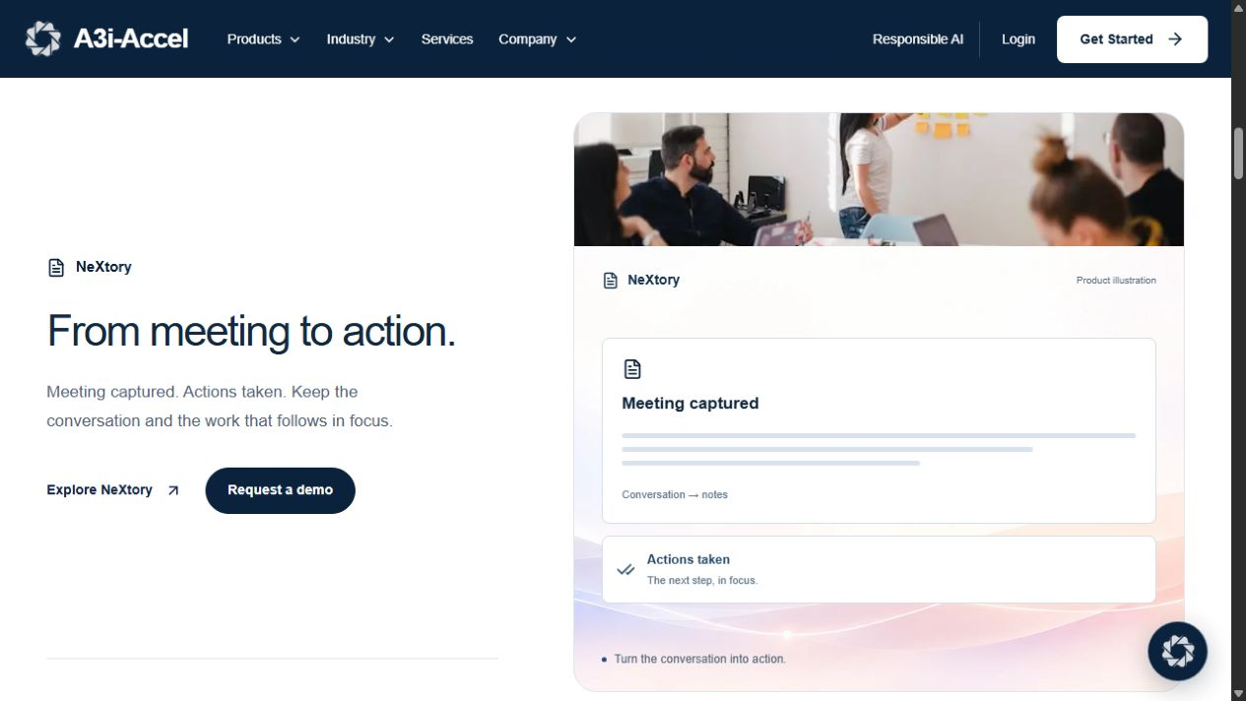
Homepage structure
The approved journey
Motto and platform introduction
Six products, Why A3i and workflow exploration
Apps / Ants / Agents, examples and demo CTA
5 / 10
Notes:
Source: src/components/home/home-preview.tsx and docs/DESIGN.md. Existing product names remain unchanged by user instruction. Figma creation is deferred. Illustration is an existing site screenshot, not a new design.

Slide 6
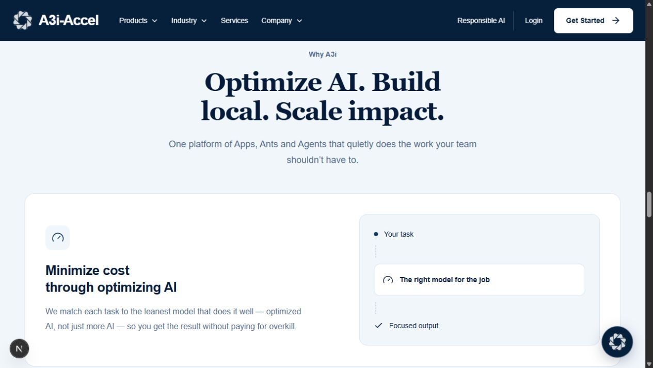
Responsive interaction
Readable content with optional motion
Keyboard controls and visible focus
Mobile stacking and natural text wrapping
Reduced-motion fallbacks and replay on scroll
6 / 10
Notes:
Source: existing Why A3i implementation and previous browser checks recorded in docs/MEMORY.md. Screenshot is previously captured implementation evidence. Full production accessibility acceptance still needs manual review.

Slide 7
Application architecture
Next.js frontend with a separate Python API
React, TypeScript and Tailwind render the site.
Server routes proxy chat and demo requests.
FastAPI connects retrieval, generation and storage.
7 / 10
Notes:
Source: package.json, src/lib/server/agent.ts, src/app/api and sibling Chatbot source. Browser -> /api/chat -> /chat/stream; browser -> /api/leads -> /leads. Model/search keys remain server-side. Netlify/GitHub publishing is deferred by user instruction.

Slide 8
Concierge and demo capture
Existing behavior and the proposed source boundary
Typed streamed replies and retry states exist.
Demo capture uses confirmed name, company and need.
Supplied-content grounding awaits proposal approval.
8 / 10
Notes:
Source: src/components/chat/chat-panel.tsx, src/components/forms/demo-form.tsx, sibling Chatbot main.py/agent.py/leads.py. Current factual answers use official-domain live search. Proposed approved-content retrieval and explicit intent routing are documented only. A saved lead is not a booked calendar appointment. Do not present an unstarted backend as working live.

Slide 9
Measured results
Desktop passes the target; mobile performance needs work
Production build and TypeScript: passed
56 imported routes checked; 44 backend tests passed
Local Lighthouse: desktop 98 / 97; mobile 72 / 97
9 / 10
Notes:
Scores are performance / accessibility, Lighthouse 13.5.0 against local production http://127.0.0.1:3000/ on 19 October 2026, before the approved workflow-label contrast adjustment. Raw reports: .tmp/assignment-lighthouse-desktop.report.json and .tmp/assignment-lighthouse-mobile.report.json. One run per mode, not published-site scores. Backend tests use mocks and do not prove ten real factual answers.

Slide 10
Submission and live demonstration
Remaining evidence and the next review
Pending: real agent review and five participant tests.
Deferred: Figma, GitHub and Netlify deliverables.
Demo: explore a task, ask a question, request a demo.
10 / 10
Notes:
Source: docs/submission-plan.md and docs/evaluation.md. User deferred external deliverables and kept current names. Show actual service states. Complete ten reviewed questions and five-second testing with five real participants before claiming acceptance. Intended business benefit is clearer discovery, not a measured conversion increase.

