Slide 1
ChatGPT
Shourya Prasad

Slide 2
What is ChatGPT
ChatGPT is an AI-based chatbot system which OpenAI launched in November 2022. OpenAI is known for creating Whisper, an automatic speech recognition system and DALLE•2, an AI image and art generator.
ChatGPT uses the company's GPT-3 technology. It stands for Generative Pre-trained Transformer 3 and is an autoregressive language model which uses deep learning to produce human-like text. It is a language-processing AI model, and right now one of the most popular.

Slide 3
The GPT-3 training model uses a ‘generative pre-training’ training method, meaning that it is trained in a way that it can predict what token is next. For this to happen, the model requires an initial prompt text and then it will continue to produce text using that initial prompt.
The model is optimized using Reinforcement Learning with Human Feedback (RLHF) to achieve conversational dialogue. The model was trained using a variety of data which were written by people to achieve responses that sounded human-like.
It creates a natural, human-like engagement with a chatbot.

Slide 4
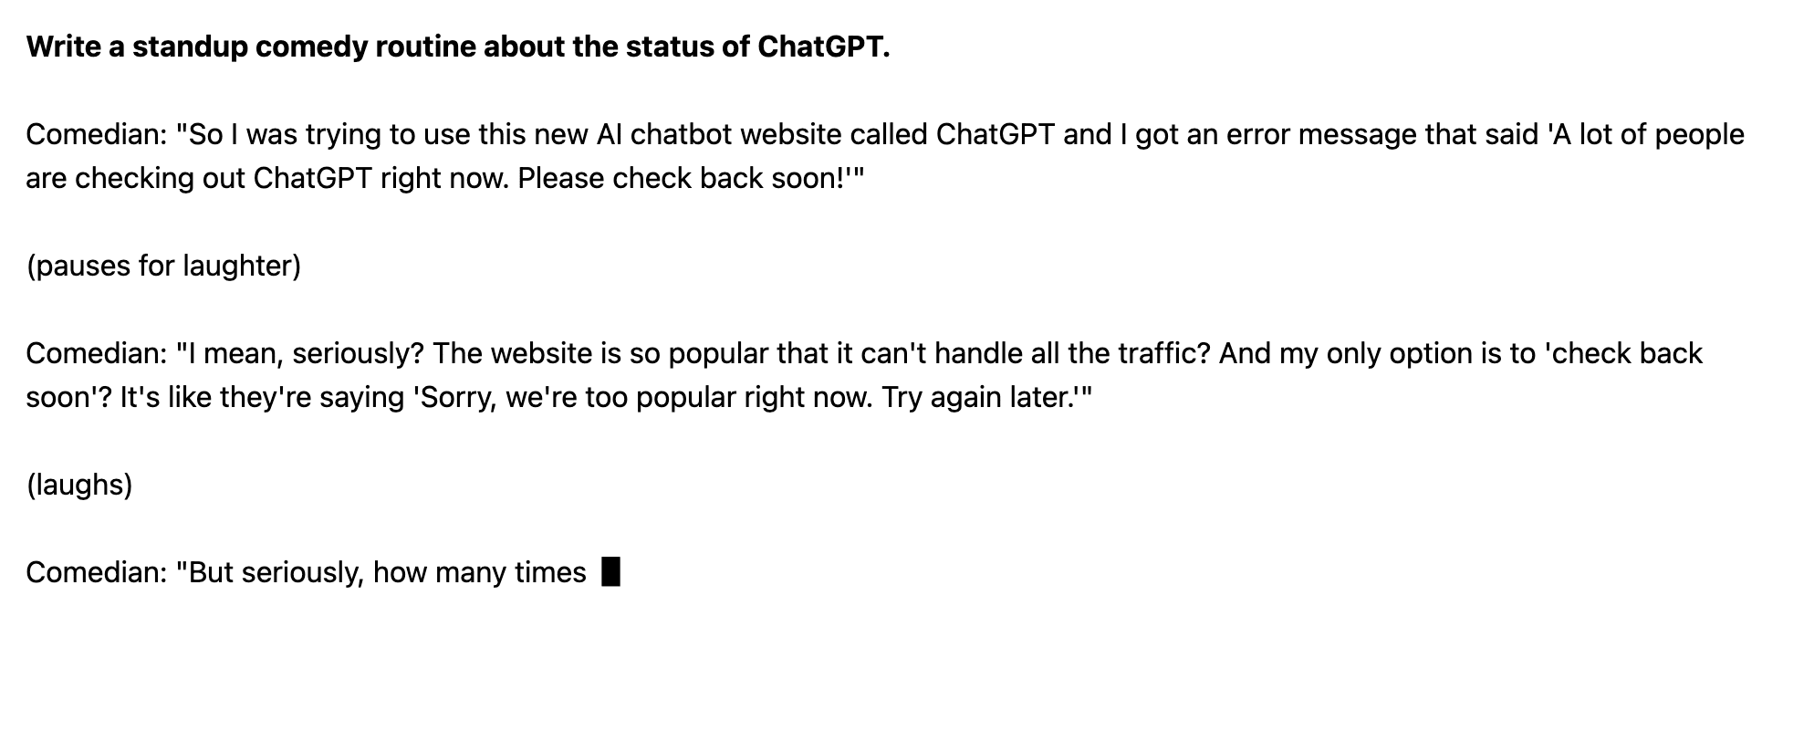
What can ChatGPT do?

Slide 5
GPT-3 is a 175 billion parameter language model, so it can be difficult to narrow down all of GPT-3’s capabilities. It is a model that focuses purely on language, so it has an in-depth understanding of the written and spoken word.
Some use cases of ChatGPT are:
Writing short-length content such as poems and limericks
Writing lengthy content such as research papers.
Explaining topics in layman’s terms or in-depth knowledge
Brainstorming topics and ideas
Personalized communication, for example, email responses
Virtual assistant that speaks in a natural and engaging tone
Summarizing long content in a shorter form
Language translations
Marketing content

Slide 6
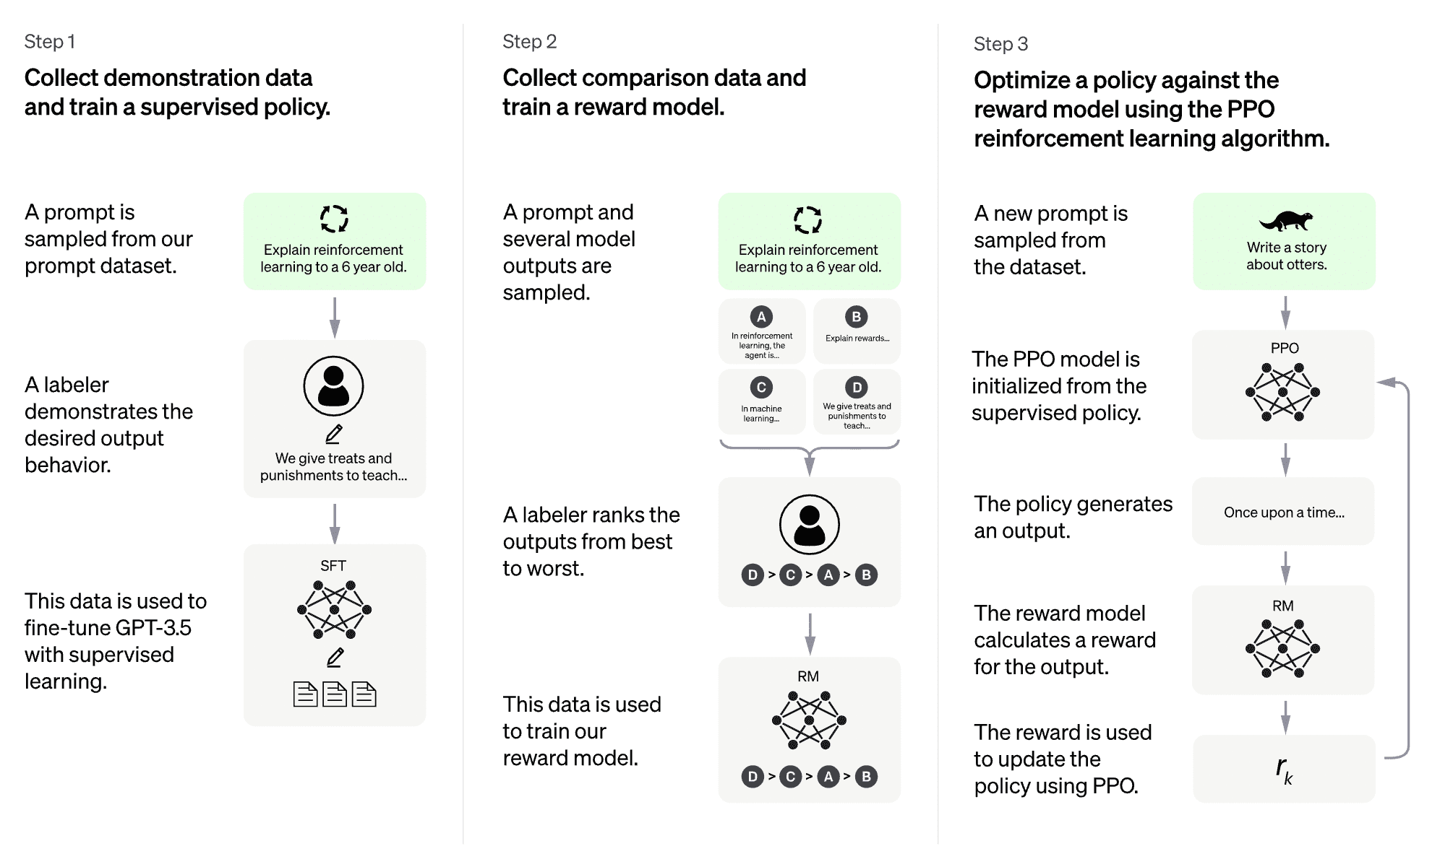
How Does ChatGPT work?

Slide 7
Limitations
ChatGPT comes with limitations.
ChatGPT has very limited knowledge of world events that occurred in the past year
It can misinterpret what you are trying to ask
It can output incorrect information
It can become overwhelming for ChatGPT if you add too many elements or become too niche in your initial prompt

