Slide 1
When can you trust a topological visualization?
A task-based evaluation of the Scikit-TDA ecosystem (ripser, persim) and KeplerMapper
Shourya Sarkar · Scientific Visualization — Evaluation of Visualization Systems · 28 October 2026
Notes:
Good morning. This talk is about a simple question: when you look at a persistence diagram or a Mapper graph, how much should you believe it? I evaluated the Scikit-TDA tools, ripser, persim and KeplerMapper, on data whose answer I know and on one real weather record. I will show what the tools give you, where the pictures can mislead, and which controls separate the effects of parameters, clustering, sampling and temporal order.

Slide 2
A topological picture is not the topology
The data's true topology
Persistent homology
Mapper graph
The drawing
What the shape really is. Usually unknown; known here only for synthetic data.
Evidence under one metric and filtration. A dominant loop means r₁ ≥ 3, a convention, not a theorem.
Depends on lens, cover, clusterer and its scale. A graph cycle is not a loop in the data.
Layout and encodings can hide components or suggest proximity without changing the graph.
• A fifth factor this study cannot measure: how a person reads the picture. No participant study was run.
• Every claim is tied to one of these four objects.
2/14
Notes:
The key move is to keep four things apart. The true topology of the data. The persistent homology evidence, which is relative to a metric and a filtration. The Mapper graph, which depends on a lens, a cover, a clustering rule and its parameters. And the drawing itself. A fifth factor, how a person reads the picture, I cannot measure, because no participant study was conducted. Throughout, a dominant loop means a gap ratio of at least three, a chosen convention and not a law of topology.

Slide 3
What was evaluated, and how
• System: ripser 0.6.15, persim 0.4.1, kmapper 2.1.0; scikit-learn, networkx and matplotlib counted as external
• Core experiments: E1 capability audit (13 tasks) · E2 Mapper parameter grid (24 cells + no-loop control) · E3 single-observer inspection
• Extension studies: weather case study · offline Mapper explorer · resampling robustness
• Controls: clusterer, null series, independent redraws, and two quantitative caveat checks
• Data with known answers: annulus (1 loop), figure-eight (2), blob (none); plus NOAA station data 2019–2024
3/14
Notes:
The system is the Scikit-TDA triad. There are three core experiments: a capability audit, a Mapper parameter sensitivity grid with a no-loop control, and a structured inspection of the figures by one observer. Three extension studies add real weather data, an offline explorer, and resampling robustness. Five control experiments test specific alternative explanations. The synthetic shapes have known answers: an annulus with one loop, a figure-eight with two, and a blob with none.

Slide 4
E1: the ecosystem computes; you assemble the rest
Native
Your code
Other packages
Not offline
install · persistent homology · diagram plot · bottleneck/Wasserstein · matching plot · static Mapper drawing
data generators · H1 barcode · reproduction harness. 130 counted glue lines in total
scikit-learn: lens and clustering · networkx: component and cycle counts · PCA baseline
KeplerMapper HTML needs D3, FileSaver and a web font from CDNs: 0 nodes drawn without a network
• Static Mapper layout can overlap disconnected components (bounding-box overlap 0.23 on three blobs)
• ripser 0.6.15 has no plotting; persim draws diagrams, not barcodes
4/14
Notes:
Experiment one asks what the tools do for you. Computing persistent homology, drawing diagrams and computing distances are native. Generators, barcodes and the harness are custom code, about 130 counted lines. Component and cycle counts need networkx, and the lens and clustering come from scikit-learn. The stock KeplerMapper HTML export loads D3 and fonts from the internet; in a cold, offline browser it throws d3 is not defined and draws zero nodes. The native static layout can also pile disconnected components on top of each other.

Slide 5
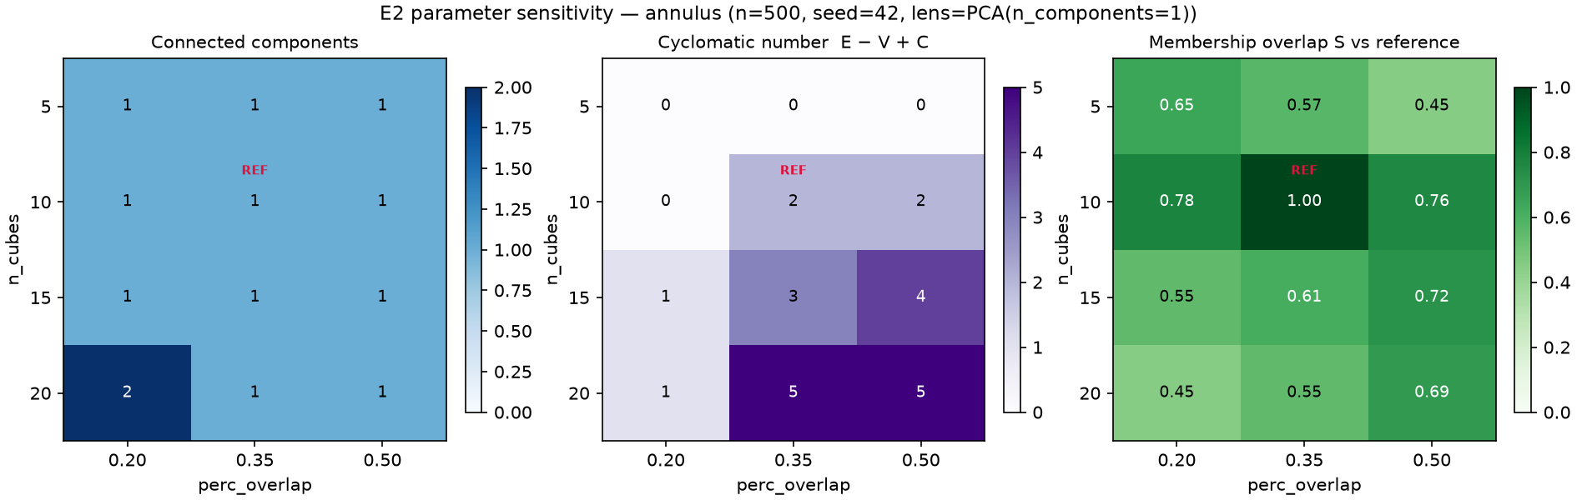
E2: cover parameters change the Mapper story
• Annulus: tree at 5 intervals, connected with 2 cycles at (10, 0.35), fragments at (20, 0.20); figure-eight: 2 components at the reference cell
• Node count = 2 × n_cubes in all 24 cells — because the clusterer is forced to make two clusters per interval
• No-loop blob: graph cycles, but no dominant H1 class
Annulus, 12 cells: components, cycles and membership overlap S by cover resolution and overlap
5/14
Notes:
Experiment two sweeps the cover. On the annulus the Mapper graph is a tree with five intervals, a connected graph with two cycles at the reference setting, and fragments at the finest setting. The figure-eight splits into two components at the reference cell. Notice that node count is exactly two times the number of intervals in all 24 cells. That is not a finding about the data. It happens because the clusterer is KMeans with two clusters in every interval. The next slide tests how much of the pattern comes from that rule.

Slide 6
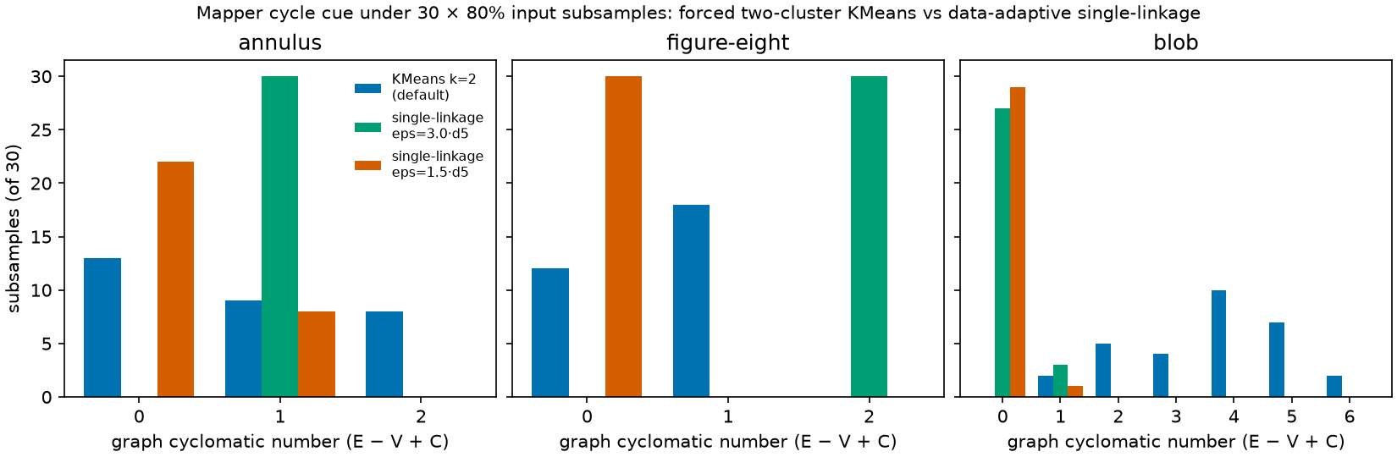
The clustering rule and scale decide whether the cycle cue survives
• Annulus, KMeans k=2: no cycle in 13/30 subsamples and 20/30 independent redraws. Single-linkage at 3× the median 5-NN distance: exactly one cycle in 30/30 and 30/30. At 1.5×: absent in 22/30, graph fragments.
• The two scales were fixed after the KMeans result was known and only these two were tried: an exploratory existence demonstration, not a recommended or independently confirmed setting.
Cyclomatic number of the Mapper graph over 30 subsamples (80%) per shape: forced two-cluster KMeans vs single-linkage at two scales
6/14
Notes:
This control asks whether the forced two-cluster rule drives the cycle result. With KMeans and two clusters, the annulus graph has no cycle in 13 of 30 subsamples and 20 of 30 independent redraws. With a data-adaptive single-linkage clusterer at three times the median five-nearest-neighbour distance, it has exactly one cycle in all 30 subsamples and all 30 redraws. At half that scale the graph fragments and the cycle is absent in 22 of 30. I chose these two scales after seeing the KMeans result, and I tried only two. So this is an exploratory existence demonstration that a data-adaptive clusterer can preserve the cycle cue. It is not an independent confirmation of a recommended scale. What it does show is that the cue depends on the clustering rule and its scale.

Slide 7
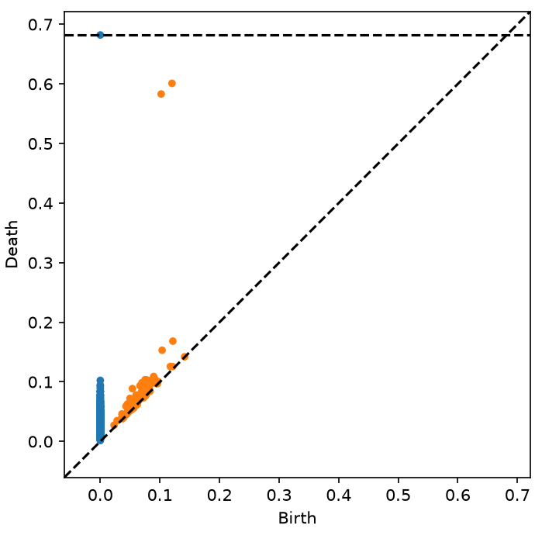
E3: what the artifacts communicate — one observer, not a study
• No participant study was conducted; no participant data exist.
• 13 stimuli inspected by the author with an AI vision model as viewing aid: 11 clearly apparent, 2 ambiguous
• Ambiguities concern encodings: unlabeled H0/H1 colours and the essential class; noise-scale Mapper cycles that look like a ring
• Evidence about artifacts, not about viewers
Stimulus S08 as inspected: no legend; the essential H0 point (top) sits on the dashed line
7/14
Notes:
Experiment three was designed as a classroom pilot. That study did not happen, and I do not imply otherwise. What exists is a structured inspection of thirteen figures by one invested observer, the author, who used an AI vision model as a viewing aid. Eleven properties were clearly apparent, two were ambiguous. Both ambiguities concern encodings: the diagram has no legend and the essential component point is drawn far from the diagonal, and a noise-scale Mapper cycle looks like a ring. This is evidence about the figures, not about how people read them.

Slide 8
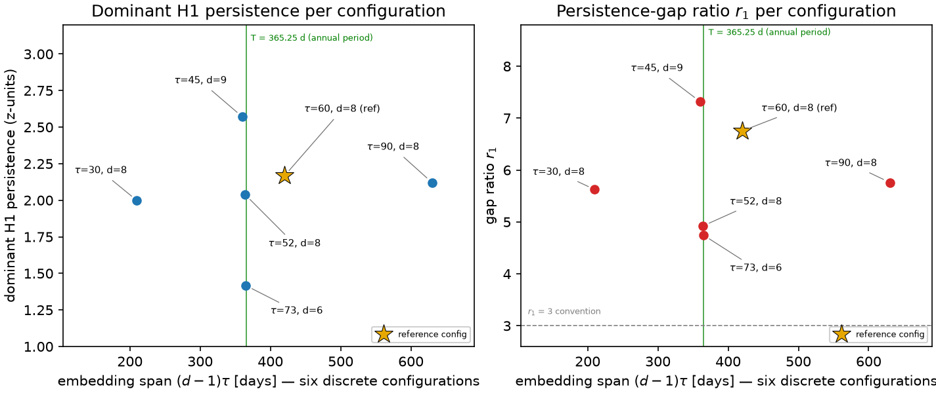
Weather: a strong H1 cue in a temporal embedding
• NOAA GSOD station 72505394728; raw files verified by hash. Embedding of daily TEMP: one dominant H1 class in all six configurations, r₁ = 4.75–7.32
• The six share one dataset and were designed around the annual period — consistency, not replication
• Static 3-D state cloud: r₁ = 1.19 — but that is an illustration, not a null control
Six sliding-window configurations of daily TEMP, Central Park, 2019–2024 (2192 days)
8/14
Notes:
On real data, I used six years of daily observations from Central Park, with raw files verified by hash. A sliding-window embedding of the temperature series shows one dominant H1 class in all six configurations, with gap ratios between 4.75 and 7.32. But the six share one dataset and were designed around the annual period, so they show consistency, not replication. The static three-dimensional cloud with ratio 1.19 is not a null control: persistence of a point cloud ignores day order, so it cannot register recurrence by construction.

Slide 9
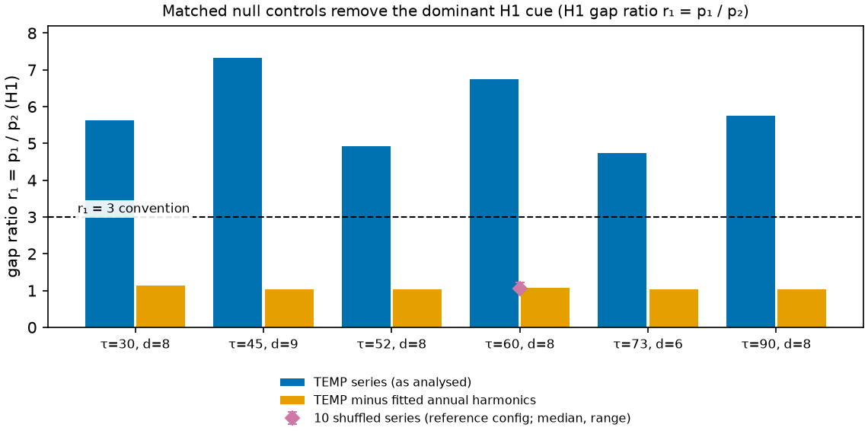
Matched null controls remove the dominant H1 cue
• Same embedding and configurations. Two annual harmonics explain 82.2% of the variance. Without them r₁ = 1.02–1.14; ten shuffles: 1.01–1.22 — none meets r₁ ≥ 3.
• H1 classes remain in the null embeddings; the dominance criterion is not met. This does not show the annual cycle is the only source, or that no loop exists.
H1 gap ratio r₁ for the TEMP series, the anomaly series (two annual harmonics removed), and 10 shuffled series; dashed line = r₁ = 3
9/14
Notes:
So I added matched null controls: same embedding, same six configurations, same ripser call. First, subtract a fitted annual cycle, two harmonics that explain 82 percent of the variance. The gap ratio falls to between 1.02 and 1.14. Second, shuffle the days: ratios between 1.01 and 1.22, none reaching the threshold of three. H1 classes are still present in these embeddings; what is absent is a dominant one under the stated criterion. So the cue depends on the annual harmonic structure and on temporal order in these tests. It does not prove the annual cycle is the only source, and it is not a climate finding.

Slide 10
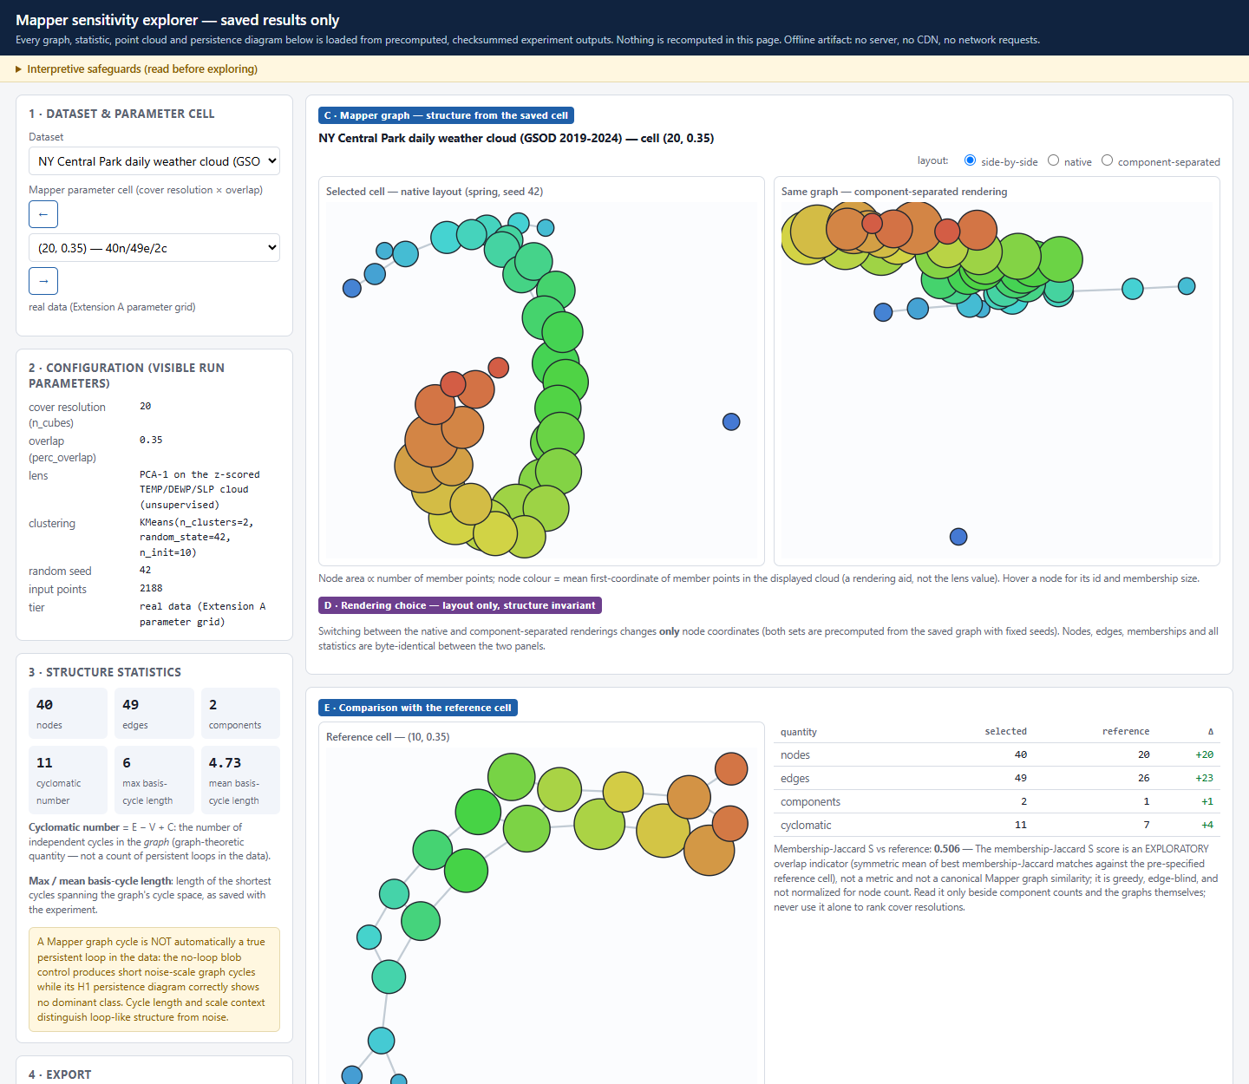
Offline explorer: inspect parameter dependence without a server
• One 0.57 MB HTML file; 35 saved cells in 4 datasets; shows saved results only, recomputes nothing
• Cold-cache, network-disabled Chrome test: 222/222 checks — zero requests, zero errors, every cell and export matches the source
• Layouts checked from 390 to 1920 px wide; ∞ class drawn as a marked convention
• Not a new algorithm and not the first Mapper explorer
Weather cell (20, 0.35): 2 components, cyclomatic 11, vs the reference cell
10/14
Notes:
Extension B is an offline explorer. One HTML file shows 35 saved Mapper cells with their parameters, statistics, a reference comparison, the persistence diagram and an export with provenance. It recomputes nothing; Mapper Interactive and giotto-tda recompute on the fly and are more general. I tested it in a fresh Chrome session with the network disabled, covering every cell and every export: 222 of 222 checks pass, with no external requests and no console errors, and the layout holds from phone width to a wide desktop. It is a display tool for saved results, not a new algorithm.

Slide 11
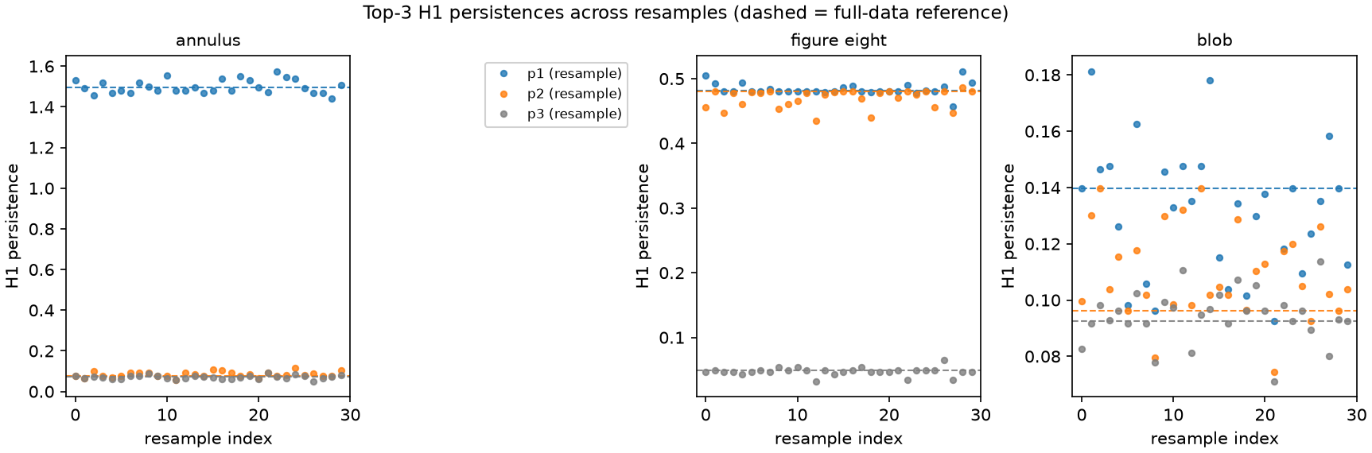
Persistence evidence for a loop holds in every sample — with caveats
• Annulus r₁ ≥ 13.2 and figure-eight r₂ ≥ 7.35 in all 60 subsamples; the blob never reaches 3
• Independent redraws: H1 bottleneck median 0.041 vs 0.029 for overlapping subsamples — overlap understates variability
• The relative 1.9% / 4.0% / 34% contrast mostly reflects the sizes of the reference features
• Leave-one-year-out: r₁ 4.376–7.754, but 10 of the 36 fold-configurations are effectively two-year omissions
Dominant H1 persistence and gap diagnostic over 30 × 80% subsamples per shape
11/14
Notes:
On robustness: the constructed loops are far above the noise floor in every one of sixty subsamples, and the blob never reaches the threshold. Three caveats. Subsamples overlap the reference, so they understate variability; thirty independent redraws give a bottleneck median of 0.041 for the annulus instead of 0.029. The relative percentages mostly reflect the size of the reference features. And leave-one-year-out is weaker than its name: in 10 of 36 fold-configurations a second year contributes almost nothing, and the annual cycle makes the check hard to fail.

Slide 12
What to do with a topological picture
• Ask which representation carries the claim: the diagram, the graph, or the drawing
• Treat Mapper structure as lens-, cover-, clusterer- and scale-dependent until shown otherwise for your data
• Use a null that shares the construction (surrogates), not a different representation
• State thresholds as conventions; report distributions over resamples, not one reference
• A graph cycle is not a loop, and a missing cycle is not a missing loop
12/14
Notes:
So what should a practitioner do? Ask which representation carries the claim. Treat Mapper structure as dependent on lens, cover, clusterer and scale until shown otherwise. Use a null control that shares the construction, such as surrogates, rather than a different representation. State thresholds as conventions and report distributions over resamples rather than one reference. And remember both directions: a graph cycle is not a loop in the data, and a missing cycle does not show a missing loop. I do not claim that people routinely confuse these. I claim the two kinds of evidence are not interchangeable.

Slide 13
Limits and non-claims
• No participant study; E3 is one observer with an AI viewing aid
• One lens, one cover family, two clusterer families; 2-D synthetic shapes and one station
• No cross-implementation check of ripser; no ranking against PCA, t-SNE or UMAP
• Overlapping resamples are descriptive; no p-values or confidence sets; the gap ratio and S are custom, not canonical
• No evidence fixes the order of design and analysis: the sweep was designed knowing the annual period, the seasonality check was post hoc, and the clusterer scales were chosen after the default result
• The weather result is not a climate claim
13/14
Notes:
The limits are part of the result. There is no participant study. Everything uses one lens, one cover family and two clusterer families, on two-dimensional synthetic shapes and one station. I did not cross-check ripser against another implementation, and I do not rank Mapper against PCA, t-SNE or UMAP. Overlapping resamples are descriptive, there are no p-values or confidence sets, and the gap ratio and S are custom indicators. No artifact fixes the order of design and analysis, so nothing is called pre-registered: the sweep was designed knowing the annual period, the seasonality check came after, and the clusterer scales were chosen after the default result. And the weather result is not a climate claim.

Slide 14
Reproducible and checked from outside
• Pinned Python 3.12 stack; results computed on Linux and independently re-executed on Windows 11
• Structural outputs, diagrams and counts identical across platforms; figures pixel-identical; floats within 1e-14
• One command runs every test suite and verification step and fails on any problem
• An evidence verifier re-derives the numbers in the report and slides from the result files
• Take-away: trust follows the construction — know which representation, which parameters, and which null
14/14
Notes:
To close: results were computed on Linux and independently re-executed in a clean pinned environment on Windows. Structural outputs, diagrams and counts are identical, figures are pixel identical and floats agree to ten to the minus fourteen. One command runs every test suite and verification step and fails on any problem, and an evidence verifier re-derives the numbers in the report and slides from the result files. The take-away: trust follows the construction. Know which representation you are reading, which parameters it depends on, and which null control it has to beat. Thank you.

