Slide 1
PRISM GENAI HACKATHON 2026 · THEME 02
OneTap
OneTap
screen keeps blinking then goes black when I unfold it
Screen flicker fix
Smart Guided Troubleshooting Engine
Adjust Navigation Bar
AUTO
1 Navigate to and open Settings.
2 Tap Display.
3 Tap Navigation bar.
A vague complaint goes in; a verified, ordered fix plan comes out, and every Settings step is one tap away.
⚡ View Navigation bar one tap →
~10 ms
~3 s
$0.0008
Force Restart
CRITICAL
always ordered last
answer from the guarded cache
full grounded pipeline
per new complaint
Did this fix it? 👍 👎
Shourya Chouhan · Shreya Singh Chouhan · Yash Mittal · Vrunda Hatwar
Team Aloo Paratha · M S Ramaiah Institute of Technology (MSRIT), Bengaluru · Theme ID 02
Notes:
Hi, we're Team Aloo Paratha from MSRIT. Our Theme 02 project is OneTap. You describe a phone problem in your own words and get back a verified, ordered troubleshooting plan, where each Settings step is a one-tap deeplink. Known problems come back from a guarded semantic cache in about 10 milliseconds. New problems go through a grounded AI pipeline in about 3 seconds, for less than a tenth of a cent.

Slide 2
01 · THE PROBLEM IN OUR OWN WORDS
Customers describe symptoms, not fixes
15 min
Why it's hard
1
Vague, colloquial language
“blinking”, “goes dark”, typos, Hinglish: none of it matches support-article wording.
of manual agent work per complaint scenario, repeated across millions of support calls. Then the user still hunts through Settings.
2
Several problems in one message
Flicker + battery drain need different fixes, and a single answer gets both wrong.
“Screen flickers and the battery dies fast”
3
Fixes hide deep in Settings
Settings › Display › Navigation bar: users give up before they reach the switch.
“My phone got slow after the update”
The reference may not fit
4
The paired article can be about a different fault, and guessing there is dangerous.
“Swipe gestures go the wrong way after installing an app”
Our framing: a compiler. Complaint + knowledge article → validated, deeplinked JSON plan, and every rule is checked by code.
OneTap · Team Aloo Paratha · 02 / 18
Notes:
Today an agent reads a vague complaint, finds a knowledge-base article, rewrites the steps and dictates Settings paths. That takes about 15 minutes per scenario, across millions of calls. Four things make it hard: vague language, several problems in one message, fixes buried deep in Settings, and reference articles that sometimes don't even match the fault. We treated it as a compiler problem: complaint plus article in, validated deeplinked JSON out.

Slide 3

02 · WHAT ONETAP DOES
One call: vague complaint in, one-tap plan out
IN
OneTap
OUT
POST /v1/troubleshoot
{ "goal": "Follow these steps to
perform this Screen Flicker
Troubleshooting",
"title": "Screen flicker fix",
"actions": [ { "category": "auto",
"stepGroups": [ { "steps": [...],
"actionableDeeplink":
"voiceassist://masked/act/…" } ] } ],
"meta": { "latency_ms": 9,
"cache_hit": true, "cost_usd": 0 } }
“my screen keeps blinking and goes black when I unfold it”
Guarded semantic cache
Grounded AI extraction
Closed-set deeplinks
+ optional SIIS article (or any pasted help text)
Rules enforced in code
Every step cited from the article
Links copied from the catalog, never generated
Safe fixes first, destructive last
No source → honest no_match
OneTap · Team Aloo Paratha · 03 / 18
Notes:
The whole product is one REST call. In goes the customer's words, plus the SIIS article if there is one. Out comes the exact JSON contract from the problem statement: goal, title, ordered actions, steps and deeplinks, with latency, cache-hit and cost metadata. Four promises hold for every response, shown along the bottom.

Slide 4
03 · ARCHITECTURE
Two paths: remember fast, reason carefully
HOT PATH · ~10 ms · $0
Normalise
Embed
Match
Guard
Serve plan
typos, Hinglish, enumerations
bge-small, ONNX, CPU (~7 ms)
cosine over paraphrase cloud, τ = 0.87
polarity · symptoms · context · source
validated at compile time
miss
write-back
COLD PATH · ~3 s · ~$0.001
Enrich ∥ Extract
Ground
Categorise
Deeplinks
Repair + gate
LLM: 8-10 rewordings; cited steps
drop unsupported, invented, outcome steps
auto / manual / critical, disruption order
exact leaf → hybrid → closed-set LLM
word rules, Pydantic schema, score
calls a language model
local, deterministic code
No article? Knowledge-base retrieval → opt-in catalog-grounded plan → otherwise honest no_siis_context.
Endpoints: POST /v1/troubleshoot · POST /v1/feedback · GET /health · GET /v1/metrics
OneTap · Team Aloo Paratha · 04 / 18
Notes:
Two paths. The hot path normalises the text, embeds it on the CPU, compares it with every stored rewording, and passes the match through our Symptom-Signature Guard. That's about 10 ms with no AI call. On a miss, the cold path runs enrichment and extraction in parallel, then grounding, categorisation, deeplink resolution, and repair plus a schema gate. Only two stages call a language model; everything else is deterministic code. The result is written back, so the next similar complaint is instant.

Slide 5

04 · REMEMBER · SEMANTIC CACHE + SYMPTOM-SIGNATURE GUARD
Similar words aren't the same problem
Every compiled plan is stored with ~10 rewordings as vectors. A new complaint is served from the cache only if it is close enough AND the guard agrees it is the same problem.
82.5%
“Wi-Fi keeps turning ON by itself”
“Wi-Fi keeps turning OFF by itself”
hit rate on 97 unseen rewordings
0.96
cosine
written by a different model · target ≥ 80%
44% → 10%
guard: polarity mismatch → not served (opposite fixes)
“flashes and goes blank when I scroll a web page”
0.88
“flashes and goes blank when I open an email in Gmail”
false hits on look-alike traps
cosine
same τ, guard off vs on (−77%)
guard: context mismatch (browse ≠ email) → full pipeline
8.8 ms
The guard compares: on/off polarity · symptom set · trigger context (charging, camera, Gmail, browsing…) · same source article
P95 cache lookup
embed + search + guard · target ≤ 300 ms
OneTap · Team Aloo Paratha · 05 / 18
Notes:
Embeddings think 'Wi-Fi keeps turning ON' and 'turning OFF' are 96% the same, but they need opposite fixes. So on top of cosine similarity we compare a small symptom signature: on/off polarity, the symptom set, the trigger context, and whether the plan came from the same article. On 97 unseen rewordings written by a different model, we hit 82.5%. On adversarial look-alikes, the guard cuts wrong answers from 44% to 10% at the same threshold, and the lookup itself takes 8.8 ms at P95.

Slide 6
05 · READ · EVIDENCE-ANCHORED EXTRACTION
Every step must cite the sentence it came from
SIIS article → numbered sentences
1
Grounding check
a step's key words must appear in its cited sentence (or a neighbour), otherwise it is dropped
[12] If you wish to keep your screen protector on, you can try enabling the Touch sensitivity option.
2
No invented UI
[13] To do this, go to Settings, tap Display, and then tap the switch next to Touch sensitivity.
'Tap on Force Restart Device' and outcome sentences like 'Your phone will restart' are removed
3
Conditions respected
[14] Usage Habits: The touchscreen might not work correctly if you're wearing gloves…
'if you're NOT using a protector…' steps only appear when the condition fits
4
Relevance gate
article doesn't address the complaint → contexts: [] + fallback: no_match
“Tap the switch next to Touch sensitivity.” src: [13] → key words found → kept
5
Multi-intent
one Goal per distinct problem; identical plans are merged
On the 20 provided scenarios: 18 grounded plans · 2 honest no_match · 3 multi-goal answers
OneTap · Team Aloo Paratha · 06 / 18
Notes:
This is how we stop hallucinated steps. The article is split into numbered sentences, and the model must return, for every step, the sentence number it came from. Code then checks that the step's key words really appear there, otherwise the step is dropped. We also remove invented UI elements and outcome sentences, respect conditional instructions, and return an honest no_match when the article doesn't cover the complaint. Complaints with several problems get one goal per problem.

Slide 7
06 · CONNECT · DEEPLINK RESOLUTION
Links are chosen from the catalog, never generated
1
Exact leaf-screen match
deterministic: “Navigation bar”, not its parent “Display”
2
Hybrid retrieval
BM25 + bge-small dense over 577 entries, RRF fusion
3
Depth-aware rerank
leaf-token bonus; enable → onURL, disable → offURL
4
Closed-set choice
small LLM returns a catalog ID or NONE; code copies URI + validation
0% wrong on/off twin (hybrid: 8.3%) · full-catalog LLM costs 43× more per action
100% of emitted links exist in the catalog: by construction, not by prompt
dummy_positive only for a real Settings screen with no catalog entry · manual actions never carry a link
OneTap · Team Aloo Paratha · 07 / 18
Notes:
Deeplinks can never be hallucinated in OneTap, because the model never writes one. First we try an exact match on the deepest screen named in the steps. Otherwise hybrid retrieval finds candidates, a depth-aware reranker prefers the leaf screen and the right on/off direction, and a small model picks a catalog ID or NONE. Code copies the URI and its validation link verbatim. On 24 ground-truth actions we recover the exact entry 95.8% of the time, with zero on/off mistakes. Putting the whole catalog in the prompt gets only 62.5%, at 43 times the cost.

Slide 8
07 · CHECK · RULES IN CODE, NOT PROMPTS
The contract is enforced by code on every response
Rule | How OneTap enforces it
goal | built from a template: “Follow these steps to perform this <Topic> Troubleshooting”
title | 2-3 words, sentence case: validator + LLM repair + deterministic fallback
actionName | Title Case; one action = one screen (segmentation in extraction prompt)
description | 5-7 words starting “It will”: word-count check, batched repair
steps | one interaction each; URLs & markdown scrubbed from every field
deeplinks | must exist in catalog; manual actions never carry one
query_variations | 8-10 distinct rewordings; deterministic top-up
schema | Pydantic gate on the provided schema.py before any response
Ordering contract
AUTO
one-tap deeplink
Settings toggles & pages
MANUAL
never a deeplink
inspect, charge, contact service
CRITICAL
always last
restart, safe mode, reset, updates
Within a block: disruption level, then reference order. Deterministic: same input, same plan.
OneTap · Team Aloo Paratha · 08 / 18
Notes:
The problem statement warns that prompt-only constraints are unreliable, so every rule is enforced in code. The goal is built from a template, titles and descriptions are word-counted and repaired, URLs are scrubbed from every field, links must exist in the catalog, and the provided schema.py is a hard gate. Ordering is fixed: auto Settings actions first, manual checks next, critical actions like restart or reset always last.

Slide 9






08 · INNOVATION
What's new in OneTap
Symptom-Signature Guard
Evidence-anchored extraction
Exact-leaf + closed-set deeplinks
Polarity, symptom set, trigger context and source check on top of cosine: 44% → 10% wrong cache answers.
Every step cites a sentence; code verifies it. Unsupported, invented and contradictory steps are dropped.
Deterministic leaf match, then the LLM may only pick an ID. 95.8% exact, 0 fabricated links.
Catalog-grounded fallback
Self-healing cache
Hedged, model-agnostic LLM layer
No article? The AI may only pick real Settings from the catalog; code writes the steps (opt-in).
👍 / 👎 on every plan; a plan with more 👎 than 👍 is evicted and rebuilt from the source.
Per-stage models, pool failover on 429/5xx, retry-after aware, prompt memo, per-request cost.
Also: Hinglish + typo normalisation · guided step-by-step mode · voice input (en-IN) · paste-any-article · explainable UI
OneTap · Team Aloo Paratha · 09 / 18
Notes:
Six innovations, each aimed at a pitfall the problem statement lists. The guard fixes semantic false hits. Evidence-anchored extraction fixes hallucinated steps. Exact-leaf plus closed-set choice fixes parent-menu matching and fabricated links. The catalog fallback answers complaints no article covers without inventing anything. The feedback loop makes the cache self-healing. And a hedged LLM layer keeps the service up when a provider is rate-limited.

Slide 10
09 · RESULTS · CONTRACT COMPLIANCE (results.jsonl, all 20 scenarios)
100% on every automated gate
100%
100%
0
schema-valid output
rule compliance
URL leaks
target ≥ 99%
goal · title · description · target ≥ 95%
target 0
100%
100%
100%
deeplinks exist in catalog
auto actions with a deeplink
8-10 query_variations
exact URI match · target 100%
target ≥ 90%
every response
Audited by scripts/report.py on every build: Pydantic schema + 12 rule checks per goal.
OneTap · Team Aloo Paratha · 10 / 18
Notes:
Against the automated gates in the problem statement we are at 100% everywhere: schema-valid output, rule compliance, zero URL leaks, every deeplink exists in the catalog, every auto action carries a deeplink, and every response has 8 to 10 query variations. This is audited by a script on every build, not checked by hand.

Slide 11
10 · RESULTS · SPEED, COST & ACCURACY
Speed, cost and accuracy at a glance
1.1 ms
10.4 ms
3.2 s
exact cache hit · P95
unseen rewording · P95
full cold pipeline · P95
N = 40 · budget 300 ms · <1% of budget used
N = 80 · budget 300 ms · 4% of budget used
N = 30 · budget 8 s · 40% of budget used
$0.0008
2.25 / 3
1.43 / 2
average cost per cold query
step accuracy
deeplink relevance
$0 on every cache hit
LLM judge from a different model family
on the provided scenarios
Cold latency is server-side, measured with provider quota available; free-tier rate limits can add seconds (see limitations).
OneTap · Team Aloo Paratha · 11 / 18
Notes:
Speed: an exact repeat takes 1.1 ms, an unseen rewording 10.4 ms at P95, both far inside the 300 ms budget. A brand-new complaint takes 3.2 seconds at P95 against an 8-second budget. Cost is about eight hundredths of a cent per new complaint and zero on a hit. Accuracy was judged by a model from a different family than ours: 2.25 out of 3 for steps, and 1.43 out of 2 for deeplink relevance.

Slide 12
11 · ABLATION
Why this design: measured against the alternatives
Deeplink variant | Acc@1 | Wrong twin | No link | $ / action
Full catalog in LLM (baseline) | 62.5% | 8.3% | 16.7% | 0.00261
A: Hybrid BM25 + dense | 91.7% | 8.3% | 0% | 0
B: Pure rules (BM25) | 91.7% | 4.2% | 0% | 0
OneTap: leaf + hybrid + rerank + closed-set | 95.8% | 0% | 4.2% | 0.00006
Guard ablation (same τ = 0.87)
Guard off: 96.9% hit · 44% false hits
Guard on: 82.5% hit · 10% false hits (−77% wrong answers, still ≥ 80% target)
We chose τ = 0.87: the highest hit rate that keeps false hits ≈ 10% and hits ≥ 80%.
OneTap · Team Aloo Paratha · 12 / 18
Notes:
The problem statement asks for an ablation, and we measured each design choice. For deeplinks, putting the full catalog in the prompt is the worst option: 62.5% accuracy at the highest cost. Our combination is the most accurate and never picks the wrong on/off twin. For the cache we swept the threshold: lower thresholds hit more but serve more wrong answers. We picked 0.87, and the guard is what keeps false hits at 10% instead of 44%.

Slide 13
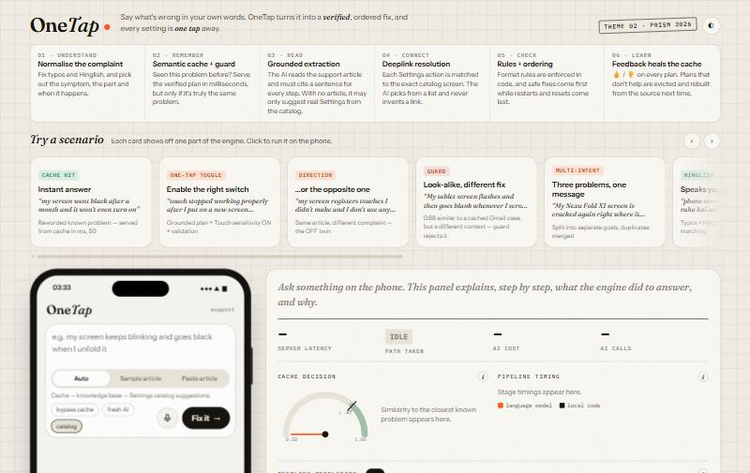
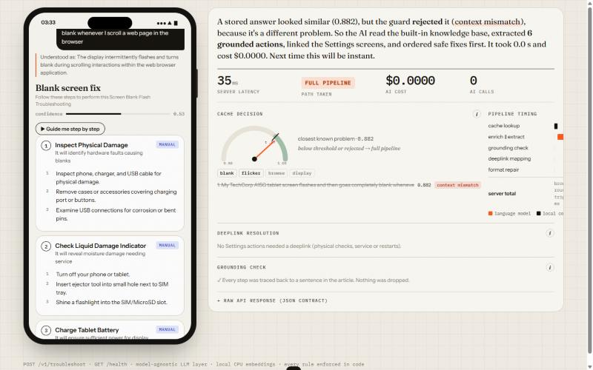
12 · THE PRODUCT
See what the engine did, and why
Guard in action: 0.88 similar to a cached Gmail case, rejected for context mismatch, and the plain-English narration explains why.
How-it-works strip lights up the path each request took · 10 one-click scenario cards · phone + live instrument panel
OneTap · Team Aloo Paratha · 13 / 18
Notes:
The demo UI is built to explain the backend. The strip at the top lights up the path each request took. Ten scenario cards each show one capability. On the right, a narration panel explains in plain English what happened. Here the guard rejected a 0.88-similar cached answer because the context was different.

Slide 14
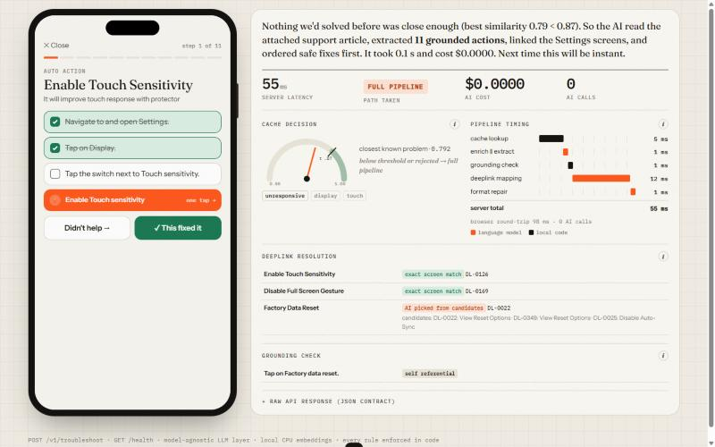






13 · BUILT FOR REAL USERS
From answer to fixed: guided, spoken, one tap
One-tap Settings
the deeplink opens a simulated Settings screen, the toggle flips and the validation check confirms
Guided step-by-step
progress bar, confetti when fixed, support hand-off when every step failed
Voice input
speak the complaint (Web Speech API, en-IN), including Hinglish
Paste any article
any help page becomes a grounded plan, not limited to the dataset
Feedback
👍 / 👎 feeds the self-healing cache
Guided mode: one action at a time, tickable steps, the one-tap link, then “Didn't help →” or “✓ This fixed it”.
Explainable
“i” explainers, similarity gauge, stage waterfall, raw JSON
OneTap · Team Aloo Paratha · 14 / 18
Notes:
For real users, a plan is only useful if it gets them to 'fixed'. Guided mode walks through one action at a time. The one-tap button opens the Settings screen, and the validation deeplink confirms the toggle changed. Users can speak the complaint, paste any help article, and give thumbs up or down, which feeds the self-healing cache.

Slide 15
14 · TECH STACK
CPU-friendly, cheap, provider-agnostic
API & runtime
Language models
Retrieval & cache
Evaluation
Frontend
FastAPI + Uvicorn
Groq gpt-oss-120b: extraction
bge-small-en-v1.5 (ONNX, CPU)
97 held-out rewordings
vanilla HTML / CSS / JS
Pydantic (schema.py gate)
gpt-oss-20b: deeplink choice
NumPy BM25 + RRF fusion
50 adversarial look-alikes
Web Speech API (voice)
Docker + compose
qwen3.8-27b: enrichment / repair
paraphrase-cloud vector cache
24-action deeplink ground truth
light + dark, mobile-ready
JSON-only responses
any OpenAI-compatible API
symptom-signature lexicon
LLM judge (Gemini) · HTTP bench
no framework, one file
Runs on CPU only · swap the LLM provider with two .env lines · every stage's model is configurable
OneTap · Team Aloo Paratha · 15 / 18
Notes:
The stack is deliberately light. FastAPI with a Pydantic gate, CPU-only ONNX embeddings, a NumPy BM25, and fast open models on Groq, with each stage on its own model. Any OpenAI-compatible provider works via two .env lines. The frontend is a single HTML file with no framework.

Slide 16
15 · FROM HACKATHON TO WORKLET
Built to scale to 10k+ scenarios
1
2
3
4
Offline scenario compiler
Stage-level caching
Feedback-driven quality
On-device + assistant
batch-compile every KB article + query into validated plans and paraphrase clouds (scripts/build_cache.py)
extraction and mapping cached separately; a reverse index deeplink → plans recompiles only what a catalog change touches
👍/👎 evicts weak plans; dashboards on hit rate, false hits and cost per query (GET /v1/metrics)
CPU embeddings fit on-device; hand plans to the voice assistant for truly hands-free fixes
Back-of-envelope at 1M complaints / day
~80% served from cache (measured hit rate) → ~200k cold compiles × ~$0.001 ≈ $200 / day
vs. 15 min of manual agent triage per scenario ≈ 250,000 agent-hours / day
OneTap · Team Aloo Paratha · 16 / 18
Notes:
Scaling to 10 thousand plus scenarios is mostly offline work. Compile every article in batch, cache stage outputs separately, and keep a reverse index from each deeplink to the plans that use it, so a One UI update only recompiles affected plans. At a million complaints a day, with our measured hit rate, the AI bill is roughly 200 dollars a day, against 250 thousand agent-hours of manual triage.

Slide 17
16 · HONEST LIMITATIONS
What we know isn't perfect yet, and what's next
Mismatched reference articles
LLM-generated look-alike set
3 of 20 scenarios were judged off-topic yet answered.
some “negatives” are arguably the same fault, so 10% false hits is conservative.
next → stricter relevance + article re-retrieval
next → human-labelled adversarial set
Lexicon-based signatures
Provider tier affects cold latency
English + common Hinglish/typos; unseen slang can slip past the guard.
free-tier daily caps pushed a spot check to ~11 s P50.
next → learned symptom classifier
next → paid tier; model-pool hedging (in place)
Catalog fallback is advisory
One UI hierarchy changes
a catalog entry says what a setting does, not that it fixes this fault.
screen paths move between versions.
next → confidence capped at 0.70; opt-in only
next → reverse index deeplink → plans for targeted recompiles
OneTap · Team Aloo Paratha · 17 / 18
Notes:
We want to be upfront about the limits. Some provided articles don't match their complaints. Our look-alike test set was generated by an LLM, so the false-hit number is conservative. Signatures are lexicon-based. Cold latency depends on the provider tier. The catalog fallback is advisory, which is why it's opt-in and capped. Each limitation already has a concrete next step.

Slide 18
THEME 02 · SMART GUIDED TROUBLESHOOTING ENGINE
Thank you
Describe it in your own words. Get a verified fix, one tap away.
100%
10.4 ms
3.2 s
95.8%
44→10%
contract compliance
P95 on unseen rewordings
P95 cold pipeline
exact deeplinks
wrong cache answers
github.com/shouryez/onetap (tag PRISM_GENAI_HACKATHON_Y2026) · demo: youtu.be/oJ5d5VblRTA
Shourya Chouhan · Shreya Singh Chouhan · Yash Mittal · Vrunda Hatwar
Team Aloo Paratha · M S Ramaiah Institute of Technology (MSRIT), Bengaluru
Notes:
To sum up: 100% contract compliance, around 10 ms for known problems, 3 seconds for new ones, 95.8% exact deeplinks, and a guard that cuts wrong cache answers from 44 to 10 percent. The code, metrics and demo video are linked in the submission. Thank you, and we're happy to take questions.

