Slide 1
Do transformers build a Bayesian belief state?
Replication of Shai et al., Transformers Represent Belief State Geometry, NeurIPS 2024
Tiny models trained from scratch: 201k parameters, 90 seconds each, one GPU
Shouvik Majumder | data club, September 2026

Slide 2
The question
• A hidden Markov process emits tokens you see while hopping between states you cannot.
• To predict the next token optimally you must track a posterior over the hidden state: the belief state.
• For a well chosen process the set of reachable beliefs has a striking shape, computable exactly in advance.
• So: train a transformer on that process, and look for the shape inside its activations.
• Why this is a good teaching problem: the ground truth is known, so the analysis cannot quietly lie to you.
2
Notes:
Contrast with the ESR project, where every measurement depended on a judge model.

Slide 3
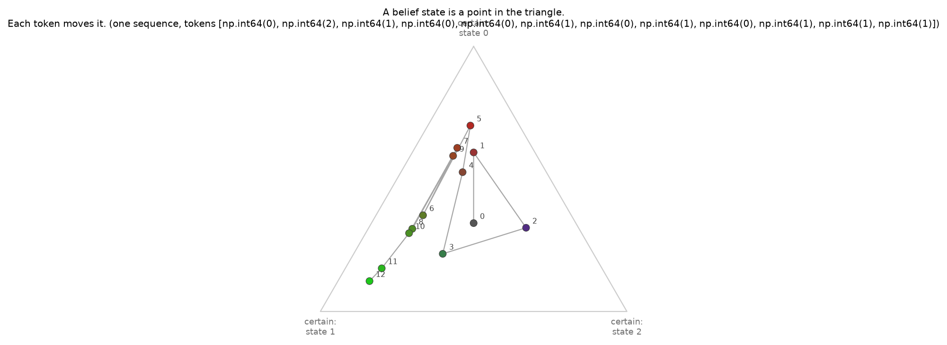
A belief state is a point in a triangle
• Three hidden states, so the belief is three numbers summing to one: a point in a 2-simplex.
• Each observed token applies Bayes rule and moves the point.
3

Slide 4
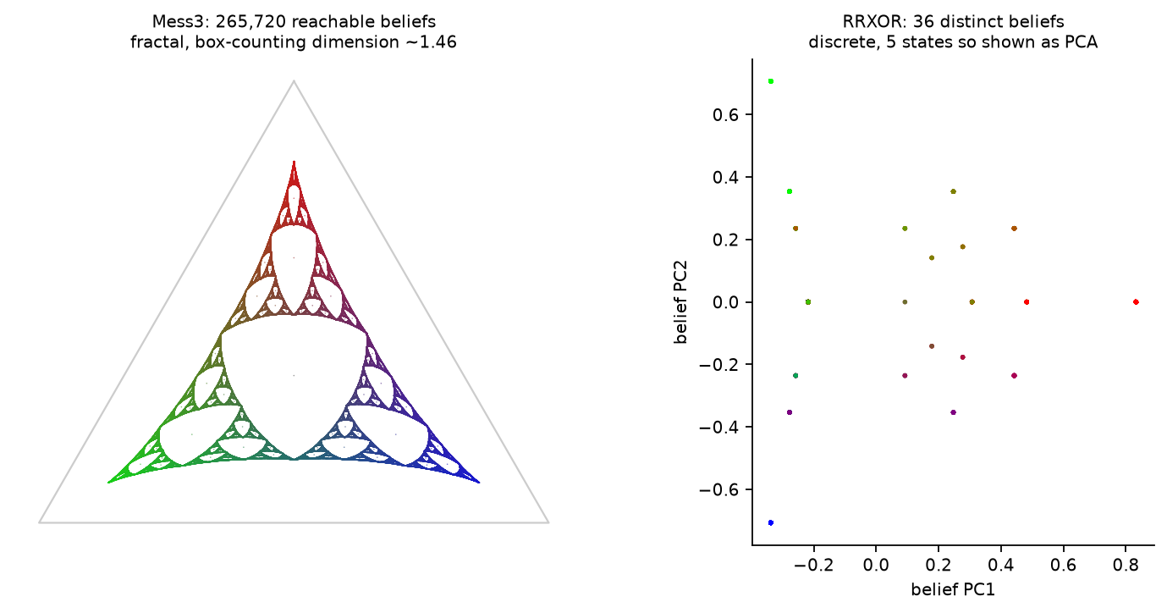
The set of all reachable beliefs
• Mess3: every token is weak evidence, beliefs never collapse, and the reachable set is a fractal.
• RRXOR: tokens are decisive, so only 36 distinct beliefs exist. Two very different target shapes.
4

Slide 5
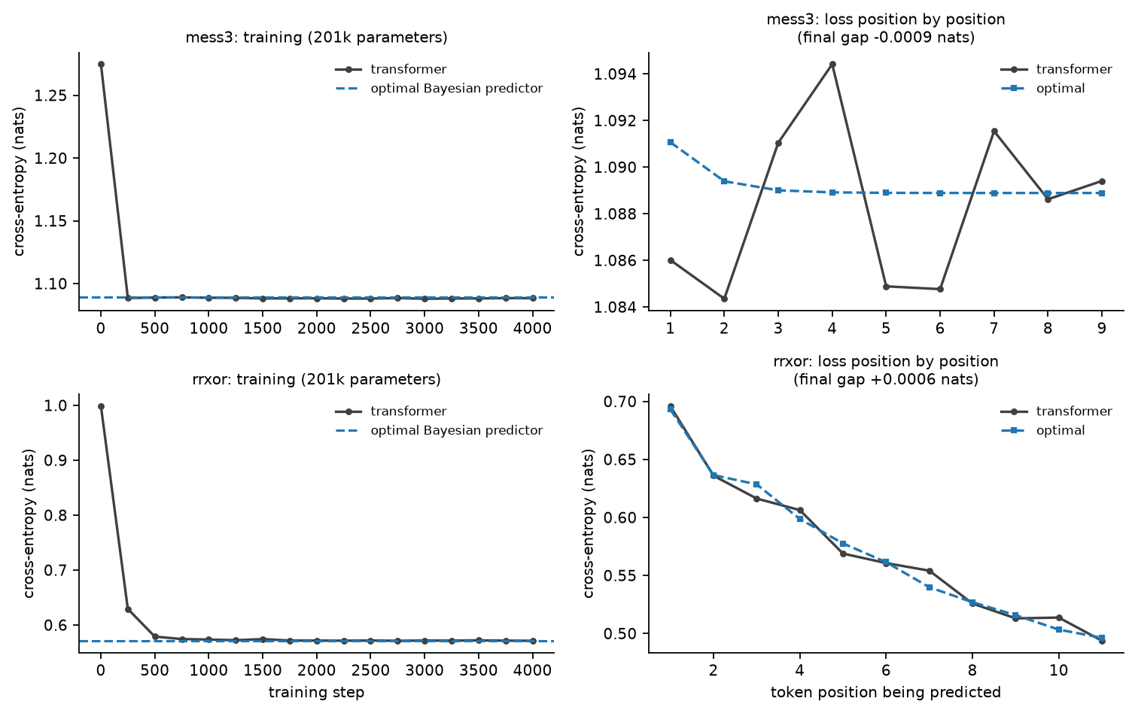
The models learn the processes exactly
• Cross-entropy reaches the information-theoretic floor to within 0.001 nats.
• The per-position curve matches the Bayesian staircase, not just its average.
5

Slide 6
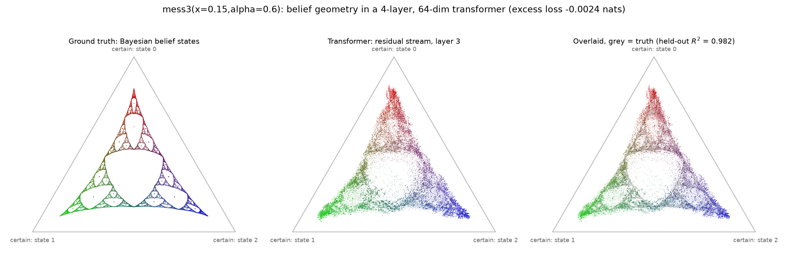
The fractal is in the residual stream
• A linear map from 64 activation dimensions to the 3 belief coordinates, fitted on half the data and scored on the other half.
• Held-out R-squared 0.98, and the colours match, not just the silhouette.
6
Notes:
This is the replication. The next slide is why it is not enough.

Slide 7
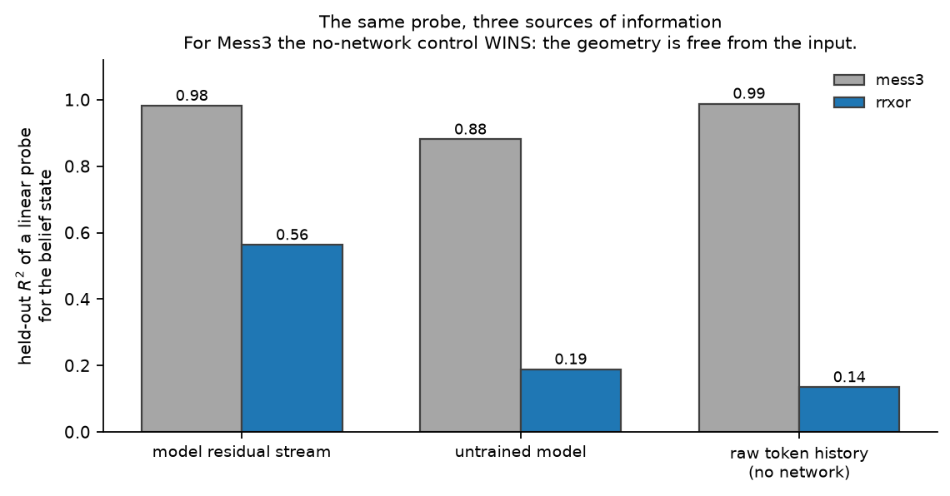
...but a control with no network at all does better
• Control: the same linear probe fitted to one-hot codes of the last six tokens.
• For Mess3 it scores 0.988 against the model's 0.982, because the belief update is close to a decaying token count.
• A high probe score is not evidence of computation unless a baseline with the same access does worse.
7

Slide 8
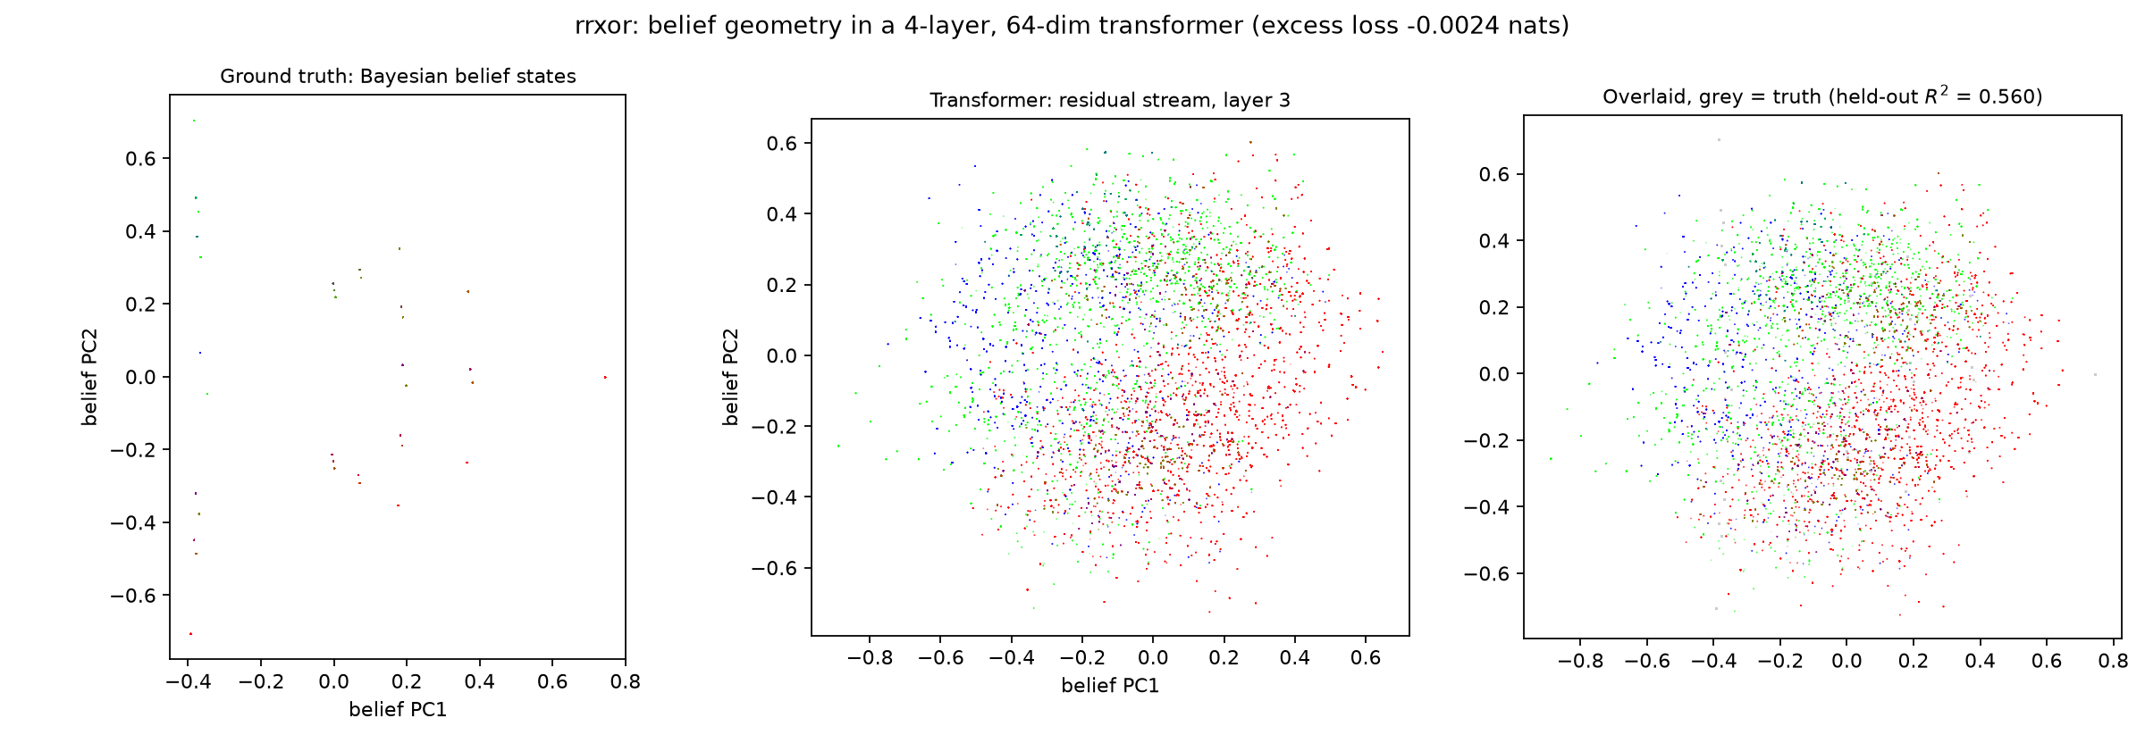
RRXOR: a process where the shortcut fails
• Two random bits, then their XOR. No weighted count of recent tokens can represent it.
• The no-network control collapses to 0.13 while the model reaches 0.56.
8

Slide 9
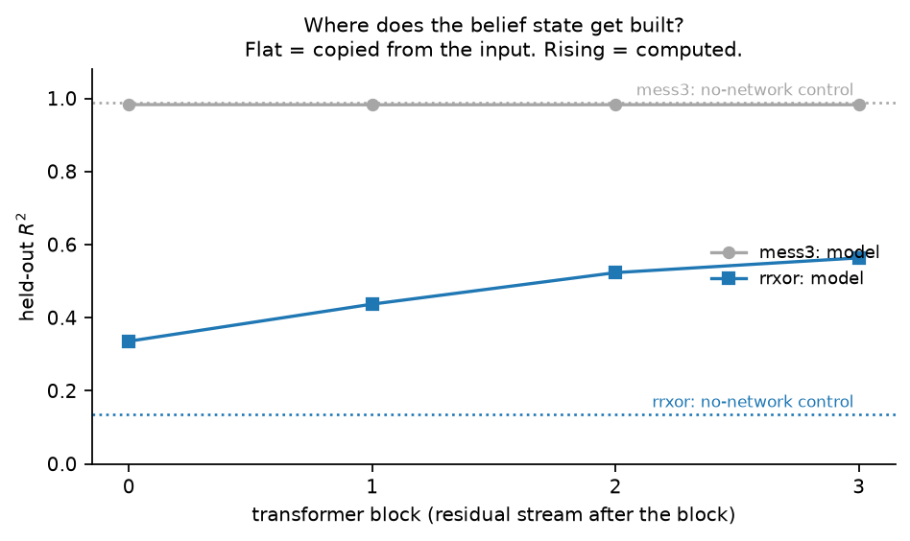
Where the belief state gets built
• Mess3: flat across layers, already present at block 0. Consistent with copying from the input.
• RRXOR: rises monotonically with depth. That is the signature of a quantity being computed.
9

Slide 10
Summary
• Replicated: a 201k-parameter transformer trained only to predict tokens carries the Bayesian belief-state geometry linearly in its residual stream.
• Added: a no-network control showing that for Mess3 the headline result is largely free from the input, and the probe score is flat across layers.
• The contrast between Mess3 and RRXOR separates 'the geometry is recoverable' from 'the model computes it'.
• Next: does the probe improve with a nonlinear readout, when during training does the geometry appear, and does intervening on it change predictions as Bayes says it should?
10

