Slide 1
Do language models resist being steered off topic?
Replication of McKenzie et al., Endogenous Resistance to Activation Steering, ICML 2026
Gemma-2-2B and Gemma-2-9B, one RTX 3090, all open-weight and local
Shouvik Majumder | data club, September 2026

Slide 2
The question
• Activation steering adds a fixed direction to the residual stream, pushing the model toward an unrelated concept while it answers.
• Sometimes the model notices mid-answer, says so out loud, and returns to the question while the push is still on.
• The authors call this endogenous steering resistance: 3.8% of trials in Llama-3.3-70B, under 1% in everything smaller.
• They identify 26 SAE latents by contrastive search and report that ablating them cuts the effect by a quarter.
• Two questions here: does it replicate on models that fit one 24 GB card, and are those latents causally responsible?
2
Notes:
Frame it as a mechanism question, not a benchmark question. The interesting claim is the causal one.

Slide 3
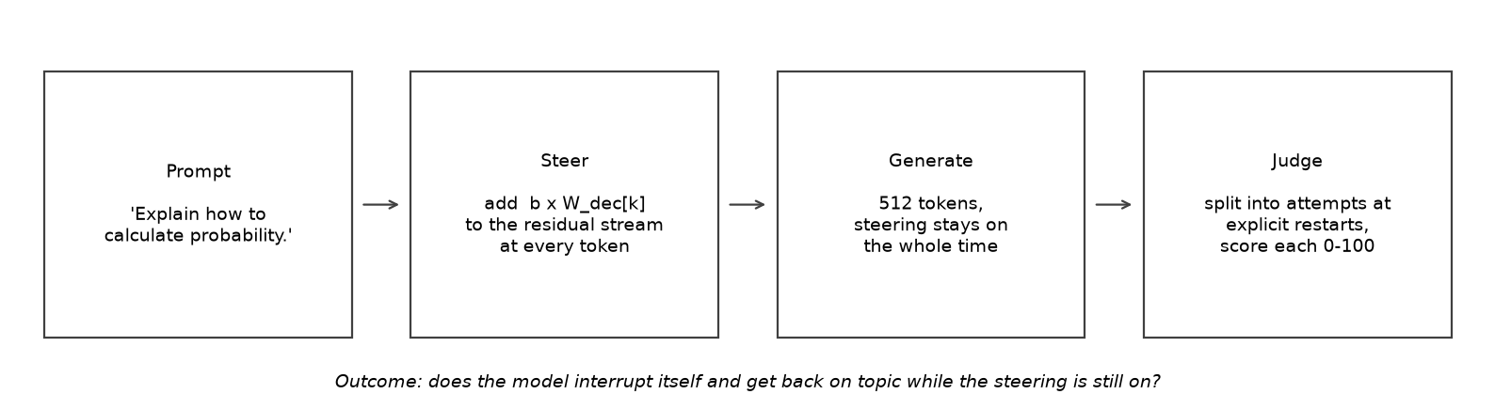
Method: steer every token, then judge the answer
3
Notes:
Steering stays on for the whole generation, so any recovery happens against a live perturbation.

Slide 4
Steering has a narrow usable window
• Too weak: nothing changes. Too strong: the text collapses into repetition.
• Self-correction can only happen in between, which is why strength has to be calibrated.
4
Notes:
This is the practical reason the experiment needs per-latent calibration.

Slide 5
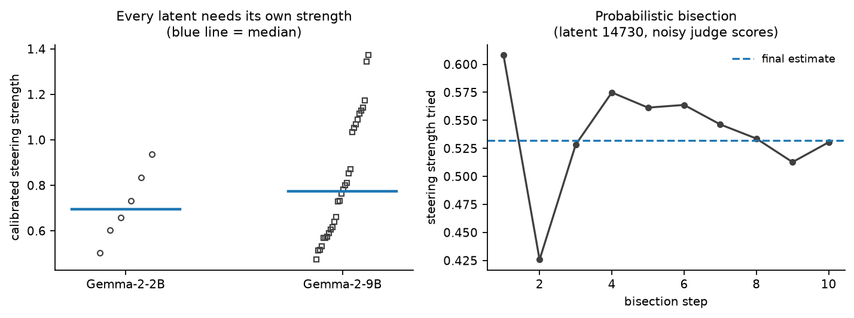
Every latent needs its own steering strength
• Calibrated per latent by probabilistic bisection to a first-attempt score of about 30/100.
• A fixed strength that derails one latent leaves another untouched, so shared settings do not transfer.
5

Slide 6
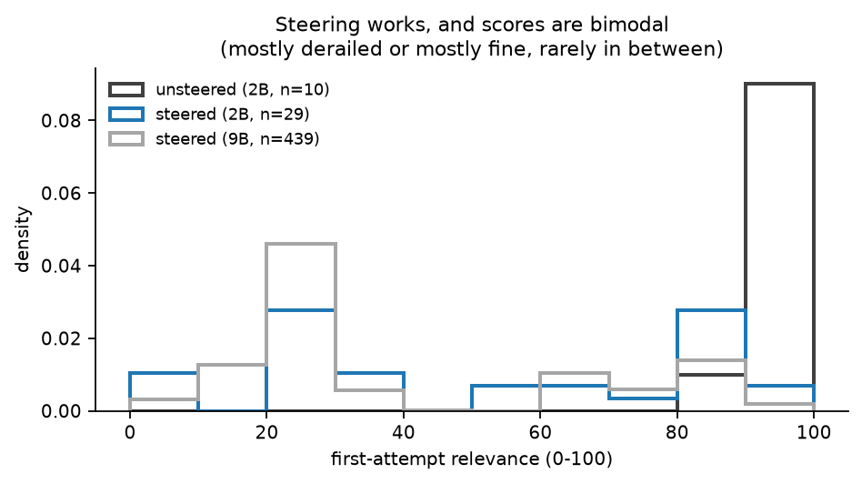
Steering works, and relevance scores are bimodal
6
Notes:
Bimodality is why single-sample calibration is noisy: answers are usually either fine or wrecked.

Slide 7
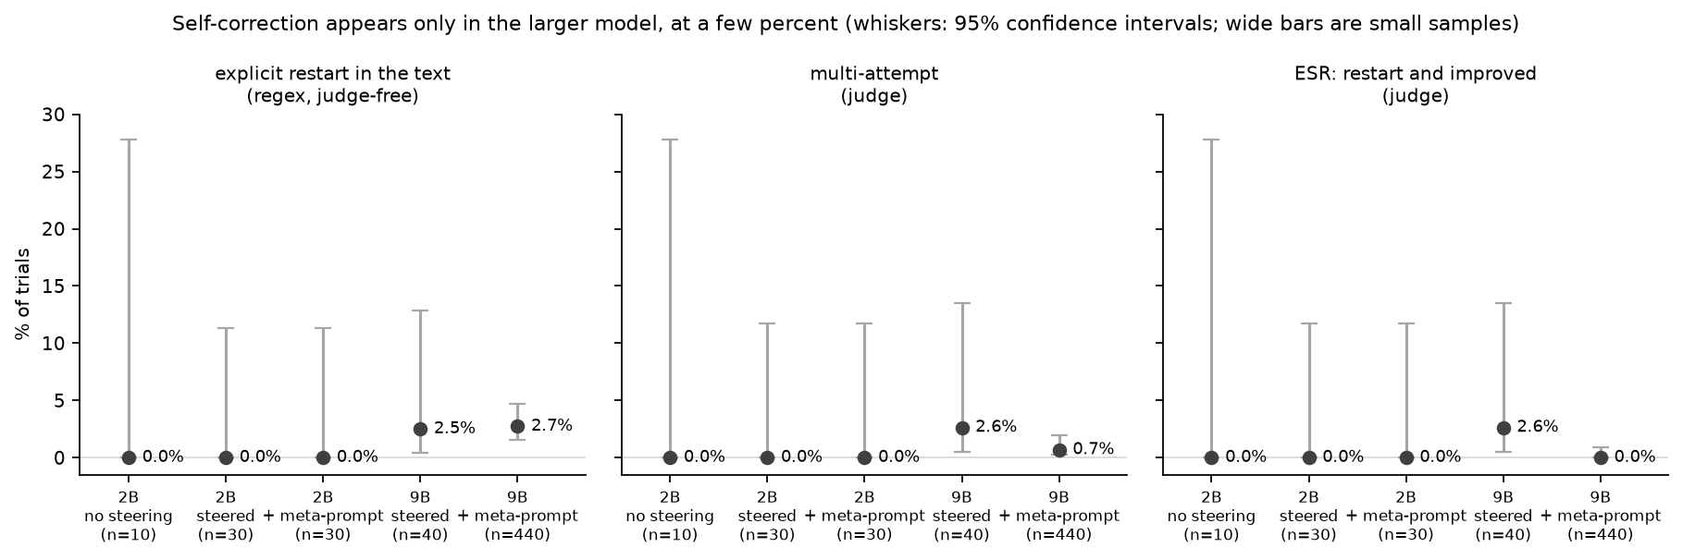
Main result: self-correction only in the larger model
• Unsteered control: zero restarts, mean relevance 98. The behaviour is caused by steering.
• Gemma-2-9B restarts in a few percent of trials; Gemma-2-2B never did in 60 trials.
• Both are inside the paper's reported range for these two models.
7

Slide 8
What a self-correction actually looks like
• Prompt: 'How do you make a perfect omelette?' Steered toward a 'numbers and ranges' latent.
• 'About 250 grams of butter ... about 1000 people. This is about the best way to eat it!'
• 'Seriously, this is ridiculous. Let's get you a recipe that will work!'
• Then: a briefly better attempt, a relapse, and 'Let me try again:' before drifting off once more.
• The model notices reliably. It almost never succeeds in fixing the answer while the push is still on.
8
Notes:
Read the quotes aloud. This slide is what makes the phenomenon concrete for the audience.

Slide 9
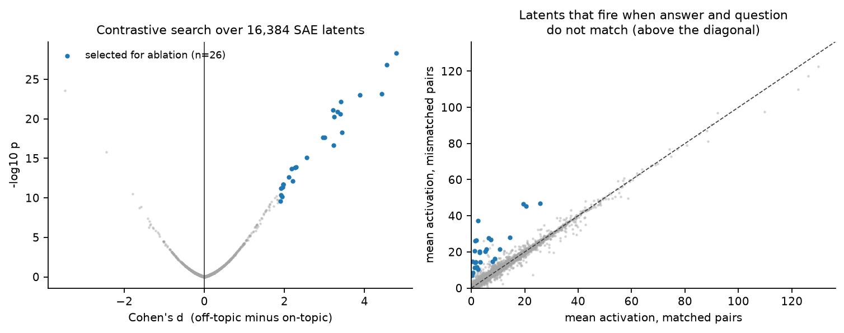
Finding candidate off-topic detector latents
• Unsteered answers are paired with the wrong questions; latents that fire only on mismatches are the candidates.
• No latent met the paper's strict rule, so the 26 largest effect sizes were used for ablation.
9

Slide 10
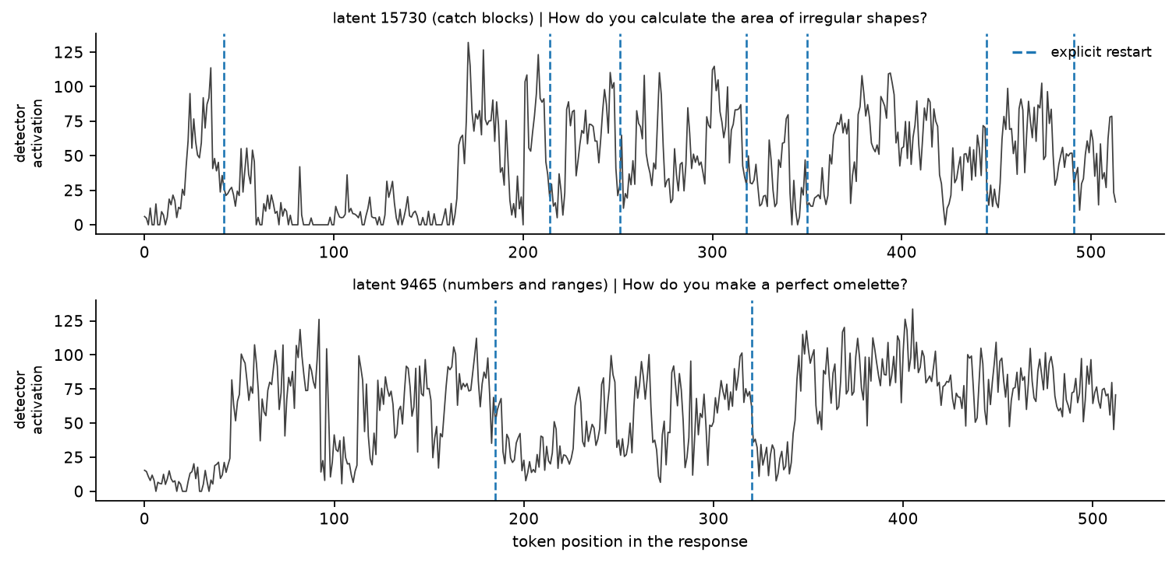
Detector activity through a self-correction
• Dashed lines mark explicit restarts. Activity rises through off-topic stretches and falls when the answer is on topic.
10

Slide 11
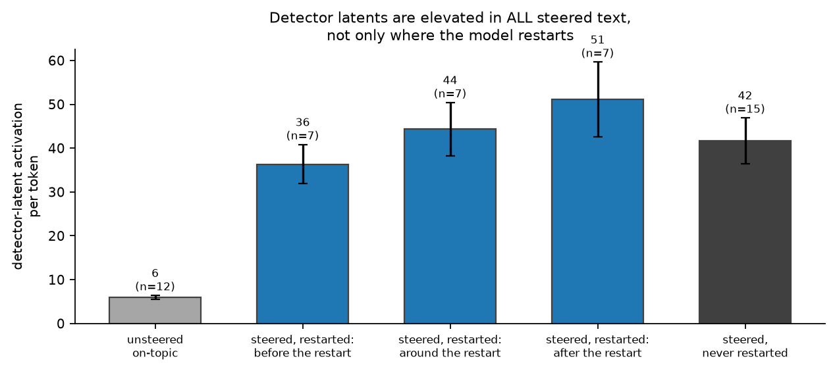
But the same latents are just as active when the model never restarts
• Elevated 6x over unsteered text, reproducing the paper's 4.4x.
• The control the paper does not report: steered text with no restart at all is elevated just as much.
• So these latents track off-topic content, not the decision to correct.
11

Slide 12
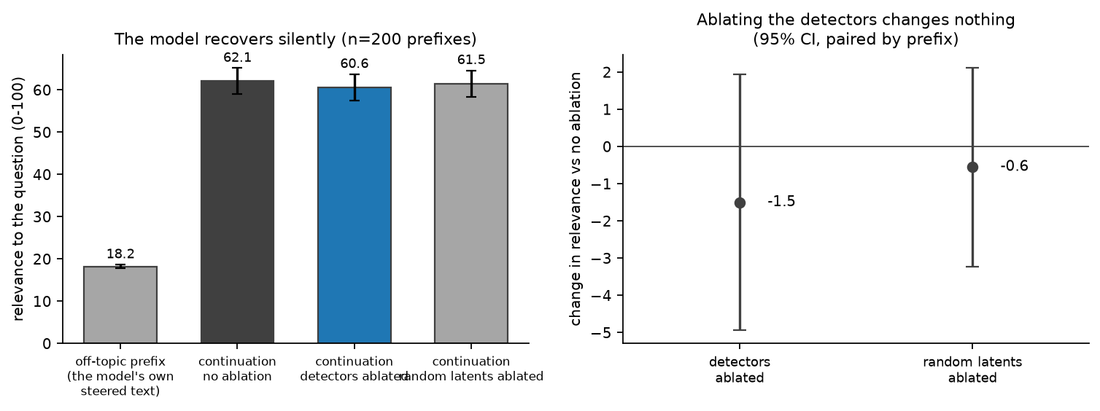
Causal test with enough power: prefill, then ablate
• Restarts are too rare to test directly, so feed the model its own off-topic text and let it continue unsteered.
• It recovers in about two thirds of cases, almost always silently: 0 of 600 continuations contain a restart phrase.
• Ablating the 26 detector latents changes recovery by -1.5 points (95% CI -5.0 to +2.0), the same as ablating random latents.
12

Slide 13
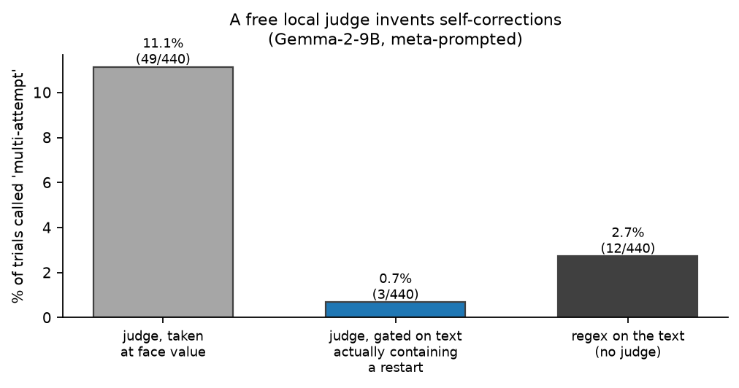
Methods caution: a free local judge invents self-corrections
• Taken at face value the judge reports several times more restarts than the text contains.
• Fix: accept an attempt boundary only where a restart phrase actually occurs in the model's own words.
• Same lesson as any probe: a number needs a baseline that shares its access to the data.
13

Slide 14
Summary
• The pipeline replicates every qualitative claim testable at this scale: no self-correction without steering, a few percent with it in the 9B model, and more insistent but no more successful correction under meta-prompting.
• The correlational mechanistic claim replicates: candidate detector latents are strongly elevated in off-topic text.
• The causal claim does not transfer. Ablation is indistinguishable from a random-latent control, in a test powered to detect a five-point effect.
• Main caveats: one layer, a 16k SAE explaining 61% of variance, and a local judge rather than the paper's Claude.
• Next: the same geometry question asked where ground truth exists, which is the second project.
14

