Slide 1
Image Classification on Imbalanced Data Using Deep Learning

Slide 2
Work is available at
https://github.com/shouvikcirca/PCB_Defect_Detection

Slide 3
Dataset
Initially, Balanced with 300X300 RGB images
Now, Imbalanced with 600X600 RGB images (Bigger holistically and instantially)

Slide 4
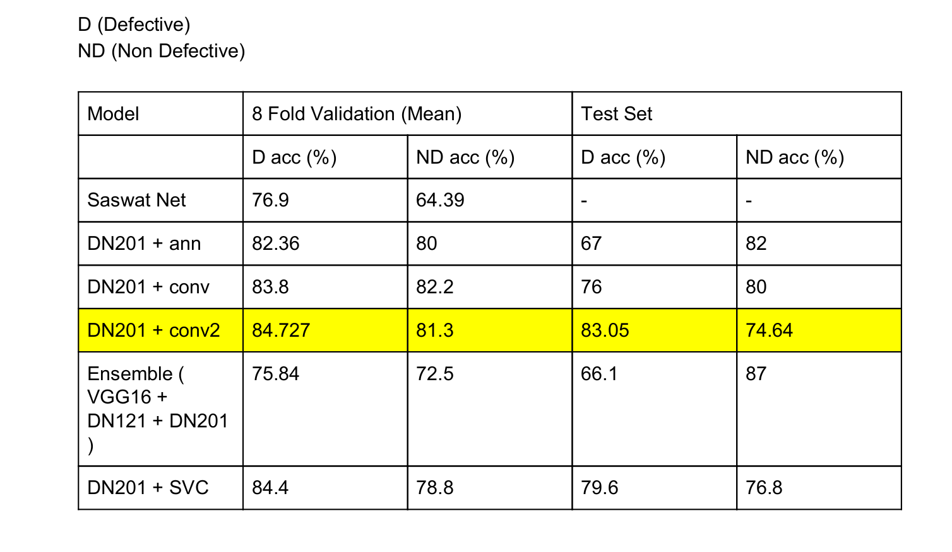

Slide 5
Defective Accuracy =
                Number of defective samples identified correctly
                Total Number of defective samples
                =
                True Negatives
                TrueNegatives + False Positives

Slide 6
Non Defective Accuracy =
                Number of non defective samples identified correctly
                Total Number of non defective samples
                =
                True Positives
                True Positives + False Negatives

Slide 7
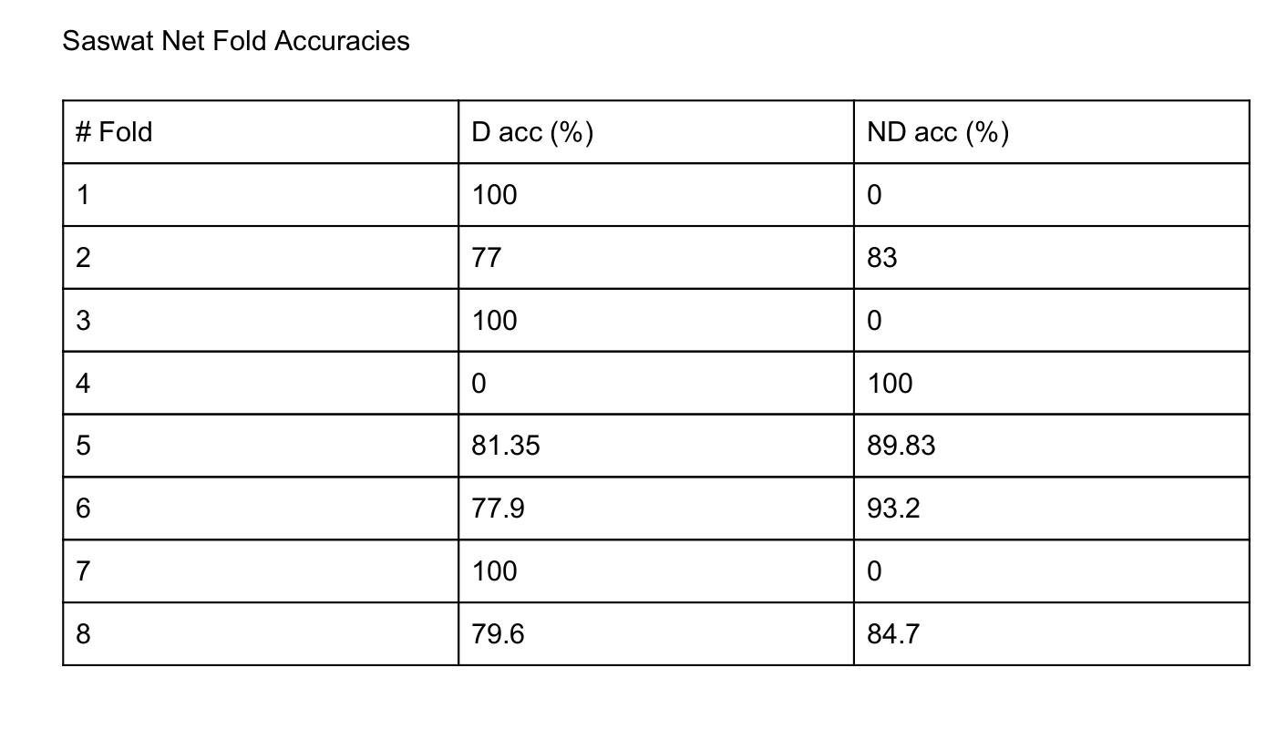

Slide 8
DN -> DenseNet, VGG -> Visual Geometry Group
DN and VGG are publicly available architectures
The suffix number indicates the number of layers

Slide 9
Feature Extraction
Pass the input through a pretrained network and use the output of the pretrained network as input for the downstream network that will be trained on your dataset.
Pretrained networks are believed to have learned very good abstract features owing to large datasets they have been trained on.

Slide 10
Ensemble
Train multiple models
Decide the label of a datapoint by majority of vote.

