Slide 1
Models | 0s (%) | 1s (%)
1. | 100 | 0.0
2. | 95.9 | 57.0
3. | 97.3 | 70.1
4. | 95.9 | 78.0
5. | 97.3 | 71.0
6. | 96.6 | 78.1
7. | 93.9 | 72.8
8. | 86.5 | 85.6
9. | 96.6 | 78.3
10. | 99.3 | 82.0
Details about the models are in the following slides.
All models have the same layers as that in LeNet5.

Slide 2
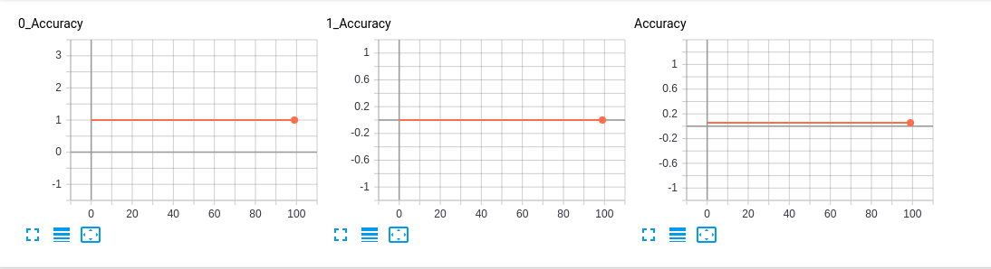
LeNet5
Input 32x32
238 samples
Normalized to 0 mean and 1 stddev
Learning rate 10⁻³
Tanh
Adam
Average Pooling
CrossEntropy Loss
L2 regularization (lambda = 0.65)
0 Accuracy 100%
1 Accuracy 0%
Epochs along Horizontal axis

Slide 3
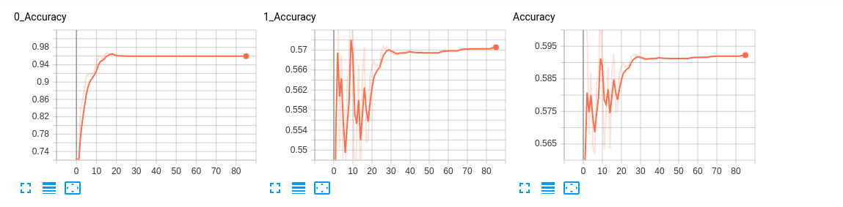
LeNet5
Input 32x32
238 samples
Normalized to 0 mean and 1 stddev
Learning rate 10⁻³
Tanh
Adam
Average Pooling
KL Divergence Loss
0 Accuracy 95.9%
1 Accuracy 57%
Epochs along Horizontal axis

Slide 4
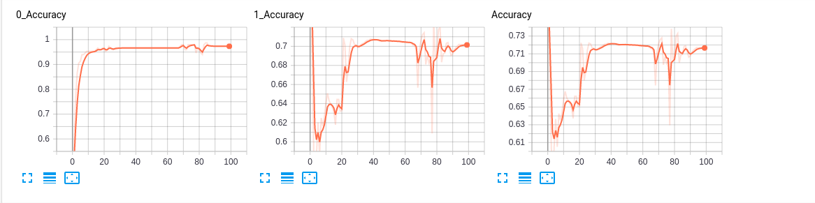
LeNet5
Input 32x32
238 samples
Normalized to 0 mean and 1 stddev
Learning rate 10⁻³
Tanh
Adam
Max Pooling
KL Divergence Loss
0 Accuracy 97.3%
1 Accuracy 70.1%
Epochs along Horizontal axis

Slide 5
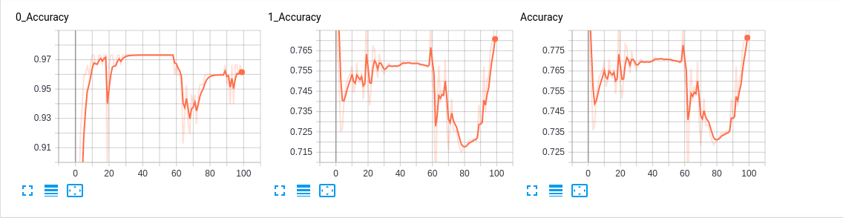
LeNet5
Input 32x32
238 samples
Normalized to 0 mean and 1 stddev
Learning rate 10⁻³
Tanh
Adam
Max Pooling
Batch Normalization
KL Divergence Loss
0 Accuracy 95.9%
1 Accuracy 78%
Epochs along Horizontal axis

Slide 6
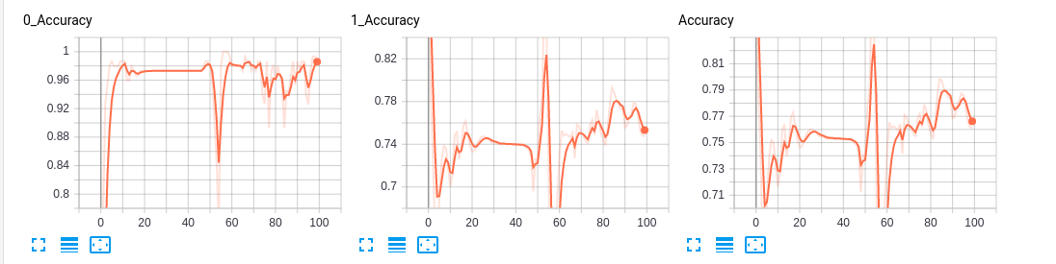
LeNet5
Input 32x32
238 samples
Normalized to 0 mean and 1 stddev
Learning rate 10⁻³
ReLU
Adam
Max Pooling
Batch Normalization
KL Divergence Loss
0 Accuracy 97.3%
1 Accuracy 71%
Epochs along Horizontal axis

Slide 7
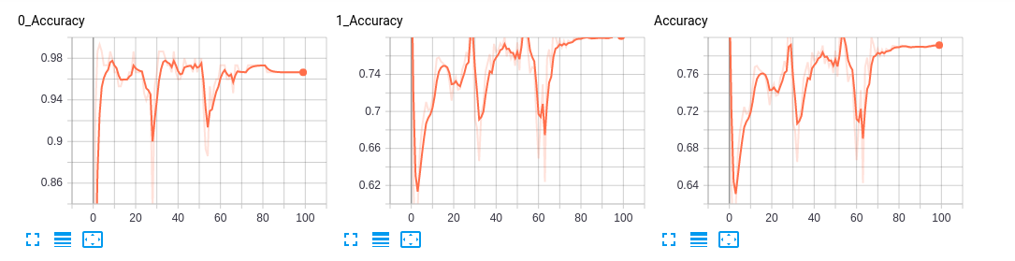
LeNet5
Input 32x32
238 samples
Normalized to 0 mean and 1 stddev
Learning rate 10⁻³
ReLU
Adam
Max Pooling
Batch Normalization
Cross Entropy Loss without
regularization
0 Accuracy 96.6%
1 Accuracy 78.1%
Epochs along Horizontal axis

Slide 8
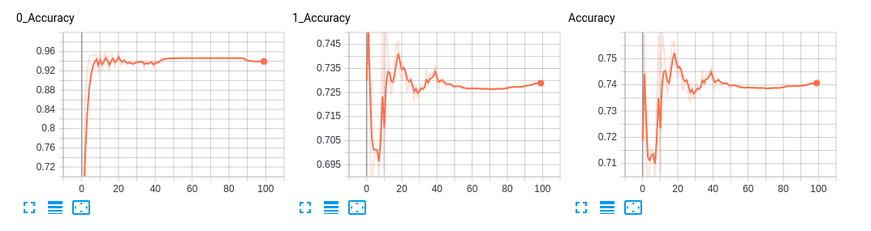
LeNet5
Input 32x32
238 samples
Normalized to 0 mean and 1 stddev
Learning rate 10⁻³
Tanh
Adam
Max Pooling
Batch Normalization
Cross Entropy Loss without
regularization
0 Accuracy 93.9%
1 Accuracy 72.8%
Epochs along Horizontal axis

Slide 9
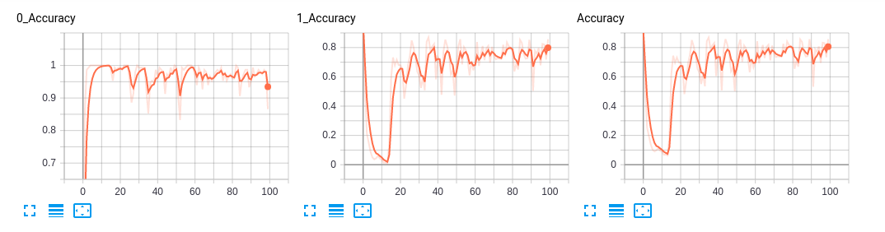
LeNet5
Input 32x32
238 samples
Normalized to 0 mean and 1 stddev
Learning rate 10⁻³
ReLU
Adam
Max Pooling
Batch Normalization
Cross Entropy Loss with L2
regularization( lambda = 0.11)
0 Accuracy 86.5%
1 Accuracy 85.6%
Epochs along Horizontal axis

Slide 10
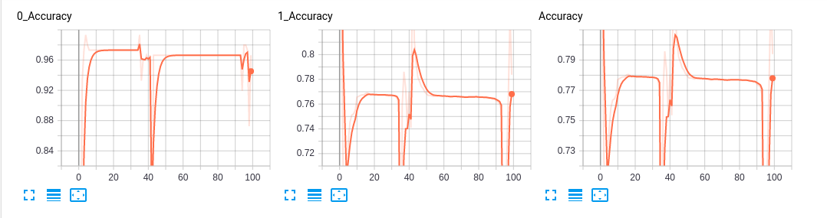
LeNet5
Input 32x32
238 samples
Normalized to 0 mean and 1 stddev
Learning rate 10⁻³
ReLU
RMSprop
(params, lr=0.01, alpha=0.99, eps=1e-08,
weight_decay=0, momentum=0, centered=False)
Max Pooling
Batch Normalization
Cross Entropy Loss without
regularization
0 Accuracy 96.6%
1 Accuracy 78.3%
Epochs Along Horizontal Axis

Slide 11
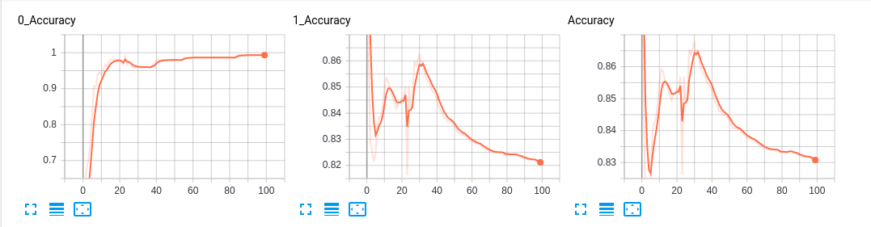
LeNet5
Input 32x32
298 samples
Normalized to 0 mean and 1 stddev
Learning rate 10⁻³
ReLU
Adam
Max Pooling
Batch Normalization
Cross Entropy Loss without
regularization
0 Accuracy 99.3%
1 Accuracy 82.0%
Epochs Along Horizontal Axis

