Slide 1
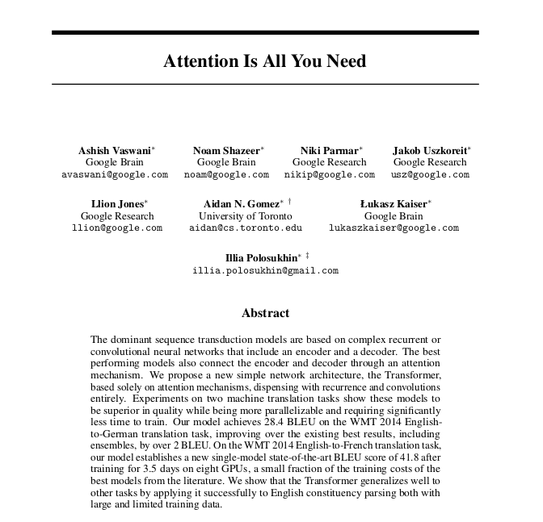
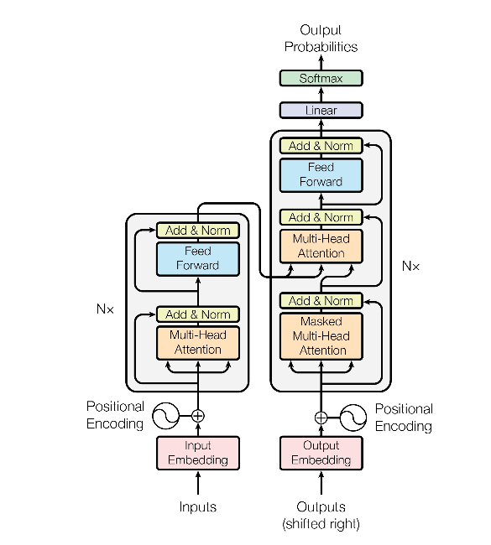
Transformers
Shouvik Sarkar
192CS022

Slide 2
Bag Of Words
I had a good day
I had a great day
I had a had day
 | I | had | a | good | great | day
I | 1 | 0 | 0 | 0 | 0 | 0
had | 0 | 1 | 0 | 0 | 0 | 0
a | 0 | 0 | 1 | 0 | 0 | 0
good | 0 | 0 | 0 | 1 | 0 | 0
great | 0 | 0 | 0 | 0 | 1 | 0
day | 0 | 0 | 0 | 0 | 0 | 1

Slide 3
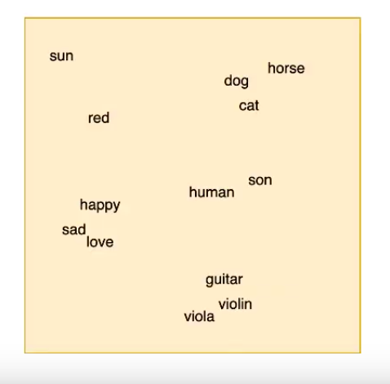
Embedding space

Slide 4
Word Embedddings
happy | 0.5 | 0.45 | 0.76
sad | 0.45 | 0.45 | 0.82
red | 0.01 | 0.9 | 0.2
Pretrained embeddings can be downloaded Gensim used

Slide 5
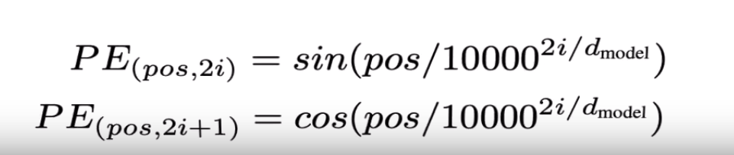
Positional Encoding
Impart positional information to the vectors
Sara’s dog is cute
Sara is cute like a dog

Slide 6
So far .....
For each word
Embedding (vector)
+
Positional Encoding (operation)
=
Context with position info
To be done for both encoder and decoder

Slide 7
Queries, Keys and Values
10X5
10X5
10X5
P
Q: 1X5
1x10
K: 1X5
V: 1X5
Do the same for all word vectors
(Let’s assume a 4 word sentence)

Slide 8
Queries, Keys and Values
Word1 Word2 Word3 Word4
P1 P2 P3 P4
Q1 Q2 Q3 Q4
K1 K2 K3 K4
V2 V2 V3 V4
Positionally Encoded Vectors
Queries
Keys
Values

Slide 9
Self - Attention
W1
Q1.K1 Q1.K2 Q1.K3 Q1.K4
scalar1 scalar2 scalar3 scalar4
Softmax
0.52 0.24 0.10 0.14
0.52*V1 + 0.24*V2 + 0.10*V3 + 0.14*V4
R11 = 1X5

Slide 10
Self - Attention
Computes attention vector for each word
The day was good
The day was good
The day was good
The day was good
0.7 | 0.6 | 0.54 | 0.32 | 0.43
0.8 | 0.9 | 0.6 | 0.5 | 0.4
.43 | 0.52 | 0.76 | 0.54 | 0.32
0.45 | 0.23 | 0.54 | 0.67 | 0.49

Slide 11
Multi Head Attention
W1 R11 Concat ( R11, R12 ) 1X10 (R1)
R12
W2 R21 Concat ( R21, R22 ) 1X10 (R2)
R22
W3 R31 Concat ( R31, R32 ) 1X10 (R3)
R32
W4 R41 Concat ( R41, R42 ) 1X10 (R4)
R42

Slide 12
Projection
[ ][ ] = [ ]
R
1x10
W0
10x10
Pr
1x10

Slide 13
Layer Normalisation
P is the positionally encoded vector fed into
the self-attention layer
Layer Normalisation ( P + Pr )

Slide 14
Feed Forward, Add and Normalize
Pri
Input size = size of a Pr vector
Output is same size as Input
Layer Normalization ( Pri + Ouputi )

Slide 15
Repeat
The operations so far constitute one encoder layer.
This output becomes the input for the next encoder
layer
Repeat process ( N = 6)
The output of the final encoder layer is used in the
multi - Head attention layer of the decoder

Slide 16
What is being attended ?
..
Target Language and Source Language
Source Language and Source Language
Target Language and Target Language

Slide 17
Masked Self Attention in Decoder
The generation of a word in the target language can pay attention only to the words already generated.
Since operations are vectorized there has to be a mechanism to mask the positions for the words that will be generated afterwards.

Slide 18
Training
Feed Forward
I there go am want come fast can to will
0.10 | 0.13 | 0.12 | 0.03 | 0.31 | 0.01 | 0.02 | 0.15 | 0.04 | 0.09
Target
0. | 0. | 0. | 0. | 0. | 1. | 0. | 0. | 0. | 0.
Loss Function = Sum of differences
Goal is to minimize the loss function

Slide 19
Preprocessing and nuances
Both german and english sentences have to be appended with eos tokens at the end
eos = end_of_sentence
Since this is English -> German, german sentences have to be appended with sos tokens at the beginning
sos = start_of_sentence
The german and english sentences have to be made of the same length else the entire thing breaks
We do this by appending ‘padding’ tokens after eos

Slide 20
Inference
The transformer is what in NLP is called a “ Language model “
The job of a language model is to predict the next word conditioned on the previous words it has seen
Inference in Machine Learning is when you use the model learned (so far) to predict (usually on test data).
This is important when using things like BatchNorm, Dropout, etc
There is a train( ) mode and eval mode in Pytorch( )

Slide 21
Linear and Softmax Layer in Decoder
Will project onto the vocabulary of the target language thereby giving a probability distribution over the
candidate next words.
Two ways of choosing words
Greedy Approach
Beam Search

Slide 22
Inference
ran here indicates some word that we don’t care about
1)
2)
Ich ran ran ran ran
ran habe ran ran ran
Encoder
Decoder
Encoder
Decoder
I have a cat eos
Sos sos sos sos sos
I have a cat eos
I have a cat eos
Ich sos sos sos sos
3)
ran ran eine ran ran
4)
ran ran ran katze ran
5)
ran ran ran ran pad
Encoder
Decoder
Encoder
Decoder
Encoder
Decoder
I have a cat eos
Ich habe sos sos sos
I have a cat eos
Ich habe eine sos sos
I have a cat eos
Ich habe eine katze sos

Slide 23
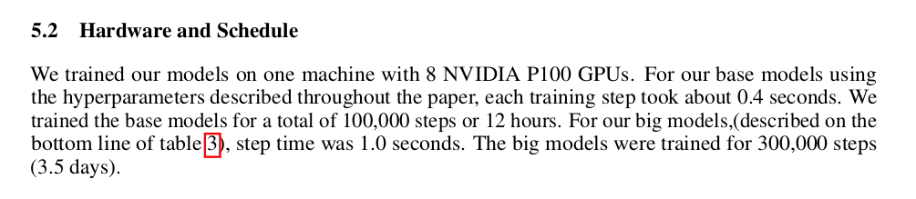
Future Work
Not possible to train
Documentation update

