Slide 1
Preprocessing and nuances
Both german and english sentences have to be appended with eos tokens at the end
eos = end_of_sentence
Since this is English -> German, german sentences have to be appended with sos tokens at the beginning
sos = start_of_sentence
The german and english sentences have to be made of the same length else the entire thing breaks
We do this by appending ‘padding’ tokens after eos

Slide 2
Inference
The transformer is what in NLP is called a “ Language model “
The job of a language model is to predict the next word conditioned on the previous words it has seen
Inference in Machine Learning is when you use the model learned (so far) to predict (usually on test data).
This is important when using things like BatchNorm, Dropout, etc
There is a train( ) mode and eval mode in Pytorch( )

Slide 3
Linear and Softmax Layer in Decoder
Will project onto the vocabulary of the target language thereby giving a probability distribution over the
candidate next words.
Two ways of choosing words
Greedy Approach
Beam Search

Slide 4
Inference
ran here indicates some word that we don’t care about
1)
2)
Ich ran ran ran ran
ran habe ran ran ran
Encoder
Decoder
Encoder
Decoder
I have a cat eos
Sos sos sos sos sos
I have a cat eos
I have a cat eos
Ich sos sos sos sos
3)
ran ran eine ran ran
4)
ran ran ran katze ran
5)
ran ran ran ran pad
Encoder
Decoder
Encoder
Decoder
Encoder
Decoder
I have a cat eos
Ich habe sos sos sos
I have a cat eos
Ich habe eine sos sos
I have a cat eos
Ich habe eine katze sos

Slide 5
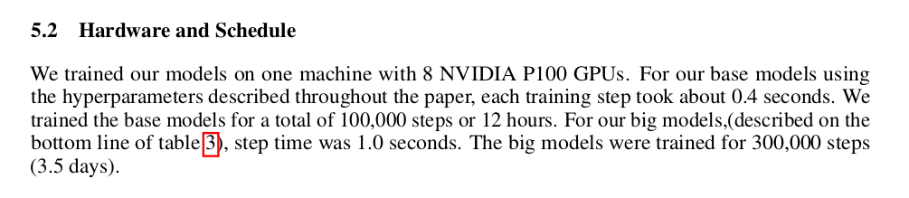
Future Work
~ Attention Is All You Need
Not possible to train
Documentation update

Slide 6
Proof Of Work
https://github.com/shouvikcirca/Transformer
References
Attention Is All You Need
Google
https://arxiv.org/abs/1706.03762
The Illustrated Transformer
http://jalammar.github.io/illustrated-transformer/
Attention Is All You Need | AISC Foundational
https://www.youtube.com/watch?v=S0KakHcj_rs

