Slide 1
Plant-wide byproduct gas distribution under uncertainty in iron and steel industry via quantile forecasting and robust optimization
Optimization Problem
1

Slide 2

Contents
Problem Statement
Traditional way of Optimization
Benefits DD-TSRO
Results
Conclusions and Discussion
Reference
2

Slide 3
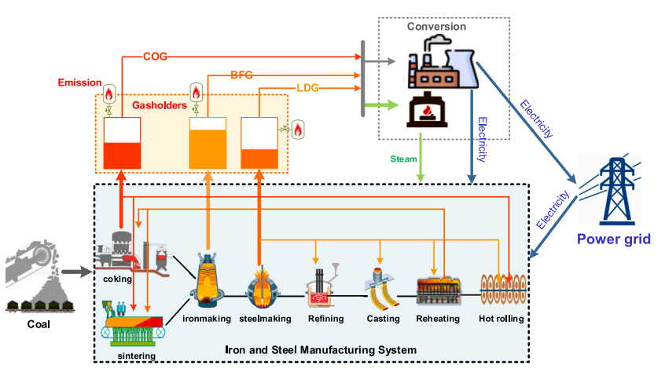
About the Problem
Manufacturing System
Storage System
Conversion system
Fig: Byproduct gas system¹
Introduction
3

Slide 4
Objective of the Study?
The primary objective : To determine the storage and conversion of surplus gases to meet the demands for steam and electricity, while minimizing the environmental pollution from gas emissions.
Introduction
4

Slide 5
Why this study is important?
Energy Management: Accurate forecasts help optimize resource allocation, reduce costs, and ensure uninterrupted supply
Improved Accuracy: This accuracy can lead to better planning, reduced waste, and improved resource utilization.
Robust Decision-Making: The Two-Stage Robust Optimization (TSRO) model provides a framework for robust decision-making under uncertainty
Introduction
5

Slide 6
Traditional ways of Optimization
Linear Programming (LP): Assumes that all input parameters are deterministic and known precisely, doesn't account for uncertainty in supply, demand,
Mixed-Integer Linear Programming (MILP): Assumes deterministic input data and doesn't naturally handle uncertainty
Introduction
6

Slide 7
New ways of Optimization
Two-Stage RO (TSRO) model to make ”here-and-now” and
”wait-and-see” decisions under uncertainty.
Data Driven Two-Stage RO (DD-TSRO) model following the idea of “first quantify, then optimize”
Introduction
7

Slide 8
DD-TSRO Advantages
Robustness to Uncertainty
Quantification of Uncertainty
Quantification provides decision-makers with a clearer understanding of the potential risks and trade-offs associated with different choices
Introduction
8

Slide 9
Data-driven uncertainty quantification
Gradient Boosting Decision Trees ML Algorithm is used
GBDT was to develop a predictive model that could effectively forecast gas supply values while considering uncertainty and capturing complex relationships within the data.
T=8,P=20,Previous 8 data to predict next. With window size of 20.
* Model Like ARIMA(AutoRegressive Integrated Moving Average),LSTM Deep Learning
Introduction
9

Slide 10
TSRO
Gradient Boosting Decision Trees ML Algorithm is used
GBDT was to develop a predictive model that could effectively forecast gas supply values while considering uncertainty and capturing complex relationships within the data.
T=8,P=20,Previous 8 data to predict next. With window size of 20.
* Model Like ARIMA(AutoRegressive Integrated Moving Average),LSTM Deep Learning
Introduction
10

Slide 11
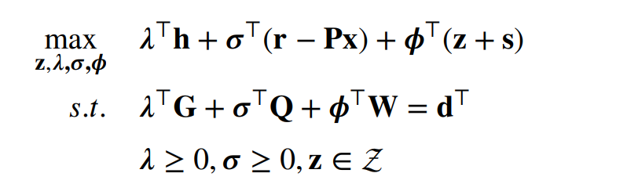
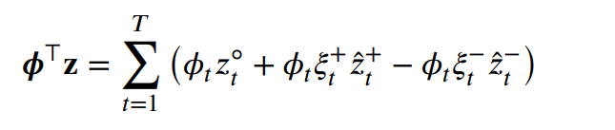
Optimization
where 𝝀, 𝝈,𝝓 are the Lagrangian multipliers of the formula
Uncertainty term (𝝓⊤𝐳) can obtain :
Introduction
11

Slide 12
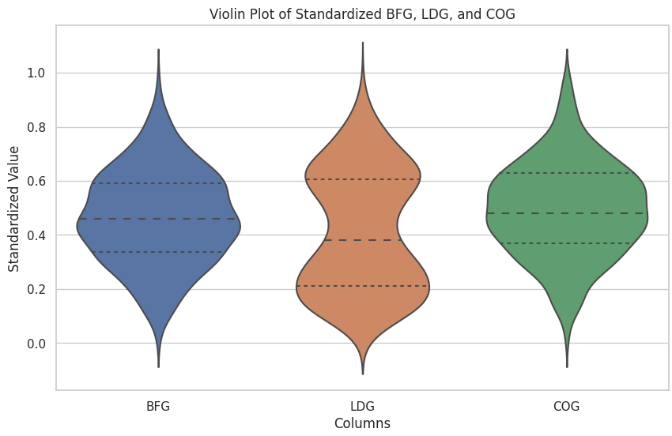
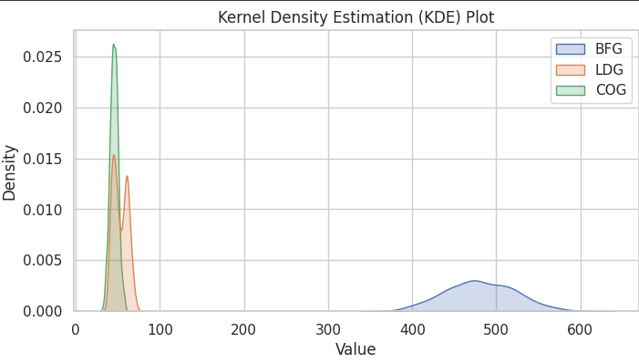
Results
Distribution of data
Result
12

Slide 13
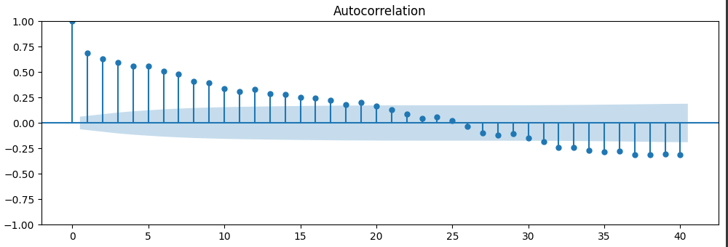
Results
Identified window or seasonal period (p=20 given )
Test stationary
Result
13

Slide 14
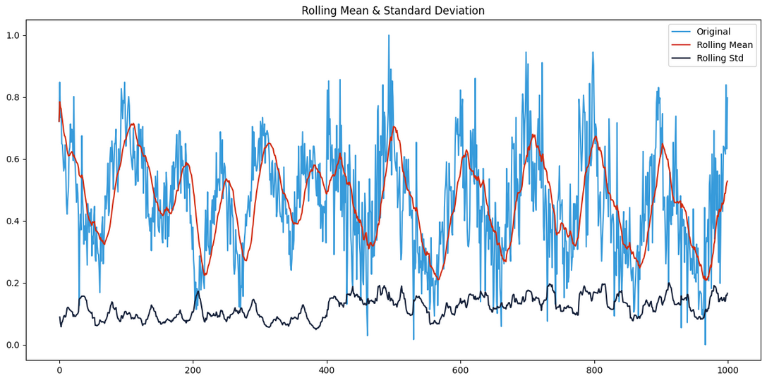
Results
Data with Rolling Avg.
BFG GAS
Result
14

Slide 15
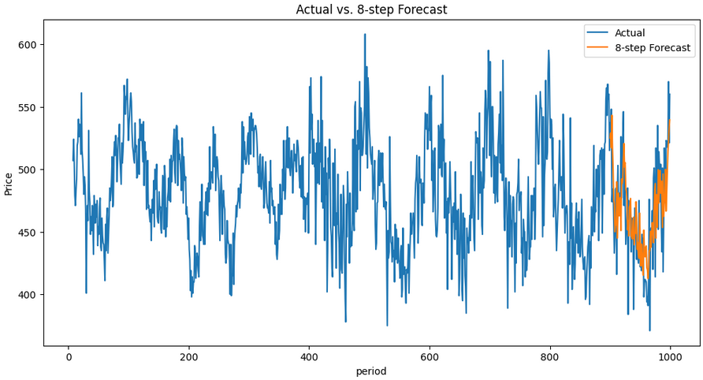
Results
Data prediction BFG gas
Result
15

Slide 16
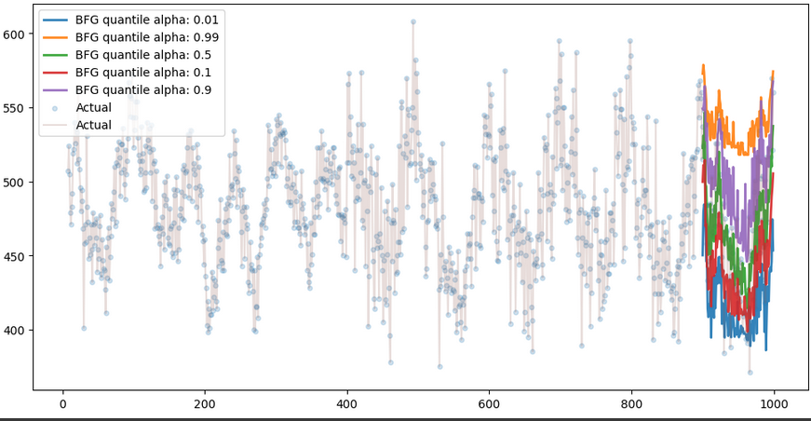
Results
Data prediction BFG gas with different quantiles
Result
16

Slide 17
Thank You !
Department of Applied Mechanics and Biomedical Engg.
17

