Slide 1
GROWTH INDUSTRIES
LOCALIZED ECONOMIC EFFECTS
Daniel Zhou

Slide 2
AN OPEN QUESTION
Would you start a family in for:
Silicon Valley (120K USD) ?
Fort MacMurray (120K CAD) ?
Shenzhen (40K RMB)?

Slide 3
CONTENTS
On Industry Hubs
Three Examples
Alberta Oil Sands
Silicon Valley
Shenzhen
Commonalities

Slide 4
ON INDUSTRY HUBS
Why Do Similar Firms Cluster?
Convenience?
Necessity?

Slide 5
ON INDUSTRY HUBS
Who Benefits? …And Who Loses?
Firms?
Local Government?
Residences?
Workers?

Slide 6
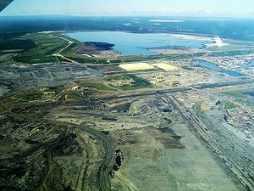
CASE 1: ALBERTA OIL SANDS
167.2 Billion Barrels
97% of Canada’s Reserves
1980’s – Two Projects
2010’s – 127 Projects

Slide 7
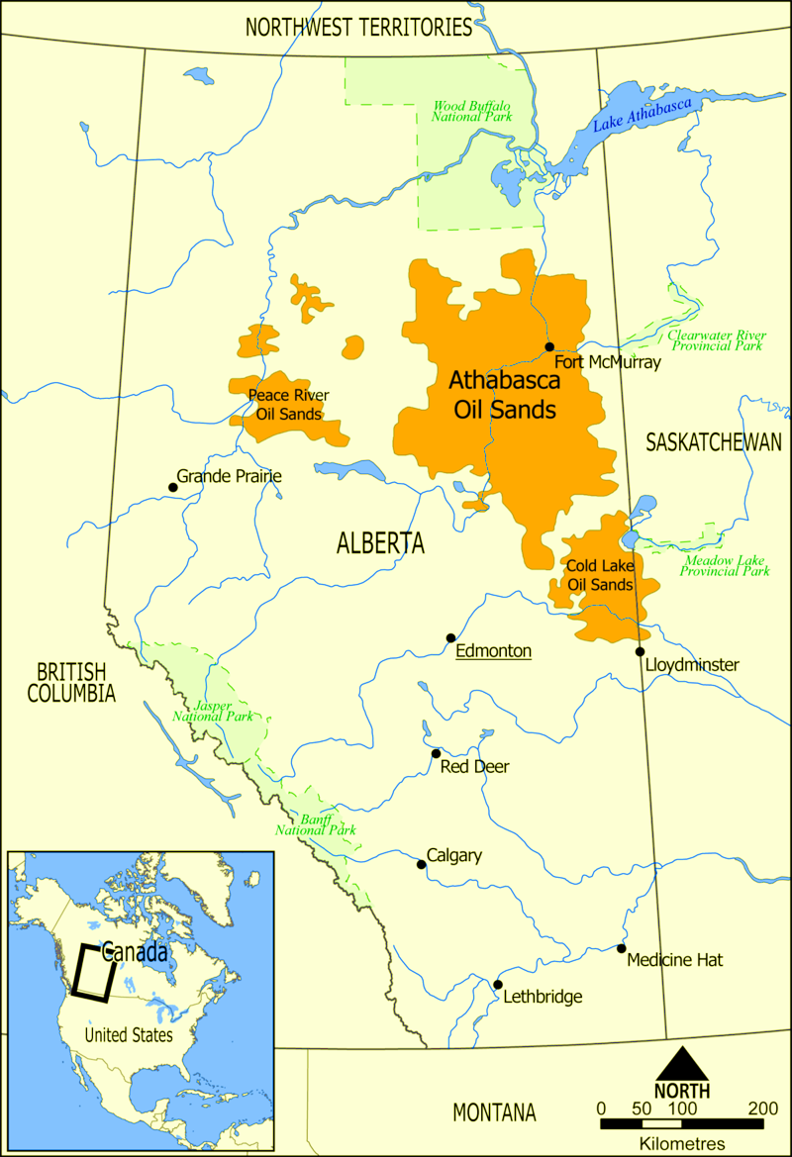
CASE 1: ALBERTA OIL SANDS
Innovation in Oil Sands
Processing
Necessity of Location
Relative Isolation

Slide 8
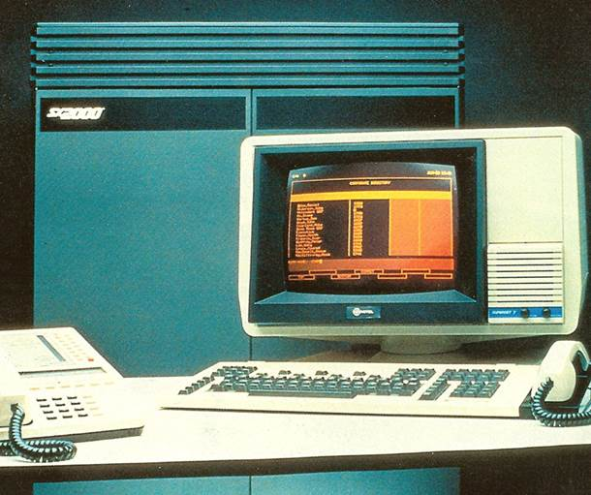
CASE 2: SILICON VALLEY
1970’s – Computers In Academia
1980’s – Widespread Adoption
1090’s – Advent of Internet
Major players
Stanford
Caltech
Fairchild Conductor
ARPA

Slide 9
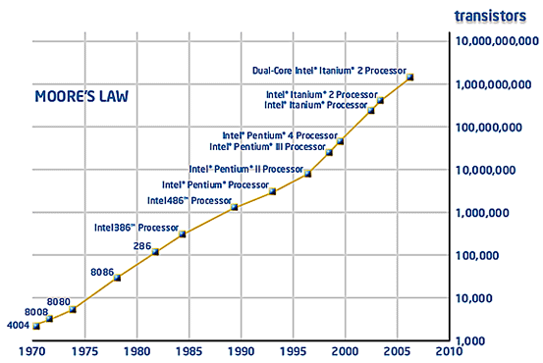
CASE 2: SILICON VALLEY
What’s Common To:
Google
Microsoft
Facebook?
“Being in Hardware Simply Wasn’t Profitable” …Software 1980s

Slide 10
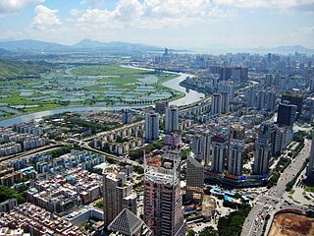
CASE 3: SHENZHEN
1970’s – Rural Fishing Village 300K Pop.
1980’s – Shenzhen SEZ Formed
2010’s – IoT
2016’s – 11.91 Million Pop.

Slide 11
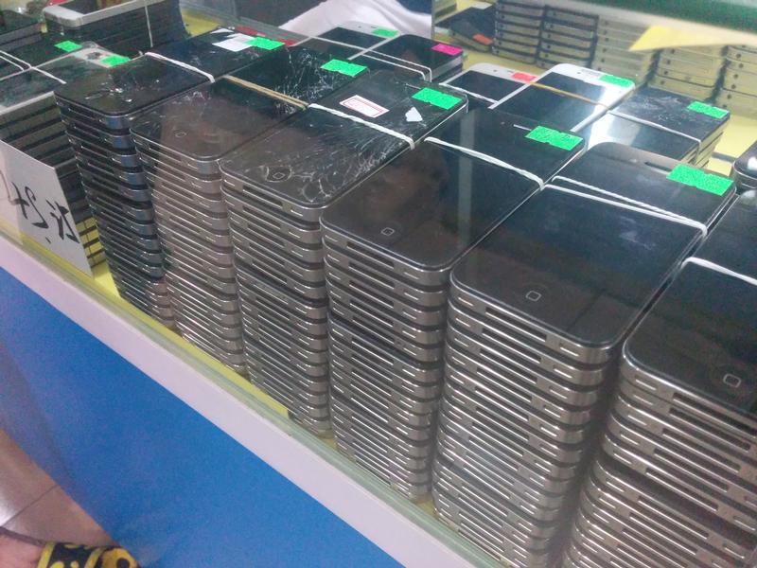
CASE 3: SHENZHEN
“Being in Software Simply Wasn’t Profitable” …Hardware 2010s
Foreign Investment
Western Capitalism
Urbanization
New Generation

Slide 12
COMMONALITIES
Rising Incomes
Population Migration
Rising Costs Of Living
Local Economy Strain
Economic Risk

Slide 13
Rising Incomes
Schumpeter's Creative Destruction
Labour Scarcity…
Trades Alberta
Programmers SF Bay Area
Labourers Shenzhen

Slide 14
Rising Incomes

Slide 15
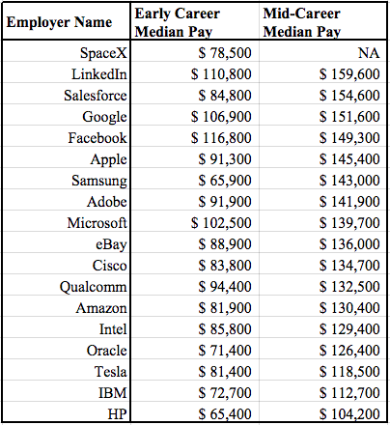
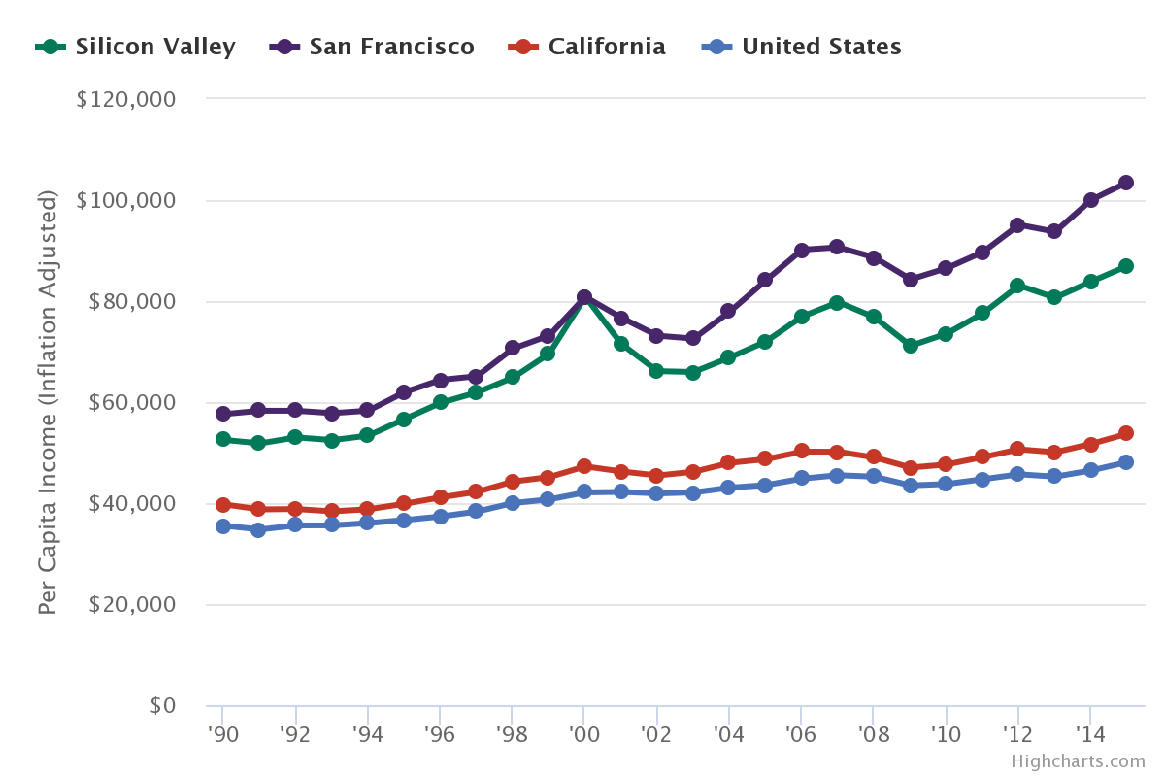
Rising Incomes

Slide 16
Population Migration
Income Seekers?
Community Seeking?
Risk Diversification?

Slide 17
Population Migration
“By 2012, there were 68,000 temporary foreign workers in Alberta, 20 per cent of the Canadian total.”

Slide 18
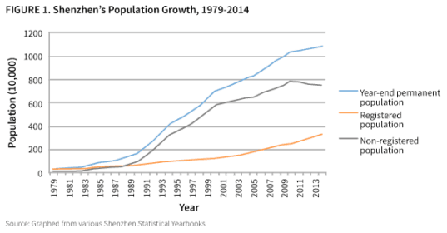
Population Migration

Slide 19
Rising Costs Of Living
Income Effect?
Housing?
Finer Tastes?
Competition?

Slide 20
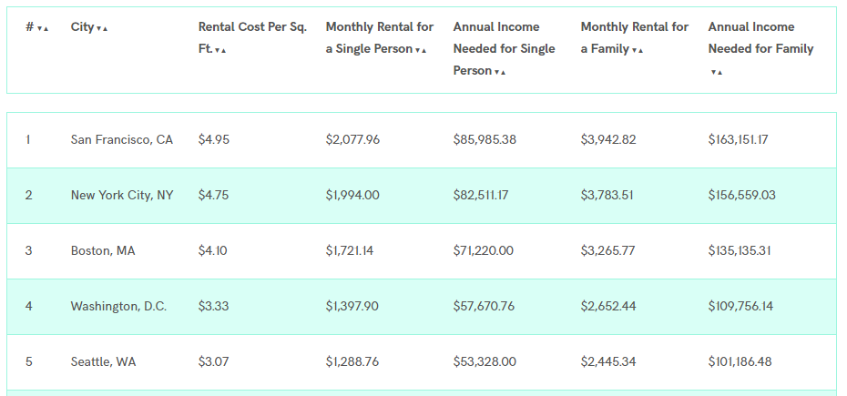
Rising Costs Of Living
Income Effect?
Housing?
Finer Tastes?
Competition?

Slide 21
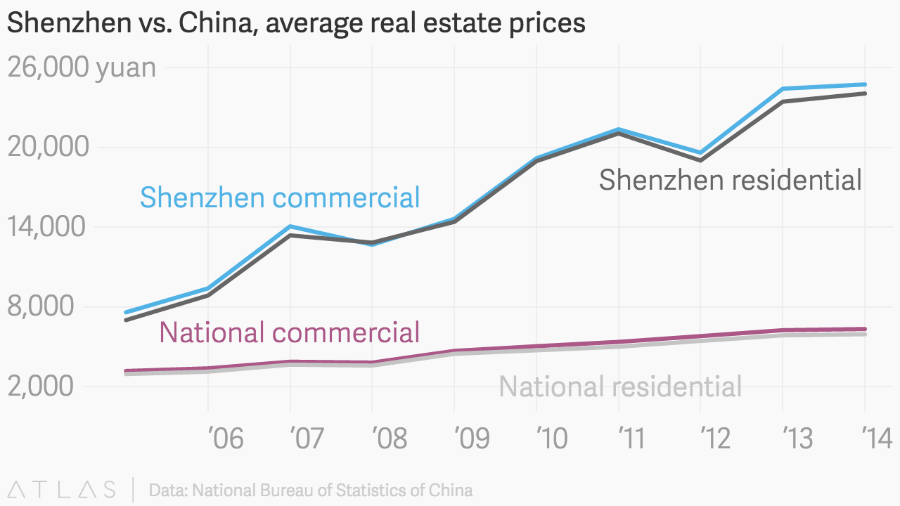
Rising Costs Of Living

Slide 22
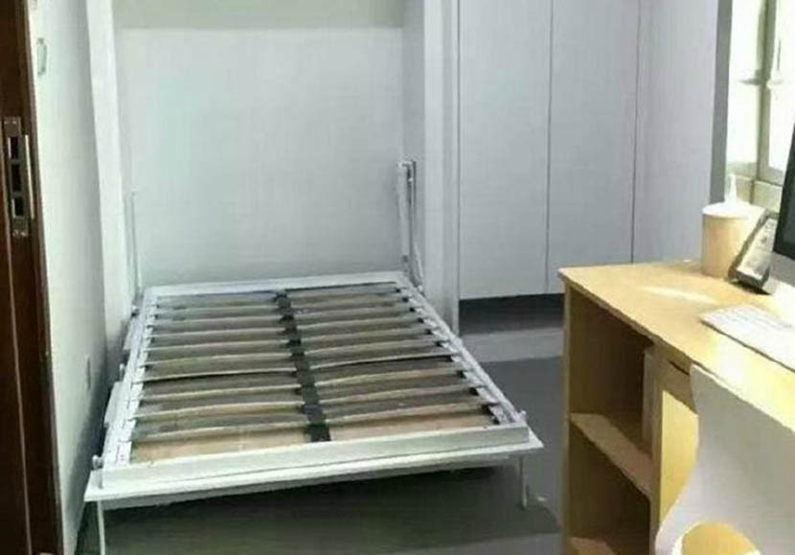

Rising Costs Of Living
Quartz on Shenzhen:
60-80 sq. ft. apartment
880,000 yuan ($131,957)
20x Average Salary

Slide 23
Local Economy Strain
Locals versus Foreigners?
Infrastructure?
Culture?
Governance?
Ecology?

Slide 24
Local Economy Strain
One of the more unusual results has been the effect on the high-school dropout rate. These young people are well aware that, in the current economic climate, they can make as much or more money than they would if they learned a trade or earned a degree. - CBC

Slide 25
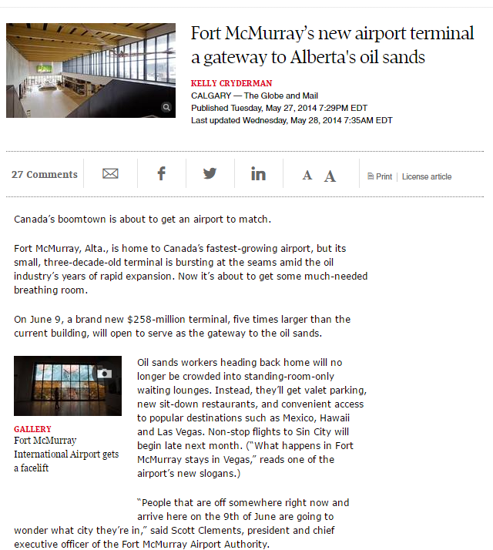
Local Economy Strain

Slide 26
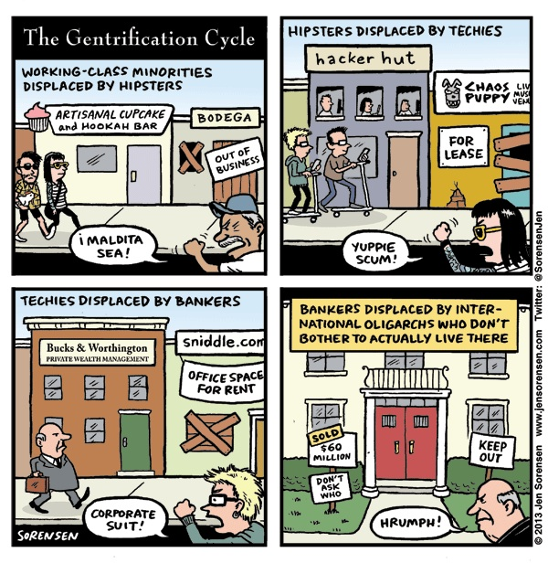
Local Economy Strain
Remarkably, slightly more than one-third of students – or 1,147 children – are defined as homeless here, mostly sharing homes with other families because their parents cannot afford one of their own, and also living in RVs and shelters. The district is being squeezed from every side: teachers, administrative staff and even principals have housing woes of their own. – The Guardian

Slide 27
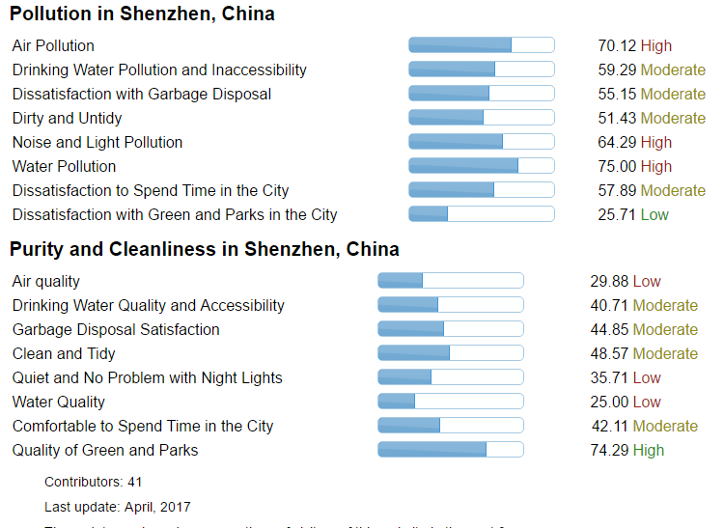
Local Economy Strain

Slide 28
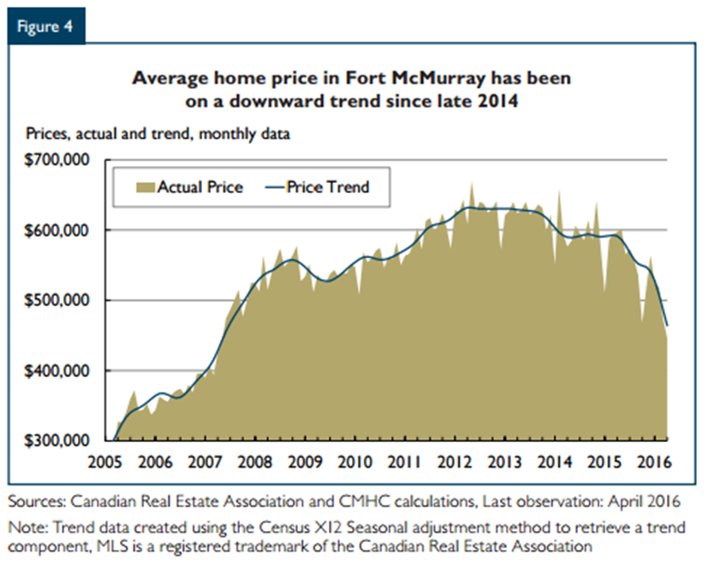
Economic Risk

Slide 29
Title
B1
B2
B3

