Slide 1
Chapter 1

Slide 2
Introduction
Rapidly changing field:
  vacuum tube -> transistor -> IC -> VLSI (see section 1.4)
  doubling every 1.5 years:
  memory capacity
  processor speed (Due to advances in technology and organization)
Things you’ll be learning:
  how computers work, a basic foundation
  how to analyze their performance (or how not to!)
  issues affecting modern processors (caches, pipelines)
Why learn this stuff?
  you want to call yourself a “computer scientist”
  you want to build software people use (need performance)
  you need to make a purchasing decision or offer “expert” advice

Slide 3
What is a computer?
Components:
  input (mouse, keyboard)
  output (display, printer)
  memory (disk drives, DRAM, SRAM, CD)
  network
Our primary focus: the processor (datapath and control)
  implemented using millions of transistors
  Impossible to understand by looking at each transistor
  We need...

Slide 4
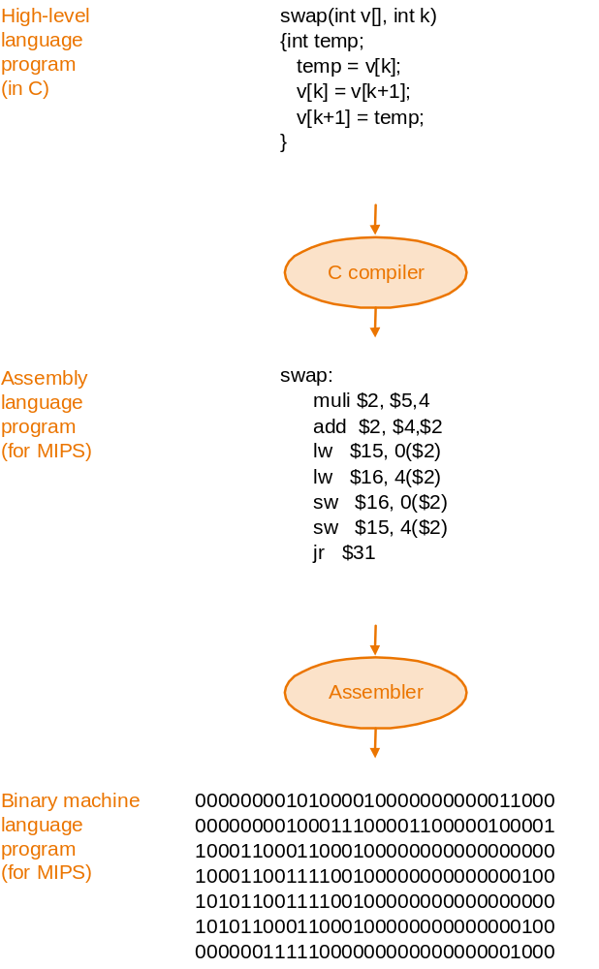
Abstraction
Delving into the depths
reveals more information
An abstraction omits unneeded detail,
helps us cope with complexity
What are some of the details that
appear in these familiar abstractions?

Slide 5
Instruction Set Architecture
A very important abstraction
  interface between hardware and low-level software
  standardizes instructions, machine language bit patterns, etc.
  advantage: different implementations of the same architecture
  disadvantage: sometimes prevents using new innovations
  True or False: Binary compatibility is extraordinarily important?
Modern instruction set architectures:
  80x86/Pentium/K6, PowerPC, DEC Alpha, MIPS, SPARC, HP

Slide 6
Where we are headed
Performance issues (Chapter 2) vocabulary and motivation
A specific instruction set architecture (Chapter 3)
Arithmetic and how to build an ALU (Chapter 4)
Constructing a processor to execute our instructions (Chapter 5)
Pipelining to improve performance (Chapter 6)
Memory: caches and virtual memory (Chapter 7)
I/O (Chapter 8)
Key to a good grade: reading the book!

