Slide 1
Chapter 3

Slide 2
Instructions:
Language of the Machine
More primitive than higher level languages
e.g., no sophisticated control flow
Very restrictive
e.g., MIPS Arithmetic Instructions
We’ll be working with the MIPS instruction set architecture
  similar to other architectures developed since the 1980's
  used by NEC, Nintendo, Silicon Graphics, Sony
Design goals: maximize performance and minimize cost, reduce design time

Slide 3
MIPS arithmetic
All instructions have 3 operands
Operand order is fixed (destination first)
Example:
C code: A = B + C
MIPS code: add $s0, $s1, $s2
(associated with variables by compiler)

Slide 4
MIPS arithmetic
Design Principle: simplicity favors regularity. Why?
Of course this complicates some things...
C code: A = B + C + D;
E = F - A;
MIPS code: add $t0, $s1, $s2
add $s0, $t0, $s3
sub $s4, $s5, $s0
Operands must be registers, only 32 registers provided
Design Principle: smaller is faster. Why?

Slide 5
Registers vs. Memory
Arithmetic instructions operands must be registers,
— only 32 registers provided
Compiler associates variables with registers
What about programs with lots of variables
Control
Input
Memory
Datapath
Output
Processor
I/O

Slide 6
Memory Organization
Viewed as a large, single-dimension array, with an address.
A memory address is an index into the array
"Byte addressing" means that the index points to a byte of memory.
0
8 bits of data
1
8 bits of data
2
8 bits of data
3
8 bits of data
4
8 bits of data
5
8 bits of data
6
8 bits of data
...

Slide 7
Memory Organization
Bytes are nice, but most data items use larger "words"
For MIPS, a word is 32 bits or 4 bytes.
2³² bytes with byte addresses from 0 to 2³²-1
2³⁰ words with byte addresses 0, 4, 8, ... 2³²-4
Words are aligned
i.e., what are the least 2 significant bits of a word address?
0
32 bits of data
4
32 bits of data
Registers hold 32 bits of data
8
32 bits of data
12
32 bits of data
...

Slide 8
Instructions
Load and store instructions
Example:
C code: A[8] = h + A[8];
MIPS code: lw $t0, 32($s3)
add $t0, $s2, $t0
sw $t0, 32($s3)
Store word has destination last
Remember arithmetic operands are registers, not memory!

Slide 9

Our First Example
Can we figure out the code?
swap(int v[], int k);
{ int temp;
temp = v[k]
v[k] = v[k+1];
v[k+1] = temp;
}
swap:
muli $2, $5, 4
add $2, $4, $2
lw $15, 0($2)
lw $16, 4($2)
sw $16, 0($2)
sw $15, 4($2)
jr $31

Slide 10
So far we’ve learned:
MIPS
— loading words but addressing bytes
— arithmetic on registers only
Instruction Meaning
add $s1, $s2, $s3 $s1 = $s2 + $s3
sub $s1, $s2, $s3 $s1 = $s2 – $s3
lw $s1, 100($s2) $s1 = Memory[$s2+100]
sw $s1, 100($s2) Memory[$s2+100] = $s1

Slide 11
Machine Language
Instructions, like registers and words of data, are also 32 bits long
  Example: add $t0, $s1, $s2
  registers have numbers, $t0=9, $s1=17, $s2=18
Instruction Format:
000000 10001 10010 01000 00000 100000
op rs rt rd shamt funct
Can you guess what the field names stand for?
Notes:
Board work: Binary Numbers

Slide 12
Machine Language
Consider the load-word and store-word instructions,
  What would the regularity principle have us do?
  New principle: Good design demands a compromise
Introduce a new type of instruction format
  I-type for data transfer instructions
  other format was R-type for register
Example: lw $t0, 32($s2)
35 18 9 32
op rs rt 16 bit number
Where's the compromise?

Slide 13
Stored Program Concept
Instructions are bits
Programs are stored in memory
— to be read or written just like data
Fetch & Execute Cycle
  Instructions are fetched and put into a special register
  Bits in the register "control" the subsequent actions
  Fetch the “next” instruction and continue
memory for data, programs,
compilers, editors, etc.
Processor
Memory

Slide 14
Control
Decision making instructions
  alter the control flow,
  i.e., change the "next" instruction to be executed
MIPS conditional branch instructions:
bne $t0, $t1, Label
beq $t0, $t1, Label
Example: if (i==j) h = i + j;
bne $s0, $s1, Label
add $s3, $s0, $s1
Label: ....

Slide 15
Control
MIPS unconditional branch instructions:
j label
Example:
if (i!=j) beq $s4, $s5, Lab1
h=i+j; add $s3, $s4, $s5
else j Lab2
h=i-j; Lab1: sub $s3, $s4, $s5
Lab2: ...
Can you build a simple for loop?

Slide 16
So far:
Instruction Meaning
add $s1,$s2,$s3 $s1 = $s2 + $s3
sub $s1,$s2,$s3 $s1 = $s2 – $s3
lw $s1,100($s2) $s1 = Memory[$s2+100]
sw $s1,100($s2) Memory[$s2+100] = $s1
bne $s4,$s5,L Next instr. is at Label if $s4 ° $s5
beq $s4,$s5,L Next instr. is at Label if $s4 = $s5
j Label Next instr. is at Label
Formats:
op rs rt rd shamt funct
R
I
J
op rs rt 16 bit address
op 26 bit address

Slide 17
Control Flow
We have: beq, bne, what about Branch-if-less-than?
New instruction:
if $s1 < $s2 then
$t0 = 1
slt $t0, $s1, $s2 else
$t0 = 0
Can use this instruction to build "blt $s1, $s2, Label"
— can now build general control structures
Note that the assembler needs a register to do this,
— there are policy of use conventions for registers
2
Notes:
Board work: Binary Numbers

Slide 18
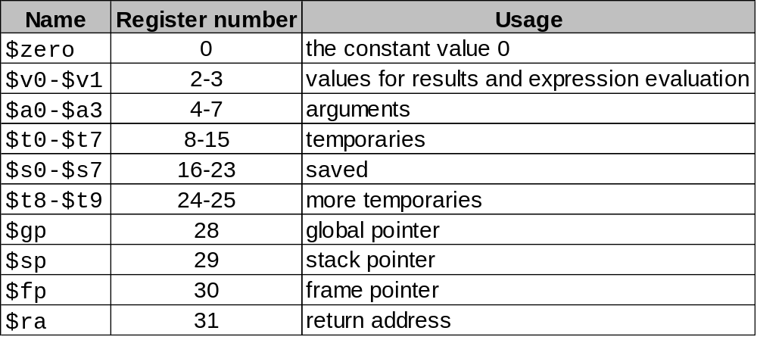
Policy of Use Conventions

Slide 19
Constants
Small constants are used quite frequently (50% of operands)
e.g., A = A + 5;
B = B + 1;
C = C - 18;
Solutions? Why not?
  put 'typical constants' in memory and load them.
  create hard-wired registers (like $zero) for constants like one.
MIPS Instructions:
addi $29, $29, 4
slti $8, $18, 10
andi $29, $29, 6
ori $29, $29, 4
How do we make this work?
3

Slide 20
How about larger constants?
We'd like to be able to load a 32 bit constant into a register
Must use two instructions, new "load upper immediate" instruction
lui $t0, 1010101010101010
Then must get the lower order bits right, i.e.,
ori $t0, $t0, 1010101010101010
filled with zeros
1010101010101010
0000000000000000
1010101010101010
0000000000000000
0000000000000000
1010101010101010
ori
1010101010101010
1010101010101010

Slide 21
Assembly Language vs. Machine Language
Assembly provides convenient symbolic representation
  much easier than writing down numbers
  e.g., destination first
Machine language is the underlying reality
  e.g., destination is no longer first
Assembly can provide 'pseudoinstructions'
  e.g., “move $t0, $t1” exists only in Assembly
  would be implemented using “add $t0,$t1,$zero”
When considering performance you should count real instructions

Slide 22
Other Issues
Things we are not going to cover
support for procedures
linkers, loaders, memory layout
stacks, frames, recursion
manipulating strings and pointers
interrupts and exceptions
system calls and conventions
Some of these we'll talk about later
We've focused on architectural issues
  basics of MIPS assembly language and machine code
  we’ll build a processor to execute these instructions.

Slide 23
Overview of MIPS
simple instructions all 32 bits wide
very structured, no unnecessary baggage
only three instruction formats
rely on compiler to achieve performance
— what are the compiler's goals?
help compiler where we can
op rs rt rd shamt funct
R
I
J
op rs rt 16 bit address
op 26 bit address

Slide 24
Addresses in Branches and Jumps
Instructions:
  bne $t4,$t5,Label Next instruction is at Label if $t4 ° $t5
  beq $t4,$t5,Label Next instruction is at Label if $t4 = $t5
  j Label Next instruction is at Label
Formats:
Addresses are not 32 bits
— How do we handle this with load and store instructions?
op rs rt 16 bit address
I
J
op 26 bit address

Slide 25
Addresses in Branches
Instructions:
  bne $t4,$t5,Label Next instruction is at Label if $t4°$t5
  beq $t4,$t5,Label Next instruction is at Label if $t4=$t5
Formats:
Could specify a register (like lw and sw) and add it to address
  use Instruction Address Register (PC = program counter)
  most branches are local (principle of locality)
Jump instructions just use high order bits of PC
  address boundaries of 256 MB
op rs rt 16 bit address
I

Slide 26
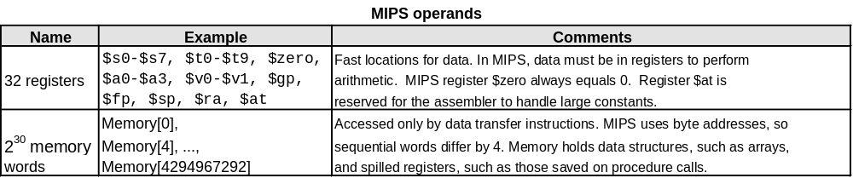
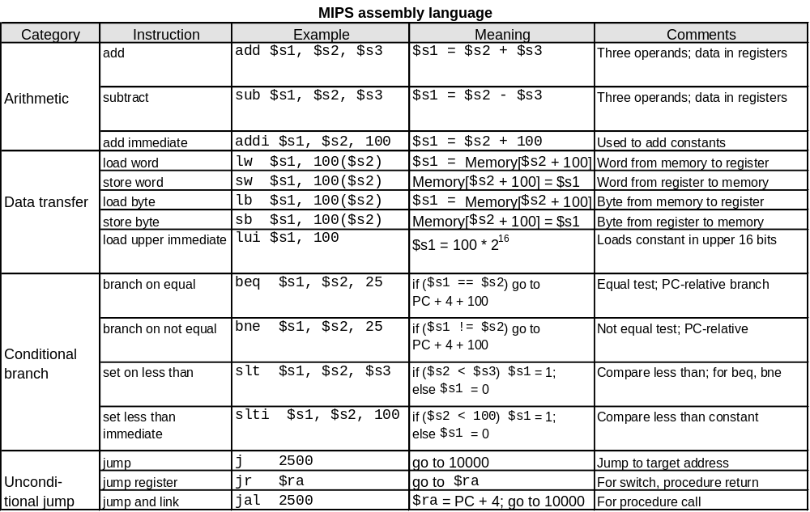
To summarize:

Slide 27
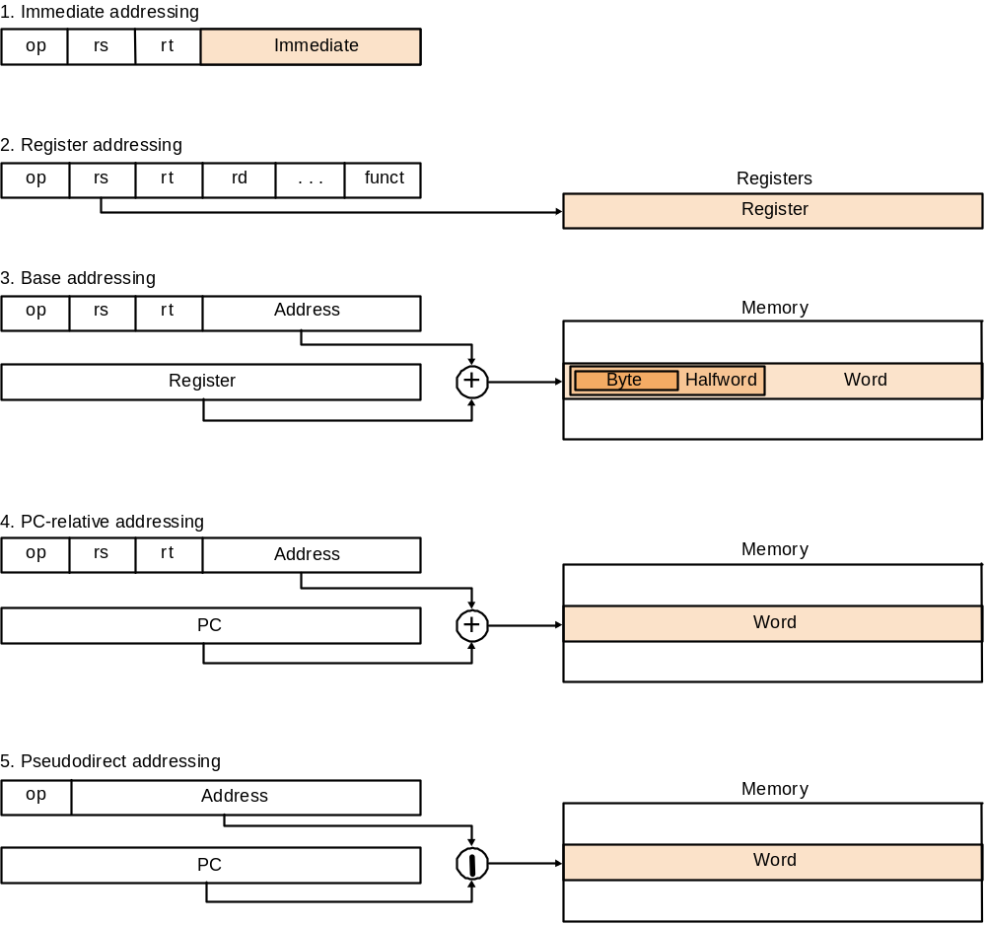

Slide 28
Alternative Architectures
Design alternative:
  provide more powerful operations
  goal is to reduce number of instructions executed
  danger is a slower cycle time and/or a higher CPI
Sometimes referred to as “RISC vs. CISC”
  virtually all new instruction sets since 1982 have been RISC
  VAX: minimize code size, make assembly language easy
  instructions from 1 to 54 bytes long!
We’ll look at PowerPC and 80x86

Slide 29
PowerPC
Indexed addressing
  example: lw $t1,$a0+$s3 #$t1=Memory[$a0+$s3]
  What do we have to do in MIPS?
Update addressing
  update a register as part of load (for marching through arrays)
  example: lwu $t0,4($s3) #$t0=Memory[$s3+4];$s3=$s3+4
  What do we have to do in MIPS?
Others:
  load multiple/store multiple
  a special counter register “bc Loop”
  decrement counter, if not 0 goto loop

Slide 30
80x86
1978: The Intel 8086 is announced (16 bit architecture)
1980: The 8087 floating point coprocessor is added
1982: The 80286 increases address space to 24 bits, +instructions
1985: The 80386 extends to 32 bits, new addressing modes
1989-1995: The 80486, Pentium, Pentium Pro add a few instructions
(mostly designed for higher performance)
1997: MMX is added
“This history illustrates the impact of the “golden handcuffs” of compatibility
“adding new features as someone might add clothing to a packed bag”
“an architecture that is difficult to explain and impossible to love”

Slide 31
A dominant architecture: 80x86
See your textbook for a more detailed description
Complexity:
  Instructions from 1 to 17 bytes long
  one operand must act as both a source and destination
  one operand can come from memory
  complex addressing modes
  e.g., “base or scaled index with 8 or 32 bit displacement”
Saving grace:
  the most frequently used instructions are not too difficult to build
  compilers avoid the portions of the architecture that are slow
“what the 80x86 lacks in style is made up in quantity,
making it beautiful from the right perspective”

Slide 32
Summary
Instruction complexity is only one variable
  lower instruction count vs. higher CPI / lower clock rate
Design Principles:
  simplicity favors regularity
  smaller is faster
  good design demands compromise
  make the common case fast
Instruction set architecture
  a very important abstraction indeed!

