Slide 1
Chapter Four

Slide 2
Arithmetic
Where we've been:
  Performance (seconds, cycles, instructions)
  Abstractions:
  Instruction Set Architecture
  Assembly Language and Machine Language
What's up ahead:
  Implementing the Architecture
operation
a
32
ALU
result
32
b
32

Slide 3
Numbers
Bits are just bits (no inherent meaning)
— conventions define relationship between bits and numbers
Binary numbers (base 2)
0000 0001 0010 0011 0100 0101 0110 0111 1000 1001...
decimal: 0...2^{n}-1
Of course it gets more complicated:
numbers are finite (overflow)
fractions and real numbers
negative numbers
e.g., no MIPS subi instruction; addi can add a negative number)
How do we represent negative numbers?
i.e., which bit patterns will represent which numbers?

Slide 4
Possible Representations
Sign Magnitude: One's Complement Two's Complement
000 = +0 000 = +0 000 = +0
001 = +1 001 = +1 001 = +1
010 = +2 010 = +2 010 = +2
011 = +3 011 = +3 011 = +3
100 = -0 100 = -3 100 = -4
101 = -1 101 = -2 101 = -3
110 = -2 110 = -1 110 = -2
111 = -3 111 = -0 111 = -1
Issues: balance, number of zeros, ease of operations
Which one is best? Why?

Slide 5
MIPS
32 bit signed numbers:
0000 0000 0000 0000 0000 0000 0000 0000_{two} = 0_{ten}
0000 0000 0000 0000 0000 0000 0000 0001_{two} = + 1_{ten}
0000 0000 0000 0000 0000 0000 0000 0010_{two} = + 2_{ten}
...
0111 1111 1111 1111 1111 1111 1111 1110_{two} = + 2,147,483,646_{ten}
0111 1111 1111 1111 1111 1111 1111 1111_{two} = + 2,147,483,647_{ten}
1000 0000 0000 0000 0000 0000 0000 0000_{two} = – 2,147,483,648_{ten}
1000 0000 0000 0000 0000 0000 0000 0001_{two} = – 2,147,483,647_{ten}
1000 0000 0000 0000 0000 0000 0000 0010_{two} = – 2,147,483,646_{ten}
...
1111 1111 1111 1111 1111 1111 1111 1101_{two} = – 3_{ten}
1111 1111 1111 1111 1111 1111 1111 1110_{two} = – 2_{ten}
1111 1111 1111 1111 1111 1111 1111 1111_{two} = – 1_{ten}
maxint
minint

Slide 6
Two's Complement Operations
Negating a two's complement number: invert all bits and add 1
  remember: “negate” and “invert” are quite different!
Converting n bit numbers into numbers with more than n bits:
  MIPS 16 bit immediate gets converted to 32 bits for arithmetic
  copy the most significant bit (the sign bit) into the other bits
  0010 -> 0000 0010
  1010 -> 1111 1010
  "sign extension" (lbu vs. lb)

Slide 7
Addition & Subtraction
Just like in grade school (carry/borrow 1s)
0111 0111 0110
+ 0110 - 0110 - 0101
Two's complement operations easy
  subtraction using addition of negative numbers
  0111
  + 1010
Overflow (result too large for finite computer word):
  e.g., adding two n-bit numbers does not yield an n-bit number
  0111
  + 0001 note that overflow term is somewhat misleading,
  1000 it does not mean a carry “overflowed”

Slide 8
Detecting Overflow
No overflow when adding a positive and a negative number
No overflow when signs are the same for subtraction
Overflow occurs when the value affects the sign:
  overflow when adding two positives yields a negative
  or, adding two negatives gives a positive
  or, subtract a negative from a positive and get a negative
  or, subtract a positive from a negative and get a positive
Consider the operations A + B, and A – B
  Can overflow occur if B is 0 ?
  Can overflow occur if A is 0 ?

Slide 9
Effects of Overflow
An exception (interrupt) occurs
  Control jumps to predefined address for exception
  Interrupted address is saved for possible resumption
Details based on software system / language
  example: flight control vs. homework assignment
Don't always want to detect overflow
— new MIPS instructions: addu, addiu, subu
note: addiu still sign-extends!
note: sltu, sltiu for unsigned comparisons

Slide 10
Review: Boolean Algebra & Gates
Problem: Consider a logic function with three inputs: A, B, and C.
Output D is true if at least one input is true
Output E is true if exactly two inputs are true
Output F is true only if all three inputs are true
Show the truth table for these three functions.
Show the Boolean equations for these three functions.
Show an implementation consisting of inverters, AND, and OR gates.

Slide 11
An ALU (arithmetic logic unit)
Let's build an ALU to support the andi and ori instructions
  we'll just build a 1 bit ALU, and use 32 of them
Possible Implementation (sum-of-products):
operation
op
a
b
res
a
result
b

Slide 12
Review: The Multiplexor
Selects one of the inputs to be the output, based on a control input
Lets build our ALU using a MUX:
S
note: we call this a 2-input mux
even though it has 3 inputs!
A
0
C
B
1

Slide 13
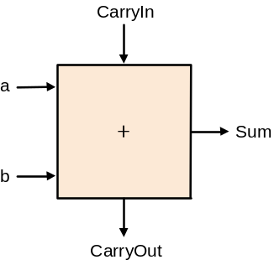
Different Implementations
Not easy to decide the “best” way to build something
  Don't want too many inputs to a single gate
  Dont want to have to go through too many gates
  for our purposes, ease of comprehension is important
Let's look at a 1-bit ALU for addition:
How could we build a 1-bit ALU for add, and, and or?
How could we build a 32-bit ALU?
c_{out} = a b + a c_{in} + b c_{in}
sum = a xor b xor c_{in}

Slide 14
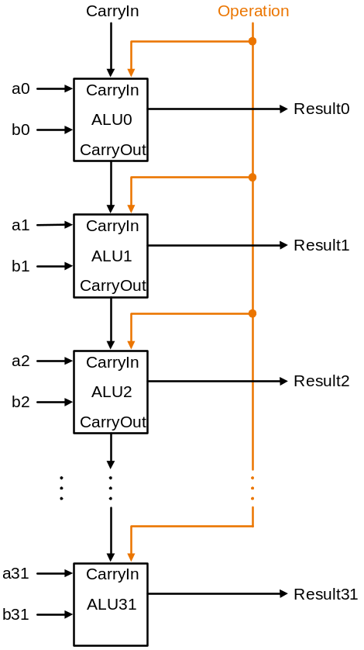
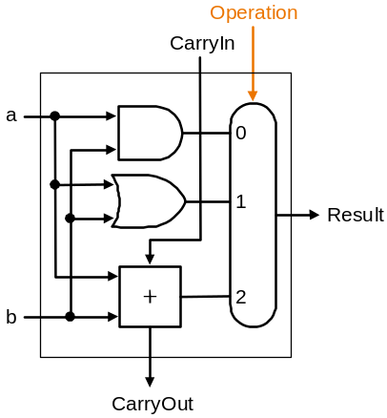
Building a 32 bit ALU

Slide 15
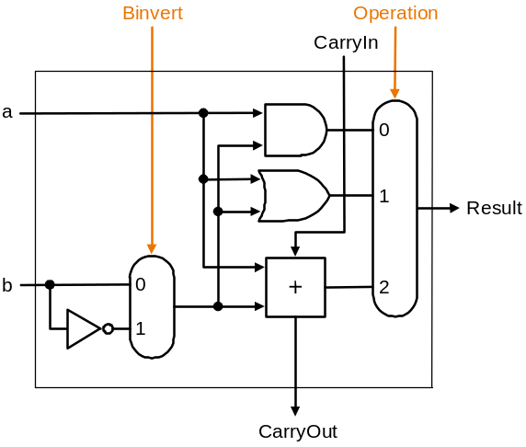
What about subtraction (a – b) ?
Two's complement approch: just negate b and add.
How do we negate?
A very clever solution:

Slide 16
Tailoring the ALU to the MIPS
Need to support the set-on-less-than instruction (slt)
  remember: slt is an arithmetic instruction
  produces a 1 if rs < rt and 0 otherwise
  use subtraction: (a-b) < 0 implies a < b
Need to support test for equality (beq $t5, $t6, $t7)
  use subtraction: (a-b) = 0 implies a = b

Slide 17
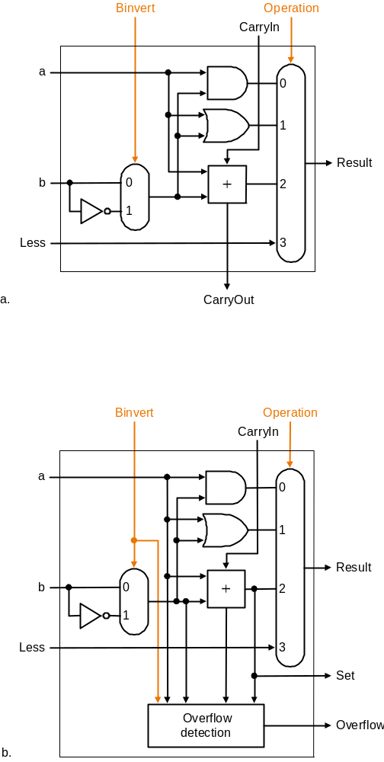
Supporting slt
Can we figure out the idea?

Slide 18
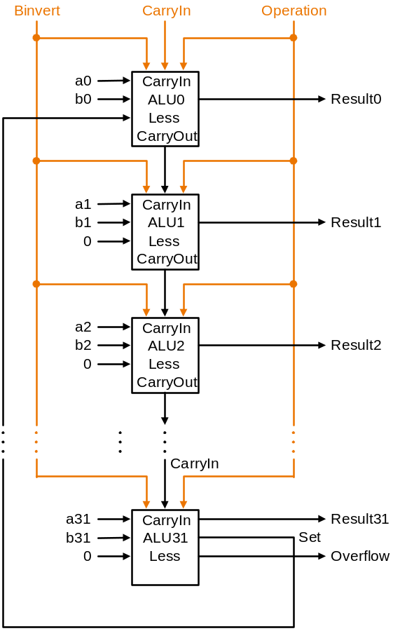

Slide 19
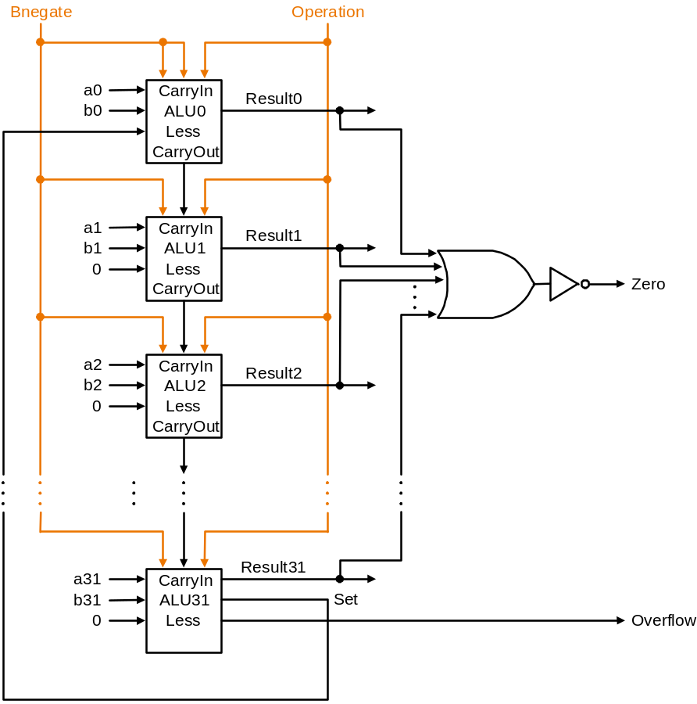
Test for equality
Notice control lines:
000 = and
001 = or
010 = add
110 = subtract
111 = slt
Note: zero is a 1 when the result is zero!

Slide 20
Conclusion
We can build an ALU to support the MIPS instruction set
  key idea: use multiplexor to select the output we want
  we can efficiently perform subtraction using two’s complement
  we can replicate a 1-bit ALU to produce a 32-bit ALU
Important points about hardware
  all of the gates are always working
  the speed of a gate is affected by the number of inputs to the gate
  the speed of a circuit is affected by the number of gates in series
  (on the “critical path” or the “deepest level of logic”)
Our primary focus: comprehension, however,
  Clever changes to organization can improve performance
  (similar to using better algorithms in software)
  we’ll look at two examples for addition and multiplication

Slide 21
Problem: ripple carry adder is slow
Is a 32-bit ALU as fast as a 1-bit ALU?
Is there more than one way to do addition?
  two extremes: ripple carry and sum-of-products
Can you see the ripple? How could you get rid of it?
c₁ = b₀c₀ + a₀c₀ + a₀b₀
c₂ = b₁c₁ + a₁c₁ + a₁b₁ c₂ =
c₃ = b₂c₂ + a₂c₂ + a₂b₂ c₃ =
c₄ = b₃c₃ + a₃c₃ + a₃b₃ c₄ =
Not feasible! Why?

Slide 22
Carry-lookahead adder
An approach in-between our two extremes
Motivation:
  If we didn't know the value of carry-in, what could we do?
  When would we always generate a carry? g_{i} = a_{i} b_{i}
  When would we propagate the carry? p_{i} = a_{i} + b_{i}
Did we get rid of the ripple?
c₁ = g₀ + p₀c₀
c₂ = g₁ + p₁c₁ c₂ =
c₃ = g₂ + p₂c₂ c₃ =
c₄ = g₃ + p₃c₃ c₄ =
Feasible! Why?

Slide 23
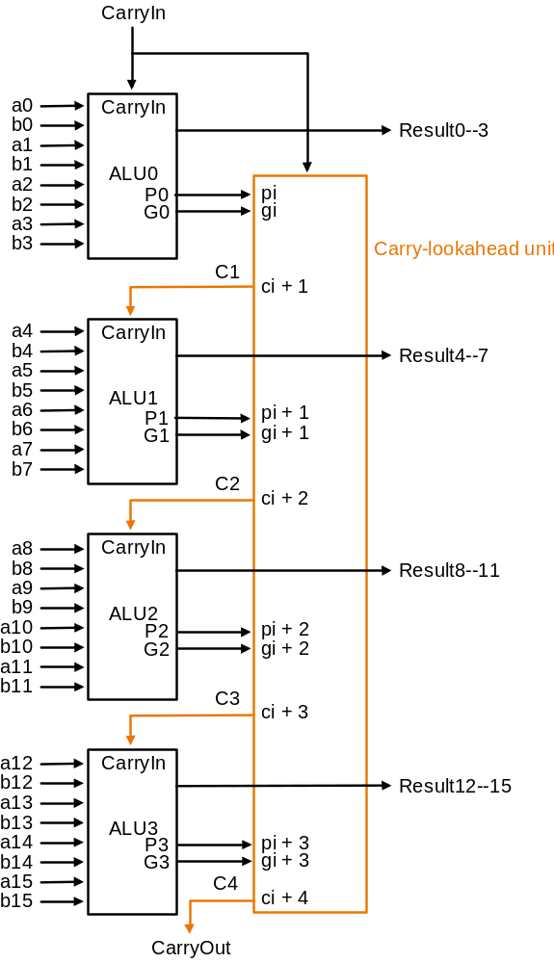
Use principle to build bigger adders
Can’t build a 16 bit adder this way... (too big)
Could use ripple carry of 4-bit CLA adders
Better: use the CLA principle again!

Slide 24
Multiplication
More complicated than addition
  accomplished via shifting and addition
More time and more area
Let's look at 3 versions based on gradeschool algorithm
0010 (multiplicand)
__x_1011 (multiplier)
Negative numbers: convert and multiply
  there are better techniques, we won’t look at them

Slide 25
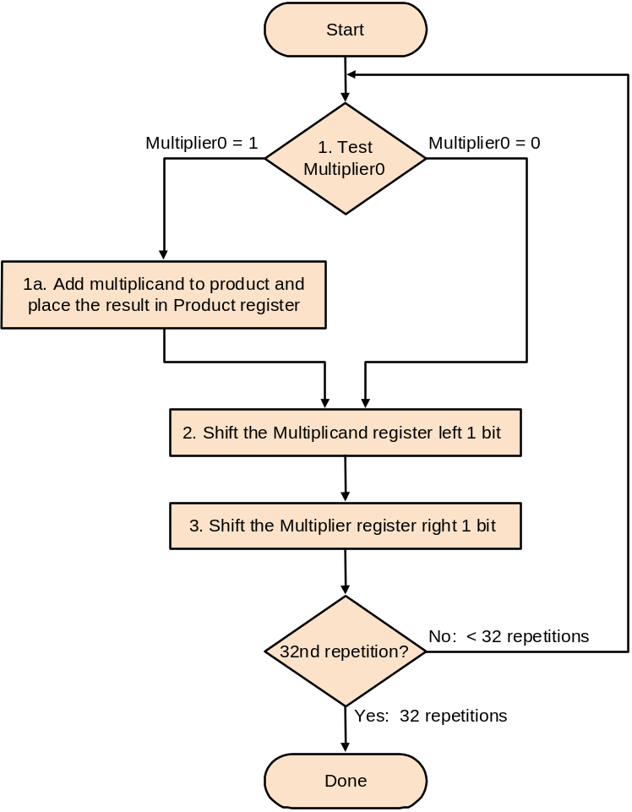
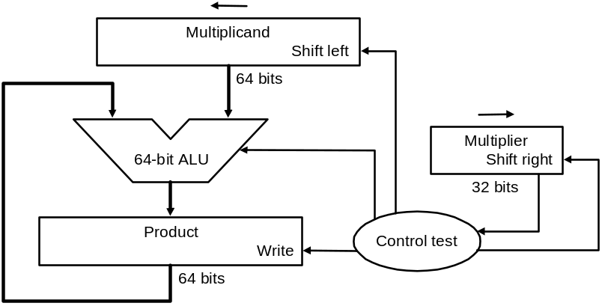
Multiplication: Implementation

Slide 26
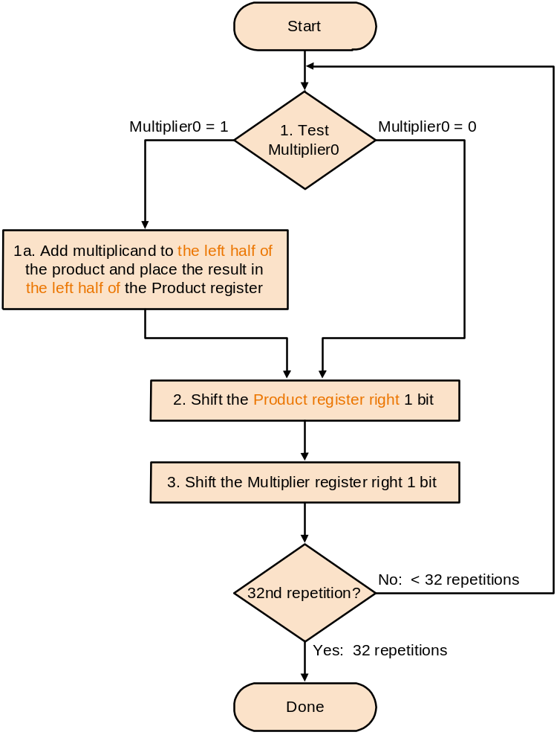
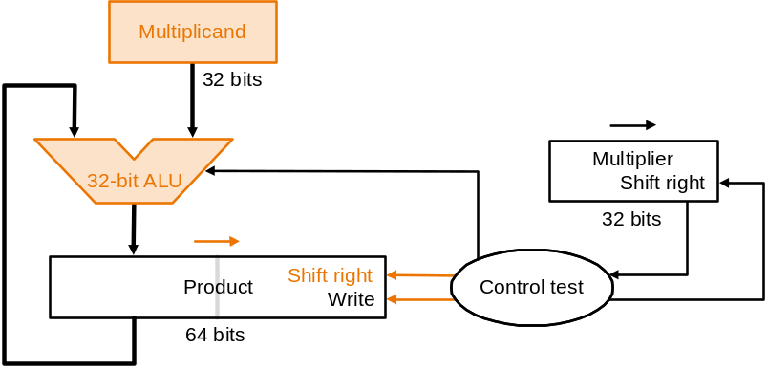
Second Version

Slide 27
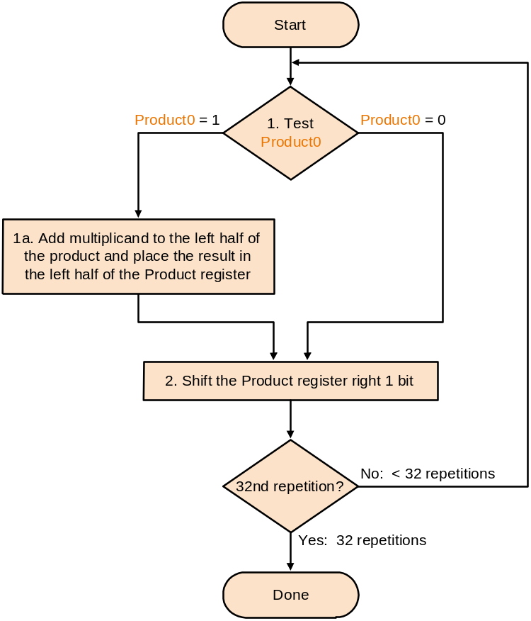
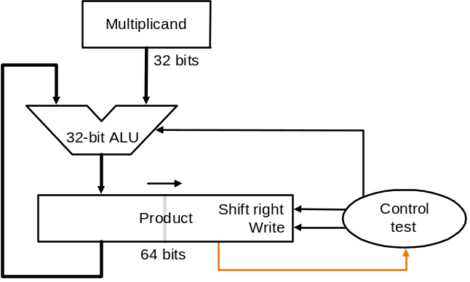
Final Version

Slide 28
Floating Point (a brief look)
We need a way to represent
  numbers with fractions, e.g., 3.1416
  very small numbers, e.g., .000000001
  very large numbers, e.g., 3.15576 × 10⁹
Representation:
  sign, exponent, significand: (–1)^{sign} × significand × 2^{exponent}
  more bits for significand gives more accuracy
  more bits for exponent increases range
IEEE 754 floating point standard:
  single precision: 8 bit exponent, 23 bit significand
  double precision: 11 bit exponent, 52 bit significand

Slide 29
IEEE 754 floating-point standard
Leading “1” bit of significand is implicit
Exponent is “biased” to make sorting easier
  all 0s is smallest exponent all 1s is largest
  bias of 127 for single precision and 1023 for double precision
  summary: (–1)^{sign} × (1+significand) × 2^{exponent – bias}
Example:
  decimal: -.75 = -3/4 = -3/2²
  binary: -.11 = -1.1 x 2⁻¹
  floating point: exponent = 126 = 01111110
  IEEE single precision: 10111111010000000000000000000000

Slide 30
Floating Point Complexities
Operations are somewhat more complicated (see text)
In addition to overflow we can have “underflow”
Accuracy can be a big problem
  IEEE 754 keeps two extra bits, guard and round
  four rounding modes
  positive divided by zero yields “infinity”
  zero divide by zero yields “not a number”
  other complexities
Implementing the standard can be tricky
Not using the standard can be even worse
  see text for description of 80x86 and Pentium bug!

Slide 31
Chapter Four Summary
Computer arithmetic is constrained by limited precision
Bit patterns have no inherent meaning but standards do exist
  two’s complement
  IEEE 754 floating point
Computer instructions determine “meaning” of the bit patterns
Performance and accuracy are important so there are many complexities in real machines (i.e., algorithms and implementation).
We are ready to move on (and implement the processor)
you may want to look back (Section 4.12 is great reading!)

