Slide 1
Linux Programming – Socket #1
Reporter: Po-Sen Wang

Slide 2

Socket Function (1/7)
int socket(int domain, int type, int protocol)
  //Create a socket.
int bind(int socket, const struct sockaddr *address, size_t address_len);
  //Name a socket.
int listen(int socket, int backlog);
  //Create a queue of socket.
int accept(int socket, struct sockaddr *address, size_t *address_len);
  //Accept connetion.
int connect(int socket, const struct sockaddr *address, size_t address_len);
//Request connection.

Slide 3
Socket Function (2/7)
#include <sys/types.h>
#include <sys/socket.h>
int socket(int domain, int type, int protocol)
  domain:
  type: SOCK_STREAM (TCP)、SOCK_DGRAM (UDP)
  protocol: 0 代表使用預設的協定。
AF_UNIX | UNIX internal (file system sockets)
AF_INET | ARPA internet protocols (UNIX network sockets)
AF_ISO | ISO standard protocols
AF_NS | Xerox network systems protocols
AF_IPX | Novell IPX protocol
AF_APPLETALK | Apple talk DDS

Slide 4
Socket Function (3/7)
#include <sys/socket.h>
int bind(int socket, const struct sockaddr *address, size_t address_len);
  socket: File descriptor.
  address: Socket address.
  address_len: Address length.

Slide 5
Socket Function (4/7)
AF_UNIX:
  struct sockaddr_un {
  sa_family_t sun_family;
  char sun_path[];
  };
AF_INET:
  struct sockaddr_in {
  short int sin_family;
  unsigned short int sin_port;
  struct in_addr sin_addr;
  };
  struct in_addr {
  unsigned long int s_addr;
  };

Slide 6
Socket Function (5/7)
#include <sys/socket.h>
int listen(int socket, int backlog);
  socket: File descriptor.
  backlog: Maximum of queue for listen.

Slide 7
Socket Function (6/7)
#include <sys/socket.h>
int accept(int socket, struct sockaddr *address, size_t *address_len);
  socket: File descriptor.
  address: Socket address.
  address_len: Address length.

Slide 8
Socket Function (7/7)
#include <sys/socket.h>
int connect(int socket, const struct sockaddr *address, size_t address_len);
  socket: File descriptor.
  address: Socket address.
  address_len: Address length.

Slide 9
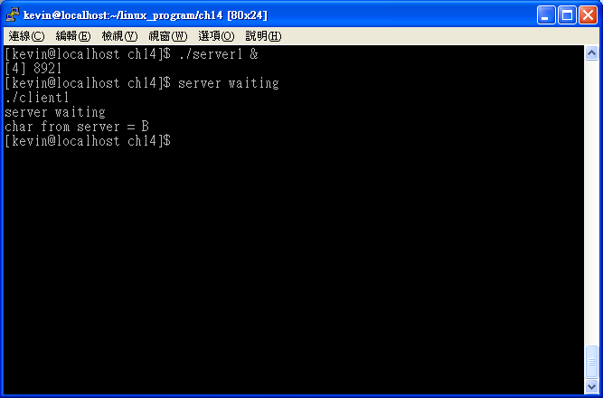
Socket Example 1 – Use AF_UNIX (1/6)

Slide 10
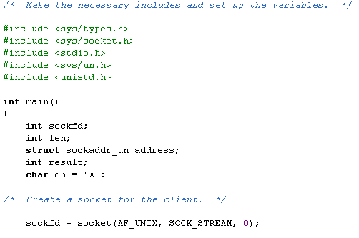
Socket Example 1 – Use AF_UNIX (2/6)
client1.c

Slide 11
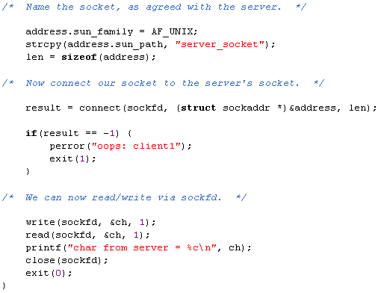
Socket Example 1 – Use AF_UNIX (3/6)
client1.c

Slide 12
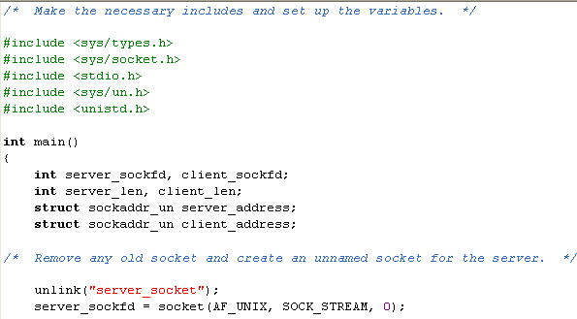
Socket Example 1 – Use AF_UNIX (4/6)
server1.c

Slide 13
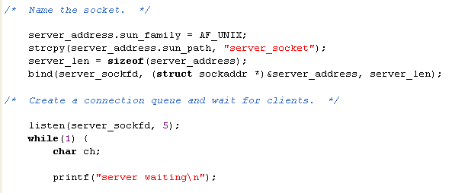
Socket Example 1 – Use AF_UNIX (5/6)
server1.c

Slide 14
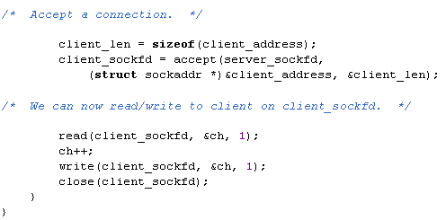
Socket Example 1 – Use AF_UNIX (6/6)
server1.c

Slide 15
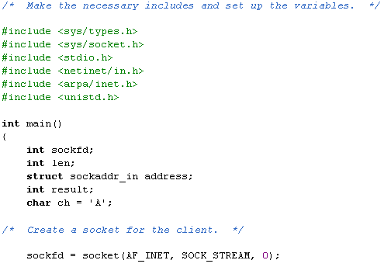
Socket Example 2 – Use AF_INET (1/5)
client2.c

Slide 16
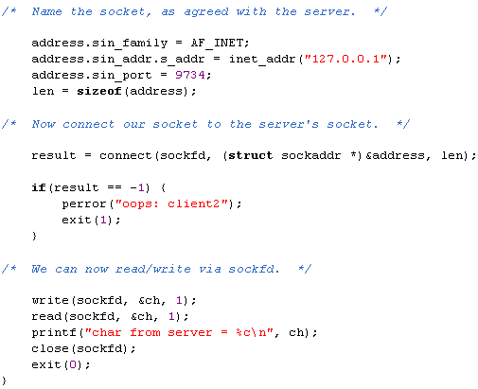
Socket Example 2 – Use AF_INET (2/5)
client2.c

Slide 17
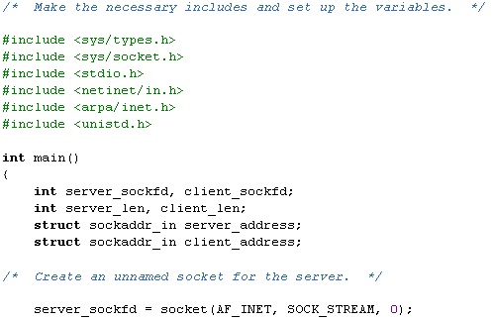
Socket Example 2 – Use AF_INET (3/5)
server2.c

Slide 18
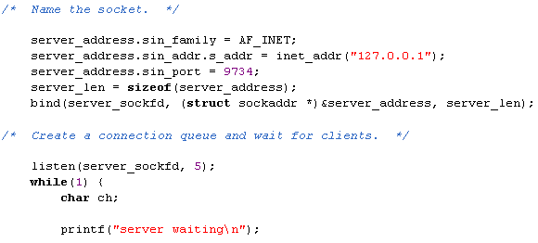
Socket Example 2 – Use AF_INET (4/5)
server2.c

Slide 19
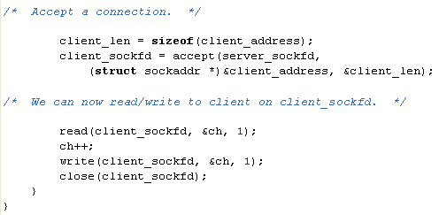
Socket Example 2 – Use AF_INET (5/5)
server2.c

Slide 20
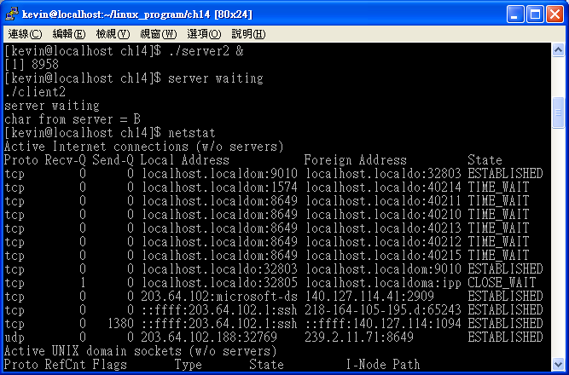
網路位元組排序 (1/4)

Slide 21
網路位元組排序 (2/4)
#include <netinet/in.h>
unsigned long int htonl(unsigned long int hostlong);
unsigned short int htons(unsigned short int hostshort);
unsigned long int ntohl(unsigned long int hostlong);
unsigned short int ntohs(unsigned short int hostshort);

Slide 22
網路位元組排序 (3/4)
server3.c:
  server_address.sin_addr.s_addr = htonl(INADDR_ANY);
  server_address.sin_port = htons(9734);
client3.c:
  address.sin_port = htons(9734);

Slide 23
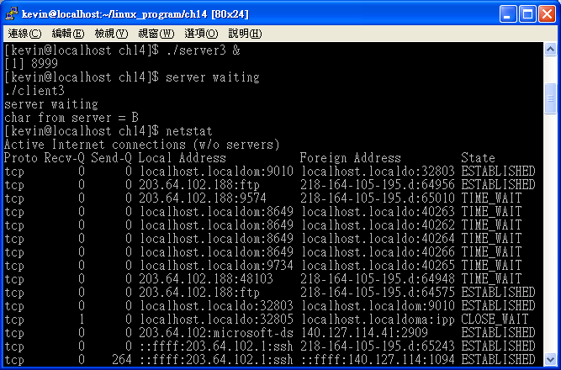
網路位元組排序 (4/4)

