Slide 1
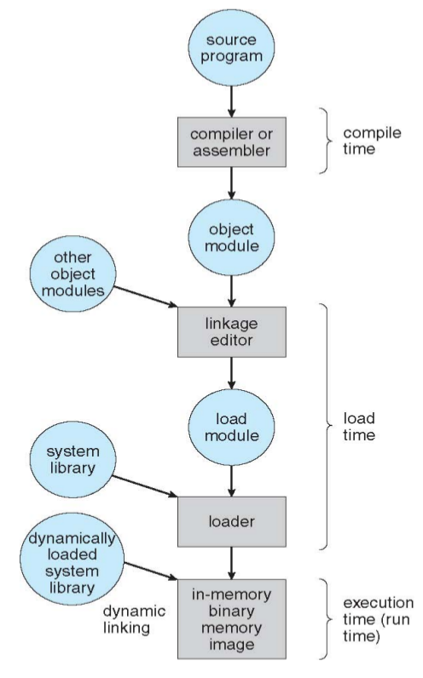
Compile time
If memory location known a priori,
absolute code can be generated; must recompile code if starting location changes
Load time
Must generate relocatable code if memory location is not known at compile time
Execution time
Binding delayed until run time if the process can be moved during its execution
from one memory segment to another
Need hardware support for address maps
(e.g., base and limit registers)

