Slide 1

Static Linking VS. Dynamic Linking
Haitao Wang, Xiaomin Liu
December 13, 2006

Slide 2

Static Linking
Carried out only once to produce an executable file.
If static libraries are called, the linker will copy all the modules referenced by the program to the executable.

Slide 3
Dynamic Linking
Allows a process to add, remove, replace or relocate object modules during its execution.
If shared libraries are called,
Only copy a little reference information when the executable file is created.
Completing the linking during loading time or running time.

Slide 4
A Big Difference
If several processes call the same object module of a shared library simultaneously,
Only one copy in memory (dynamic)
Several copies each for a process in memory (static)

Slide 5
Which one is better, static or dynamic?
Construct some programs of different size linked in both versions to compare:
  Executable size
  Loading time
  Running time
  System call
  Memory usage

Slide 6
Executable size (Byte)
 | Static | Dynamic (Loading) | Dynamic (Running)
Small | 422596 | 5152 | 6300
Median | 431413 | 5152 | 6297
Large | 443384 | 5134 | 6312

Slide 7
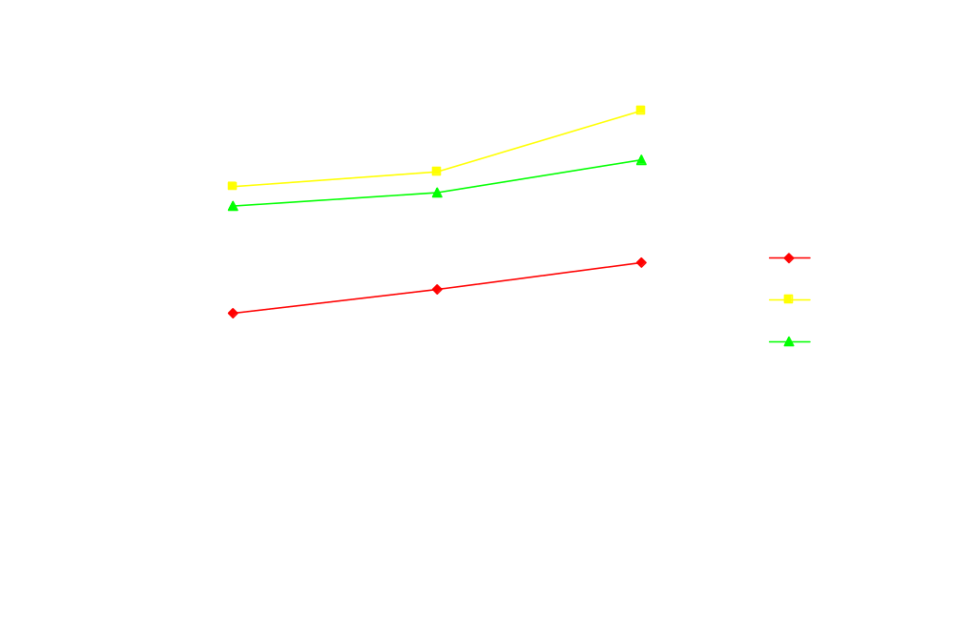
Loading time (us)

Slide 8
Running time (s)

Slide 9
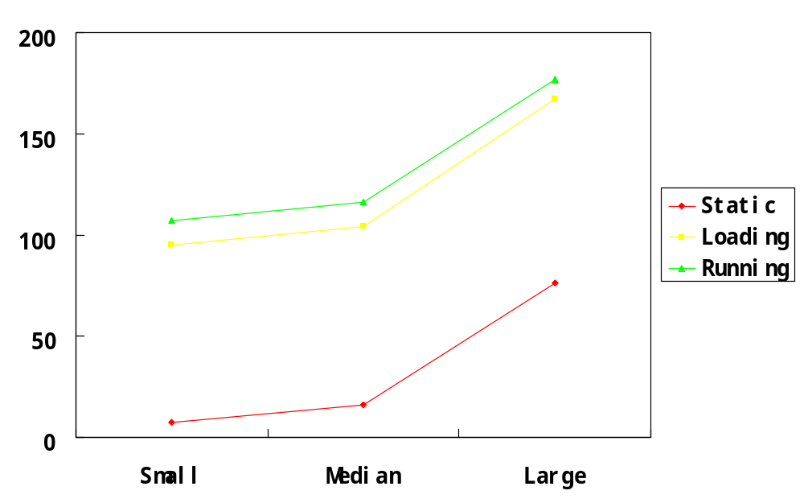
Number of System Calls

Slide 10
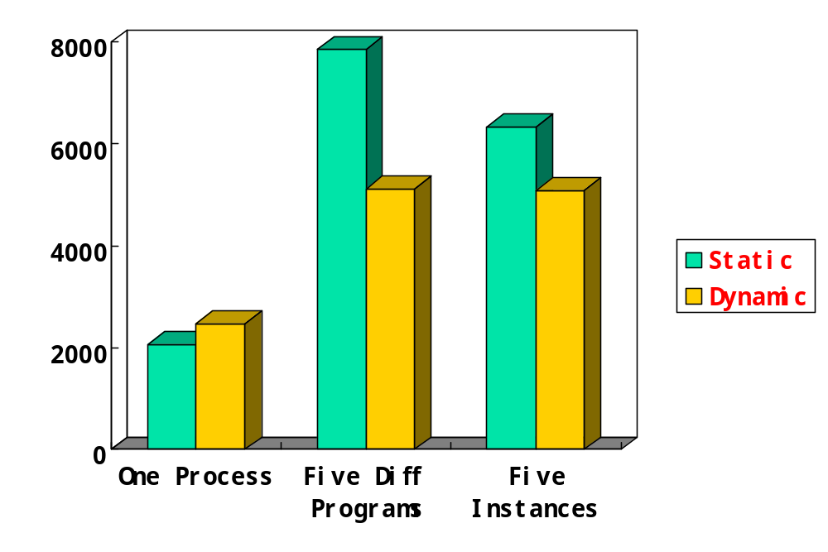
Memory Usage (Byte)

Slide 11
Change the Percentage of Static Lib
Produce several different versions of executables by changing the percentage of the static libraries among all libraries written by ourselves when programs are linked (those standard libs, such as libc, are always dynamically linked).

Slide 12
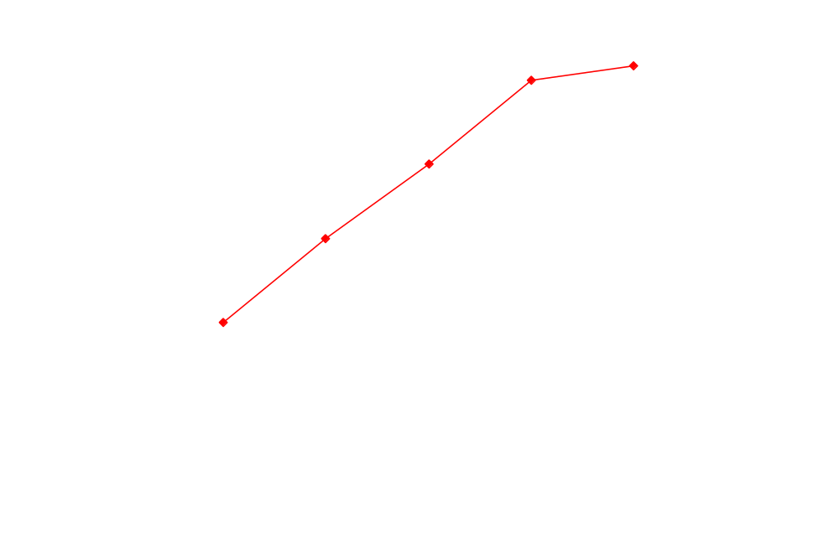
Executable Sizes

Slide 13
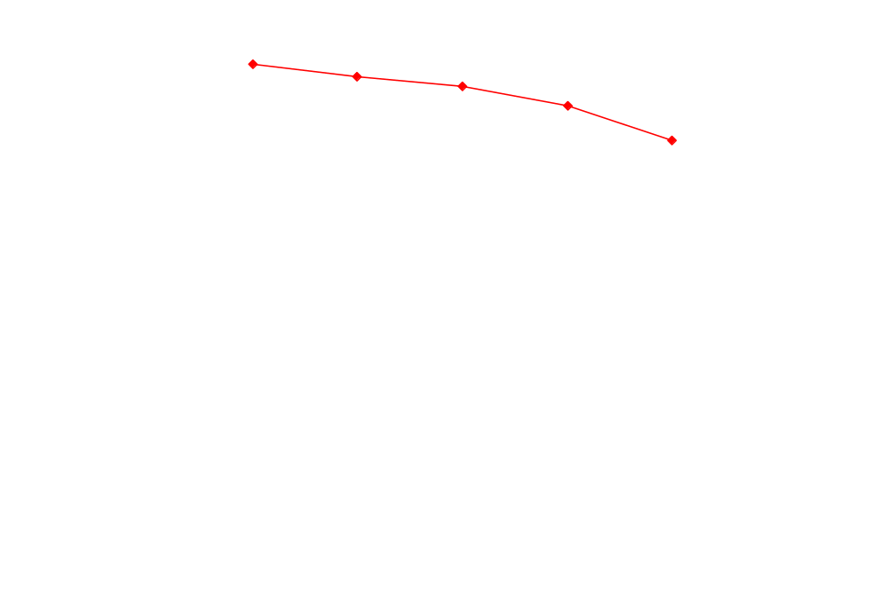
Loading Time

Slide 14
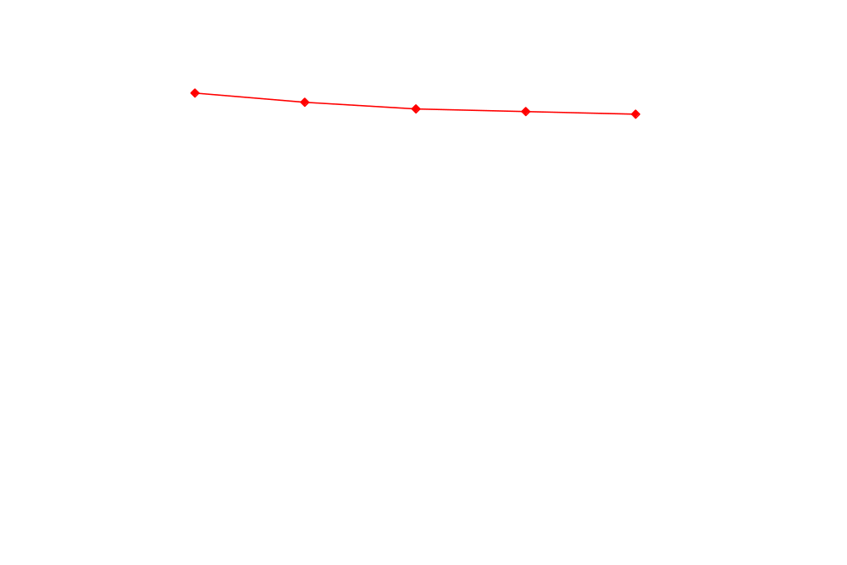
Running Time

Slide 15
Static linking VS. Dynamic linking
Dynamic produces smaller executable files.
Dynamic consumes less memory.
Dynamic runs more slowly.
Dynamic has more system calls.
Dynamic need more loading time

Slide 16
Standard Programs
Some programs in Linux system are rebuilt. Both static and dynamic versions are created and some benchmarks are compared.
PMEM, MPG123, FGET, VIM

Slide 17
Executable Size (Bytes)
 | PMEM | MPG | FGET | VIM
Static | 46043 | 979931 | 582796 | 9935633
Dynamic | 17892 | 494443 | 93721 | 3875807

Slide 18
Number of System Calls
 | PMEM | MPG | FGET | VIM
Static | 5 | 34 | 11 | 1626
Dynamic | 102 | 178 | 119 | 2218

Slide 19
Vim System Call
Sys call | Open | Close | Read | Stat64 | Old_mmap
Static | 88 | 58 | 473 | 11 | 40
Dynamic | 296 | 102 | 569 | 55 | 110

Slide 20
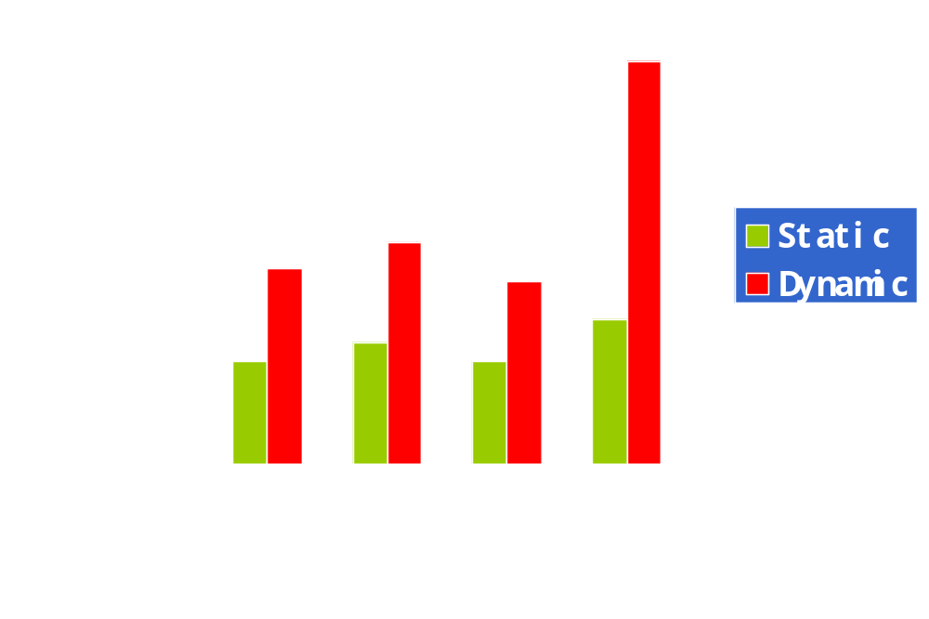
Loading Time

Slide 21
Sharing Across File System
Examine the contents of executables and libraries in a standard Linux system.
Programs in /bin and /usr/bin are examined.

Slide 22
There are 1831 dynamically linked programs and only one static linked (/bin/ash.static), which also has its dynamic version (/bin/ash) in the system.
Dynamic linking is dominant throughout the system.

Slide 23
Most Frequently Referenced Libs
Name | Directory | Prog Num
libc.so.6 | /lib/tls/libc.so.6 | 1831
ld-linux.so.2 | /lib/ld-linux.so.2 | 1831
libm.so.6 | /lib/tls/libm.so.6 | 1084
libdl.so.2 | /lib/libdl.so.2 | 684
libz.so.1 | /usr/lib/libz.so.1 | 596
libpthread.so.0 | /lib/tls/libpthread.so.0 | 569
libresolv.so.2 | /lib/libresolv.so.2 | 438
libX11.so.6 | /usr/X11R6/lib/libX11.so.6 | 424
libXext.so.6 | /usrX11R6/lib/libXext.so.6 | 412

Slide 24
Programs with Most Libs
Program Name | Number of Libraries
Ximian-connector-setup-2.0 | 87
Evolution-2.0 | 75
Nautilus | 70
Nautilus-file-management-properties | 70
Srcore | 70
Gnomemeeting | 68
Create-branching-keyboard | 67
Devhelp | 67
Gok | 67

Slide 25
Future Work
Build some much larger standard programs in both versions and compare them.
Construct an entire system distribution both statically and dynamically to evaluate the performance.

