Slide 1
Computer Systems II
Creating and Executing Processes

Slide 2
Unix system calls
fork( )
wait( )
exit( )

Slide 3
How To Create New Processes?
Underlying mechanism
  A process runs fork to create a child process
  Parent and children execute concurrently
  Child process is a duplicate of the parent process
parent
fork()
child

Slide 4
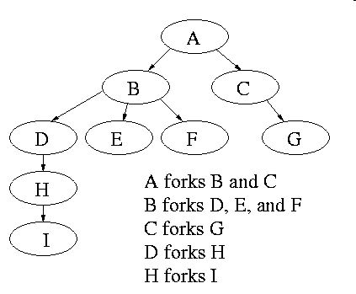
Process Creation
After a fork, both parent and child keep running, and each can fork off other processes.
A process tree results. The root of the tree is a special process created by the OS during startup.
A process can choose to wait for children to terminate. For example, if C issued a wait() system call, it would block until G finished.

Slide 5
Bootstrapping
When a computer is switched on or reset, there must be an initial program that gets the system running
This is the bootstrap program
  Initialize CPU registers, device controllers, memory
  Load the OS into memory
  Start the OS running
OS starts the first process (such as “init”)
OS waits for some event to occur
  Hardware interrupts or software interrupts (traps)
Notes:
Indeed in unix only one process is created at system initialization (the process is called init); all the others are children of this first process.
Why have init? That is why not have all processes created via method 2?
Ans: Because without init there would be no running process to create any others.

Slide 6
Fork System Call
Current process split into 2 processes: parent, child
Returns -1 if unsuccessful
Returns 0 in the child
Returns the child’s identifier in the parent
fork()
Stack
Stack
ret = 0
Data
Data
Text
ret = xxx
Text

Slide 7
Fork System Call
The child process inherits from parent
  identical copy of memory
  CPU registers
  all files that have been opened by the parent
Execution proceeds concurrently with the instruction following the fork system call
The execution context (PCB) for the child process is a copy of the parent’s context at the time of the call

Slide 8
How fork Works (1)
pid = 25
Data
Resources
Text
Stack
PCB
File
ret = fork();
switch(ret)
{
case -1:
  perror(“fork”);
  exit(1);
case 0: // I am the child
<code for child >
exit(0);
default: // I am parent ...
  <code for parent >
  wait(0);
}
UNIX

Slide 9
How fork Works (2)
pid = 25
pid = 26
Data
Resources
Data
Text
Text
Stack
Stack
PCB
File
PCB
ret = 0
ret = 26
ret = fork();
switch(ret)
{
case -1:
  perror(“fork”);
  exit(1);
case 0: // I am the child
<code for child >
exit(0);
default: // I am parent ...
  <code for parent >
  wait(0);
}
ret = fork();
switch(ret)
{
case -1:
  perror(“fork”);
  exit(1);
case 0: // I am the child
<code for child >
exit(0);
default: // I am parent ...
  <code for parent >
  wait(0);
}
UNIX

Slide 10
How fork Works (3)
pid = 25
pid = 26
Data
Resources
Data
Text
Text
Stack
Stack
PCB
File
PCB
ret = 0
ret = 26
ret = fork();
switch(ret)
{
case -1:
  perror(“fork”);
  exit(1);
case 0: // I am the child
<code for child >
exit(0);
default: // I am parent ...
  <code for parent >
  wait(0);
}
ret = fork();
switch(ret)
{
case -1:
  perror(“fork”);
  exit(1);
case 0: // I am the child
<code for child >
exit(0);
default: // I am parent ...
  <code for parent >
  wait(0);
}
UNIX

Slide 11
How fork Works (4)
pid = 25
pid = 26
Data
Resources
Data
Text
Text
Stack
Stack
PCB
File
PCB
ret = 0
ret = 26
ret = fork();
switch(ret)
{
case -1:
  perror(“fork”);
  exit(1);
case 0: // I am the child
<code for child >
exit(0);
default: // I am parent ...
  <code for parent >
  wait(0);
}
ret = fork();
switch(ret)
{
case -1:
  perror(“fork”);
  exit(1);
case 0: // I am the child
<code for child >
exit(0);
default: // I am parent ...
  <code for parent >
  wait(0);
}
UNIX

Slide 12
How fork Works (5)
pid = 25
pid = 26
Data
Resources
Data
Text
Text
Stack
Stack
PCB
File
PCB
ret = 0
ret = 26
ret = fork();
switch(ret)
{
case -1:
  perror(“fork”);
  exit(1);
case 0: // I am the child
<code for child >
exit(0);
default: // I am parent ...
  <code for parent >
  wait(0);
}
ret = fork();
switch(ret)
{
case -1:
  perror(“fork”);
  exit(1);
case 0: // I am the child
<code for child >
exit(0);
default: // I am parent ...
  <code for parent >
  wait(0);
}
UNIX

Slide 13
How fork Works (6)
pid = 25
Data
Resources
Text
Stack
Process Status
File
ret = 26
ret = fork();
switch(ret)
{
case -1:
  perror(“fork”);
  exit(1);
case 0: // I am the child
<code for child >
exit(0);
default: // I am parent ...
  <code for parent >
  wait(0);
< … >
UNIX

Slide 14
Orderly Termination: exit()
To finish execution, a child may call exit(number)
This system call:
  Saves result = argument of exit
  Closes all open files, connections
  Deallocates memory
  Checks if parent is alive
  If parent is alive, holds the result value until the parent requests it (with wait); in this case, the child process does not really die, but it enters a zombie/defunct state
  If parent is not alive, the child terminates (dies)

Slide 15
Waiting for the Child to Finish
Parent may want to wait for children to finish
  Example: a shell waiting for operations to complete
Waiting for any some child to terminate: wait()
  Blocks until some child terminates
  Returns the process ID of the child process
  Or returns -1 if no children exist (i.e., already exited)
Waiting for a specific child to terminate: waitpid()
  Blocks till a child with particular process ID terminates
#include <sys/types.h>
#include <sys/wait.h>
pid_t wait(int *status);
pid_t waitpid(pid_t pid, int *status, int options);

Slide 16
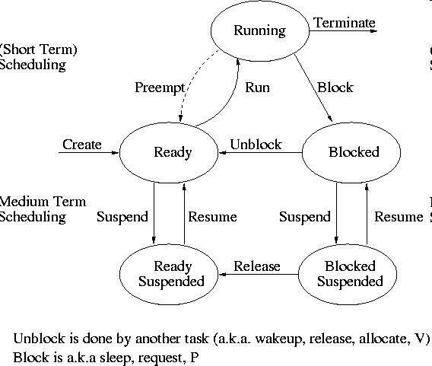
State Transition on wait and exit Calls

Slide 17
Other useful system calls: getpid, getppid
getpid returns the identifier of the calling process. Example call (pid is an integer):
pid = getpid();
getppid returns the identifier of the parent.
Note:
  Zombies can be noticed by running the 'ps' command (shows the process list); you will see the string "<defunct>" as their command name:
        ps -ef
        ps –ef | grep mdamian

Slide 18
Fork Example 1: What Output?
int main()
{
pid_t pid;
int x = 1;
pid = fork();
if (pid != 0) {
printf(“parent: x = %d\n”, --x);
exit(0);
} else {
printf(“child: x = %d\n”, ++x);
exit(0);
}
}

Slide 19
Fork Example 2
Key Points
  Both parent and child can continue forking
void fork2()
{
printf("L0\n");
fork();
printf("L1\n");
fork();
printf("Bye\n");
}
Bye
L1
Bye
Bye
L0
L1
Bye

Slide 20
Fork Example 3
void fork3()
{
printf("L0\n");
fork();
printf("L1\n");
fork();
printf("L2\n");
fork();
printf("Bye\n");
}
Bye
L2
Bye
Bye
L1
L2
Bye
Bye
L2
Bye
Bye
L0
L1
L2
Bye

Slide 21
Fork Example 4
void fork4()
{
printf("L0\n");
if (fork() != 0) {
printf("L1\n");
if (fork() != 0) {
printf("L2\n");
fork();
}
}
printf("Bye\n");
}

Slide 22
Fork Example 5
void fork5()
{
printf("L0\n");
if (fork() == 0) {
printf("L1\n");
if (fork() == 0) {
printf("L2\n");
fork();
}
}
printf("Bye\n");
}

Slide 23
Summary
Fork
  Creates a duplicate of the calling process
  The result is two processes: parent and child
  Both continue executing from the same point on
Exit
  Orderly program termination
  Unblocks waiting parent
Wait
  Used by parent
  Waits for child to finish execution

Slide 24
Unix system calls
execv
execl

Slide 25
Unix’s execv
The system call execv executes a file, transforming the calling process into a new process. After a successful execv, there is no return to the calling process.
    execv(const char * path, char * const argv[])
  path is the full path for the file to be executed
  argv is the array of arguments for the program to execute
    each argument is a null-terminated string
    the first argument is the name of the program
    the last entry in argv is NULL

Slide 26
How execv Works (1)
pid = 25
pid = 26
Data
Resources
Data
Text
Text
Stack
Stack
PCB
File
PCB
char * argv[ ] = {“/bin/ls”, 0};
<…>
int cpid = fork( );
if (cpid = = 0) {
execv(argv[0], argv);
exit(0);
}
<parent code>
wait(&cpid);
cpid = 26
cpid = 0
char * argv[ ] = {“/bin/ls”, 0};
<…>
int cpid = fork( );
if (cpid = = 0) {
execv(argv[0], argv);
exit(0);
}
<parent code>
wait(&cpid);
/bin/ls
UNIX kernel

Slide 27
How execv Works (2)
pid = 25
pid = 26
Data
Resources
Text
Stack
PCB
File
char * argv[ ] = {“/bin/ls”, 0};
<…>
int cpid = fork( );
if (cpid = = 0) {
execv(argv[0], argv);
exit(0);
}
<parent code>
wait(&cpid);
cpid = 26
Exec destroys the process image of the calling process. A new process image is constructed from the executable file (ls).
/bin/ls
UNIX kernel

Slide 28
How execv Works (3)
pid = 25
pid = 26
Data
Resources
Data
Text
Text
Stack
Stack
PCB
File
PCB
char * argv[ ] = {“/bin/ls”, 0};
<…>
int cpid = fork( );
if (cpid = = 0) {
execv(argv[0], argv);
exit(0);
}
<parent code>
wait(&cpid);
cpid = 26
<first line of ls>
<…>
<…>
<…>
exit(0);
/bin/ls
UNIX kernel

Slide 29
Example: A Simple Shell
Shell is the parent process
  E.g., bash
Parses command line
  E.g., “ls –l”
Invokes child process
  Fork, execvp
Waits for child
  Wait
bash
fork
execvp
wait
ls

Slide 30
execv Example
#include <stdio.h>
#include <unistd.h>
char * argv[] = {“/bin/ls”, “-l”, 0};
int main()
{
int pid, status;
if ( (pid = fork() ) < 0 )
{
printf(“Fork error \n”);
exit(1);
}
if(pid == 0) { /* Child executes here */
execv(argv[0], argv);
printf(“Exec error \n”);
exit(1);
} else /* Parent executes here */
wait(&status);
printf("Hello there! \n”);
return 0;
}
Note the NULL string
at the end

Slide 31
execv Example – Sample Output
Sample output:
  total 282
  drwxr-xr-x 2 mdamian faculty 512 Jan 29 14:02 assignments
  -rw-r--r-- 1 mdamian faculty 3404 Jan 29 14:05 index.html
  drwxr-xr-x 2 mdamian faculty 512 Jan 28 15:02 notes
  Hello there!

Slide 32
execl
Same as execv, but takes the arguments of the new program as a list, not a vector:
Example:
  execl(“/bin/ls”, “/bin/ls”, “-l”, 0);
Is equivalent to
  char * argv[] = {“/bin/ls”, “-l”, 0};
  execv(argv[0], argv);
execl is mainly used when the number of arguments is known in advance
Note the NULL string at the end

Slide 33
General purpose process creation
In the parent process:
int childPid;
char * const argv[ ] = {…};
main {
childPid = fork();
if(childPid == 0)
{
  // I am child ...
  // Do some cleaning, close files
  execv(argv[0], argv);
}
else
{
  // I am parent ...
  <code for parent process>
  wait(0);
}
}

Slide 34
Combined fork/exec/wait
Common combination of operations
  Fork to create a new child process
  Exec to invoke new program in child process
  Wait in the parent process for the child to complete
Single call that combines all three
  int system(const char *cmd);
Example
int main()
{
system(“echo Hello world”);
}

Slide 35
Properties of fork / exec sequence
In 99% of the time, we call execv(…) after fork()
  the memory copying during fork() is useless
  the child process will likely close open files and connections
  overhead is therefore high
  might as well combine both in one call (OS/2)
vfork()
  a system call that creates a process without creating an identical memory image
  sometimes called “lightweight” fork
  child process is understood to call execv() almost immediately

Slide 36
Variations of execv
execv
  Program arguments passed as an array of strings
execvp
  Extension of execv
  Searches for the program name in the PATH environment
execl
  Program arguments passed directly as a list
execlp
  Extension of execv
  Searches for the program name in the PATH environment

Slide 37
Summary
exec(v,vp,l,lp)
  Does NOT create a new process
  Loads a new program in the image of the calling process
  The first argument is the program name (or full path)
  Program arguments are passed as a vector (v,vp) or list (l,lp)
  Commonly called by a forked child
system:
  combines fork, wait, and exec all in one

