Slide 1
Today’s topic
Pthread
  Some materials and figures are obtained from the POSIX threads Programming tutorial at https://computing.llnl.gov/tutorials/pthreads

Slide 2
What is a Thread?
OS view: A thread is an independent stream of instructions that can be scheduled to run by the OS.
Software developer view: a thread can be considered as a “procedure” that runs independently from the main program.
  Sequential program: a single stream of instructions in a program.
  Multi-threaded program: a program with multiple streams
    Multiple threads are needed to use multiple cores/CPUs

Slide 3
Example multithread programs?
Computer games
  each thread controls the movement of an object.
Scientific simulations
  Hurricane movement simulation: each thread simulates the hurricane in a small domain.
  Molecular dynamic: each thread simulates a subset of particulars.
  ……
Web server
  Each thread handles a connection.
……

Slide 4
Process and Thread
Process context
  Process ID, process group ID, user ID, and group ID
  Environment
  Working directory.
  Program instructions
  Registers (including PC)
  Stack
  Heap
  File descriptors
  Signal actions
  Shared libraries
  Inter-process communication tools
Two parts in the context: self-contained domain (protection) and execution of instructions.

Slide 5
Process and Thread
What are absolutely needed to support a stream of instructions, given the process context?
  Process ID, process group ID, user ID, and group ID
  Environment
  Working directory.
  Program instructions
  Registers (including PC)
  Stack
  Heap
  File descriptors
  Signal actions
  Shared libraries
  Inter-process communication tools

Slide 6
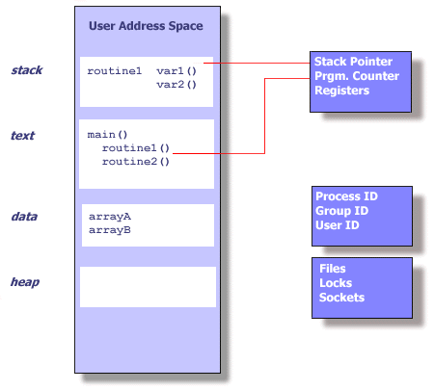
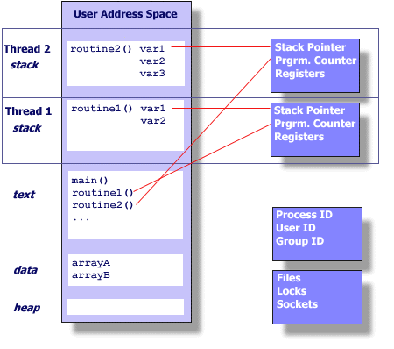
Process and Thread

Slide 7
Threads…
Exist within processes
Die if the process dies
Use process resources
Duplicate only the essential resources for OS to schedule them independently
Each thread maintains
  Stack
  Registers
  Scheduling properties (e.g. priority)
  Set of pending and blocked signals (to allow different react differently to signals)
  Thread specific data

Slide 8
Pthreads…
Hardware vendors used to implement proprietary versions of threads
  Thread programs are not portable
Pthreads = POSIX threads, specified in IEEE POSIX 1003.1c (1995)

Slide 9
Advantages of Threads
Light-weight
  Lower overhead for thread creation
  Lower Context Switching Overhead
    Fewer OS resources

Slide 10
Platform
fork()
pthread_create()
real
user
sys
real
user
sys
AMD 2.4 GHz Opteron (8cpus/node)
41.1
60.1
9.0
0.7
0.2
0.4
IBM 1.9 GHz POWER5 p5-575 (8cpus/node)
64.2
30.8
27.7
1.8
0.7
1.1
IBM 1.5 GHz POWER4 (8cpus/node)
104.1
48.6
47.2
2.0
1.0
1.5
INTEL 2.4 GHz Xeon (2 cpus/node)
55.0
1.5
20.8
1.6
0.7
0.9
INTEL 1.4 GHz Itanium2 (4 cpus/node)
54.5
1.1
22.2
2.0
1.3
0.7

Slide 11
Advantages of Threads
Shared State
  Don’t need IPC-like mechanism to communicate between threads of same process

Slide 12
Disadvantages of Threads
Shared State!
  Global variables are shared between threads. Accidental changes can be fatal.
Many library functions are not thread-safe
  Library Functions that return pointers to static internal memory. E.g. gethostbyname()
Lack of robustness
  Crash in one thread will crash the entire process.

Slide 13
The Pthreads API
Three types of routines:
  Thread management: create, terminate, join, and detach
  Mutexes: mutual exclusion, creating, destroying, locking, and unlocking mutexes
  Condition variables: event driven synchronizaiton.
  Mutexes and condition variables are concerned about synchronization.
  Why not anything related to inter-thread communication?
The concept of opaque objects pervades the design of the API.

Slide 14
The Pthreads API naming convention
Routine Prefix | Function
Pthread_ | General pthread
Pthread_attr_ | Thread attributes
Pthread_mutex_ | mutex
Pthread_mutexattr | Mutex attributes
Pthread_cond_ | Condition variables
Pthread_condaddr | Conditional variable attributes
Pthread_key_ | Thread specific data keys

Slide 15
Thread management routines
Creation: pthread_create
Termination:
  Return
  Pthread_exit
  Can we still use exit?
Wait (parent/child synchronization): pthread_join
Pthread header file <pthread.h>
Compiling pthread programs: gcc –lpthread aaa.c

Slide 16
Creation
Thread equivalent of fork()
int pthread_create(
  pthread_t * thread,
  pthread_attr_t * attr,
  void * (*start_routine)(void *),
  void * arg
  );
Returns 0 if OK, and non-zero (> 0) if error.
Parameters for the routines are passed through void * arg.
  What if we want to pass a structure?

Slide 17
Termination
Thread Termination
  void pthread_exit(void * status)
Process Termination
  exit()
  main()

Slide 18
Waiting for child thread
int pthread_join( pthread_t tid, void **status)
Equivalent of waitpid()for processes

Slide 19
Detaching a thread
The detached thread can act as daemon thread
The parent thread doesn’t need to wait
int pthread_detach(pthread_t tid)
Detaching self :
pthread_detach(pthread_self())

Slide 20
Some multi-thread program examples
A multi-thread program example: Example1.c
Making multiple producers: example2.c
  What is going on in this program?

Slide 21
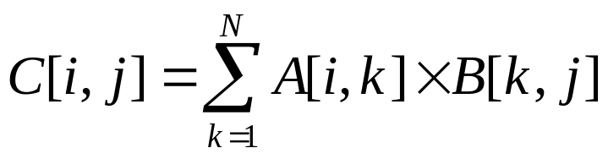
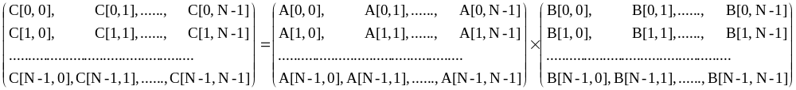
Matrix multiply and threaded matrix multiply
Matrix multiply: C = A × B

Slide 22
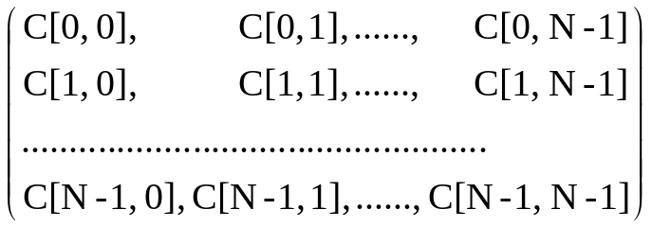
Matrix multiply and threaded matrix multiply
Sequential code:
  For (i=0; i<N; i++)
  for (j=0; j<N; j++)
  for (k=0; k<N; k++) C[I, j] = C[I, j] + A[I, k] * A[k, j]
Threaded code program
  Do the same sequential operation, different threads work on different part of the C array. How to decide who does what? Need three parameters: N, nthreads, myid

Slide 23
Matrix multiply and threaded matrix multiply
Threaded code program
  From N, nthreads, myid
    I am responsiable for sub-array
    C[0..N-1][N/Nthreads*myrank ..N/Nthreads*(myrank+1))
  The calculation of c[I,j] does not depend on other C term. Mm_pthread.c.

Slide 24
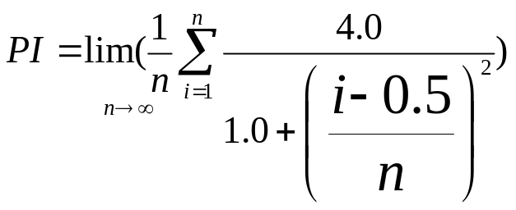
PI calculation
Sequential code: pi.c
Multi-threaded version: pi_pthread.c
  Again domain partition based on N, nthreads, and myid.

