Slide 1
Linux Programming - Pthread
Reporter: Po-Sen Wang

Slide 2
Pthread Function(1/3)
#include <pthread.h>
int pthread_create(pthread_t *thread, pthread_attr_t *attr, void *(*start_routine)(void *), void *arg);
  //create a thread
void pthread_exit(void *retval);
  //terminate a thread
int pthread_join(pthread_t th, void **thread_return);
  //wait for thread termination
2007/8/30
Po-Sen Wang

Slide 3
Pthread Function(2/3)
int pthread_create(pthread_t *thread, pthread_attr_t *attr, void *(*start_routine)(void *), void *arg);
  pthread_t *thread: thread 的識別字
  pthread_attr_t *attr: thread 的屬性。設定為 NULL
  表示使用預設
  void *(*start_routine)(void*): thread要執行的function
  void *arg: 傳遞給 thread 的參數
2007/8/30
Po-Sen Wang

Slide 4
Pthread Function(3/3)
void pthread_exit(void *retval);
  void *retval: thread 結束時回傳的變數
int pthread_join(pthread_t th, void **thread_return);
  pthread_t th: thread 識別字
  void **thread_return: 接收 pthread_exit 傳回的變數
2007/8/30
Po-Sen Wang

Slide 5
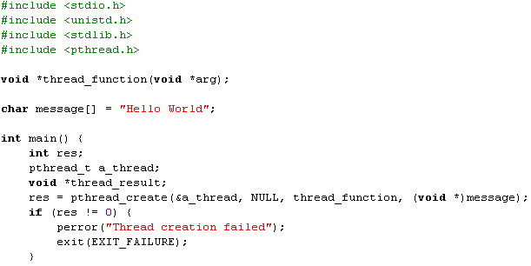
Example 1 (1/3)
gcc thread1.c -o thread1 -L/usr/lib/nptl –lpthread
thread1.c
2007/8/30
Po-Sen Wang

Slide 6
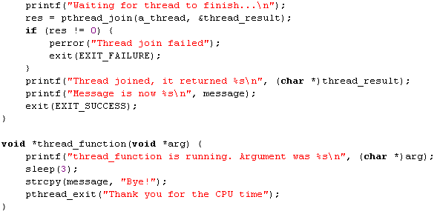
Example 1 (2/3)
thread1.c
2007/8/30
Po-Sen Wang

Slide 7
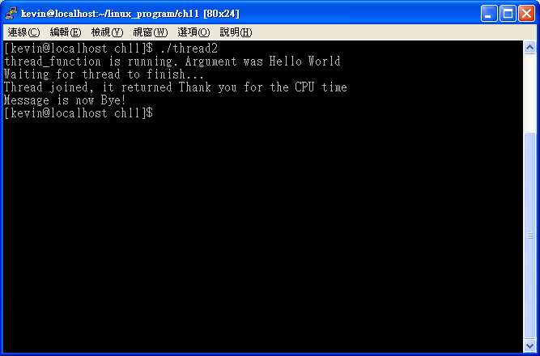
Example 1 (3/3)
thread1.c
2007/8/30
Po-Sen Wang

Slide 8
Synchronization – Using Semaphore (1/3)
#include <semaphore.h>
int sem_init(sem_t *sem, int pshared, unsigned int value);
  //create a semaphore
int sem_wait(sem_t *sem);
  //lock a semaphore
int sem_post(sem_t *sem);
  //unlock a semaphore
int sem_destroy(sem_t *sem);
  //delete a semaphore
2007/8/30
Po-Sen Wang

Slide 9
Synchronization – Using Semaphore (2/3)
int sem_init(sem_t *sem, int pshared, unsigned int value);
  sem_t *sem: semaphore 識別字
  int pshared: 設定為 0 表示僅供目前的 process
及其 thread 使用。非零值表示此
semaphore 與其他 process 共用
  unsigned int value: semaphore 的初始值
2007/8/30
Po-Sen Wang

Slide 10
Synchronization – Using Semaphore (3/3)
int sem_wait(sem_t *sem);
  若 semaphore 為非零值，則 semaphore 值減 1；若 semaphore 為 0，則呼叫此 function 的 thread 會被 block，直到 semaphore 值不為零。
int sem_post(sem_t *sem);
  對 semaphore 值加 1。
2007/8/30
Po-Sen Wang

Slide 11
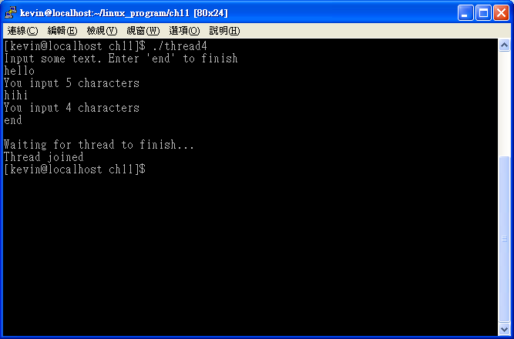
Example 2 – Using Semaphore (1/4)
thread3.c
2007/8/30
Po-Sen Wang

Slide 12
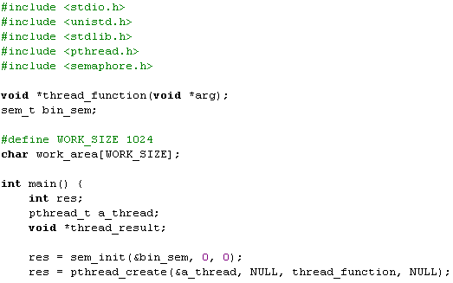
Example 2 – Using Semaphore (2/4)
thread3.c
2007/8/30
Po-Sen Wang

Slide 13
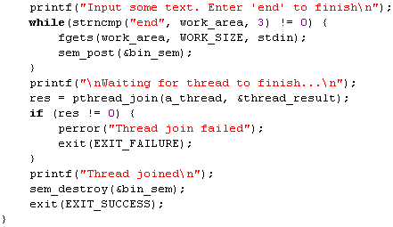
Example 2 – Using Semaphore (3/4)
thread3.c
2007/8/30
Po-Sen Wang

Slide 14
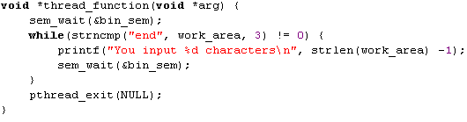
Example 2 – Using Semaphore (4/4)
thread3.c
2007/8/30
Po-Sen Wang

Slide 15
Synchronization – Using Mutex (1/3)
#include <pthread.h>
int pthread_mutex_init(pthread_mutex_t *mutex, const pthread_mutexattr_t *mutexattr);
  //create a mutex
int pthread_mutex_lock(pthread_mutex_t *mutex);
  //lock a mutex
int pthread_mutex_unlock(pthread_mutex_t *mutex);
  //unlock a mutex
int pthread_mutex_destroy(pthread_mutex_t *mutex);
  //delete a mutex
2007/8/30
Po-Sen Wang

Slide 16
Synchronization – Using Mutex (2/3)
int pthread_mutex_init(pthread_mutex_t *mutex, const pthread_mutexattr_t *mutexattr);
  pthread_mutex_t *mutex: mutex 識別字
  const pthread_mutexattr_t *mutexattr:
mutex 的屬性。設定為 NULL 表示使用預設。
2007/8/30
Po-Sen Wang

Slide 17

Synchronization – Using Mutex (2/3)
mutex
block
Thread 1
Thread 2
pthread_mutex_unlock
pthread_mutex_lock
pthread_mutex_lock
2007/8/30
Po-Sen Wang

Slide 18
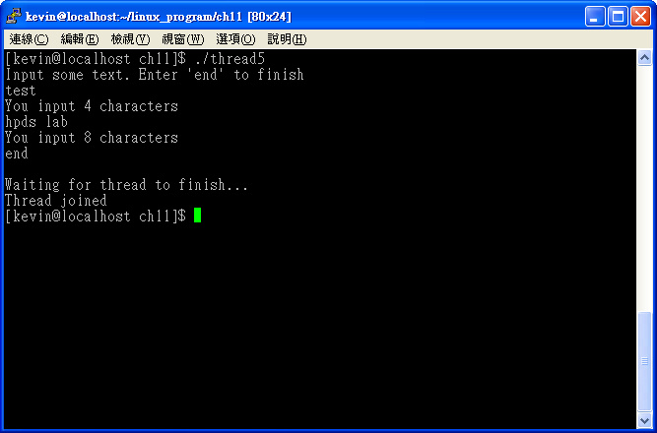
Example 3 – Using Mutex(1/4)
thread4.c
2007/8/30
Po-Sen Wang

Slide 19
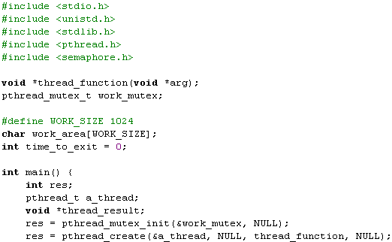
Example 3 – Using Mutex(2/4)
thread4.c
2007/8/30
Po-Sen Wang

Slide 20
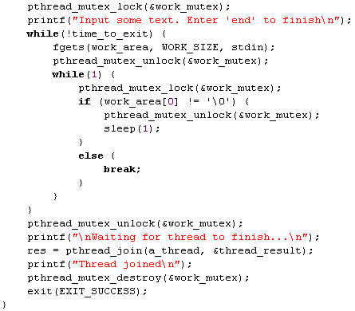
Example 3 – Using Mutex(3/4)
thread4.c
2007/8/30
Po-Sen Wang

Slide 21
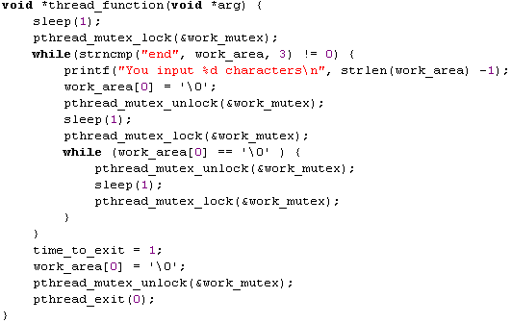
Example 3 – Using Mutex(4/4)
thread4.c
2007/8/30
Po-Sen Wang

Slide 22
Cancellation(1/2)
#include <pthread.h>
int pthread_cancel(pthread_t thread);
  //cancel a thread
int pthread_setcancelstate(int state, int *oldstate);
  //set cancellation state
int pthread_setcanceltype(int type, int *oldtype);
  //set cancellation type
2007/8/30
Po-Sen Wang

Slide 23
Cancellation(2/2)
int pthread_setcancelstate(int state, int *oldstate);
  int state: 設定為 PTHREAD_CANCEL_ENABLE 即表示允許
  取消 thread 的請求；
  設定為 PTHREAD_CANCEL_DISABLE 即表示忽略
  取消的請求。
  int *oldstate: 此指標指向前一個狀態
int pthread_setcanceltype(int type, int *oldtype);
  int type: 設定為 PTHREAD_CANCEL_ASYNCHRONOUS 則
  立即取消 thread；
  設定為 PTHREAD_CANCEL_DEFERRED 則會遇到
  取消點才會取消 thread。取消點即是下列函數：
  pthread_join、pthread_cond_wait、pthread_testcancel等
  int *oldtype: 此指標指向前一個型態
2007/8/30
Po-Sen Wang

Slide 24
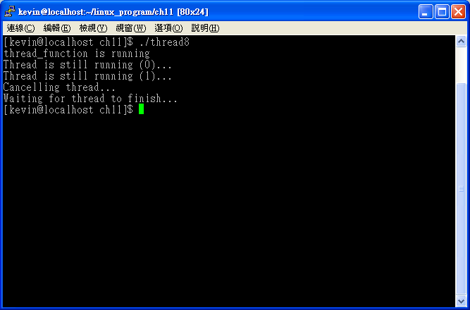
Example 4 (1/3)
thread7.c
2007/8/30
Po-Sen Wang

Slide 25
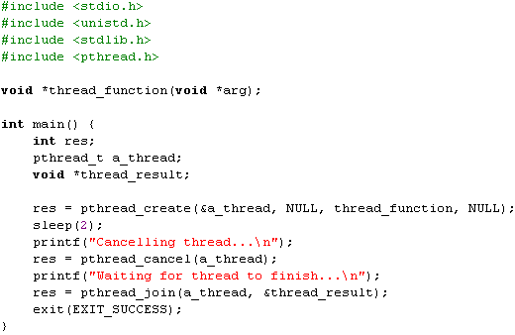
Example 4 (2/3)
thread7.c
2007/8/30
Po-Sen Wang

Slide 26
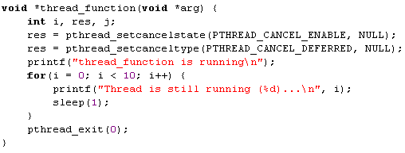
Example 4 (3/3)
thread7.c
2007/8/30
Po-Sen Wang

Slide 27
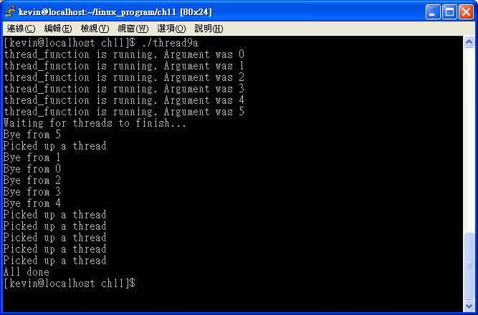
Example – Multi-Thread (1/4)
thread8a.c
2007/8/30
Po-Sen Wang

Slide 28
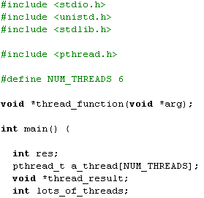
Example – Multi-Thread (2/4)
thread8a.c
2007/8/30
Po-Sen Wang

Slide 29
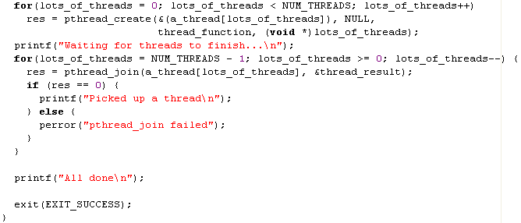
Example – Multi-Thread (3/4)
thread8a.c
2007/8/30
Po-Sen Wang

Slide 30
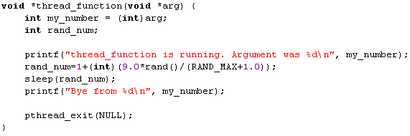
Example – Multi-Thread (4/4)
thread8a.c
2007/8/30
Po-Sen Wang

Slide 31
Condition Variables
pthread_cond_init (condition,attr) pthread_cond_destroy (condition)
pthread_condattr_init (attr)
pthread_condattr_destroy (attr)
2007/8/30
Po-Sen Wang

Slide 32
Condition Variables
Example :condition_variable
2007/8/30
Po-Sen Wang

Slide 33
Homework 1
撰寫一個程式，create 10 threads，共同計算計算1+2+3+4+…..+10000
Thread 0, 計算1~1000總和，並將總和累計至共用變數total
Thread 1, 計算1001~2000總和，並將總和累計至共用變數total
以此類推
MAIN thread join 10個child thread後，列印出總和total
2007/8/30
Po-Sen Wang

Slide 34
Homework 2
定義一結構barrier如下：
  count_mutex
  cond_var
  count // the number of threads that has arrived at the barrier
  limit // the number of threads that will arrive at the barrier
void barrier_init( struct barrier *, int num);
void barrier_arrive(struct barrier *);
寫一個程式create 10 threads
每一個thread都執行下列function
2007/8/30
Po-Sen Wang

Slide 35
Homework 2
work(void* arg)
{ int myid= (int) arg;
int i;
for(i=0 ; i<3 ; i++){
printf(“Thread %d echo in %d iteration\n”, myid, i);
barrier_arrive(&bar);
}
2007/8/30
Po-Sen Wang

