Slide 1
ATTENDANCE TRACKING MANAGEMENT SYSTEM
-Shovini Guha(12021002016002), Debasmita Ghosh(22022002016006)
-CSE(AIML)

Slide 2

InTRODUCTION
A Student Attendance Tracking Management System, underpinned by a powerful database infrastructure, marks a significant advancement in how educational institutions oversee and optimize attendance records. This sophisticated solution automates the capture of student attendance, meticulously storing this critical information in a secure, organized database. The database-driven approach ensures data integrity, offers real-time access to attendance records, and supports advanced reporting and analytics. Educators benefit from the ability to identify patterns, trends, and anomalies, enabling them to make informed decisions to improve student engagement and outcomes. This streamlined system, through its elimination of manual record-keeping, minimizes administrative overhead, freeing up valuable time and resources for more impactful educational initiatives.

Slide 3
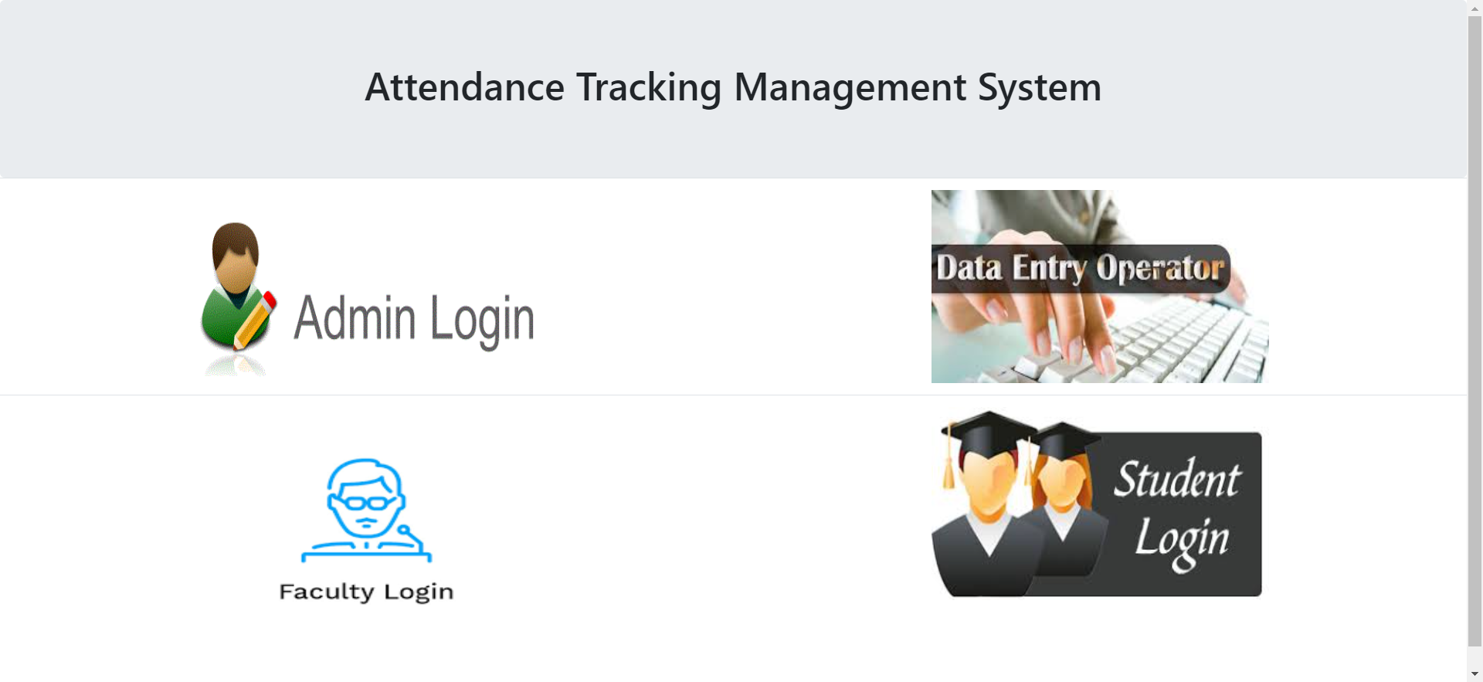
SYSTEM FEATURES
ADMIN:
-Can view details of student, faculty, admins, data entry operators and course list.
-Can edit details of faculty, data entry operators, admins or students.
-Can delete any record if needed.
STUDENT:
-Can view attendance in each course taken.
-Can edit their own details.
-Can view details of courses taken.
FACULTY:
-Can view their own details and edit them.
-Can view attendance of each student in their course.
DATA ENTRY OPERATOR:
-Can enter any new admin, student, faculty or course.
-Can enter attendance details of students.

Slide 4
LEVEL 0 DFD
ADMIN
STUDENT
Edit details of all users and courses
Edit profile details
ATTENDANCE TRACKING MANAGEMENT SYSTEM
Check attendance
Delete a user
Enter attendance details
Edit profile details
Enter attendance details
Check attendance of students and defaulter list
FACULTY
Enter details of any user or course
DATA ENTRY OPERATOR

Slide 5
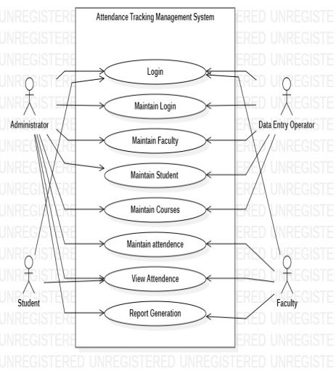
USE CASE DIAGRAM

Slide 6
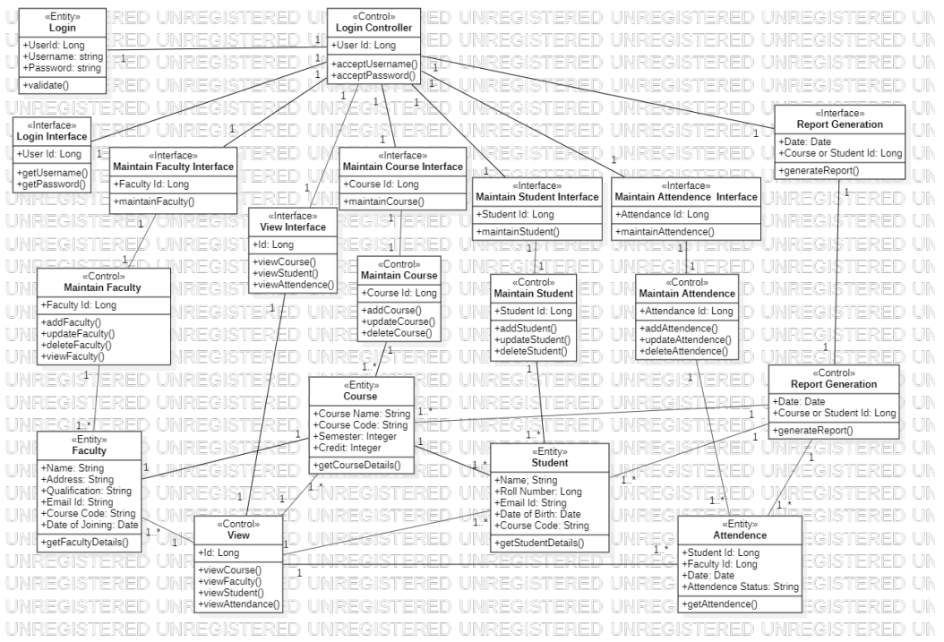
CLASS DIAGRAM

Slide 7
CONCLUSION
In conclusion, a Student Attendance Tracking Management System offers a multitude of benefits and perks for educational institutions. Firstly, it provides real-time access to attendance data, enabling educators to identify and address absenteeism promptly. This, in turn, enhances student engagement and performance. With automated record-keeping, administrative overhead is significantly reduced, freeing up resources for more meaningful tasks. Additionally, the database-driven system ensures data accuracy and integrity, eliminating the risk of manual errors. Advanced reporting and analytics empower educators to make informed decisions, improve teaching strategies, and optimize resource allocation. Overall, the system streamlines operations, fosters accountability, and supports a proactive approach to student success and institution-wide efficiency.

Slide 8
THANK YOU

