Slide 1
Data Science Bootcamp – Fundamentals / Building Foundation

Slide 2

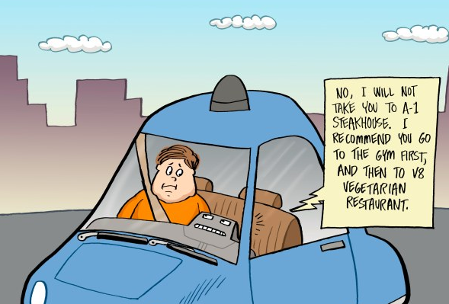
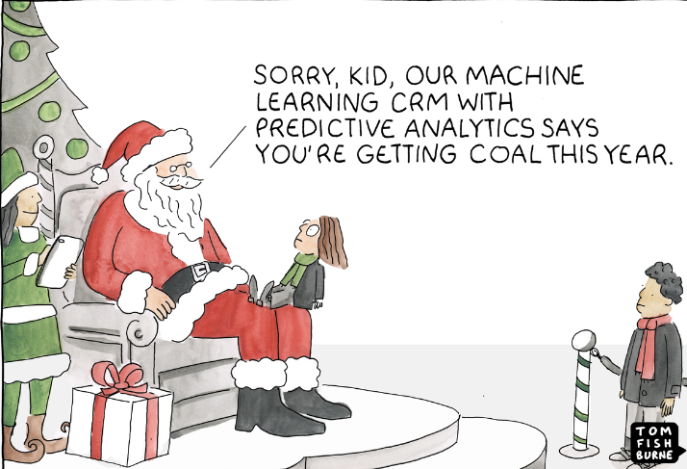

Machine Learning Snippets…

Slide 3
What’s NOT in Data Science Bootcamp…
Game Theory,
Detail Reinforcement Learning
MDP – Markovian Decision Process
Bayesian Regression,
Q-learning
Deep Q-learning
Gaussian Regression process
Deep Learning - RNN/LSTM/GRU/NARX/CNN/Capsule Network

Slide 4
Foundation Building Covers…
Difference between Statistical Models and ML Models
Supervised, unsupervised and reinforcement learning
Predictive Analytics Lifecycle
Observation window, performance window
Event, non-event, continuous, multi-class
Steps in ML model development and deployment
Data Wrangling/Munging
Overview – Web Scrapping/parsing
Sampling
Uni-Variate and Bi-Variate Analysis
Missing & Outliers
Feature Engineering
Bias – Variance Trade off
Cross Validation (K-fold)
Grid - Search
Machine Learning Losses
When to stop training Machine Learning Model

Slide 5
Machine Learning, Statistical Learning and More
Overview – Statistical Learning
Major differences between statistical modeling and machine learning :
Though there are inherent similarities between statistical modeling and machine learning methodologies, sometimes it is not obviously apparent for many practitioners. In the following table, we explain the differences succinctly to show the ways in which both streams are similar and the differences between them:
Statistical Modeling | Machine Learning
Formalization of relationships between variables in the form of mathematical equations. | Algorithm that can learn from the data without relying on rule-based programming.
Required to assume shape of the model curve prior to perform model fitting on the data (for example, linear, polynomial, and so on). | Does not need to assume underlying shape, as machine learning algo(s) can learn complex patterns automatically based on the provided data.
Statistical model predicts the output with accuracy of for example say 85 percent and having 90 percent confidence about it. | Machine learning just predicts the output with accuracy for example say: of 85 percent. No explicit assumptions about the underlying distribution of the data
In statistical modeling, various diagnostics of parameters are performed, like p-value, and so on. | Machine learning models do not perform any statistical diagnostic significance tests.
Data will be split into 70 percent – 30 percent to create training and testing data. Model developed on training data and tested on testing data. | Data will be split into 50 percent - 25 percent - 25 percent to create training, validation, and testing data. Models developed on training and hyper-parameters are tuned on validation data and finally get evaluated against test data.
Statistical models can be developed on a single dataset called training data, as diagnostics are performed at both overall accuracy and individual variable level. | Due to lack of diagnostics on variables, machine learning algorithms need to be trained on two datasets, called training and validation data, to ensure two-point validation.
From the school of statistics and mathematics. | From the School of Computer Science.

Slide 6
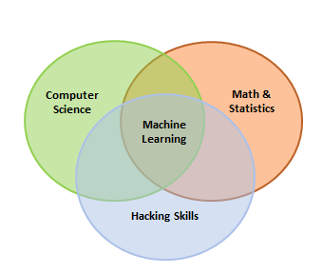
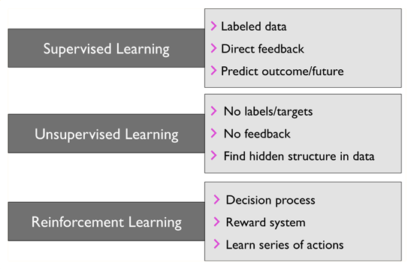
Machine Learning, Statistical Learning and More…….
Overview – Machine Learning
Machine Learning – A Brief Overview :
Machine learning is a branch of study in which a model can learn automatically from the experiences based on data without exclusively being modeled like in statistical models. Over a period and with more data, model predictions will become better. Machine learning is the branch of computer science that utilizes past experience to learn from and use its knowledge to make future decisions. Machine learning is at the intersection of computer science, engineering, and statistics. The goal of machine learning is to generalize a detectable pattern or to create an unknown rule from given examples. An
overview of machine learning landscape is as follows:
Machine learning is broadly classified into three categories but nonetheless, based on the situation, these categories can be combined to achieve the desired results for particular
applications:
Supervised learning: This is teaching machines to learn the relationship between other variables and a target variable, similar to the way in which a teacher provides feedback to students on their performance. The major segments within supervised learning are as follows:
Classification Problem
Regression Problem
Unsupervised learning: In unsupervised learning, algorithms learn by themselves without any supervision or without any target variable provided. It is a question of finding hidden patterns and relations in the given data. The categories in unsupervised learning are as follows:
Dimensionality Reduction
Clustering
Reinforcement learning: This allows the machine or agent to learn its behavior based on feedback from the environment. In reinforcement learning, the agent takes a series of decisive actions without supervision and, in the end, a reward will be given, either +1 or -1. Based on the final payoff/reward, the agent re-evaluates its paths. Reinforcement learning problems are closer to the artificial intelligence methodology rather than frequently used machine learning algorithms.

Slide 7
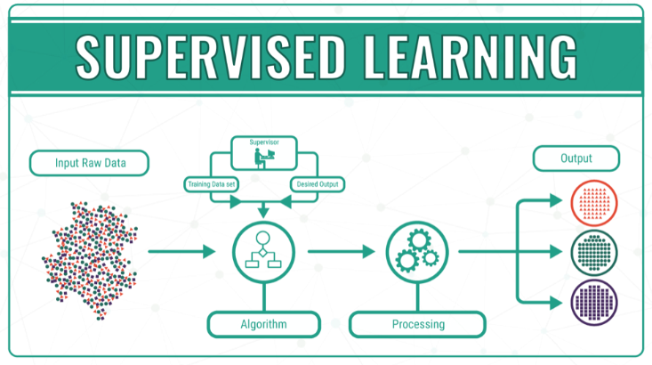
Supervised learning: Overview (1/2)
With supervised learning, you feed the output of your algorithm into the system. This means that in supervised learning, the machine already knows the output of the algorithm before it starts working on it or learning it. A basic example of this concept would be a student learning a course from an instructor. The student knows what he/she is learning from the course.
With the output of the algorithm known, all that a system needs to do is to work out the steps or process needed to reach from the input to the output. The algorithm is being taught through a training data set that guides the machine. If the process goes haywire and the algorithms come up with results completely different than what should be expected, then the training data does its part to guide the algorithm back towards the right path.
Supervised Machine Learning currently makes up most of the ML that is being used by systems across the world. The input variable (x) is used to connect with the output variable (y) through the use of an algorithm. All of the input, the output, the algorithm, and the scenario are being provided by humans. We can understand supervised learning in an even better way by looking at it through two types of problems – Classifications and Regressions

Slide 8
Supervised learning: Overview (2/2)
Classification: Classification problems categorize all the variables that form the output. Examples of these categories formed through classification would include demographic data such as marital status, sex, or age. The most common model used for this type of service status is the support vector machine. The support vector machines set forth to define the linear decision boundaries.
Regression: Problems that can be classified as regression problems include types where the output variables are set as a real number. The format for this problem often follows a linear format.

Slide 9
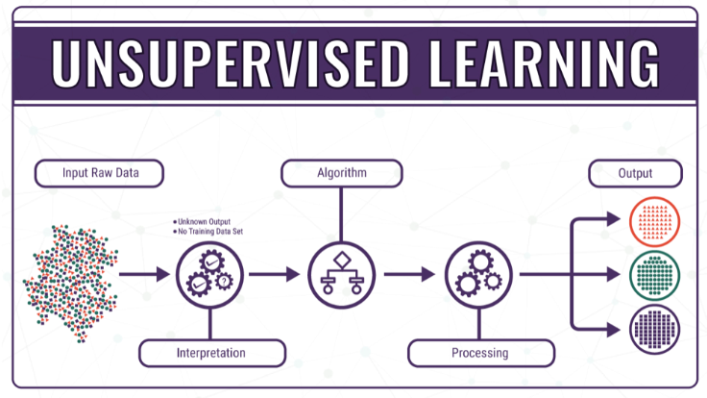
Unsupervised learning: Overview
During the process of unsupervised learning, the system does not have concrete data sets, and the outcomes to most of the problems are largely unknown. In simple terminology, the AI system and the ML objective is blinded when it goes into the operation. The system has its faultless and immense logical operations to guide it along the way, but the lack of proper input and output algorithms makes the process even more challenging. Incredible as the whole process may sound, unsupervised learning has the ability to interpret and find solutions to a limitless amount of data, through the input data and the binary logic mechanism present in all computer systems. The system has no reference data at all.
Since we expect readers to have a basic imagery of unsupervised learning by now, it would be pertinent to make the understanding even simpler through the use of an example. Just consider that we have a digital image that has a variety of colored geometric shapes on it. These geometric shapes needed to be matched into groups according to color and other classification features. For a system that follows supervised learning, this whole process is a bit too simple. The procedure is extremely straightforward, as you just have to teach the computer all the details pertaining to the figures. You can let the system know that all shapes with four sides are known as squares, and others with eight sides are known as octagons, etc. We can also teach the system to interpret the colors and see how the light being given out is classified.

Slide 10
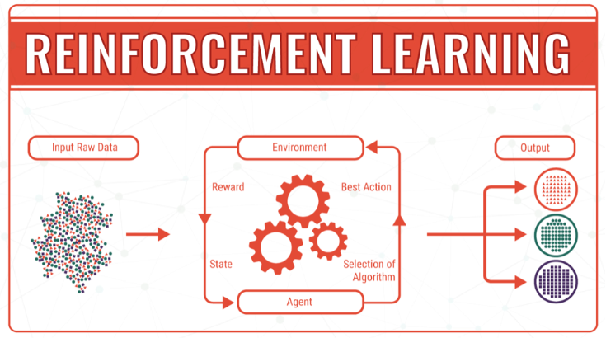
Reinforcement Learning: Overview
Reinforcement Learning is another part of Machine Learning that is gaining a lot of prestige in how it helps the machine learn from its progress. Readers who have studied psychology in college would be able to relate to this concept on a better level.
Reinforcement Learning spurs off from the concept of Unsupervised Learning, and gives a high sphere of control to software agents and machines to determine what the ideal behavior within a context can be. This link is formed to maximize the performance of the machine in a way that helps it to grow. Simple feedback that informs the machine about its progress is required here to help the machine learn its behavior.
Reinforcement Learning is not simple, and is tackled by a plethora of different algorithms. As a matter of fact, in Reinforcement Learning an agent decides the best action based on the current state of the results.

Slide 11
Supervised vs Unsupervised vs Reinforcement Learning
Supervised vs Reinforcement Learning: In Supervised Learning we have an external supervisor who has sufficient knowledge of the environment and also shares the learning with a supervisor to form a better understanding and complete the task, but since we have problems where the agent can perform so many different kind of subtasks by itself to achieve the overall objective, the presence of a supervisor is unnecessary and impractical. We can take up the example of a chess game, where the player can play tens of thousands of moves to achieve the ultimate objective. Creating a knowledge base for this purpose can be a really complicated task. Thus, it is imperative that in such tasks, the computer learn how to manage affairs by itself. It is hence more feasible and pertinent for the machine to learn from its own experience. Once the machine has started learning from its own experience, it can then gain knowledge from these experiences to implement in the future moves. This is probably the biggest and most imperative difference between the concepts of reinforcement and supervised learning. In both these learning types, there is a certain type of mapping between the output and input. But in the concept of Reinforcement Learning, there is an exemplary reward function, unlike Supervised Learning, that lets the system know about its progress down the right path.
Reinforcement vs. Unsupervised Learning: Reinforcement Learning basically has a mapping structure that guides the machine from input to output. However, Unsupervised Learning has no such features present in it. In Unsupervised Learning, the machine focuses on the underlying task of locating the patterns rather than the mapping for progressing towards the end goal. For example, if the task for the machine is to suggest a good news update to a user, a Reinforcement Learning algorithm will look to get regular feedback from the user in question, and would then through the feedback build a reputable knowledge graph of all news related articles that the person may like. On the contrary, an Unsupervised Learning algorithm will try looking at many other articles that the person has read, similar to this one, and suggest something that matches the user’s preferences.

Slide 12
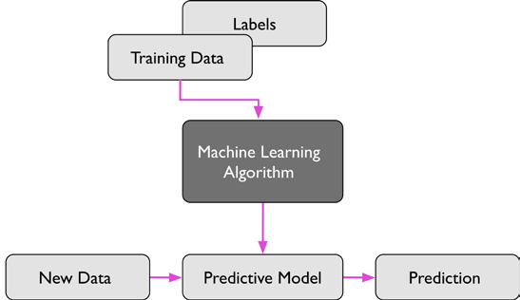
Steps in ML model development and Deployment.
Steps in ML Model development
The development and deployment of machine learning models involves a series of steps that are almost similar to the statistical modeling process, in order to develop, validate, and implement machine learning models. The steps are as follows:
Collection of data : Data for machine learning is collected directly from structured source data, web scrapping, API, chat interaction, and so on, as machine learning can work on both structured and unstructured data (voice, image, and text).
Data preparation and missing/outlier treatment: Data is to be formatted as per the chosen machine learning algorithm; also, missing value treatment needs to be performed by replacing missing and outlier values with the mean/median, and so on.
Data analysis and feature engineering: Data needs to be analyzed in order to find any hidden patterns and relations between variables, and so on. Correct feature engineering with appropriate business knowledge will solve 70 percent of the problems. Also, in practice, 70 percent of the data scientist's time is spent on feature engineering tasks.
Training algorithm on Training and Validation Data: Post feature engineering, data will be divided into three chunks (train, validation, and test data) rather than two (train and test) in statistical modeling. Machine learning are applied on training data and the hyper-parameters of the model are tuned based on validation data to avoid overfitting.
Test the algorithm on the Test Data : Once the model has shown a good enough performance on train and validation data, its performance will be checked against unseen test data. If the performance is still good enough, we can proceed to the next and final step.
Deploy the algorithm: Trained machine learning algorithms will be deployed on live streaming
data to classify the outcomes. One example could be recommender systems implemented
by e-commerce websites.

Slide 13
Processing, Wrangling and Visualizing the data.
Data Processing
The world around us has changed tremendously since computers and the Internet became mainstream. With the ubiquitous mobile phones and now Internet enabled devices, the line between the digital and physical worlds is more blurred than it ever was. At the heart of all this is data. Here we make an attempt to cover the journey data takes through a typical Machine Learning related use case where it goes from its initial raw form to a form where it can be used by Machine Learning algorithms/ models to work upon. We cover various data formats, processing and wrangling techniques to get the data into a form where it can be utilized by Machine Learning algorithms for analysis. We also learn about different visualization techniques to better understand the data at hand:
Collection of data : To understand different data retrieval mechanisms for different data types.
Data description: To understand various attributes and properties of the data collected.
Data wrangling: To prepare data for consumption in the modeling steps.
Data Visualization: To visualize different attributes for sharing results, better understanding, and so on
Overview of different types of Data Source:
Overview of Data Description:
CSV | JSON | XML | HTML | SQL | SCRAPE
Numeric | Text | Categorical
We will showcase in detail about various steps in Data Processing *

Slide 14
Overview: Web Scrapping/Parsing
Web Scrapping/Parsing
Web Scrapping:
Web scraping is a technique to scrape or extract data from the web, particularly from web pages. Web scraping may involve manually copying the data or using automation to crawl, parse, and extract information from web pages. In most contexts, web scraping refers to automatically crawling a particular web site or a portion of the web to extract and parse information that can be later on used for analytics or
other use cases. A typical web scraping flow can be summarized as follows:
Crawl: A bot or a web crawler is designed to query a web server using the required set of URLs to fetch the web pages. A crawler may employ sophisticated techniques to fetch information from pages linked from the URLs in question and even parse information to a certain extent. Web sites maintain a file called robots.txt to employ what is called as the “Robots Exclusion Protocol” to restrict/provide access to their content. More details are available at http://www.robotstxt.org/robotstxt.html.
Scrape: Once the raw web page has been fetched, the next task is to extract information from it. The task of scraping involves utilizing techniques like regular expressions, extraction based on XPath, or specific tags and so on to narrow down to the required information on the page.
Parsing : Parsing is more about reading the .xml content and parse the meaningful information.
Web scraping involves creativity from the point of view of narrowing down to the exact piece of information required. With web sites changing constantly and web pages becoming dynamic (see asp, jsp, etc.), presence of access controls (username/password, CAPTCHA, and so on) complicate the task even more. Python is a very powerful programming language, which should be evident by now, and scraping the
web is another task for which it provides multiple utilities.
Useful Link for Parsing the Data:
https://listly.io/
Example Url:
https://www.fidelity.com/viewpoints/personal-finance/7-year-end-tax-tips

Slide 15
Data Collection (1/3)
Observation and Performance window – data collection is done over two different periods of time referred as observation and performance period.
Type | Definition
Observation Period | The time at which variables used for prediction are measure. All the independent variables are calculated from this period.
Performance Period | The time period over which the dependent variables or the target variables are been tracked. The dependent variables are calculated from this period
Observation Period
Performance Period
Jan’16
Dec’16
Jan’17
Dec’17

Slide 16
Data Collection (2/3)
Dependent variable (Y) and Independent variables (X’s)
Target Variable | How to Define Good/Bad
Event/Non-Event | A person who responds is tagged as 1 (Good) vs. non-responders as 0 (Bad) Frauds = 1 (Bad) ; Rest population = 0 (Good), Attrition = 1 , No-Attrition = 0
Multi-Class | High Risk = 2, Medium Risk = 1 , Low Risk = 0 Promoter = 1, Passive = 0, Detractor = -1
Continuous | Sales, House Price, Salary, Age, Weight etc.
Once, the target variable is defined, we need to define what kind of information we have that may help us predict the Target well in advance.
The set of attributes that may be used to predict the target variables are called predictor/explanatory/independent variables
Type of Independent Variable | Example
Demographic | Industry, Plan Age, Age of Company, Total Participants
Geographical | State, Zip code, Area
Internal performance | Average account balance, average employee/employer contribution
Economic Factors | Economic variables

Slide 17
Data Collection (3/3)
Observation and Performance Exclusions
After preparing the initial modeling dataset, we need to apply some exclusions
These exclusions will be in line of the modeling
Exclusion is necessary as keeping them can dilute predictive power of a model
Category | Description
Performance Period Exclusion | These represent exclusions made to weed out the observations where performance information is either missing or incomplete. Example – New plans less than performance period age, withdrawn application etc.
Observation Period Exclusion | These represent exclusions made to remove observations with muddied performance. For example – Non operative zone, Lost or stolen cards

Slide 18
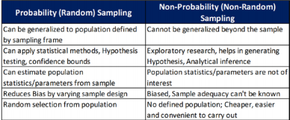
Sampling “An approximate answer to the right problem is worth a good deal more than an exact answer to an approximate problem.” —John Tukey
What is a sample? - A sample is a set of units or individuals selected from a parent population to provide some useful information about the population.
Types of Sampling- -
Probability Sampling
Non-Probability Sampling
Sampling Methods
Sampling without replacement – Once a unit is selected, it is removed from population
Sampling with replacement – A unit can be selected multiple times
Sampling Techniques –
Sample Random Sampling
Systematic Sampling
Stratified Random Sampling
Cluster Sampling
Bootstrap Sampling
Reservoir Sampling – For Continuous stream of data
Monte Carlo Methods – Monte Carlo methods leverage the computationally heavy random sampling techniques to estimate the underlying parameters. This techniques is important in stochastic equations where a exact solution is not possible. The Monte Carlo techniques are very popular in the financial world, specifically in financial instrument valuation and forecasting.

Slide 19
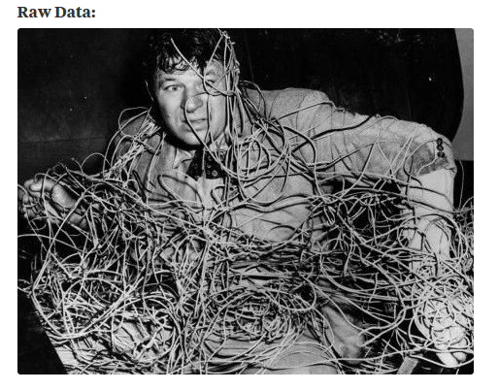
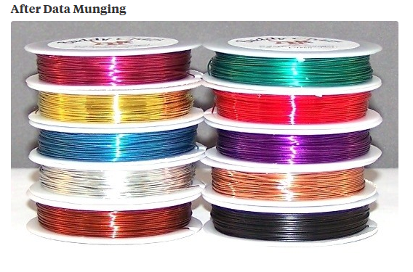
Data Wrangling / Data Munging Overview (1/2)

Slide 20
Data Wrangling / Data Munging Overview (2/2)
What is Data Wrangling/Munging: Suppose you are working on a Machine Learning analytical challenge. You decide to use your favorite classification algorithm only to realize that the training data set contains a mixture of continuous and categorical variables and you’ll need to transform some of the variables into a suitable format. You realize that the raw data you have can’t be used for your analysis without some manipulation — what you’ll soon know as data wrangling. You’ll need to clean this messy data to get anywhere with it.
It is often the case with data science projects that you’ll have to deal with messy or incomplete data. The raw data we obtain from different data sources is often unusable at the beginning. All the activity that you do on the raw data to make it “clean” enough to input to your analytical algorithm is called data wrangling. If you want to create an efficient ETL pipeline (extract, transform and load) or create beautiful data visualizations, you should be prepared to do a lot of data wrangling.
As most statisticians, data analysts and data scientists will admit, most of the time spent implementing an analysis is devoted to cleaning or wrangling the data itself, rather than to coding or running a particular model that uses the data. According to O’Reilly’s 2016 Data Science Salary Survey, 69% of data scientists will spend a significant amount of time in their day-to-day dealing with basic exploratory data analysis, while 53% spend time cleaning their data. Data wrangling is an essential part of the data science role — and if you gain data wrangling skills and become proficient at it, you’ll quickly be recognized as somebody who can contribute to cutting-edge data science work and who can hold their own as a data professional.
To sum it all up: take messy, incomplete data or data that is too complex and simplify and/or clean it so that it’s useable for analysis — and you’ll have done data wrangling.
Examples:
Dropping missing or null values in the dataset
Filtering Data
Data Consistency
Grouping Data

Slide 21
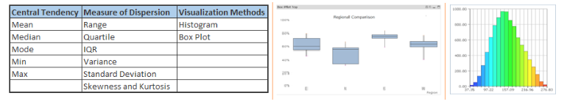
Univariate Analysis
At this stage, we explore variables one by one. Method to perform uni-variate analysis will depend on whether the variable type is categorical or continuous. Let’s look at these methods and statistical measures for categorical and continuous variables individually:
Continuous Variables:- In case of continuous variables, we need to understand the central tendency and spread of the variable. These are measured using various statistical metrics visualization methods as shown below:
Categorical Variables:- For categorical variables, we’ll use frequency table to understand distribution of each category. We can also read as percentage of values under each category. It can be measured using two metrics, Count and Count% against each category. Bar chart can be used as visualization.

Slide 22
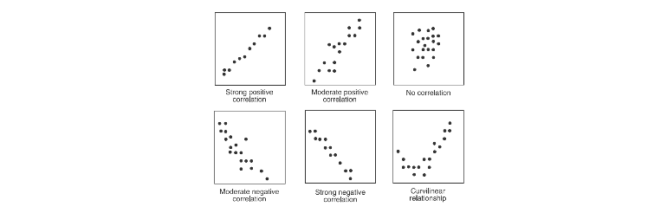
Bi-Variate Analysis (1/3)
Bi-variate Analysis finds out the relationship between two variables. Here, we look for association and disassociation between variables at a pre-defined significance level. We can perform bi-variate analysis for any combination of categorical and continuous variables. The combination can be: Categorical & Categorical, Categorical & Continuous and Continuous & Continuous. Different methods are used to tackle these combinations during analysis process.
Continuous & Continuous: While doing bi-variate analysis between two continuous variables, we should look at scatter plot. It is a nifty way to find out the relationship between two variables. The pattern of scatter plot indicates the relationship between variables. The relationship can be linear or non-linear. Scatter plot shows the relationship between two variable but does not indicates the strength of relationship amongst them. To find the strength of the relationship, we use Correlation. Correlation varies between -1 and +1.

Slide 23
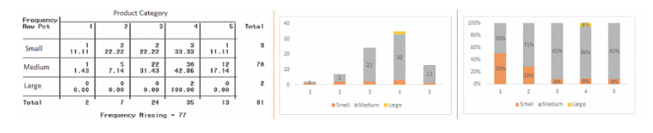
Bi-Variate Analysis (2/3)
Categorical & Categorical: To find the relationship between two categorical variables, we can use following methods:
Two-way table: We can start analyzing the relationship by creating a two-way table of count and count%. The rows represents the category of one variable and the columns represent the categories of the other variable. We show count or count% of observations available in each combination of row and column categories.
•Stacked Column Chart: This method is more of a visual form of Two-way table.
Chi-Square Test: This test is used to derive the statistical significance of relationship between the variables. Also, it tests whether the evidence in the sample is strong enough to generalize that the relationship for a larger population as well. Chi-square is based on the difference between the expected and observed frequencies in one or more categories in the two-way table. It returns probability for the computed chi-square distribution with the degree of freedom.
Probability of 0: It indicates that both categorical variable are dependent
Probability of 1: It shows that both variables are independent
Probability less than 0.05: It indicates that the relationship between the variables is significant at 95% confidence.

Slide 24
Bi-Variate Analysis (3/3)
Categorical & Continuous: While exploring relation between categorical and continuous variables, we can draw box plots for each level of categorical variables. If levels are small in number, it will not show the statistical significance. To look at the statistical significance we can perform Z-test, T-test or ANOVA.
Z-Test/ T-Test:- Either test assess whether mean of two groups are statistically different from each other or not. the probability of Z is small then the difference of two averages is more significant. The T-test is very similar to Z-test but it is used when number of observation for both categories is less than 30
ANOVA:- It assesses whether the average of more than two groups is statistically different
Example: Suppose, we want to test the effect of five different exercises. For this, we recruit 20 men and assign one type of exercise to 4 men (5 groups). Their weights are recorded after a few weeks. We need to find out whether the effect of these exercises on them is significantly different or not. This can be done by comparing the weights of the 5 groups of 4 men each.

Slide 25
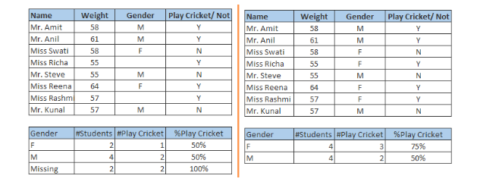
Missing Value Treatment (1/2)
Why missing values treatment is required: Missing data in the training data set can reduce the power / fit of a model or can lead to a biased model because we have not analyzed the behavior and relationship with other variables correctly. It can lead to wrong prediction or classification.
Why my data has missing values? They may occur at two stages:
Data Extraction: It is possible that there are problems with extraction process. In such cases, we should double-check for correct data with data guardians. Some hashing procedures can also be used to make sure data extraction is correct. Errors at data extraction stage are typically easy to find and can be corrected easily as well.
Data collection: These errors occur at time of data collection and are harder to correct. They can be categorized in four types: Missing completely at random: This is a case when the probability of missing variable is same for all observations. For example: respondents of data collection process decide that they will declare their earning after tossing a fair coin. If an head occurs, respondent declares his / her earnings & vice versa. Here each observation has equal chance of missing value.
Missing at random: This is a case when variable is missing at random and missing ratio varies for different values / level of other input variables. For example: We are collecting data for age and female has higher missing value compare to male.
Missing that depends on unobserved predictors: This is a case when the missing values are not random and are related to the unobserved input variable. For example: In a medical study, if a particular diagnostic causes discomfort, then there is higher chance of drop out from the study. This missing value is not at random unless we have included “discomfort” as an input variable for all patients.
Missing that depends on the missing value itself: This is a case when the probability of missing value is directly correlated with missing value itself. For example: People with higher or lower income are likely to provide non-response to their earning.

Slide 26
Missing Value Treatment (2/2)
Which are the methods to treat missing values ?
Deletion: It is of two types: List Wise Deletion and Pair Wise Deletion.
In list wise deletion, we delete observations where any of the variable is missing. Simplicity is one of the major advantage of this method, but this method reduces the power of model because it reduces the sample size.
In pair wise deletion, we perform analysis with all cases in which the variables of interest are present. Advantage of this method is, it keeps as many cases available for analysis. One of the disadvantage of this method, it uses different sample size for different variable.
Mean/ Mode/ Median Imputation: Imputation is a method to fill in the missing values with estimated ones. The objective is to employ known relationships that can be identified in the valid values of the data set to assist in estimating the missing values. Mean / Mode / Median imputation is one of the most frequently used methods. It consists of replacing the missing data for a given attribute by the mean or median (quantitative attribute) or mode (qualitative attribute) of all known values of that variable. It can be of two types: (1) Generalized Imputation: In this case, we calculate the mean or median for all non missing values of that variable then replace missing value with mean or median. (2) Similar case Imputation: In this case, we calculate average for gender “Male” and “Female” individually of non missing values then replace the missing value based on gender.
Prediction Model: Prediction model is one of the sophisticated method for handling missing data. Here, we create a predictive model to estimate values that will substitute the missing data. In this case, we divide our data set into two sets: One set with no missing values for the variable and another one with missing values. First data set become training data set of the model while second data set with missing values is test data set and variable with missing values is treated as target variable. Next, we create a model to predict target variable based on other attributes of the training data set and populate missing values of test data set. We can use regression, ANOVA, Logistic regression and various modeling technique to perform this. There are 2 drawbacks for this approach: 1.The model estimated values are usually more well-behaved than the true values 2.If there are no relationships with attributes in the data set and the attribute with missing values, then the model will not be precise for estimating missing values.
KNN Imputation: In this method of imputation, the missing values of an attribute are imputed using the given number of attributes that are most similar to the attribute whose values are missing. The similarity of two attributes is determined using a distance function. It is also known to have certain advantage & disadvantages. Advantages (1)k-nearest neighbor can predict both qualitative & quantitative attributes (2) Creation of predictive model for each attribute with missing data is not required (3) Attributes with multiple missing values can be easily treated
(4) Correlation structure of the data is taken into consideration. Disadvantage: (1) KNN algorithm is very time-consuming in analyzing large database. It searches through all the dataset looking for the most similar instances. (2) Choice of k-value is very critical. Higher value of k would include attributes which are significantly different from what we need whereas lower value of k implies missing out of significant attributes.

Slide 27
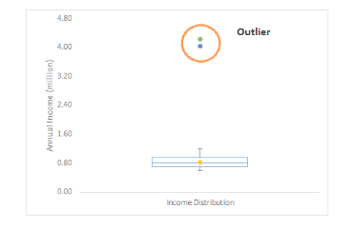
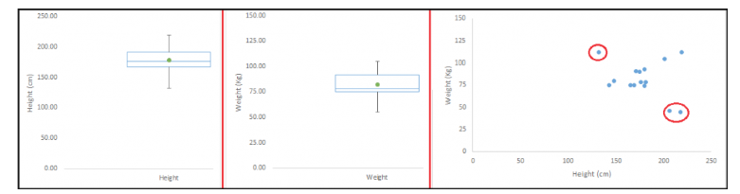
Outlier Treatment (1/4)
Outlier is a commonly used terminology by analysts and data scientists as it needs close attention else it can result in wildly wrong estimations. Simply speaking, Outlier is an observation that appears far away and diverges from an overall pattern in a sample.
Let’s take an example, we do customer profiling and find out that the average annual income of customers is $0.8 million. But, there are two customers having annual income of $4 and $4.2 million. These two customers annual income is much higher than rest of the population. These two observations will be seen as Outliers
Outlier can be of two types: Univariate and Multivariate. Above, we have discussed the example of univariate outlier. These outliers can be found when we look at distribution of a single variable. Multi-variate outliers are outliers in an n-dimensional space. In order to find them, you have to look at distributions in multi-dimensions.
Let us understand this with an example. Let us say we are understanding the relationship between height and weight. Below, we have univariate and bivariate distribution for Height, Weight. Take a look at the box plot. We do not have any outlier (above and below 1.5*IQR, most common method). Now look at the scatter plot. Here, we have two values below and one above the average in a specific segment of weight and height.

Slide 28
Outlier Treatment (2/4)
Let’s understand various types of outliers in more detail:
Data Entry Errors:- Human errors such as errors caused during data collection, recording, or entry can cause outliers in data. For example: Annual income of a customer is $100,000. Accidentally, the data entry operator puts an additional zero in the figure. Now the income becomes $1,000,000 which is 10 times higher. Evidently, this will be the outlier value when compared with rest of the population.
Measurement Error: It is the most common source of outliers. This is caused when the measurement instrument used turns out to be faulty. For example: There are 10 weighing machines. 9 of them are correct, 1 is faulty. Weight measured by people on the faulty machine will be higher / lower than the rest of people in the group. The weights measured on faulty machine can lead to outliers.
Experimental Error: Another cause of outliers is experimental error. For example: In a 100m sprint of 7 runners, one runner missed out on concentrating on the ‘Go’ call which caused him to start late. Hence, this caused the runner’s run time to be more than other runners. His total run time can be an outlier.
Intentional Outlier: This is commonly found in self-reported measures that involves sensitive data. For example: Teens would typically under report the amount of alcohol that they consume. Only a fraction of them would report actual value. Here actual values might look like outliers because rest of the teens are under reporting the consumption.
Data Processing Error: Whenever we perform data mining, we extract data from multiple sources. It is possible that some manipulation or extraction errors may lead to outliers in the dataset.
Sampling error: For instance, we have to measure the height of athletes. By mistake, we include a few basketball players in the sample. This inclusion is likely to cause outliers in the dataset.
Natural Outlier: When an outlier is not artificial (due to error), it is a natural outlier. For instance: In my last assignment with one of the renowned insurance company, I noticed that the performance of top 50 financial advisors was far higher than rest of the population. Surprisingly, it was not due to any error. Hence, whenever we perform any data mining activity with advisors, we used to treat this segment separately.
What is the impact of Outliers on a dataset?
Outliers can drastically change the results of the data analysis and statistical modeling. There are numerous unfavorable impacts of outliers in the data set:
It increases the error variance and reduces the power of statistical tests
If the outliers are non-randomly distributed, they can decrease normality
They can bias or influence estimates that may be of substantive interest
They can also impact the basic assumption of Regression, ANOVA and other statistical model assumptions

Slide 29

Outlier Identification (3/4)
There are different methods in place that can be used to find out the outliers in Data:
Standardized Residual – An observation with SR >= |3| is considered to be a potential outlier.
Cook’s D – An influential observation has a value of at least 50th percentile of the F- distribution. It detects outlying observations by evaluating all variables simultaneously. A Cook’s D greater than |2| should be investigated.
RSTUDENT is the studentized deleted residual. The studentized deleted residual checks if the model is significantly different if an observation is removed. An RSTUDENT whose absolute value is larger than 2 should be investigated.
The DFFITS statistic also test if an observation is strongly influencing the model. Interpretation of DFFITS depends on the size of the dataset. If your dataset is small to medium size, you can use 1.0 as a cut off point. DFFITS greater than 1.0 warrant investigating. For large datasets, investigate observations where DFFITS > 2[sqrt(p/n)]. DFFITS can also be evaluated by comparing the observations among themselves. Observations whose DFFITS values are extreme in relation to the others should be investigated. (Here p is the number of features being used excluding the intercept and n is the sample size).
In addition to tests for outliers that affect the overall model, the Dfbetas statistics can be used to find outliers that influence an particular parameter's coefficient. There will be a Dfbetas statistic for each term in the model. For small to medium sized datasets, a Dfbetas over 1.0 should be investigated. Suspected outliers of large datasets have Dfbetas greater than 2/sqrt(n).
Outliers can be addressed by: assigning weights, modifying the model (eg. transform variables) or deleting the observations (eg. if data entry error suspected). Whatever approach is chosen to deal with outliers should be done for a reason and not just to get a better fit!
Note- Analysts need to check whether the outlier and influential observations are either correct or entry errors. If the observations are entry errors, either correct it or remove it from the data set for modeling. If the observations are correct, run the model again without those observations to see if the parameter coefficients are unstable. If so, analysts need to decide whether to keep or remove those influential observations for modeling.

Slide 30
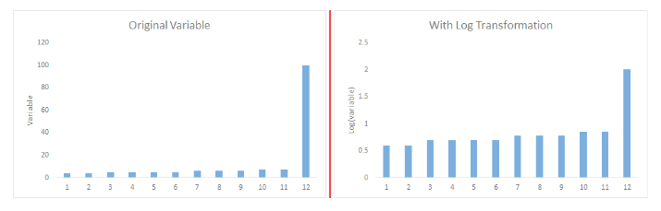
Outlier Treatment (4/4)
How to remove Outliers: Most of the ways to deal with outliers are similar to the methods of missing values like deleting observations, transforming them, binning them, treat them as a separate group, imputing values and other statistical methods. Here, we will discuss the common techniques used to deal with outliers
Deleting observations: We delete outlier values if it is due to data entry error, data processing error or outlier observations are very small in numbers. We can also use trimming at both ends to remove outliers.
Transforming and binning values: Transforming variables can also eliminate outliers. Natural log of a value reduces the variation caused by extreme values. Binning is also a form of variable transformation. Decision Tree algorithm allows to deal with outliers well due to binning of variable. We can also use the process of assigning weights to different observations.
Imputing: Like imputation of missing values, we can also impute outliers. We can use mean, median, mode imputation methods. Before imputing values, we should analyze if it is natural outlier or artificial. If it is artificial, we can go with imputing values. We can also use statistical model to predict values of outlier observation and after that we can impute it with predicted values.
Treat separately: If there are significant number of outliers, we should treat them separately in the statistical model. One of the approach is to treat both groups as two different groups and build individual model for both groups and then combine the output.
Capping and Flooring are other popular methods of outlier treatment

Slide 31
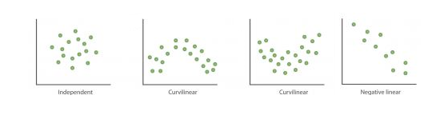
Feature Engineering (1/7)
What is Feature Engineering: Feature engineering is the science (and art) of extracting more information from existing data. You are not adding any new data here, but you are actually making the data you already have more useful. For example, let’s say you are trying to predict foot fall in a shopping mall based on dates. If you try and use the dates directly, you may not be able to extract meaningful insights from the data. This is because the foot fall is less affected by the day of the month than it is by the day of the week. Now this information about day of week is implicit in your data. You need to bring it out to make your model better. This exercising of bringing out information from data in known as feature engineering.
Variable transformation.
Variable / Feature creation.
These two techniques are vital in data exploration and have a remarkable impact on the power of prediction. Let’s understand each of this step in more details.
What is Variable Transformation: In data modelling, transformation refers to the replacement of a variable by a function. For instance, replacing a variable x by the square / cube root or logarithm x is a transformation. In other words, transformation is a process that changes the distribution or relationship of a variable with others.
When should we use Variable Transformation:
When we want to change the scale of a variable or standardize the values of a variable for better understanding. While this transformation is a must if you have data in different scales, this transformation does not change the shape of the variable distribution
When we can transform complex non-linear relationships into linear relationships. Existence of a linear relationship between variables is easier to comprehend compared to a non-linear or curved relation. Transformation helps us to convert a non-linear relation into linear relation. Scatter plot can be used to find the relationship between two continuous variables. These transformations also improve the prediction. Log transformation is one of the commonly used transformation technique used in these situations.

Slide 32
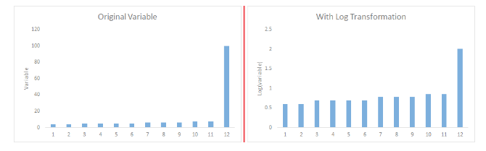
Feature Engineering (2/7)
Symmetric distribution is preferred over skewed distribution as it is easier to interpret and generate inferences. Some modeling techniques requires normal distribution of variables. So, whenever we have a skewed distribution, we can use transformations which reduce skewness. For right skewed distribution, we take square / cube root or logarithm of variable and for left skewed, we take square / cube or exponential of variables.
What are the common methods of Variable Transformation? There are various methods used to transform variables. As discussed, some of them include square root, cube root, logarithmic, binning, reciprocal and many others. Let’s look at these methods in detail by highlighting the pros and cons of these transformation methods.
Logarithm: Log of a variable is a common transformation method used to change the shape of distribution of the variable on a distribution plot. It is generally used for reducing right skewness of variables. Though, It can’t be applied to zero or negative values as well
Square / Cube root: The square and cube root of a variable has a sound effect on variable distribution. However, it is not as significant as logarithmic transformation. Cube root has its own advantage. It can be applied to negative values including zero. Square root can be applied to positive values including zero.
Binning: It is used to categorize variables. It is performed on original values, percentile or frequency. Decision of categorization technique is based on business understanding. For example, we can categorize income in three categories, namely: High, Average and Low. We can also perform co-variate binning which depends on the value of more than one variables.

Slide 33
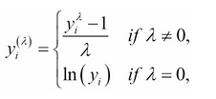
Feature Engineering (3/7)
Scaling/ Standardization
Mean/Variance -Zero Mean and Unit Variance
Min-Max - An alternative standardization is scaling features to lie between a given minimum and maximum value, often between zero and one, or so that the maximum absolute value of each feature is scaled to unit size.
Robust Scaler – Mostly appropriate for data which exhibits lot of outliers in the defined range.
Bi-narization / Dummy variable/ One-Hot Encoding.
Box-Cox Transformation – A Box Cox transformation is a way to transform non-normal dependent variables into a normal shape. Normality is an important assumption for many statistical techniques; if your data isn’t normal, applying a Box-Cox means that you are able to run a broader number of tests.

Slide 34
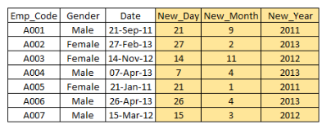
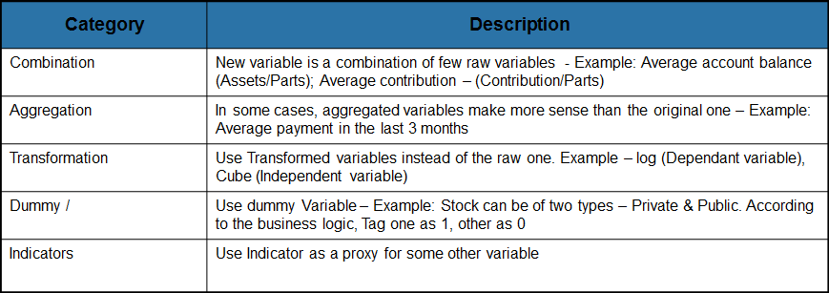
Feature Engineering (4/7)
What is Feature / Variable Creation & its Benefits: Feature / Variable creation is a process to generate a new variables / features based on existing variable(s). For example, say, we have date(dd-mm-yy) as an input variable in a data set. We can generate new variables like day, month, year, week, weekday that may have better relationship with target variable. This step is used to highlight the hidden relationship in a variable:
There are various techniques to create new features. Let’s look at the some of the commonly used methods:

Slide 35
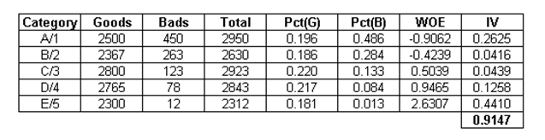
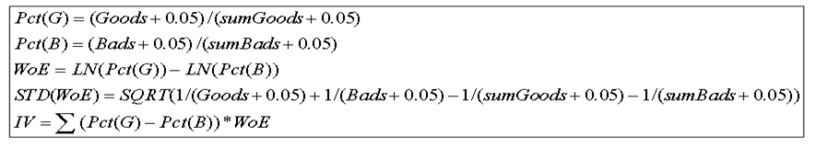
Feature Engineering (5/7)
Binning – Fine Classing: Say Event = 1 = Good, Non-Event = 0 = Bad
Fine Classing is a process that allows to determine which characteristics are worthy of consideration in the development of a model
Each characteristics is investigated to determine the underlying good/bad trends in the at attribute level for discrete data and in small bands for continuous data.
This process brings out the information values of the variable which indicates the ability of the variable to separate goods from the bads.
Log of Odds (Weight of Evidence) – Log of odds represents the proportion of Goods vs. the proportion of bads in a particular attribute. WOE = ln(g/b)
Information Value: Information Value (IV) is a measurement of how well the characteristics can differentiate between good & bad and whether the characteristics/variable should be considered for modeling.
Information value (IV) :
Define all responders into Goods/Bad based on the dependent variable.
Rank the observation in 5/10/15 etc manageable number of groups based on the independent variable.
Count the number of goods and Bads in each group.
Check the distribution of Goods & Bads across the groups.
Measure the difference into an index.
IV < 0.03 – Not Predictive
0.03 <= IV < 0.1 – Slightly Predictive
IV > 0.1 – Highly Predictive

Slide 36
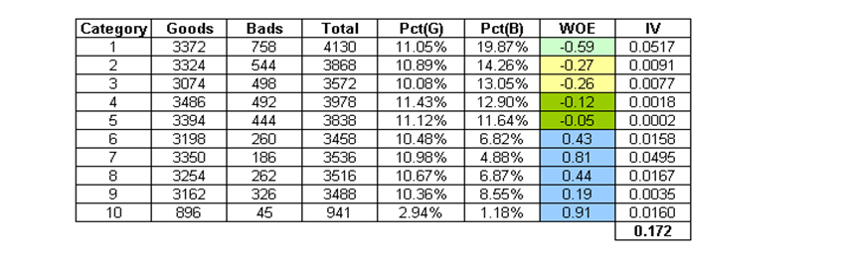
Feature Engineering (6/7)
Coarse Classing:
From Fine classing output, we can get WOE values for each groups/categories.
Coarse classing is grouping together of attributes of characteristics with similar performance in the fine classing output into coarser group.
This allows statistically valid groupings to be modeled and allows for fluctuations within characteristics to be smoothed out. These coarse groupings are called “dummy variables”.
Post coarse classing, variables are need to be replaced by their re-coded counter-part.
Try to make classes with around 5% of the population.
Be cautious and maintain linearity at the time of inclusion of dummies in to the model

Slide 37
Feature Engineering (7/7)
Feature Selection: Top reasons to use feature selection are:
It enables the machine learning algorithm to train faster.
It reduces the complexity of a model and makes it easier to interpret.
It improves the accuracy of a model if the right subset is chosen.
It reduces overfitting.
Few Techniques Includes:
Pearson’s Correlation: It is used as a measure for quantifying linear dependence between two continuous variables X and Y. Its value varies from -1 to +1
Linear discriminant analysis is used to find a linear combination of features that characterizes or separates two or more classes (or levels) of a categorical variable.
ANOVA stands for Analysis of variance. It is similar to LDA except for the fact that it is operated using one or more categorical independent features and one continuous dependent feature. It provides a statistical test of whether the means of several groups are equal or not.
Chi-Square is a is a statistical test applied to the groups of categorical features to evaluate the likelihood of correlation or association between them using their frequency distribution.
Forward Selection: Forward selection is an iterative method in which we start with having no feature in the model. In each iteration, we keep adding the feature which best improves our model till an addition of a new variable does not improve the performance of the model.
Backward Elimination: In backward elimination, we start with all the features and removes the least significant feature at each iteration which improves the performance of the model. We repeat this until no improvement is observed on removal of features.
Recursive Feature elimination: It is a greedy optimization algorithm which aims to find the best performing feature subset. It repeatedly creates models and keeps aside the best or the worst performing feature at each iteration. It constructs the next model with the left features until all the features are exhausted. It then ranks the features based on the order of their elimination.
Lasso regression performs L1 regularization which adds penalty equivalent to absolute value of the magnitude of coefficients.
Ridge regression performs L2 regularization which adds penalty equivalent to square of the magnitude of coefficients.
Varclus: The VARCLUS procedure divides a set of numeric variables into disjoint or hierarchical clusters. Associated with each cluster is a linear combination of the variables in the cluster. This linear combination can be either the first principal component or the centroid component
PCA/KPCA/RPCA/Mini-Batch PCA/RBM/Auto-Encoder/Random Forest/Elliptical Envelope/One class SVM (To be covered in module-III)

Slide 38
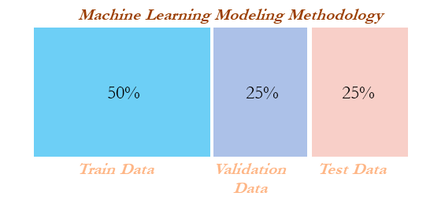
Train, Validation and Test Data…
Concept builder
Cross-validation is not popular in the statistical modeling world for many reasons; statistical models are linear in nature and robust, and do not have a high variance/overfitting problem. Hence, the model fit will remain the same either on train or test data, which does not hold true in the machine learning world. Also, in statistical modeling, lots of tests are performed at the individual parameter level apart from aggregated metrics, whereas in machine learning we do not have visibility at the individual parameter level:

Slide 39

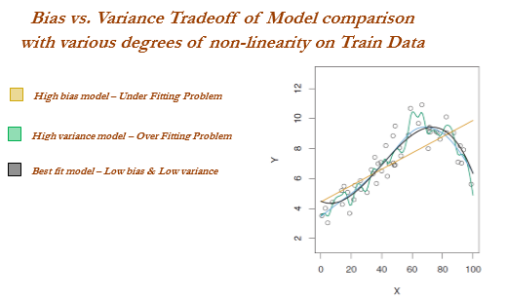
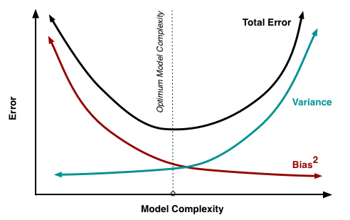
Bias – Variance Trade off….
Concept builder
Every model has both bias and variance error components in addition to white noise. Bias and variance are inversely related to each other; while trying to reduce one component, the other component of the model will increase. The true art lies in creating a good fit by balancing both. The ideal model will have both low bias and low variance.
Errors from the bias component come from erroneous assumptions in the underlying learning algorithm. High bias can cause an algorithm to miss the relevant relations between features and target outputs; this phenomenon causes an under-fitting problem.
On the other hand, errors from the variance component come from sensitivity to change in the fit of the model, even a small change in training data; high variance can cause an overfitting problem:
An example of a high bias model is logistic or linear regression, in which the fit of the model is merely a straight line and may have a high error component due to the fact that a linear model could not approximate underlying data well.
An example of a high variance model is a decision tree, in which the model may create too much wiggly curve as a fit, in which even a small change in training data will cause a drastic change in the fit of the curve.

Slide 40
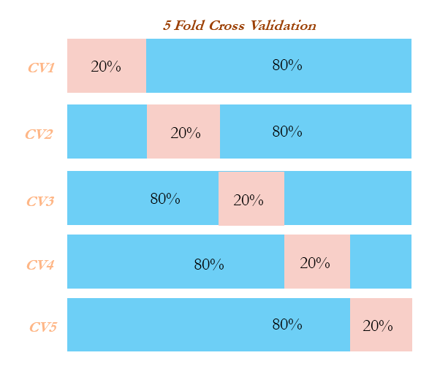
Cross Validation (K-fold)…
Concept builder
Cross-validation is another way of ensuring robustness in the model at the expense of computation. In the ordinary modeling methodology, a model is developed on train data and evaluated on test data. In some extreme cases, train and test might not have been homogeneously selected and some unseen extreme cases might appear in the test data, which will drag down the performance of the model.
On the other hand, in cross-validation methodology, data was divided into equal parts and training performed on all the other parts of the data except one part, on which performance will be evaluated. This process repeated as many parts user has chosen.
Example: In five-fold cross-validation, data will be divided into five parts, subsequently trained on four parts of the data, and tested on the one part of the data. This process will run five times, in order to cover all points in the data. Finally, the error calculated will be the average of all the errors:

Slide 41
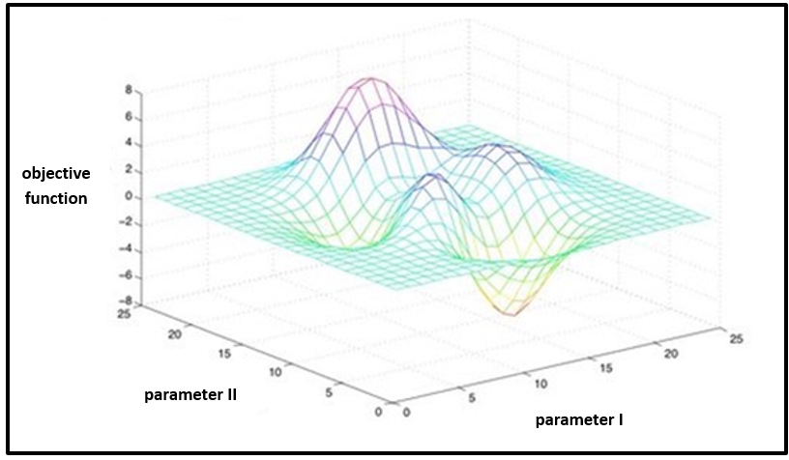
Grid - Search
Concept builder
Grid search in machine learning is a popular way to tune the hyper-parameters of the model in order to find the best combination for determining the best fit:
In grid search, we primarily define different grid of values for various hyper-parameters and test the performance of the learners to decide on the best performing set of values.

Slide 42
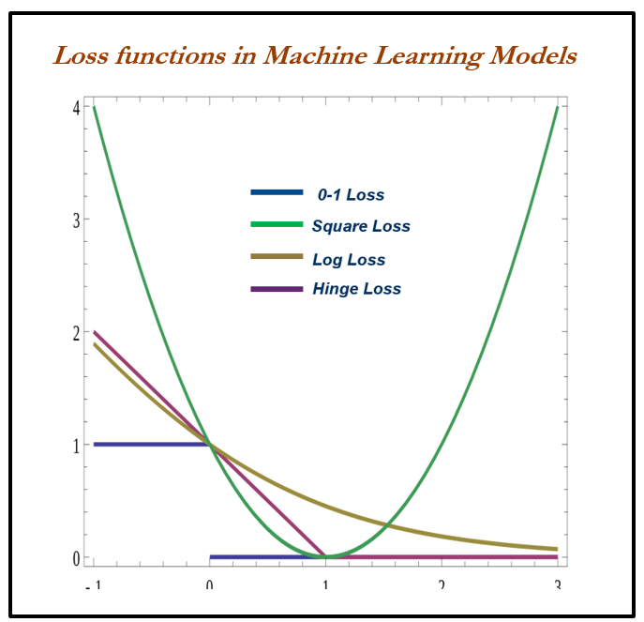

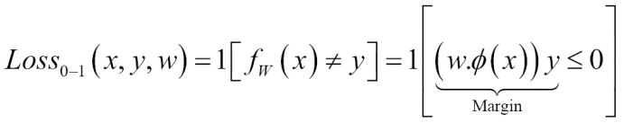
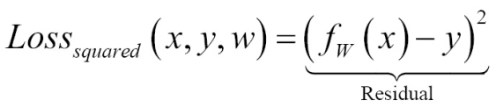
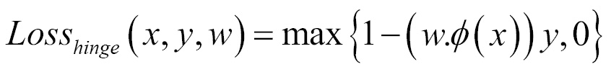
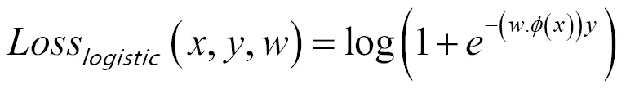
Machine Learning Losses….
Concept builder
The loss function or cost function in machine learning is a function that maps the values of variables onto a real number intuitively representing some cost associated with the variable values. Optimization methods are applied to minimize the loss function by changing the parameter values, which is the central theme of machine learning.
Zero-one loss is L0-1 = 1 (m <= 0); in zero-one loss, value of loss is 0 for m >= 0 whereas 1 for m < 0. The difficult part with this loss is it is not differentiable, non-convex, and also NP-hard. Hence, in order to make optimization feasible and solvable, these losses are replaced by different surrogate losses for different problems.
Surrogate losses used for machine learning in place of zero-one loss are given as follows. The zero-one loss is not differentiable, hence approximated losses are being used instead:
Squared loss (for regression)
Hinge loss (SVM)
Logistic/log loss (logistic regression)
Examples of various loss-function

Slide 43
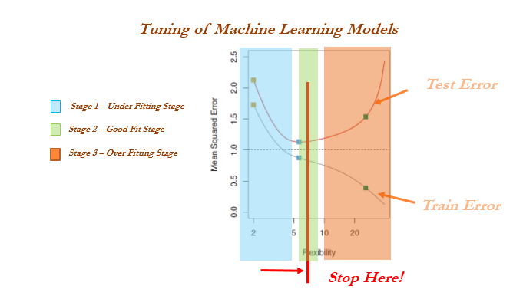
When to stop training Machine Learning Model…
Concept builder
When to stop tuning the hyper-parameters in a machine learning model is a million-dollar question. This problem can be mostly solved by keeping tabs on training and testing errors. While increasing the complexity of a model, the following stages occur:
Stage 1: Under-fitting stage - high train and high test errors (or low train and low test accuracy)
Stage 2: Good fit stage (ideal scenario) - low train and low test errors (or high train and high test accuracy.
Stage 3: Overfitting stage - low train and high test errors (or high train and low test accuracy)

