Slide 1
Data Science Bootcamp – KNN/LDA/QDA

Slide 2
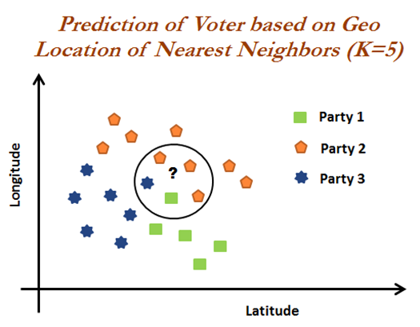
k Nearest Neighbors - Explained
Overview – KNN
K-nearest neighbors is a non-parametric machine learning model in which the model memorizes the training observation for classifying the unseen test data. It can also be called instance-based learning. This model is often termed as lazy learning, as it does not learn anything during the training phase like regression, random forest, and so on. Instead it starts working only during the testing/evaluation phase to compare the given test observations with nearest training observations, which will take significant time in comparing each test data point. Hence, this technique is not efficient on big data; also, performance does deteriorate when the number of variables is high due to the curse of dimensionality.
KNN voter example –
KNN is explained better with the following short example. Objective is to predict the party for which voter will vote based on their neighborhood, precisely geolocation (latitude and longitude). Here we assume that we can identify the potential voter to which political party they would be voting based on majority voters did voted for that particular party in that vicinity, so that they have high probability to vote for the majority party. However, tuning the k-value (number to consider, among which majority should be counted) is the million dollar question (as same as any machine learning algorithm):
In the diagram, we can see that the voter of the study will vote for Party 2. As within the vicinity, one neighbor has voted for Party 1 and the other voter voted for Party 3. But three voters voted for Party 2. In fact, by this way KNN solves any given classification problem. Regression problems are solved by taking mean of its neighbors within the given circle or vicinity or k-value.
The Algorithm :
When a lot of training data samples along with their independent features and labels are fed, it stores all of it in the memory, or, rather plots the data in an n-dimensional space on the basis of its features. Hence, every sample is represented by a certain point in this plot, and colored or marked in a way to indicate its label.
When this algorithm is faced by a test sample, it plots that sample in the same n-dimensional space as the training data and then searches for its k nearest neighbors based on any of these distance measures from the training samples. Yes, it goes through the complete training data every time it needs to predict a test sample’s classification label! This is why it’s called a Lazy learning technique.

Slide 3
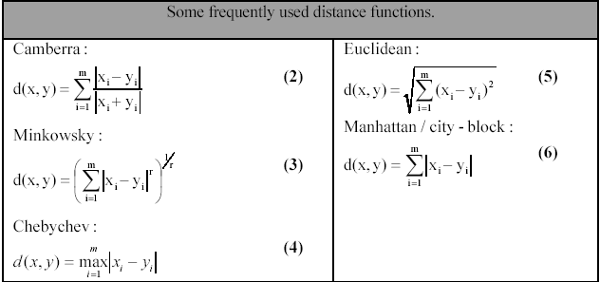
k Nearest Neighbors – Contd.
Some important distance Measures
Selecting which measure to use where, is experience based and depends on the type of data to be processed. In the real data set we can have Categorical, Numerical or mixed type (both numerical and categorical) of attributes, based on which distance measures may change.
The nearest neighbor search doesn’t necessarily mean that the algorithm would linearly compare the test sample to the training data as if it were a list. Certain optimized searching algorithms exist for this purpose, like KDTree, and BallTree.
In short - An object is classified by a majority vote of its neighbors, with the object being assigned to the class most common among its k nearest neighbors (k is a positive integer, typically small). If k = 1, then the object is simply assigned to the class of that single nearest neighbor.

Slide 4
k Nearest Neighbors – Contd.
How do we choose Neighbors
Brute Force -
Lets consider for simple case with two dimension plot. If we look mathematically, the simple intuition is to calculate the Euclidean distance from point of interest ( of whose class we need to determine) to all the points in training set. Then we take class with majority points. This is called brute force method. For N samples in D dimensions the running time complexity turns out to be O[DN²]. If we have small number of dimensions and training set, this would run in reasonable time. But as the training set size increases, the running time grows quickly. Brute force performs worst when there are large dimensions and large training set.
K-D Tree -
To improve the running time, alternate approaches were invented on the line of building a growing tree from point of interest. These methods attempt to reduce the required number of distance calculations by efficiently encoding aggregate distance information for the sample. The basic idea is that if point A is very distant from point B, and point B is very close to point C, then we know that points A and C are very distant, without having to explicitly calculate their distance. (This may not be correct all the time.)In this way, the computational cost of a nearest neighbors search can be reduced to O[D N *log(N)] or better. This is a significant improvement over brute-force for large N.K-D tree performs well enough when D <20. With larger D it again takes longer time. This is known as “curse of dimensionality”.
Ball Tree -
Ball tree assumes the data in multidimensional dimensional space and creates the nested hyper spheres. Query Time complexity is O[Dlog(N)].
Weighted kNN -
We can assign weights to the attributes which are more relevant to our classification than the others. The weight assignment is random initially, and can be changed later on the basis of classification error. Once the nearest neighbors are spotted, weights are assigned to all of them so as to register their vote on the label of the test sample. The weights can either be uniform (equal dominance of all neighbors) or inversely proportional to the distance of the neighbor from the test sample. You can also devise your own weight assignment algorithm. This is comprehensively what kNN classification is all about.
Which one to choose when?
The selection of the relevant algorithm for problem at hand depends on the number of dimensions and the size of training set.
For small sample size and small dimensions, brute force performs well.
Sparsity of data : If data is sparse with small dimensions (< 20) KD tree will perform better than Ball Tree algorithm.
Value of K (neighbors) : As the K increases, query time of both KD tree and Ball tree increases.

Slide 5
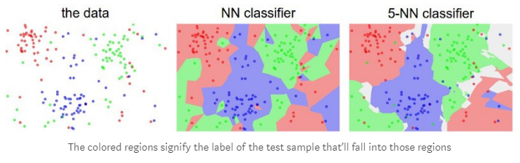
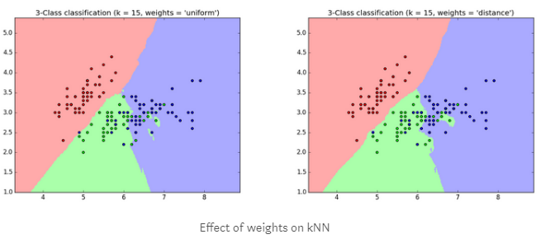
k Nearest Neighbors – Contd.
Important Parameters -
n_neighbors (int) :
number of nearest neighbors to be brought under consideration, denoted by k. By default, its value is 5. Higher value can lead to overfitting.
weights (str) :
your weighting algorithm — uniform(default), distance(inverse proportionality to Euclidean distances) or user defined.
algorithm :
the searching algorithm you plan to deploy — auto (default, looks through the training data and selects one algorithm on its own), kd_tree (uses KDTree), ball_tree (uses BallTree) and brute (uses brute force search).

Slide 6
k Nearest Neighbors – Contd.
Key aspects and Shortcomings -
Key Aspects
It’s very intuitive, given that all that needs to be done is a comparison among samples.
The training time is extremely short spanned, since data storage is all that’s actually happening.
For small values of k, the classification becomes locally sensitive, i.e., training samples similar to the test sample heavily dominate its classification. The decision boundary, or rather decision surface becomes quite jittery.
For large values of k, the local sensitivity of the classification decreases, i.e., training samples less-like the test sample also affect its classification. The decision surface becomes smoother.
Shortcomings
The test sample processing is really time consuming, since for every test sample, the model has to run through the entire data set to find the nearest neighbors.
The training data needs to be numeric in nature, since the classification is driven by Euclidean distances.
kNN classifier doesn’t perform very well on imbalanced data. E.g. consider two classes, A and B. If majority of the training data, say 70–80% of it is classified as A, then the model will ultimately give a lot of preference to A no matter how small k is. This might result in a lot of data getting wrongly classified.
On a conclusive note, kNN is a very simple and intuitive algorithm, but this simplicity causes it to provide a really time consuming analysis. It’s often suggested by expert data scientists to use this algorithm in case nothing else works out for your problem. At the same time, kNN also reduces several of our worries, like you don’t really need a linearly separable data set. Your intuition about the data and the problem is among the prime things that matter. Make sure to give a really nice thought to the problem before getting on with any algorithm that, sort of, looks good!

Slide 7
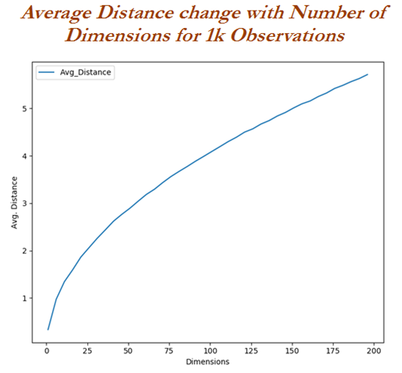
k Nearest Neighbors – Contd.
Curse of Dimensionality -
KNN completely depends on distance. Hence, it is worth studying about the curse of dimensionality to understand when KNN deteriorates its predictive power with the increase in number of variables required for prediction. This is an obvious fact that high-dimensional spaces are vast. Points in high-dimensional spaces tend to be dispersing from each other more compared with the points in low-dimensional space. Though there are many ways to check the curve of dimensionality, here we are using uniform random values between zero and one generated for 1D, 2D, and 3D space to validate this hypothesis.
From the preceding graph, it is proved that with the increase in dimensions, mean distance increases logarithmically. Hence the higher the dimensions, the more data is needed to overcome the curse of dimensionality!

Slide 8
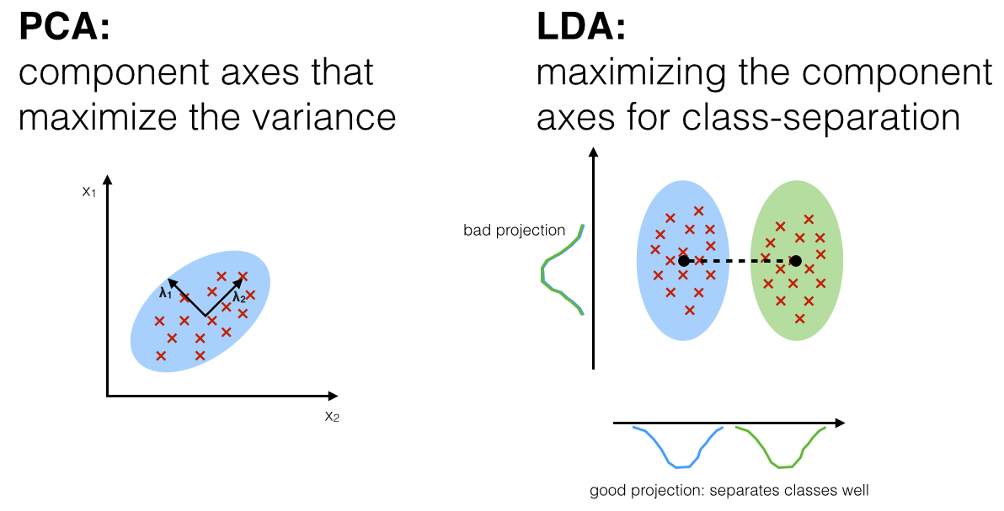
LDA – Linear Discriminant Analysis -
Overview - LDA
Linear Discriminant Analysis (LDA) is most commonly used as dimensionality reduction technique in the pre-processing step for pattern-classification and machine learning applications. The goal is to project a dataset onto a lower-dimensional space with good class - separability in order avoid overfitting (“curse of dimensionality”) and also reduce computational costs.
The general LDA approach is very similar to a Principal Component Analysis but in addition to finding the component axes that maximize the variance of our data (PCA), we are additionally interested in the axes that maximize the separation between multiple classes (LDA).
So, in a nutshell, often the goal of an LDA is to project a feature space (a dataset n-dimensional samples) onto a smaller subspace k(where k ≤ n−1) while maintaining the class-discriminatory information. In general, dimensionality reduction does not only help reducing computational costs for a given classification task, but it can also be helpful to avoid overfitting by minimizing the error in parameter estimation (“curse of dimensionality”).
Comparison between PCA and LDA –
Both Linear Discriminant Analysis (LDA) and Principal Component Analysis (PCA) are linear transformation techniques that are commonly used for dimensionality reduction. PCA can be described as an “unsupervised” algorithm, since it “ignores” class labels and its goal is to find the directions (the so-called principal components) that maximize the variance in a dataset. In contrast to PCA, LDA is “supervised” and computes the directions (“linear discriminants”) that will represent the axes that that maximize the separation between multiple classes.
Although it might sound intuitive that LDA is superior to PCA for a multi-class classification task where the class labels are known, this might not always the case. For example, comparisons between classification accuracies for image recognition after using PCA or LDA show that PCA tends to outperform LDA if the number of samples per class is relatively small (PCA vs. LDA, A.M. Martinez et al., 2001). In practice, it is also not uncommon to use both LDA and PCA in combination: E.g., PCA for dimensionality reduction followed by an LDA.

Slide 9
LDA – Linear Discriminant Analysis – Contd..
Process Summary
What is a “good” feature subspace?
Let’s assume that our goal is to reduce the dimensions of a d-dimensional dataset by projecting it onto a (k)(k)-dimensional subspace (where k<dk<d). So, how do we know what size we should choose for k (kk = the number of dimensions of the new feature subspace), and how do we know if we have a feature space that represents our data “well”?
Later, we will compute eigenvectors (the components) from our data set and collect them in a so-called scatter-matrices (i.e., the in-between-class scatter matrix and within-class scatter matrix).
Each of these eigenvectors is associated with an eigenvalue, which tells us about the “length” or “magnitude” of the eigenvectors.
If we would observe that all eigenvalues have a similar magnitude, then this may be a good indicator that our data is already projected on a “good” feature space.
And in the other scenario, if some of the eigenvalues are much much larger than others, we might be interested in keeping only those eigenvectors with the highest eigenvalues, since they contain more information about our data distribution. Vice versa, eigenvalues that are close to 0 are less informative and we might consider dropping those for constructing the new feature subspace.
Summarizing the LDA approach in 5 steps
Listed below are the 5 general steps for performing a linear discriminant analysis; we will explore them in more detail in the following sections.
Compute the d-dimensional mean vectors for the different classes from the dataset.
Compute the scatter matrices (in-between-class and within-class scatter matrix).
Compute the eigenvectors (e₁,e_{2,}...,e_{n}) and corresponding eigenvalues (λ₁, ,λ₂,...,λ_{d}) for the scatter matrices.
Sort the eigenvectors by decreasing eigenvalues and choose k- eigenvectors with the largest eigenvalues to form a d×k dimensional matrix W (where every column represents an eigenvector).
Use this (d×k) eigenvector matrix to transform the samples onto the new subspace. This can be summarized by the matrix multiplication: Y=X×W (where X is a (n×d) - d-dimensional matrix representing the n samples, and y are the transformed (n×k)dimensional samples in the new subspace).
For a more detailed overview please refer to - http://sebastianraschka.com/Articles/2014_python_lda.html

Slide 10
Linear and Quadratic Discriminant Analysis.
Overview
In the previous tutorial you learned that logistic regression is a classification algorithm traditionally limited to only two-class classification problems (i.e. default = Yes or No). However, if you have more than two classes then Linear (and its cousin Quadratic) Discriminant Analysis (LDA & QDA) is an often-preferred classification technique. Discriminant analysis models the distribution of the predictors X separately in each of the response classes (i.e. default = “Yes”, default = “No” ), and then uses Bayes’ theorem to flip these around into estimates for the probability of the response category given the value of X.
Why Discriminant Analysis
In the previous tutorial we saw that a logistic regression model does a fairly good job classifying customers that default.
So why do we need another classification method beyond logistic regression? There are several reasons:
When the classes of the response variable Y (i.e. default = “Yes”, default = “No”) are well-separated,
the parameter estimates for the logistic regression model are surprisingly unstable. LDA & QDA do not suffer from this problem.
If n is small and the distribution of the predictors X is approximately normal in each of the classes the LDA & QDA models are again more stable than the logistic regression model.
LDA & QDA are often preferred over logistic regression when we have more than two non-ordinal response classes (i.e.: stroke, drug overdose, and epileptic seizure).
It is always good to compare the results of different analytic techniques; this can either help to confirm results or highlight how different modeling assumptions and characteristics uncover new insights.
However, its important to note that LDA & QDA have assumptions that are often more restrictive then logistic regression:
Both LDA and QDA assume the predictor variables X are drawn from a multivariate Gaussian (aka normal) distribution.
LDA assumes equality of covariance among the predictor variables X across each all levels of Y. This assumption is relaxed with the QDA model.
LDA and QDA require the number of predictor variables (p) to be less then the sample size (n). Furthermore, its important to keep in mind that performance will severely decline as p approaches n. A simple rule of thumb is to use LDA & QDA on datasets where n >=5*P
Also, when considering between LDA & QDA its important to know that LDA is a much less flexible classifier than QDA, and so has substantially lower variance. This can potentially lead to improved prediction performance. But there is a trade-off: if LDA’s assumption that the predictor variable share a common variance across each Y response class is badly off, then LDA can suffer from high bias. Roughly speaking, LDA tends to be a better bet than QDA if there are relatively few training observations and so reducing variance is crucial. In contrast, QDA is recommended if the training set is very large, so that the variance of the classifier is not a major concern, or if the assumption of a common covariance matrix is clearly untenable.

Slide 11
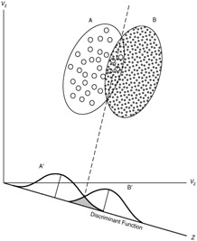
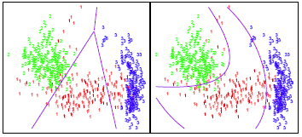
Linear and Quadratic Discriminant Analysis- Contd..
LDA and QDA- Overview
LDA computes “discriminant scores” for each observation to classify what response variable class it is in (i.e. default or not default). These scores are obtained by finding linear combinations of the independent variables.
This classifier assigns an observation to the kth class of Y_{k} for which discriminant score is largest. For example, lets assume there are two classes (A and B) for the response variable Y. Based on the predictor variable(s), LDA is going to compute the probability distribution of being classified as class Aor B. The linear decision boundary between the probability distributions is represented by the dashed line. Discriminant scores to the left of the dashed line will be classified as A and scores to the right will be classified as B.
When dealing with more than one predictor variable, the LDA classifier assumes that the observations in the
kth class are drawn from a multivariate Gaussian distribution where there is a class-specific
mean vector, and a covariance matrix that is common to all K classes.
Non –Linear Discriminant Analysis –
As previously mentioned, LDA assumes that the observations within each class are drawn from a multivariate Gaussian distribution and the covariance of the predictor variables are common across all k levels of the response variable Y. Quadratic discriminant analysis (QDA) provides an alternative approach. Like LDA, the QDA classifier assumes that the observations from each class of Y are drawn from a Gaussian distribution. However, unlike LDA, QDA assumes that each class has its own covariance matrix. In other words, the predictor variables are not assumed to have common variance across each of the k levels in Y.
Consider the image. In trying to classify the observations into the three (color-coded) classes, LDA (left plot) provides linear decision boundaries that are based on the assumption that the observations vary consistently across all classes. However, when looking at the data it becomes apparent that the variability of the observations within each class differ. Consequently, QDA (right plot) is able to capture the differing covariances and provide more accurate non-linear classification decision boundaries.
Notes:
Link for the detailed discussion –
http://uc-r.github.io/discriminant_analysis

