Slide 1
CS-1713-01T-Summer-2018-Intro to Computer Program II
Rifatul Islam

Slide 2

Remember File Input/Output?
Can you remember how to open file and read it’s content?
Can you read each line from a file?
Can you write something on a file?
Can you use delimiter to tokenize file?
Let’s Open Lecture 3 from BlackBoard and Review from page 10
.

Slide 3
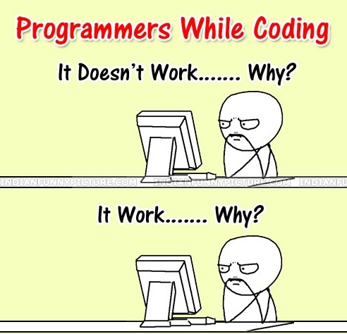
Hey Let’s Do Something!!
A Quick Motivation
Our task is to design a Text Analyzer that can count the number of Words,
Sentences, Vowels, and Consonant from a text file.
DEBUG, DEBUG and DEBUG

Slide 4
Hey Let’s Do Something!!
Download the file from this link:
Use the input file as an input to the program.
Output the followings:
Words: 493
Sentences: 64
Characters: 3310
Vowels: 1160
Consonant: 1545

Slide 5
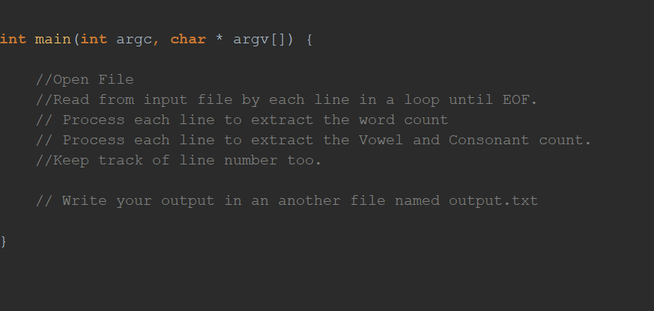
Hey Let’s Do Something!!
Pseudo Code:
Output: (For the input file)
Words: 493
Sentences: 64
Characters: 3310
Vowels: 1160
Consonant: 1545
Your output should be exact match or very close match
Upload your Code and input output file to Blackboard Assignment #

