Slide 2
Outline
Web of Things
Web
Things
IoT vs WoT
Architecture
Accessibility layer
Findability layer
Sharing layer
Composition layer
SoLiD
Decentralization
The SoLiD
SoLiD vs. Typical Web
The SoLiD Specification
Identity: WebID
Profiles
Authentication
Authorization
Content Representation: Linked Data
Reading and Writing Resources
Social Web App Protocols
SoLiD in WoT
Challenges
Discovery
Actuation
Existing Works
Proposed Architecture
The Demo
Conclusion

Slide 3
Web?

Slide 4
Web?

Slide 5
Things?

Slide 6
Web Of Things

Slide 7
Decentralization?

Slide 8
SoLiD?

Slide 9
How SoLiD is different than Web?

Slide 10
SoLiD: The Specification

Slide 11
WebID

Slide 12
Linked Data?

Slide 13
Linked Data applied to SoLiD

Slide 14
WoT Challenges

Slide 15
Existing Works

Slide 16
Motivation
Data Controls us

Slide 17
Introducing SoLiD to support WoT

Slide 18
The Proposed Framework 1

Slide 19
The Proposed Framework 2

Slide 20
The Demo

Slide 21
Conclusion

Slide 22

?

Slide 23
SoLiD
Conforms Linked Data Platform (LDP)
LDP Client
A HTTP Client: Follows LDP Resources and Containers specifications [1]
LDP Server
A HTTP Server: Follows LDP Resources and Containers specifications [1]

Slide 24

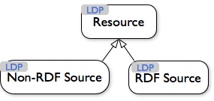
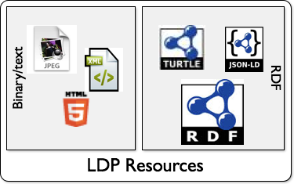
SoLiD: Content Representation
Two kinds of Resources
Linked Data resources
RDF in the form of JSON-LD, Turtle, HTML+RDFa, etc
Everything else
Binary data and non-linked-data structured text
Linked Data provides considerable benefits
In terms of interoperability with the rest of the Solid app ecosystem.

Slide 25
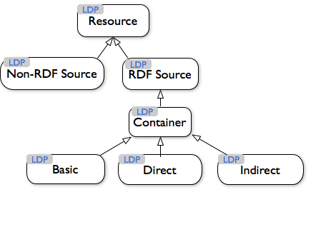
SoLiD: Content Representation
Resources are grouped in directory-like Containers

Slide 26
[1] https://www.w3.org/TR/ldp/#conformance

Slide 27
HTTP Protocol
HTTP Documents
Interfaces: GET/POST/PUT/DELETE etc
RDF Protocol
RDF Documents
Interface: SPARQL (On top of HTTP)

Slide 28
Secondly, the request-response nature of HTTP is often cited as one of the limitations for IoT use-cases as it does not match the event-driven nature of applications that are common in the Wireless Sensor Networks.[3][6][12] To overcome this shortcoming while keeping a focus on fostering integration with the Web, several authors have suggested the use of HTML5 WebSockets either natively or through the use of translation brokers (e.g., translating from MQTT or CoAP to WebSockets).[5][6][10][13] This complements the REST API of things with a publish subscribe mechanism that is largely integrated with the Web eco-system.
https://en.wikipedia.org/wiki/Web_of_Things

Slide 29
Application
TextBox: POD WEB ID
Discover
Discoverability
Actuating
Data Sharing

Slide 30
Question?

Slide 31
Demo

