Slide 1

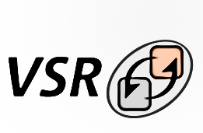
Seminar Web Engineering 112- SoLiD for WoT Devices
Advisor:
Mahda Noura
Presented by: Sagar Kafle
Shovra Das

Slide 2
Outline
Web of Things
Web
Things
IoT vs WoT
Architecture
SoLiD
Decentralization
Linked Data
SoLiD vs. Typical Web
The SoLiD Specification
SoLiD in WoT
Relevant Works
Proposed System
Implementation
The Demo
Conclusion

Slide 3
WoT
Web of Things

Slide 4
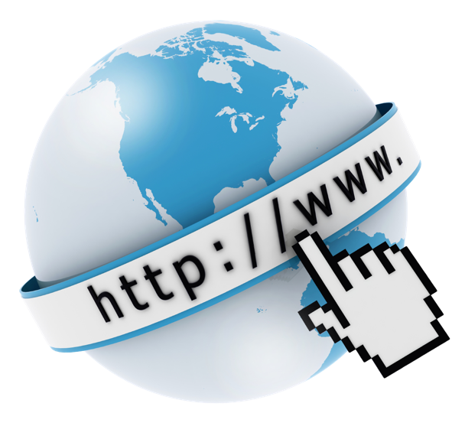
Web?
Common name for World Wide Web (WWW)
Resources are identified by Uniform Resource Locators
Resources are linked through HTML anchors
Internet Vs Web
The Internet is a global network of networks
The infrastructure
Physical Network
Uses TCP/IP
Web is the service on top of Internet
Network of documents
Logical Network
Uses HTTP on top of TCP/IP

Slide 5
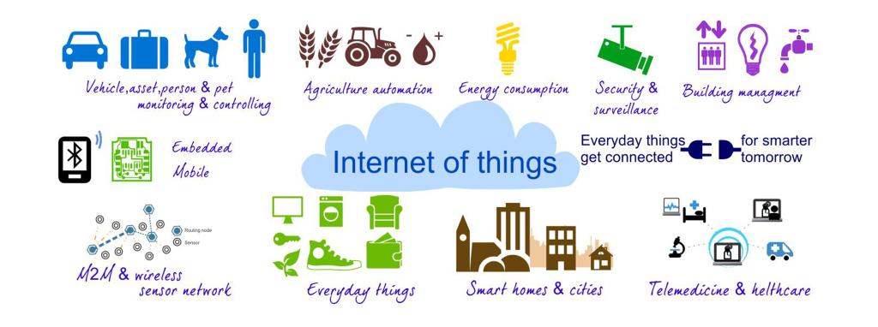
Thing?
Refers to Anything
Typically a computing device
Connected to internet
Able to send and receive data over some predefined protocol
Typical criterias to be fulfilled
Identification and info storage (RFID tags, MAC address)
Information collection (Sensor networks, store sensor values)
Information processing (Understanding commands, filtering data)
Communications (Transmit and receive messages),
Actuation (Switch control, motor control)

Slide 6
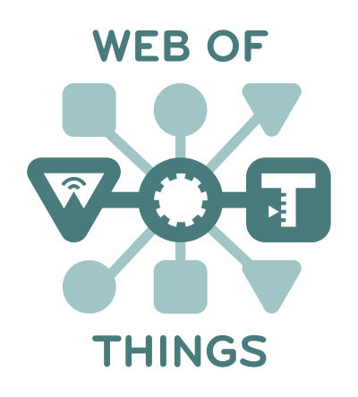
Web Of Things
A computing concept that describes a future where everyday objects are fully integrated with the Web.
You could think of the Web of Things as everyday objects being able to access Web services.
The key point is that this doesn't involve the reinvention of the means of communication beause existing standards are used.

Slide 7
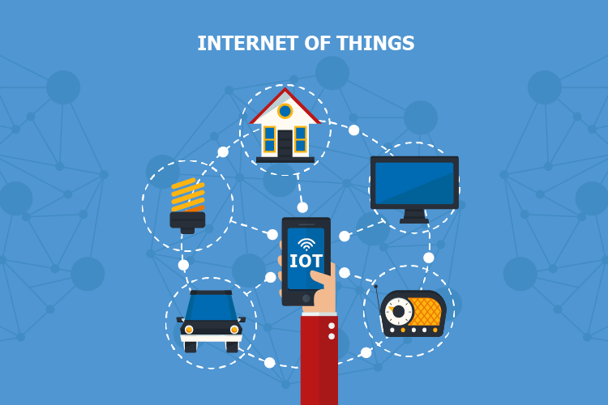
IoT vs WoT
The Internet of Things is simply "A network of Internet connected objects able to collect and exchange data.„
Interoperability is a major challenge on the Internet of Things
Web of things is the subset of Internet Of Things.
WoT is Application Layer over IoT.
Interoperability challenge is taken care of by using existing web technologies

Slide 8
WoT vs IoT: Way of doing things
IoT
WoT
Fosters a event-driven nature of applications
Use protocols like MQTT or CoAP etc
Integrates Things with the Web
Limitations: The request-response nature of HTTP
The event-driven nature is suggested to be implemented by the use of HTML5 WebSockets
Natively or through the use of translation brokers
e.g., translating from MQTT or CoAP to WebSockets)

Slide 9
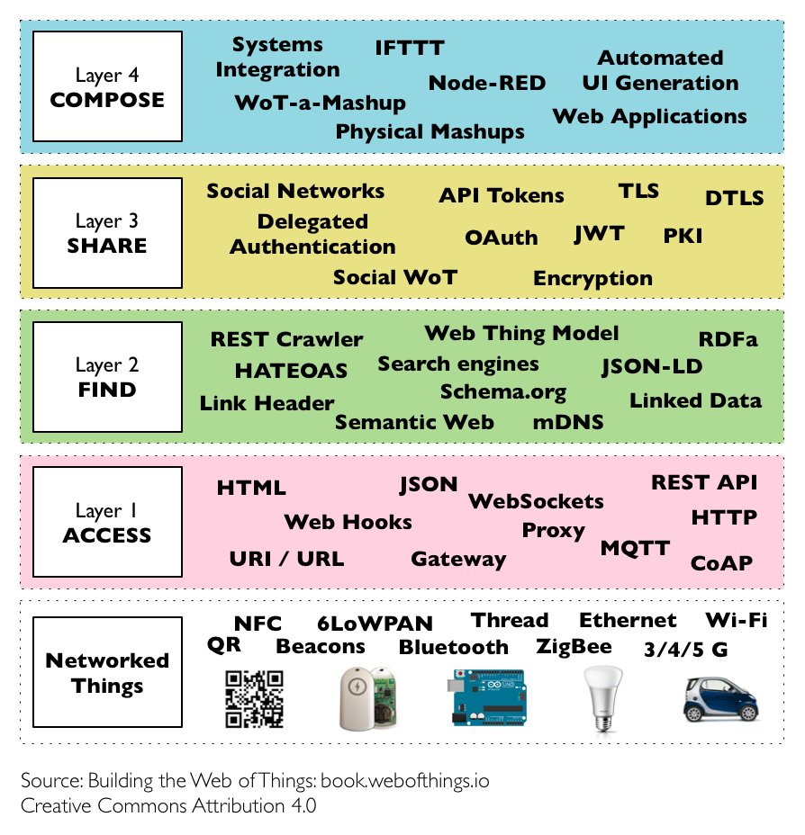
WoT Architecture
4 Main layers
Describes the framework to classify the different patterns and protocols involved.

Slide 10
WoT :: Layer-1: Accessibility Layer
This is the core layer of the WoT
Deals with the access of things to the Internet
Ensure they expose their services via Web APIs.

Slide 11
WoT :: Layer-2: Findability Layer
Focus: To provide a way to find and locate things on the Web
Strongly influenced by the semantic Web
Reuse Web semantic standards to describe things and their services.
HTML5 Microdata integration, RDF / RDFa, JSON-LD etc.
Enables machine to machine interaction following some standards.

Slide 12
WoT :: Layer-3: Sharing Layer
Deals with the idea of things pushing data to the Web
Intelligence and Big-data patterns can be applied
Manage our health (Wearables),
Optimize energy consumption (Smart Grid)
Ensures that data generated by things can be shared in an efficient and secure manner.

Slide 13
WoT :: Layer-4: Composition Layer
Integrates the services and data offered by things into higher level Web tools
Analytics software
Mashup applications such as IFTTT
Makes simpler to create applications involving things and virtual Web services.

Slide 14
SoLiD
The Web Decentralization Project by Prof. Tim Berners-Lee

Slide 15
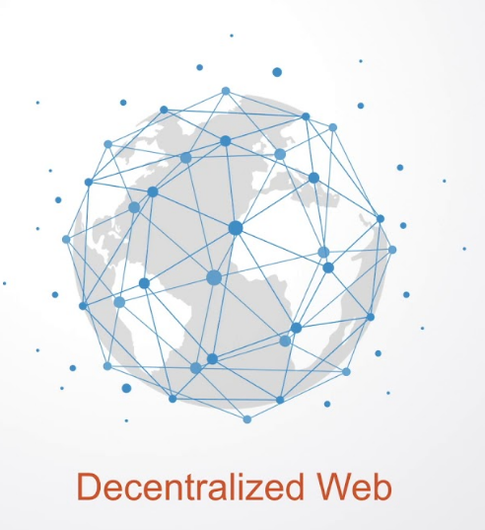
Decentralization
Web runs across a number of machines that are owned by regular users rather than owned in a central place like a server.
It is supposed to be like the web you know but without relying on centralised operators.
Individual user have the full control of there data instead of any big tech firms.

Slide 16
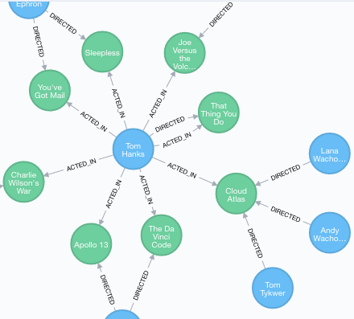
Linked Data
A Structured data
Interlinked with other data
Described based on some semantic vocabularies
Can be useful through semantic queries.
Based on the RDF model
Views data as a collection and in relation to other data.
Provides a single standardized access mechanism for all involved
Shareable, Extensible and Reusable, even on different results and different interfaces.

Slide 17
Typical HTML Data vs Linked Data
HTTP Protocol
HTTP Documents
Interfaces: GET/POST/PUT/DELETE etc
RDF Protocol
RDF Documents
Interface: SPARQL (On top of HTTP)

Slide 18
Linked Data Platform
The term Linked Data was coined on around 2006
Data model: RDF (Developed in the 1990s)
Format: RDF/RDFa, Turtle, JSON-LD etc.
Communication protocol: HTTP
Architectural style: REST

Slide 19

SoLiD
Social Linked Data is a web decentralization project led by Tim Berners-Lee.
Proposed set of conventions and tools for building decentralized social applications
Based on Linked Data Principles
Today’s web applications is centralized for a variety of reasons. User data became the source of power and income for Internet companies. Solid is a solution to this.
POD: Allow users to have full control of their own data, including access control and storage location

Slide 20
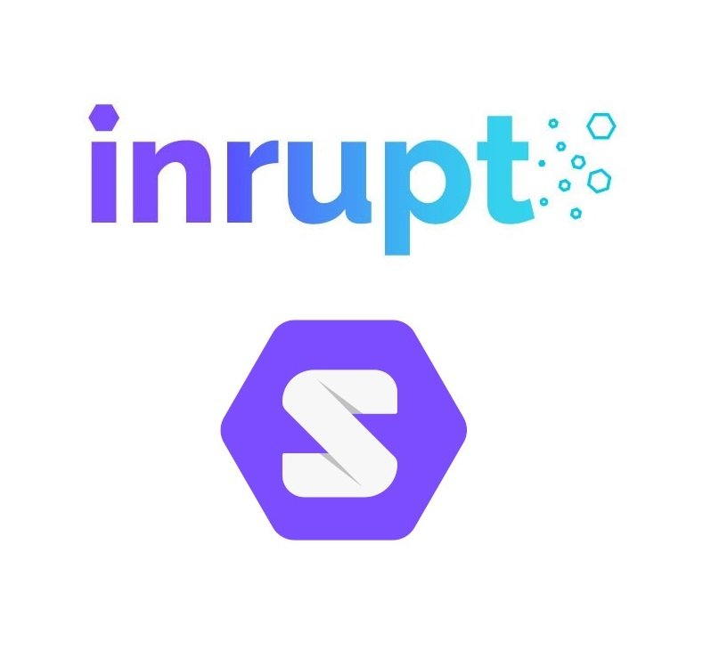
SoLiD Specification
Identity (WebId)
Profiles
WebID Profile Documents
Authentication
Primary Authentication: WebID-TLS
Alternative Authentication Mechanisms
Secondary Authentication: Account Recovery
Authorization and Access Control
Web Access Control
Content Representation
RDF in the form of JSON-LD, Turtle, HTML+RDFa, etc
Reading and Writing Resources
HTTPS REST API
WebSockets API
Social Web App Protocols (Under Development)

Slide 21
Linked Data applied to SoLiD
Profile
A RDF Resource
Content Representation
RDF Containers or Resource
Authorization
RDF Resource (ACL files)
Social Web App Protocols
Yet to discover

Slide 22

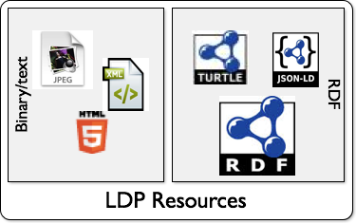
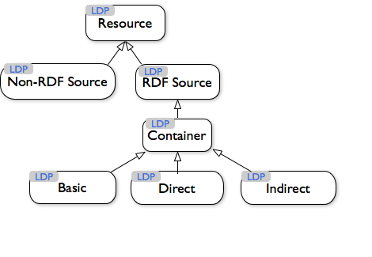
SoLiD: Content Representation
Two kinds of Resources
Linked Data resources
RDF in the form of JSON-LD, Turtle, HTML+RDFa, etc
Everything else
Binary data and non-linked-data structured text
Linked Data provides considerable benefits
In terms of interoperability with the rest of the Solid app ecosystem.

Slide 23
SoLiD & WoT
How they make sense together

Slide 24
SoLiD & WoT at a glance
WoT Requires
SoLiD Provides
Access
Discover Things
Share Data
Actuate
REST interface
RDF+SPARQL
POD
Web Socket + SPARQL

Slide 25

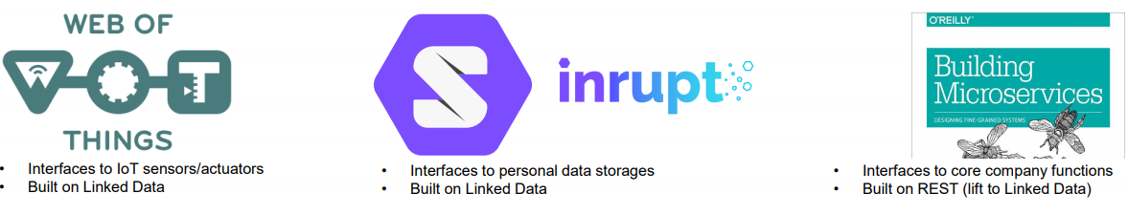
Related Works
[1] Käfer, T., & Harth, A. (2018, October). Specifying, monitoring, and executing workflows in linked data environments. In International Semantic Web Conference (pp. 424-440). Springer, Cham.
WiLD

Slide 26
Further Motivation
Data Controls us
We think the things as entities of the Social Web
One thing will be able communicate with each other and share data as we share thoughts
Things will take decision based on the data generated by other things as we human being do
Proper semantic is needed to assure to facilitate the above points

Slide 27



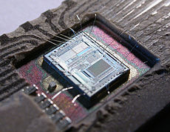
WoT Scenario: A Top Level View
S
S
S
SMART GATEWAY
MQTT
HTTP
S
MQTT
S
S
MQTT
MQTT
S
S

Slide 28
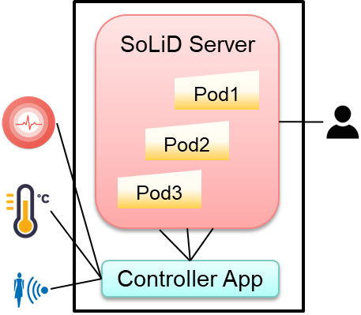
Previous Proposal
POD per sensors

Slide 29




The Proposed Secnerio-1
POD can be configured using WebID
SMART GATEWAY
(SoLiD Server)
POD
Controller Device

Slide 30
The Proposed Scenerio-2
PODs can be configured using WebID
THE DEVICE ITSELF
(SoLiD Server)
POD
Controller Module

Slide 31






SoLiD-SERVER
POD
device.ttl
USER-AGENT
CONTROLLER-MODULE
HOST-DEVICE

Slide 32
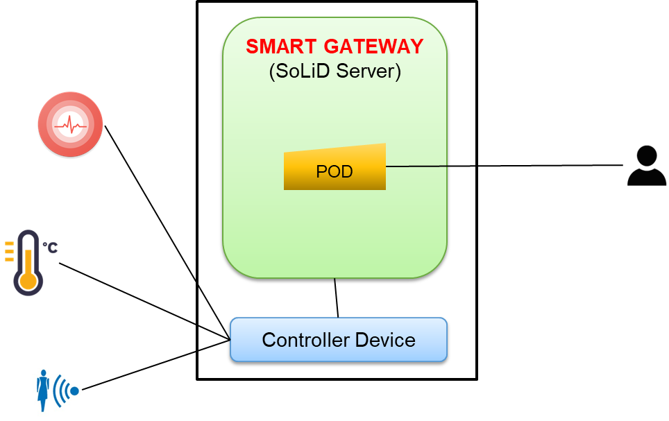
The Implementation: Scenerio-1
Controller Device was simulated as a web app
Developed using Node.js
User Interface is another web app
Developed using Node.js
Solid Server
node-solid-server 5.1.1

Slide 33
Challenges We Faced
Understand the RDF Ecosystem
Deal with the poor SoLiD documentation
Describing things
Actuating things
How we solved
Had some previous knowledge about RDF
Regarding the documentation, we had to deal with it
Describing things: used RDF
Actuating things: used Web Socket

Slide 34
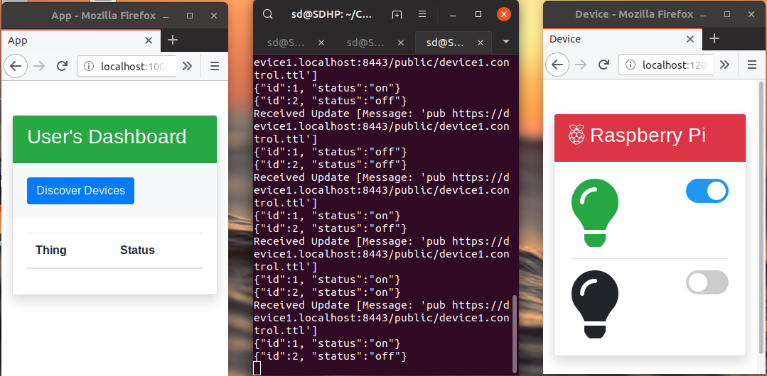
The Demo

Slide 35
Conclusion
SoLiD can foster WoT
Enormous Research opportunity
As of future work we intend to implement the Secenerio 2
Providing native support for WoT in SoLiD Ecosystem

Slide 36

?
Thank you!

