Slide 1

Seminar Web Engineering
112- Microservices
Advisor:
Valentin Siegert
Presented by: Asad Hayat
Anusha Mogera

Slide 2
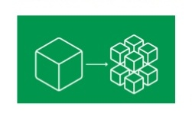
Microservices Architecture.
It is an architectural style that structures an application as a collection of loosely coupled services, which implement business capabilities.
Better testability
Better deployability
Easier for a developer to understand
Improved fault isolation
The IDE is faster, which makes developers more productive

Slide 3
Planned Demo:
To Create a Weather Forecast Microservice.
Main focus revolves around the idea of loosely coupled architecture.
It can be reusable for any kind of application which requires weather forecasting.
References:
[1] Microservices Architecture [Online] Available from: https://microservices.io/patterns/microservices.html [Accessed on 10th November 2018]
[2] IEEE Xplore Digital Library. Microservices written by Johannes Thönes https://ieeexplore.ieee.org/abstract/document/7030212

