Slide 2
Outline
Web of Things
Web
Things
IoT vs WoT
Architecture
Accessibility layer
Findability layer
Sharing layer
Composition layer
SoLiD
Decentralization
The SoLiD
SoLiD vs. Typical Web
The SoLiD Specification
Identity: WebID
Profiles
Authentication
Authorization
Content Representation: Linked Data
Reading and Writing Resources
Social Web App Protocols
SoLiD in WoT
Challenges
Discovery
Actuation
Existing Works
Proposed Architecture
The Demo
Conclusion

Slide 3
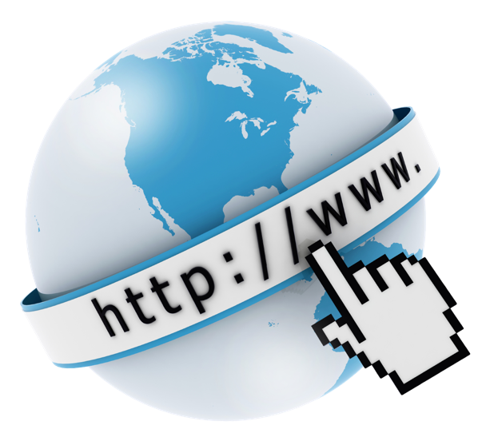
Web?
Common name for World Wide Web(WWW)
Information system where documents and other web resources are identified by Uniform Resource Locators which are accessible over the internet.
Internet Vs Web
- The Internet is a global network of networks
- the Internet is infrastructure while the Web is service on top of that infrastructure

Slide 4
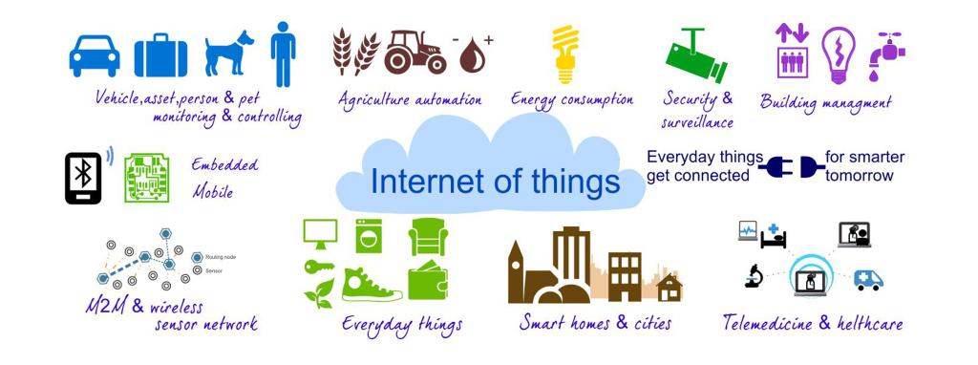
Thing in IoT/WoT
An embedded computing device (or embedded system) that transmits and receives information over a network (need not be able to interface with internet directly) for the purpose of controlling another device or interacting with a user
For anything to become a “Thing” in IoT/WoT we need to add the one or all of the below features to day to day things externally or have them inbuilt
Identification and info storage(RFID tags, MAC address), Information collection (Sensor networks, store sensor values),Information processing(Understanding commands, filtering data),Communications (Transmit and receive messages),Actuation (Switch control, motor control)

Slide 5
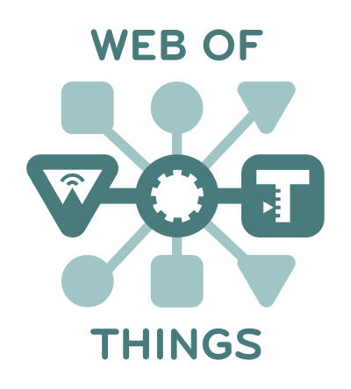
Web Of Things
A computing concept that describes a future where everyday objects are fully integrated with the Web.
You could think of the Web of Things as everyday objects being able to access Web services.
The key point is that this doesn't involve the reinvention of the means of communication beause existing standards are used.

Slide 6
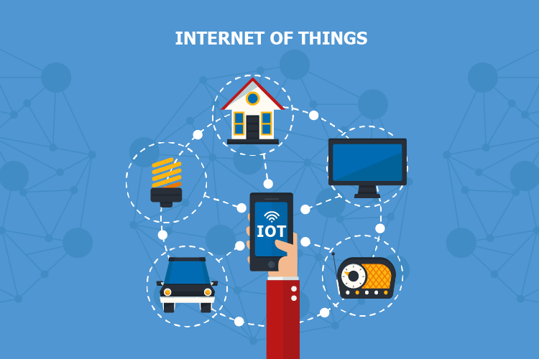
IoT Vs Wot
The Internet of Things is simply "A network of Internet connected objects able to collect and exchange data."
Web of things is the subset of Internet Of Things.
WoT is Application Layer over IoT.
Interoperability is a major challenge on the Internet of Things. people from industry and academia have started to use web technologies, which are built for large-scale interoperability based on open standards, to address the interoperability challenge on the Internet of Things.

Slide 7
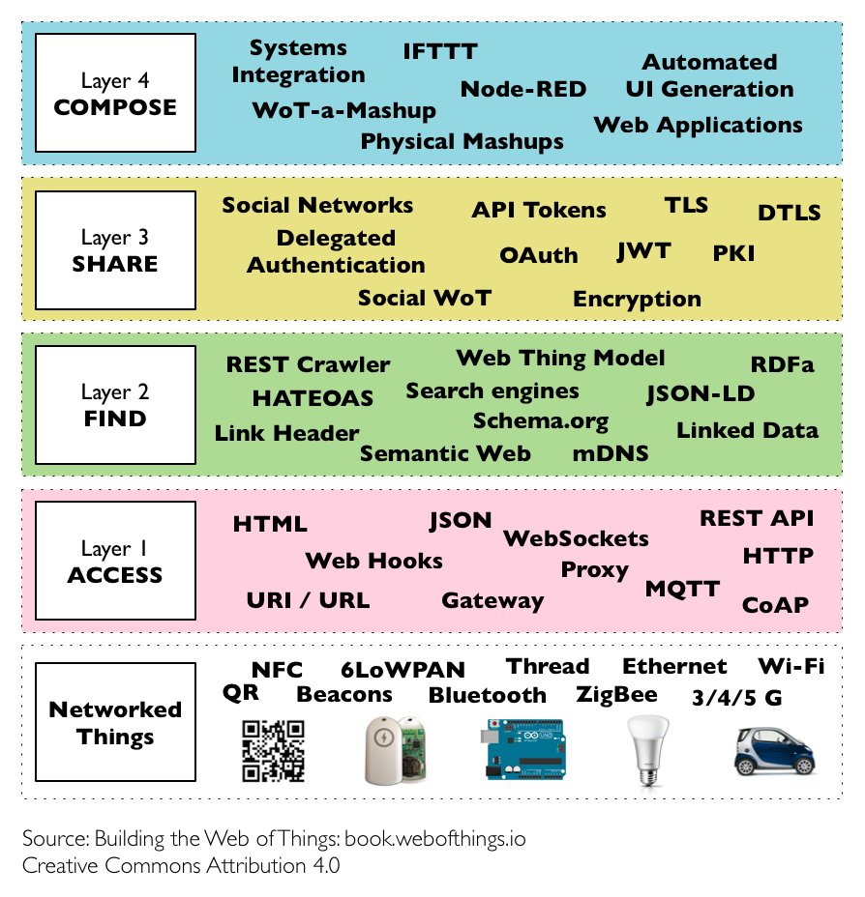
WoT Architecture
The architecture proposes four
main layers (or stages) that are
used as a framework to classify
the different patterns and
protocols involved.
- Accessebility Layer
- Findability Layer
- Sharability Layer
- Composability Layer

Slide 8
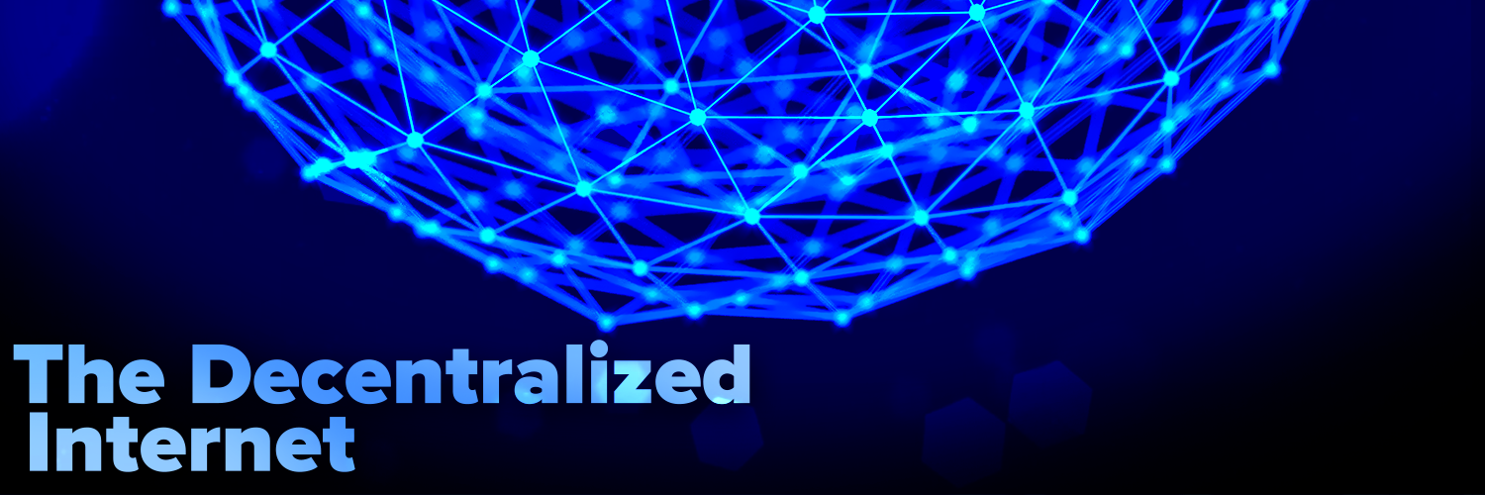
Decentralization
Decentralized internet is the idea that the web is run across a number of machines that are owned by regular users rather than owned in a central place like a server.
It is supposed to be like the web you know but without relying on centralised operators.
Individual user have the full control of there data instead of any big tech firms.

Slide 9

SoLiD
Solid (Social Linked Data) is a web decentralization project led by Tim Berners-Lee.
Solid (derived from "social linked data") is a proposed set of conventions and tools for building decentralized social applications based on Linked Data principles
Today’s web applications is centralized for a variety of reasons. User data became the source of power and income for Internet companies. Solid is a solution to this.
Solid allow users to have full control of their own data, including access control and storage location

Slide 10
SoLiD Specification: Identity(WebId)
Solid uses WebID URIs as universal usernames or actor identifiers.
WebIDs provide globally unique decentralized identifiers, enable cross-service federated signin, prevent service provider lock-in, and give users control over their own identity.
The WebID URI's primary function is to point to the location of a public WebID Profile document
Example WebIDs: https://chemnitz.databox.com/profile/card#me or http://somename.com/#webid

Slide 11
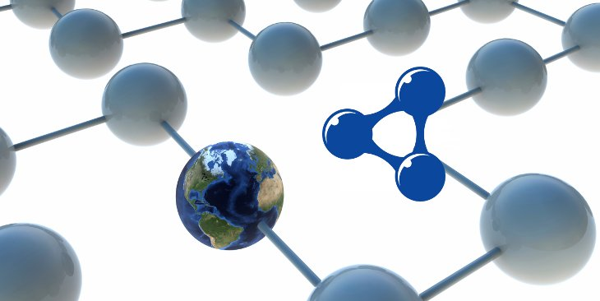
Linked Data
A structured data which is interlinked with other data so that become more useful through semantic queries.
Based on the RDF model, linked data views data as a collection and in relation to other data.
It provides a single standardized access mechanism for all involved and also is shareable, extensible and reusable, even on different results and different interfaces.

Slide 12
Linked Data applied to SoLiD

Slide 13
WoT Challenges

Slide 14
Existing Works

Slide 15
Motivation
Data Controls us

Slide 16
Introducing SoLiD to support WoT

Slide 17
The Proposed Framework 1

Slide 18
The Proposed Framework 2

Slide 19
The Demo

Slide 20
Conclusion

Slide 21

?

Slide 22
SoLiD
Conforms Linked Data Platform (LDP)
LDP Client
A HTTP Client: Follows LDP Resources and Containers specifications [1]
LDP Server
A HTTP Server: Follows LDP Resources and Containers specifications [1]

Slide 23

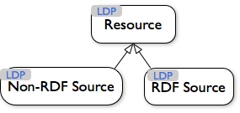
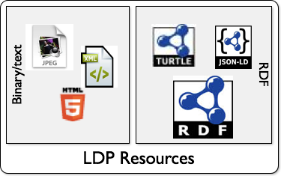
SoLiD: Content Representation
Two kinds of Resources
Linked Data resources
RDF in the form of JSON-LD, Turtle, HTML+RDFa, etc
Everything else
Binary data and non-linked-data structured text
Linked Data provides considerable benefits
In terms of interoperability with the rest of the Solid app ecosystem.

Slide 24
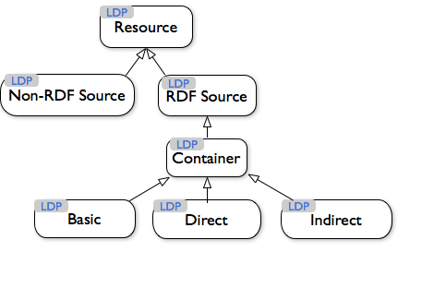
SoLiD: Content Representation
Resources are grouped in directory-like Containers

Slide 25
[1] https://www.w3.org/TR/ldp/#conformance

Slide 26
HTTP Protocol
HTTP Documents
Interfaces: GET/POST/PUT/DELETE etc
RDF Protocol
RDF Documents
Interface: SPARQL (On top of HTTP)

Slide 27
Secondly, the request-response nature of HTTP is often cited as one of the limitations for IoT use-cases as it does not match the event-driven nature of applications that are common in the Wireless Sensor Networks.[3][6][12] To overcome this shortcoming while keeping a focus on fostering integration with the Web, several authors have suggested the use of HTML5 WebSockets either natively or through the use of translation brokers (e.g., translating from MQTT or CoAP to WebSockets).[5][6][10][13] This complements the REST API of things with a publish subscribe mechanism that is largely integrated with the Web eco-system.
https://en.wikipedia.org/wiki/Web_of_Things

Slide 28
Application
TextBox: POD WEB ID
Discover
Discoverability
Actuating
Data Sharing

Slide 29
Question?

Slide 30
Demo

