Slide 1

A Survey on In-Memory KV Store Designs for Today’s Data Centers
Showan Asyabi
A Survey on In-Memory KV Store Designs for Today’s Data Centers

Slide 2





In-Memory KV Stores
Services
Cache
Backend
Low latency
High throughput
Keep load off of backend services
A caching server can replace tens of backend servers
RocksDB
Ad
RocksDB
Timeline
MYSQL
Rate Limiter
MYSQL
Memcached
100 us Latency
10 ms Latency
100 times lower latency

Slide 3
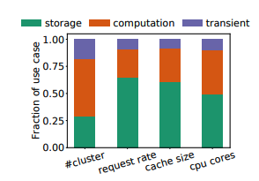
In-memory KV store use cases
Storage caching
Most common
Read heavy
Notably reduce the load of storage and databases systems
Computation caching
Example: stream processing systems and ML
Typically write-heavy and ephemeral
Transient data caching
hold objects that merely live in the cache
Rate limiters
A Survey on In-Memory KV Store Designs for Today’s Data Centers
/36

Slide 4
Memcached Architecture
Worker thread
Dispatcher thread
Hash Bucket
Object pointer
Object data
Slab chunks
5
1
2
LRU queue
3
4
Slab Class 1 (96 bytes)
LRU queue
d
Slab Class 2 (120 bytes)
Memcached API
c
e
LRU queue
Slab Class 3 (150 bytes)
b
Hash Table
a
1) High metadata
Index pointers
LRU pointers
TTL
Creation time
2) Internal fragmentation
At end of each chunk
At the end of slab
3) Scalability issuers
Locking
Dispatcher
/36

Slide 5
Workload Characterization
Object popularity
Object Size
Burstiness and Diurnal pattern
Workload Composition
TTL
A Survey on In-Memory KV Store Designs for Today’s Data Centers
/36

Slide 6
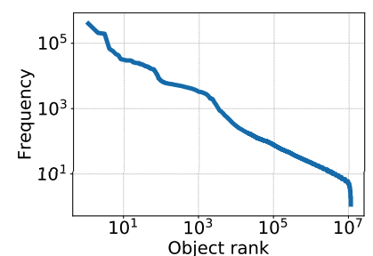
Object popularity
Twitter and Facebook their workloads follow Zipfian popularity
Informally, 80% of requests is for 20% of objects
Workloads with Zipfian popularity benefit more from the cache
/36

Slide 7
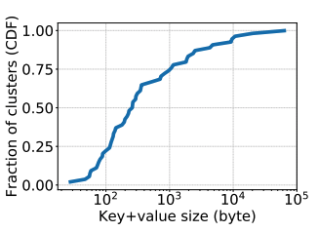
Object size
The average tweet size is 33B
Facebook reports significant fraction of objects is between 10B and 20B
The smaller objects -> Larger index and caching metadata
A Survey on In-Memory KV Store Designs for Today’s Data Centers

Slide 8
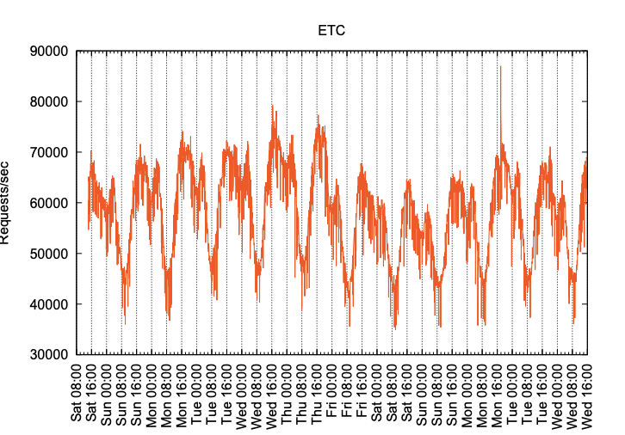
Diurnal Pattern
Both Facebook and Twitter report that the workload follows a daily pattern
Facebook’s traffic is quite bursty.
Burtsy workload→ Overprovisioning
Daily patter → Elastic KV stores
/36

Slide 9
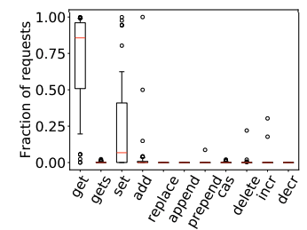
Workload Composition
Get and Set are the most dominant operations
90% of the operations are read operations
35% of Twitter cache nodes are write heavy
Scalability is challenging in write-heavy KV stores
/36

Slide 10
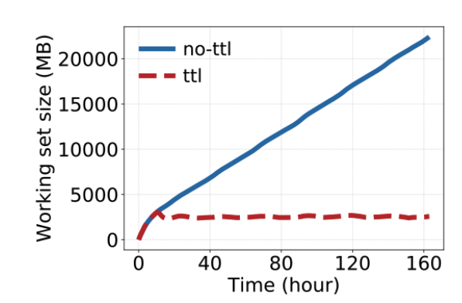
TTL (Time-to-live)
TTL indicates the expiration time
Data freshness
Comply with regulations such as GDPR
Timely removal of expired objects -> Higher memory efficiency

Slide 11
Memory Management
DRAM is expensive and energy-hungry
Memory allocation
Reduce metadata
Timely removal of expired objects
/36

Slide 12
Memory allocation
1) External memory allocation (e.g., Malloc ) ( Redis) -> External memory fragmentation
2) Slab-based memory allocation (Memcached) -> Internal memory fragmentation
3) Log-structures memory allocation –
Cache and write friendly
No fragmentation
Garbage collector (Costly)
Hash Table
Tail
Head
Log

Slide 13
Mica [NSDI 13]
Mica employ slog-structured memory allocation
Mica employs a circular log to reduce the cost of garbage collectors
Mica’s eviction algorithms is FIFO
might degrades the hit ratio
A Survey on In-Memory KV Store Designs for Today’s Data Centers
/36

Slide 14
Timely removal of expired object
Lazy expiration (Delete expired objects on access)
Straightforward
Low memory efficiency
LRU queue (Delete expired objects from the tail of LRU queues) – Memcached
LRU queues hampers thread scalability
Opportunistic
Low memory efficiency
Full cache scan
Costly
High memory efficiency
Random sampling (Randomly choose some items and delete the expired ones) - Redis
Costly
Low memory efficiency

Slide 15
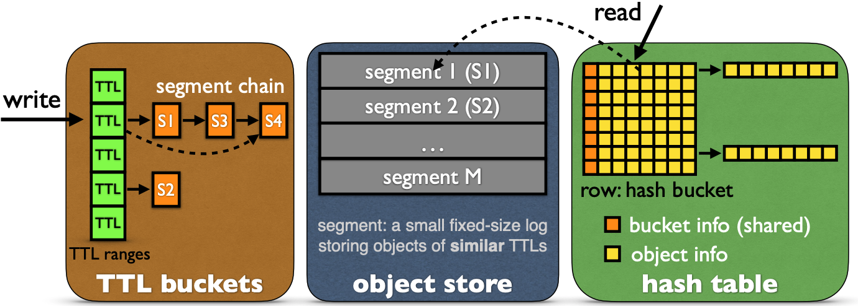
SegCache [NSDI 21]
Reduce the metadata -> macro management
Timely removal of expired objects

Slide 16
Elastic Memory Allocation
Multitenant KV store -> enhance data center utilization
Existing solution (MemShare- Amazon ElasticCache- Facebook) statistically partition their memory among application
Static partitioning is straightforward
Degrades the memory efficiency and performance
Elastic memory partitioning
Dynamically adjust memory share of tenants
A Survey on In-Memory KV Store Designs for Today’s Data Centers
/36

Slide 17

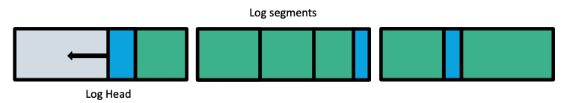
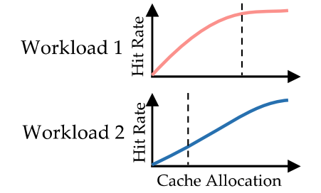
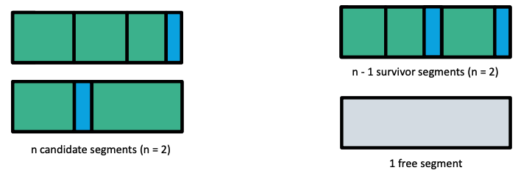
MemShare – Usenix ATC 17
1
Goal : Dynamic memory allocation in three steps
1) How much memory should be allocated to each application
2) How to enforce memory allocation
2
Track access frequency of recently evicted items
Higher access -> Need more memory
3

Slide 18
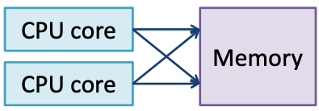
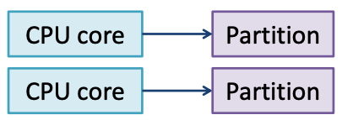
Scalability
Use multi-core systems to increase throughput
Faster servers -> mitigate the cost, power consumption, and data center footprint
Concurrent Write and Read
Exclusive Write
Load can be evenly distributed
High CPU scalability
Hampers CPU scalability (e.g., synchronization )
Degrades the performance under skewed workload
A Survey on In-Memory KV Store Designs for Today’s Data Centers

Slide 19
Mica [NSDI 13]
Client
Key 1
Key 2
NIC
Client
Key 2
Key 1
Mica also uses bulk chaining – Log structured memory allocators
A Survey on In-Memory KV Store Designs for Today’s Data Centers
/36

Slide 20
Power-proportional KV stores
Facebook’s ETC workload follows a diurnal pattern
long-term variations -> leverage power-proportional KV stores-> save power consumption
Microsecond-scale tail latency

Slide 21
Existing Approaches
CPUs feature several power saving modes called c-states
Feedback-based controllers
Controller
Application
OS

Slide 22
Peafowl [ SOCC 20]
Scheduler
Worker
An elastic in-memory KV store designed to exploit load variability to save power while maintaining low microsecond-scale tail latency
The key insight behind Peafowl’s design is to handle the scheduling in the application rather than the operating system
Peafowl’s main components:
Monitoring
Scale-up algorithm
Scale-down algorithm
Application
OS

Slide 23
Monitoring
Peak load
Load
Time
Peafowl dispatches newly created connections among workers in a round-robin fashion.
It assigns this initial worker as the connection’s home worker
Each worker learns the peak load
Peak load establish a baseline performance goal
Application
OS

Slide 24
Scale-Down Process
Load
Scale-down worker
Destination worker
Scale-down worker
Destination worker
Instruct the scale-down worker to transfer one connection to the destination worker
Moving connections one at a time
Once all connections are migrated, enables idle-state
Time
Application
OS

Slide 25
Scale-up Process
Load
When a worker’s load approaches its load limit , migrate guest connections to their home
Workers can independently respond to load increases immediately
This conservative approach allows Peafowl to maintain low tail latencies
Time
Application
OS

Slide 26
Hybrid KV Stores
Small objects are prevalent
working sets add up to TBs of data-> High DRAM consumption
Flash is persistent, cheaper, and more power-efficient
Flash 100X cheaper per bit
limited write endurance- > there is a limit on the number of writes before the Flash wears out.
Flash can be read and written only at multi-KB granularity (e.g., 4KB)
Write amplification
For example, writing a 100 B object requires writing a 4 KB flash page, amplifying bytes written by 40×
A Survey on In-Memory KV Store Designs for Today’s Data Centers
/36

Slide 27
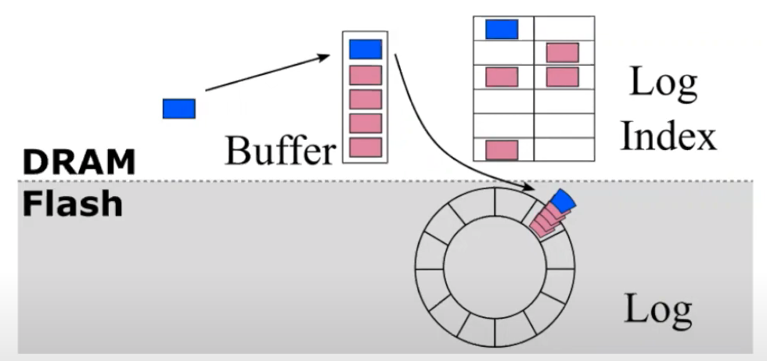
Log-Structured Design
Buffer all writes to minimize the number writes to Flash
Index in memory
30 bits per object and Object size = 100 bytes
2TB flash -> 75 GB index memory
A Survey on In-Memory KV Store Designs for Today’s Data Centers

Slide 28
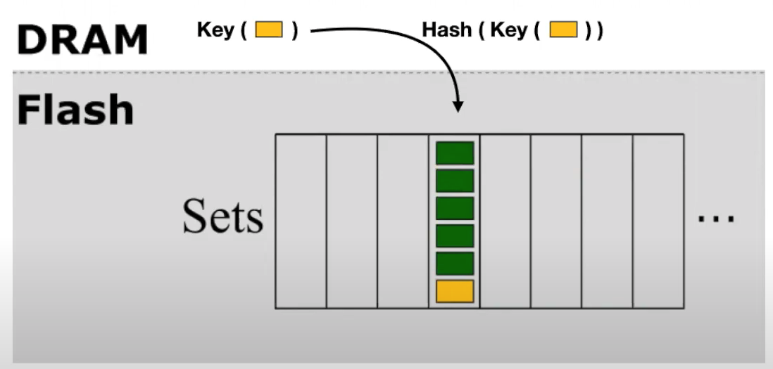
Set associative cache
No Index in memory -> High Memory efficiency
High write amplification (# bytes written / # bytes requests)
For example, for writing 100 B object= 4096/100 = 40
High Memory efficiency
)
A Survey on In-Memory KV Store Designs for Today’s Data Centers

Slide 29
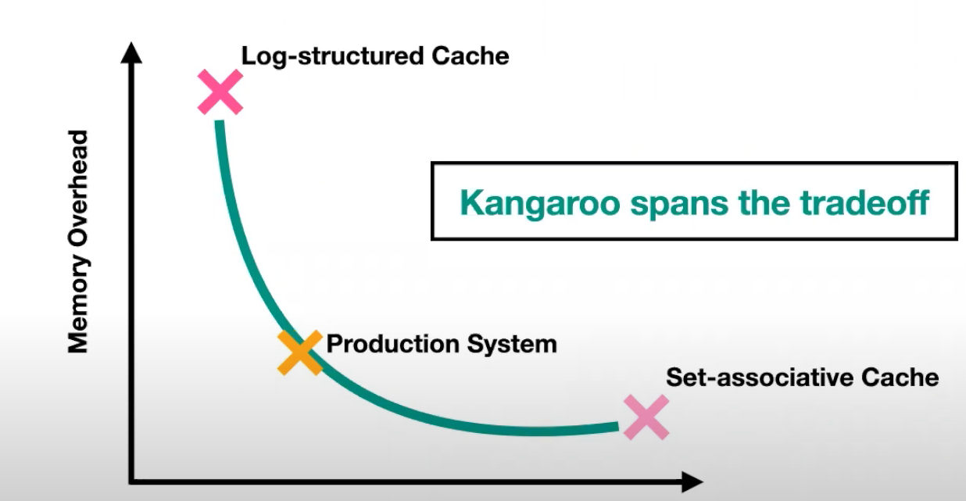
Kangaroo [sosp 21]
Write Amplification
A Survey on In-Memory KV Store Designs for Today’s Data Centers
/36

Slide 30
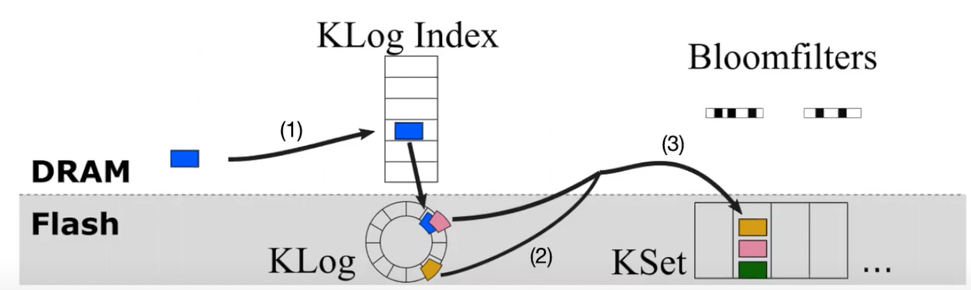
Kangaroo
/36

Slide 31
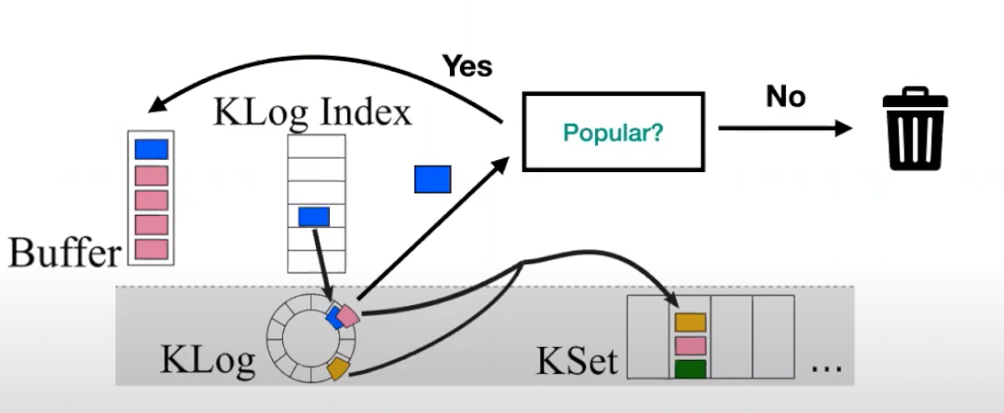
Threshold admission
A Survey on In-Memory KV Store Designs for Today’s Data Centers

Slide 32
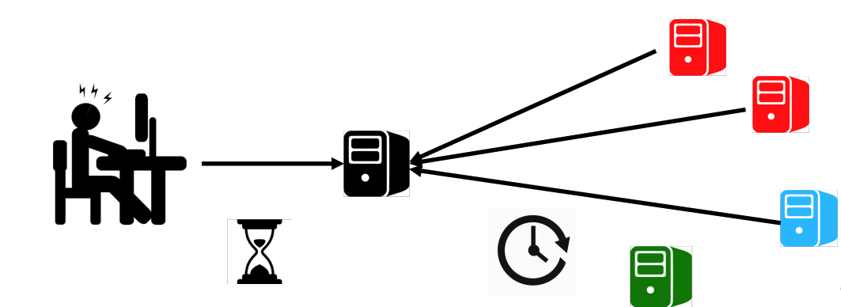
Tail latency
/36

Slide 33

Head-of-line blocking
Small Request
Large Request
/36

Slide 34
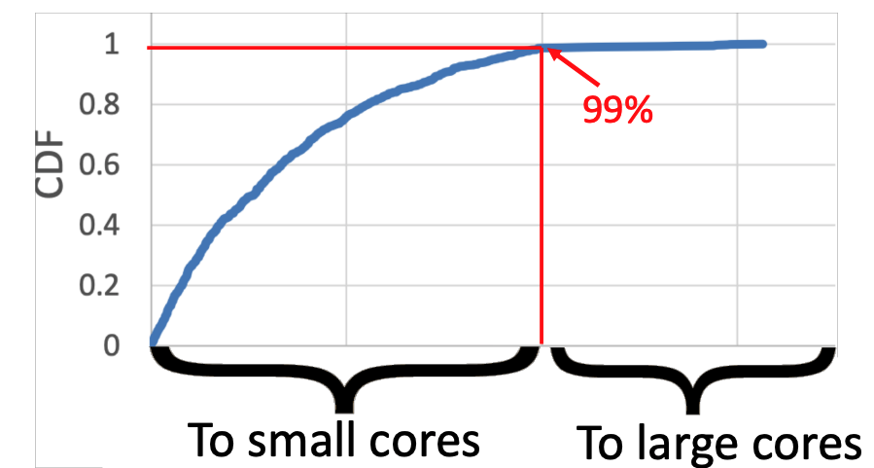
Sharding [NSDI 17]
Small Cores
K% of the load for small requests - > K% of cores to small cores›$
Large Cores

Slide 35
Future research
Elasticity
Persistent memory
Write-heavy workloads
Non-flat data structures
Benchmarking
A Survey on In-Memory KV Store Designs for Today’s Data Centers
/36

Slide 36
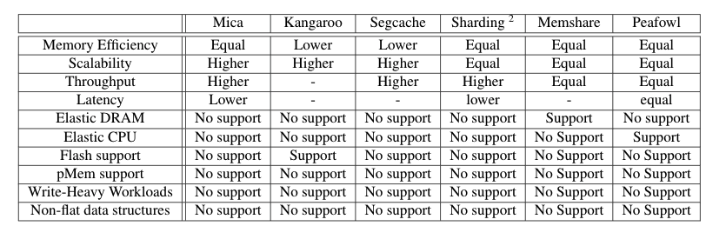
Surveyed works compared to Memcached
/36

Slide 37


