Slide 1

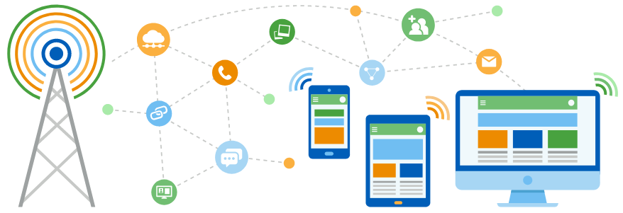
Faculty of Computing and Informatics
Department of Computer Science
IT Infrastructure Administration and Services
ITA711S
2023 - Semester 1
Event Specific Picture – behind red graphic
Chapter 2
Requirements

Slide 2
Outline
Requirement Analysis
Installation procedures
Security Issues

Slide 3
Classify & explain different types of servers
  Requirement analysis
  Hardware and software overview
  Installation procedure
  Configuration management
  Deployment and testing
  Security issues

Slide 4
Requirement Analysis
A good requirement analysis, reduces project risk and ensures a smooth flow of the project.
Factors to consider include:
  Scoping
    Understand system entities
    Define the problem/requirement
  Understand Non-Functional Requirements
    Usability, Scalability, Extensibility, Security, Performance, maintainability

Slide 5
Requirement Analysis
  Understand Functional Requirements
    Comprehend High Level Use Cases e.g. on a web-server, how will you handle it if 10000 users access the site at the same time.
    User Interface Needs
    Best Architecture and Technology Selection based on Client Requirements
  Best Protocol and Process Specifications
  Understand the Business Needs

Slide 6
Installation Procedures
Pre-Install
  Hardware Requirements
    Service requirements
    Assessing your application performance requirements
      level of activity expected on your server
      anticipated number of users
      number of requests
      acceptable response time
    Focus should be put on maximum performance requirements and set measurable objectives for capacity.

Slide 7
Installation Procedures
During Server installation
    Documentation
    Monitoring
    Configuring
Post-Install
    Third Party Software packages
    Parameter configuration
    Improving Application Performance

Slide 8
Installation Procedures
Services
  Capabilities of Servers
  Integrated services (UNIX and Windows)
    Data Security, continuity and backup/recovery solutions
    Disaster recovery planning
    Storage Area Networks / Storage management
    Application services: installation, configuration and troubleshooting
    E-mail systems / spam prevention
    File sharing solutions

Slide 9
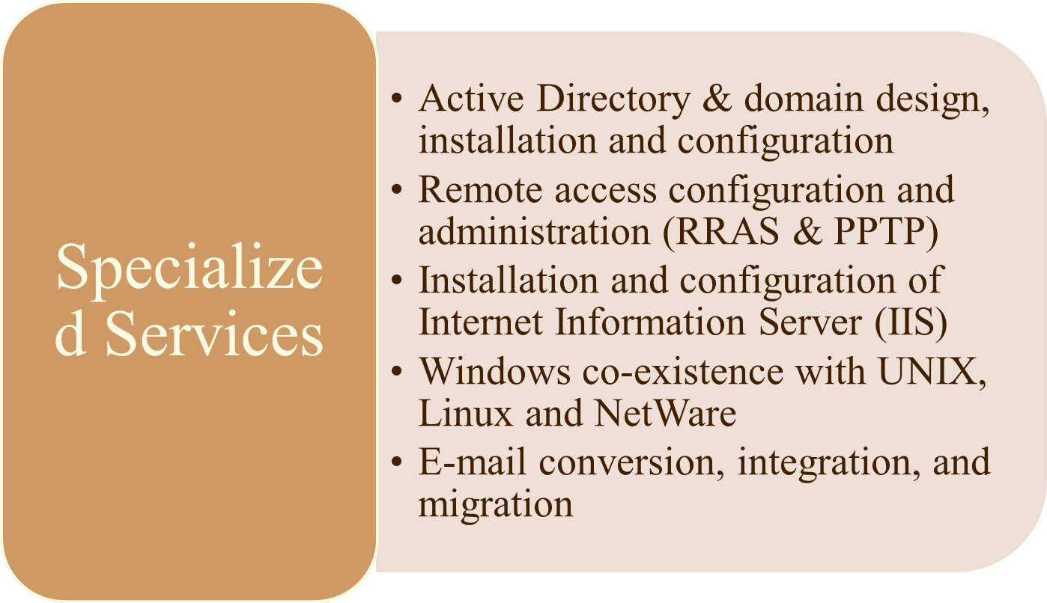
Installation Procedures

Slide 10
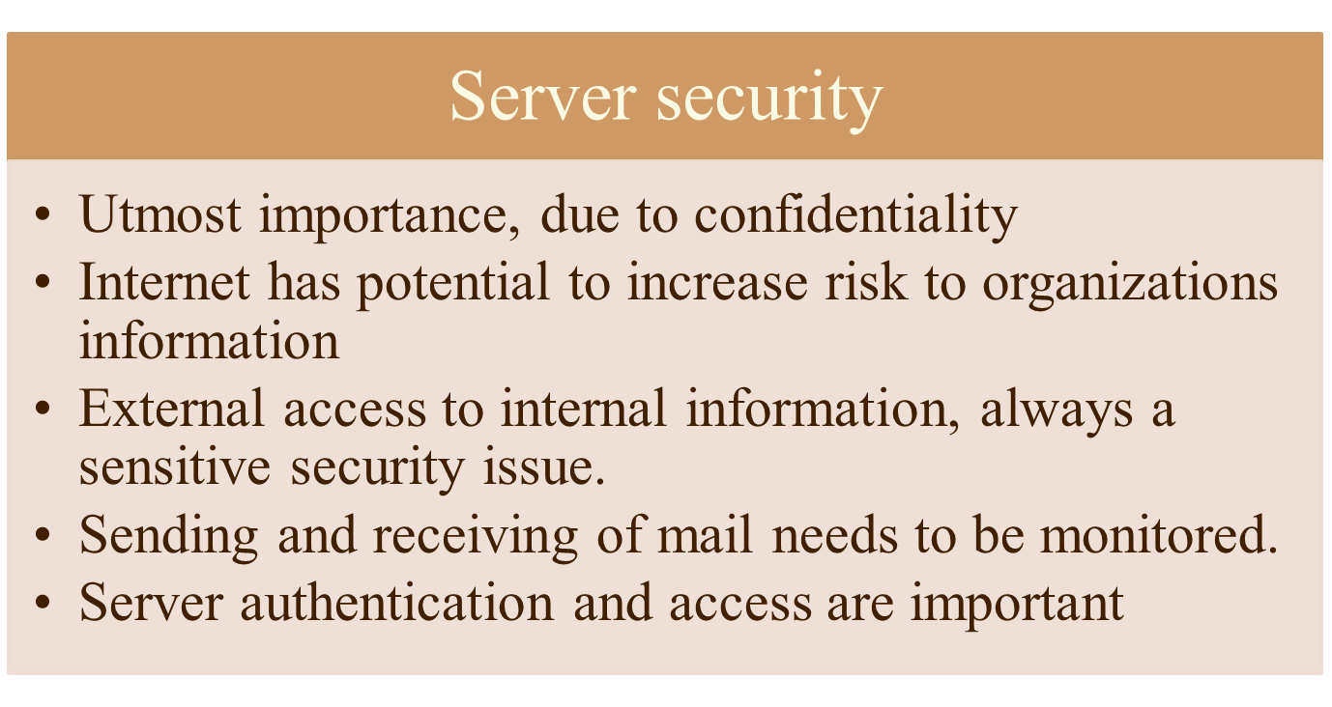
Security Issues

Slide 11
Security Issues
Some important areas to consider:
Internet - 'concerned with keeping things out' (Privacy and Intrusion Detection)
    Web Site authorization
      Restrictions through authentication mechanisms, use of HTTPS (Secure Socket Layer)
      FTP server with authentication to send or receive and SSL (FTP over SSL).
    Uncontrolled Environment

Slide 12
Security Issues
Some important areas to consider:
  Mail Encryption
    E-mail used to send sensitive information to save time
  Intranet - 'concerned with keeping things in' (Privacy and control)
    External access to internal files or vice versa
      Employee access
        Setup VPN, dial-up access
      Non-employee access
        VPN’s, dial-up lines, leased lines, unencrypted access (telnet)

Slide 13
Security Issues
  Some Common Security issues
    Malware (e.g. spyware)
    Cookies
    Zero day attack
    Zero hour attack
    Viruses
    Illegal access

Slide 14
Security Issues
Countermeasures:
  Firewalls
  Have anti-virus, anti-spy-ware, and cookie control
  Intrusion Detection System
  Intrusion Prevention System
  Firewall as security feature
  Third Party control/software
  ACL measures

Slide 15

End

