Slide 1

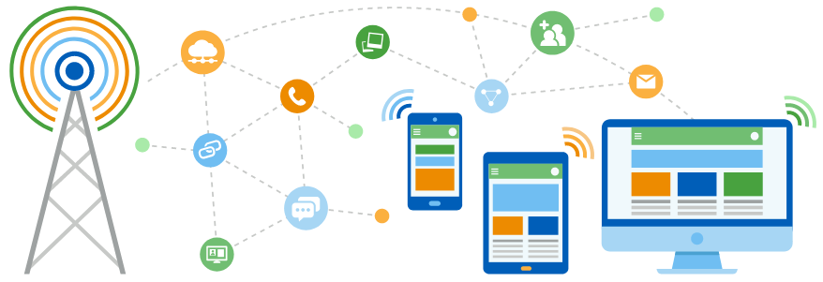
Faculty of Computing and Informatics
Department of Computer Science
IT Infrastructure Administration and Services
ITA711S
2023 - Semester 1
Event Specific Picture – behind red graphic
DHCP

Slide 2
Outline
Introduction
Overview
IP Address Allocation
Components of DHCP
DHCP Messages
DHCP Relay Agent
Configuring DHCP
Drawbacks of DHCP

Slide 3
Introduction
DHCP is a communication protocol that lets network administrators centrally manage and automate the assignment of Internet Protocol (IP) addresses in an organization’s network.
Basically it frees a network administrator from having to manually configure each host connected to the network.

Slide 4
Purpose
To deliver host-specific configuration parameters from a DHCP server to a host.
Allocation of network addresses to hosts.

Slide 5
Overview
DHCP is an application-layer protocol in the TCP/IP model.
DHCP is a UDP Service and it runs on port 67 and 68.
DHCP supports three mechanisms for IP address allocation.
      Automatic allocation
      Dynamic allocation
      Manual allocation

Slide 6
IP Address Allocation
Manual Allocation: The administrator assigns a pre-allocated IP address to the client and DHCP only communicates the IP address to the device.
Automatic Allocation: DHCP assigns a static IP address permanently to a device, An IP address, once associated with a MAC address, is permanently associated with it until the server's administrator intervenes.
Dynamic Allocation: DHCP dynamically assigns, or leases, an IP address from a pool of addresses for a limited period of time chosen by the server, or until the client tells the DHCP server that it no longer needs the address.

Slide 7
Components of DHCP
DHCP Server
DHCP Client
DHCP Relay Agent
  Used to facilitate the conversation if the DHCP server and the DHCP client are on different IP subnet.

Slide 8
DHCP must:
Guarantee unique network address.
Retain DHCP client configuration across a client reboot.
Allow automated assignment of configuration parameters to new clients.
Support fixed allocation of configuration parameters to specific clients.

Slide 9
DHCP Messages (1 of 3)
DHCPDISCOVER - Client broadcast to locate available servers.
DHCPOFFER - Server to the client in response to a DHCPDISCOVER. The server uses the DHCPOFFER message to "offer" an IP address, lease time, and network configuration parameters to the client.
DHCPREQUEST Sent by the client to the server in response to a DHCPOFFER. The "server identifier" field of the DHCPREQUEST indicates which server the client has chosen to further interact with. All servers that sent the client a DHCPOFFER receive the DHCPREQUEST. The ones that are not chosen simply use the message as notification that they have not been chosen. The server that is chosen responds to the request, either with a DHCPACK or a DHCPNAK.

Slide 10
DHCP Messages (2 of 3)
DHCPACK - Server to the client in response to a DHCPREQUEST. The DHCPACK indicates that the server "acknowledges" the request, and the DHCPACK message contains fields which indicate the IP address, lease time, and network configuration parameters that the client is being configured with.
DHCPNAK - Server to the client in response to a DHCPREQUEST. The DHCPNAK indicates that the server does not acknowledge the request, and does not agree to lease the specified IP address.

Slide 11
DHCP Messages (3 of 3)
DHCPRELEASE - Client to server to give up an IP address lease. If the client knows that it no longer needs an IP address, it should send the server a DHCPRELEASE.
DHCPDECLINE - Client to server in response to a DHCPACK. If the client receives a DHCPACK, but, for some reason, is not satisfied with the lease time and/or network parameters in the message, it can send the server a DHCPDECLINE indicating that it refuses to use the IP address.
DHCPINFORM - Client to server, asking only for local configuration parameters; client already has externally configured network address.

Slide 12
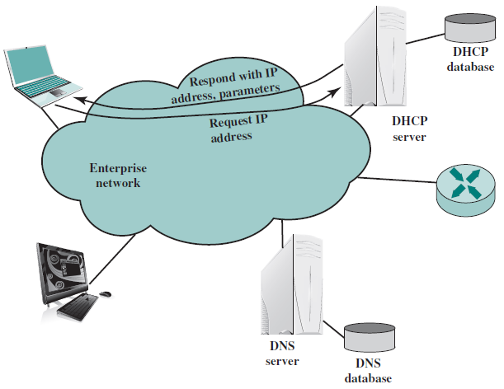
Basic DHCP Role

Slide 13
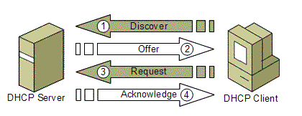
Dynamic allocation of a network address

Slide 14
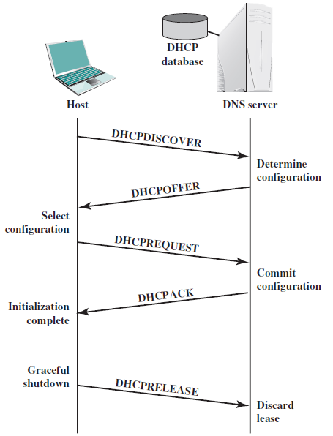
DHCP Message exchange

Slide 15
Even flow diagram
Two cases:
    Client-server interaction while allocating a new network address
    Client-server interaction while reusing previously allocated network address

Slide 16
DHCP Relay Agent
Typically the clients and DHCP servers are not in the same network segment.
Network administrators can configure a local router to forward DHCP packets to a DHCP server from a different subnet.

Slide 17
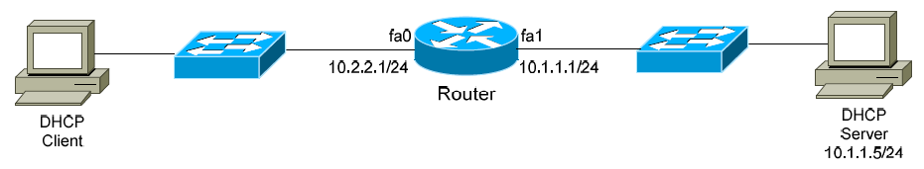
IP helper-address (Relay)
The router needs to be configured in such a way that whenever it receives a DHCP broadcast from a device that is not in the same network segment as the DHCP servers it forwards the packet to the DHCP servers.
On cisco routers you can configure the nearest interface to the device with ip helper-address command
Router(config)# interface fa0
Router(config-if)# ip helper-address 10.1.1.5

Slide 18
Additional DHCP Parameters
In addition to IP address and subnet mask information, DHCP can provide the following protocol parameters:
• Default Gateway
• Domain Name and DNS servers
• Time Servers
• WINS servers

Slide 19
Configuring DHCP
Creating a pool:
  Router(config)# ip dhcp pool MYPOOL
  Router(dhcp-config)# network 192.168.1.0 255.255.255.0
Excluding specific addresses from being leased:
  Router(config)# ip dhcp excluded-address 192.168.1.1
  Router Router(config)# ip dhcp excluded-address 192.168.1.5 192.168.1.10
Specifying the duration of the DHCP lease:
  Router(config)# ip dhcp pool MYPOOL
  Router(dhcp-config)# lease 1 12

Slide 20
Drawbacks of DHCP
When DHCP server is unavailable, client is unable to access enterprises network
The machine name does not change when it gets a new IP address
Hard to keep information on and used IP addresses
Uses UDP, an unreliable and insecure protocol.
When connecting to a network, the user is not required to provide credentials in order to obtain a lease.
Malicious users with physical access to the DHCP-enabled network can instigate a denial-of-service attack on DHCP servers by requesting many leases from the server, thereby depleting the number of leases that are available to other DHCP clients

Slide 21

End

