Slide 1

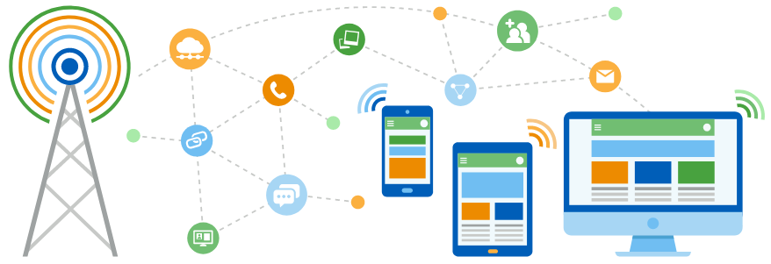
Faculty of Computing and Informatics
Department of Computer Science
IT Infrastructure Administration and Services
ITA711S
2023 - Semester 1
Event Specific Picture – behind red graphic
Chapter 7
Web Servers

Slide 2
Outline
Web servers
Web sites
Web hosting
Examples
Configurations terms/commands

Slide 3
Web servers
A web server is software and hardware that uses HTTP (Hypertext Transfer Protocol) and other protocols to respond to client requests made over the World Wide Web.
The main job of a web server is to display website content through storing, processing and delivering webpages to clients/users.
Web server software is accessed through the domain names of websites and ensures the delivery of the site's content to the requesting user.
Three primary uses of web servers:
  Hosting websites or web applications.
  Process File Transfer Protocol (FTP) requests.
  Send and receive emails.

Slide 4
How does a web server works?
A user enters the URL or domain name of the web site they want to access in the web browser.
The browser translates the URL or domain name into an IP address and sends a HTTP/HTTPS request to the web server providing the service.
The web server will send back the requested file via HTTP. If, in case, the file does not exist, an error message will be sent.
The browser displays the web page.

Slide 5
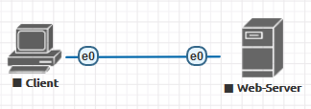
Web server

Slide 6

Common web server software
Apache HTTP Server
Microsoft Internet Information Service (IIS)
Nginx
Lighttpd
Sun Java System web server
Google Web Server (GWS)
Novell’s Netware server
Apache Tomcat

Slide 7
Choosing a web server
Physical capability of the server (storage, RAM, computing power, etc.)
Security characteristics
Operating system
Ability to work with other servers
High throughput
Low latency

Slide 8
Web site tools
Joomla
Drupal
Dreamweaver
WordPress
Wix
Webflow
Nova
Google web designer
Figma

Slide 9
Web hosting
Process where a web hosting provider stores and maintains website files and applications on a server so that clients can access it from the internet.
Web hosting requires the use of one or more servers to serve as the web host.
Web hosting providers are required to have the needed technology and resources in order to ensure a website's efficiency and continuous operation.
A hosting provider must obtain accreditation from the Internet Corporation for Assigned Names and Numbers (ICANN).
Research some web hosting companies in Namibia.

Slide 10
Web hosting
Choosing a web hosting provider:
Pricing
Security
Bandwidth allowance
Uptime / reliability
Maintenance / upgrade
Customer support
Backup

Slide 11
Service profile: HTTPD
Apache HTTP server configuration:
Daemon: httpd
Packages: httpd, httpd-manual
Configuration: /etc/httpd, /var/www
Module Configuration: /etc/httpd/conf/httpd.conf
Port(s): 80, 443

Slide 12
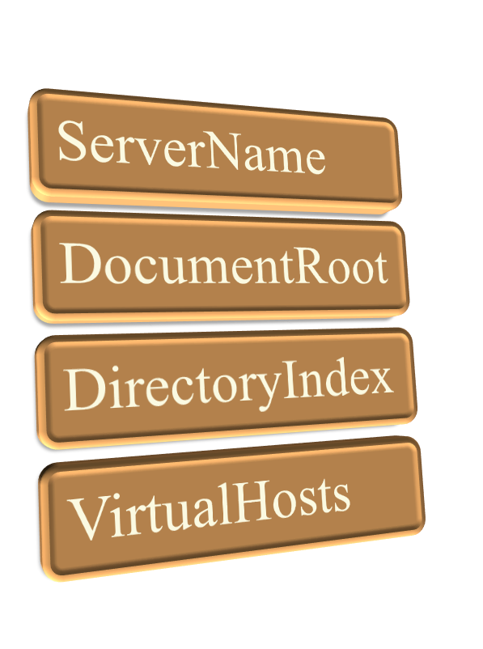
Configuration terms

Slide 13
Commands
Service httpd <options>
      start
      stop
      restart
      reload
      configtest
      apachectl -t

Slide 14

End

