Slide 1
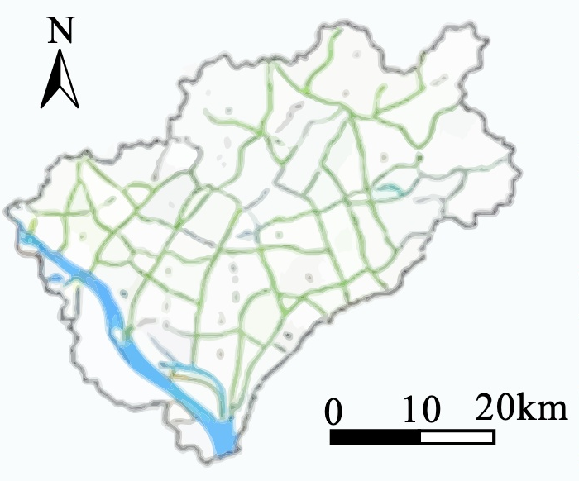



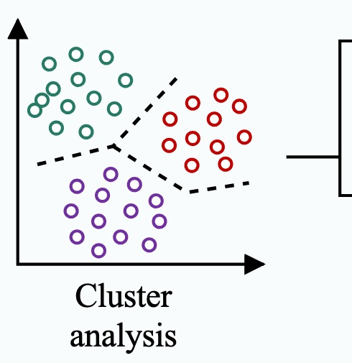









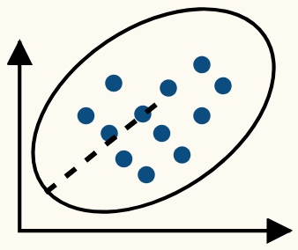




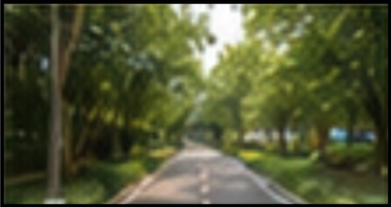




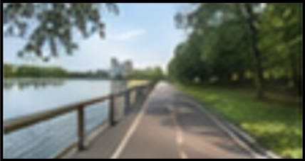





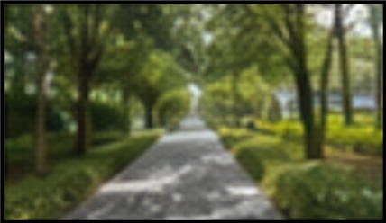



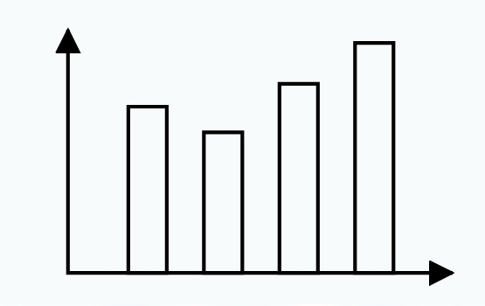
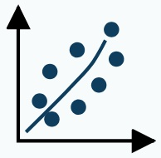

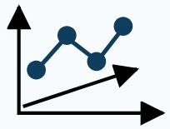









Research framework: How greenway landscape characteristics affect visual-thermal perception in Guangzhou, China
Step 1: Greenway image database construction and type identification
1
Study area and data acquisition
2
Semantic segmentation of greenway scenes
3
Greenway typology and prototype selection
Guangzhou greenway network
Urban greenways
OSM official greenway
planning data
Community leisure
Roadside
Baidu street view sampling
every 50 m
DeepLab v3+
Open
Countryside greenways
ADE20K dataset
Waterfront forest
Mountain exploration
8,428 images collected;
2,994 valid panoramic images
Quantification of visual elements
Community leisure greenway
selected as the VR prototype
...
Sky
Trees
Road
Buildings
Water
Other
Step 2: Construction of visual-thermal landscape feature indicators
1
Candidate factor extraction
2
Questionnaire screening and dimension reduction
3
Expert confirmation and final indicator system
Derived from
Interview and
17 experts/students
semantic results
UAV-video-assisted review
consulted
Derived from
Final 7 dimensions and 10 key factors
Plant
density
19 candidate
literature
Environmental
naturalness
Water
visibility
Plant color
richness
Plant
morphology
landscape
Derived from linear
306 valid
Reliability
Principal component
Sky
shading
factors
greenway characteristics
questionnaires
analysis
analysis(PCA)
Road material
naturalness
Surrounding
environment type
Sky
condition
Greenway
curvature
Step 3: Field validation and VR-climate chamber experiment
1
Outdoor field measurements
2
VR platform feasibility validation
3
Controlled VR experiment under thermal conditions
3 typical scenes on a
1:1 scene reconstruction
Consistency results
Pretest based on 12 monthly
typical meteorological days
campus community greenway
with MARS2020
Temperature difference
< 0.5 °C
83 participants,
randomized into
3 groups
Microclimate: Ta, RH, Va,
3 thermal conditions:
cold(December),
hot(June), moderate(August)
Tg.MRT
Immersive display by
Humidity difference < 2%
Subjective survey
HTC VIVE
Blood pressure difference
< 4 mmHg
30 min adaptation+
5 min observation
per scene
physiological measurements
Compare real vs.
11 standardized VR scenes:
1 base scene+ 10 single-
factor scenarios
40 participants
virtual environment
Most subjective vote
differences 8%
Step 4: Coupling analysis and design implication extraction
1
Statistical analysis
2
Mechanism identification
3
Key findings and design outputs
Pearson correlation analysis
Coupling between perception and satisfaction
Water visibility is the most influential
cross-dimensional factor
Multiple linear regression
Visual
perception
Thermal
perception
Overall
satisfaction
Important factors: environmental
naturalness, road material naturalness,
greenway curvature, sky shading,
plant density
Comparison across thermal
conditions and scenarios
Overall satisfaction 0.659 × visual satisfaction + 0.344 × thermal satisfaction
Output: evidence for visual-thermal
integrated greenway design and
climate-adaptive planning in hot-humid cities
Core contribution: an integrated workflow linking image analytics, field measurement, VR validation,
controlled experimentation, and perception-coupling analysis for climate-adaptive greenway design.

