Slide 1
Software Requirements Specification Research & Development (RND) Department Prepared by Supervised by Showkat Ali Md. Rajaul Islam ID : 1247484 Used Technology Primefaces, Hibernate, JSF Java, Netbeans,& Mysql

Slide 2
Requirements
Mr. Alamgir Hossain has a textile mill. He is running his mill from many days. The world has changed. At present every textile mill they are trying to be digitalized. So, they are going to software company for buying soft ware by which they can able to paly there textile mill smoothly and digitally. There will have employees detail, workers detail & overview of total productivity.

Slide 3
Requirement analysis Have to buy thread to produce fabric. Have to buy chemical to dye fabric. Have to have summary of all production. Have to knit fabric. Have to dye fabric.

Slide 4
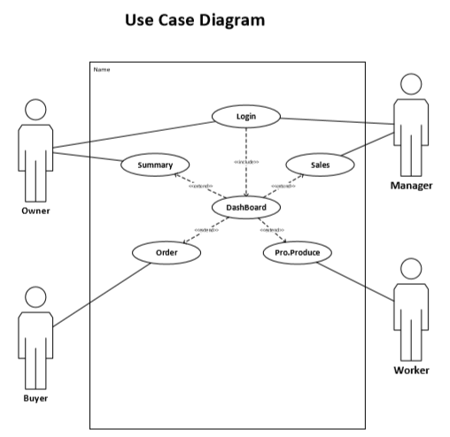

Slide 5
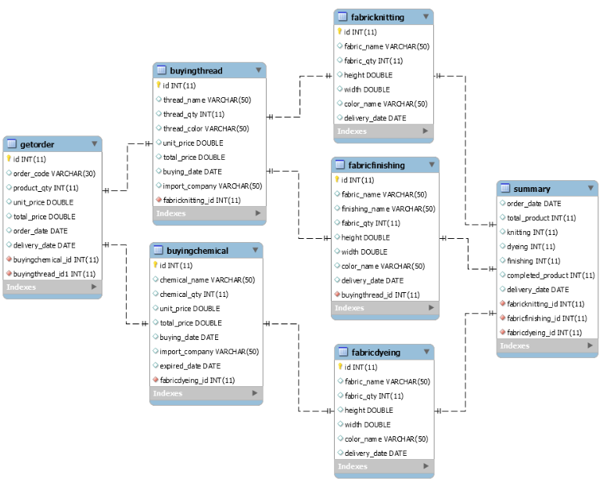
Class Diagram

Slide 6
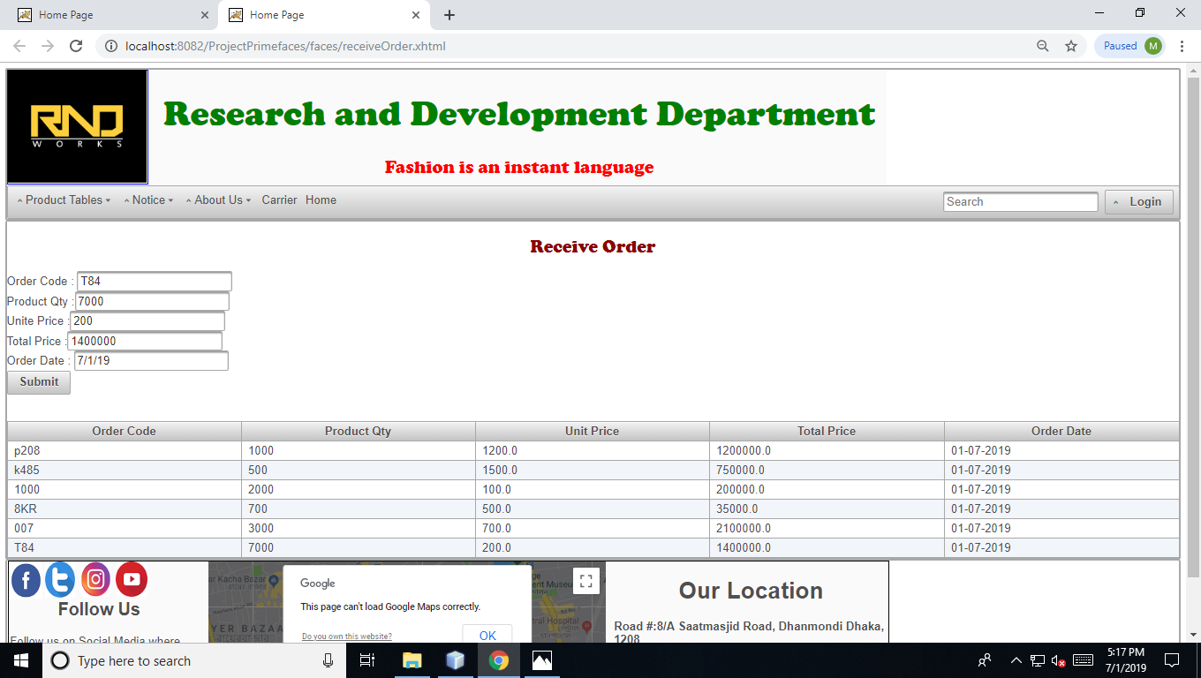
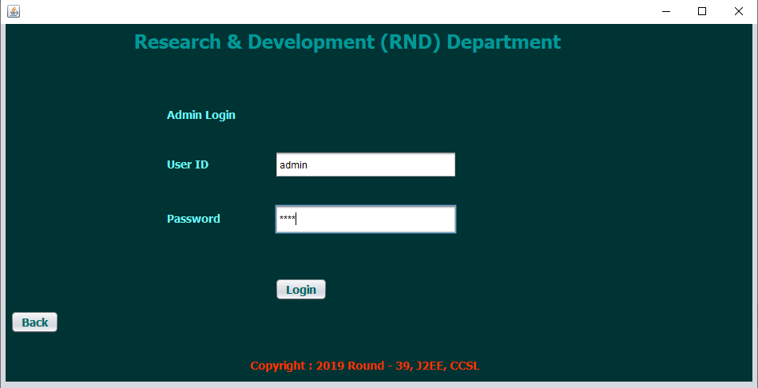

Slide 7
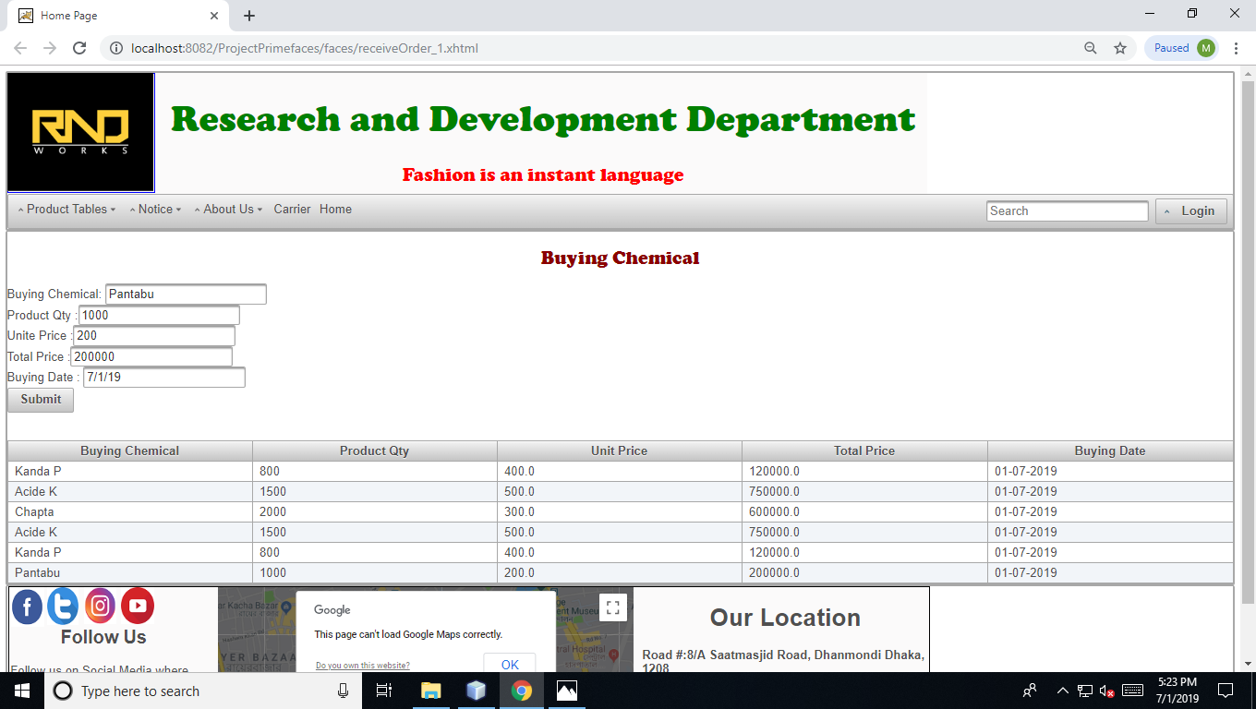

Slide 8


Slide 9
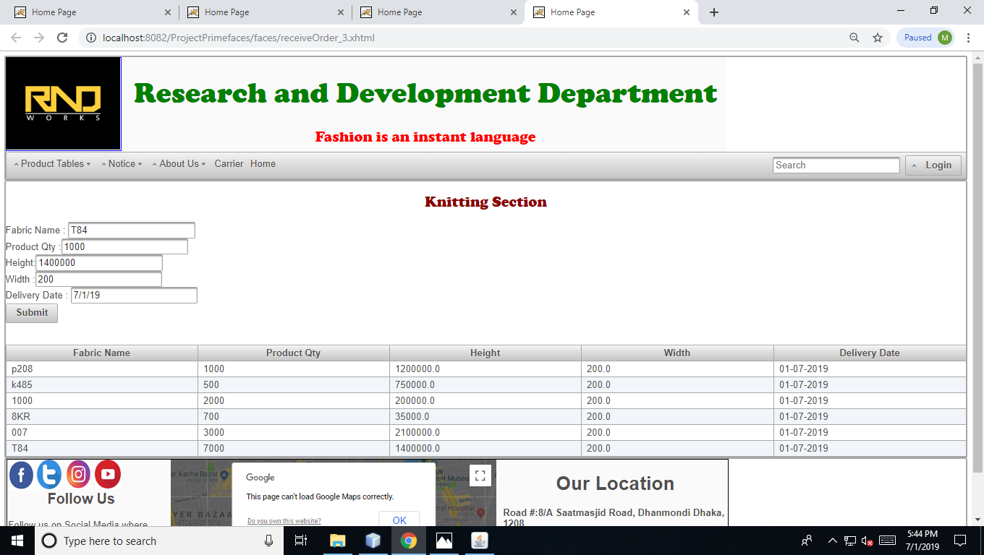

Slide 10
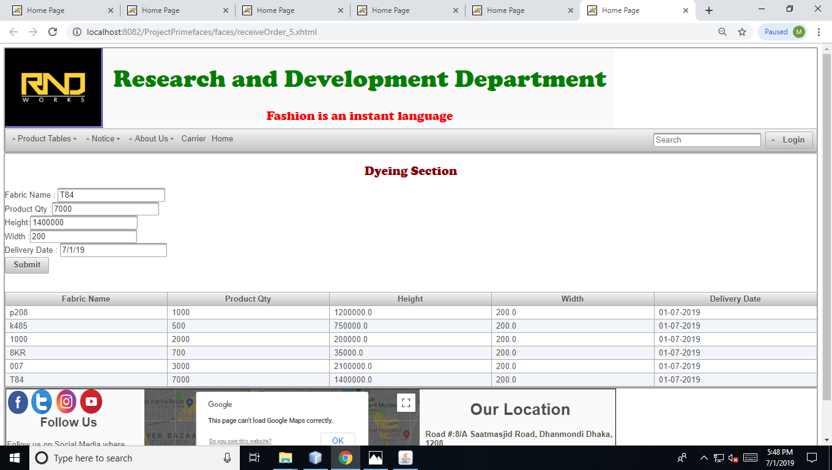

Slide 11


Slide 12
