Slide 1

Data Structure
Overview of Trees
Tapas Kumar Maiti
Asst. Prof, CSE & IT
CEM, Kolaghat

Slide 2
Overview
Binary Search Tree
2-3 Trees
2-3-4 Trees
Red-Black Trees
AVL Trees
General Trees
N-ary Trees
B-Trees
B+ Tress
Digital Search Tress

Slide 3
AVL Tree: Remarks
The height of an AVL tree with n nodes will always be close to the theoretical minimum of ⎡ log₂ (n + 1) ⎤ .
Consequently, search, insertion and deletion can all be done efficiently as O( log n ) operations.
Also, no extra space needs to be reserved in each node for potential, future items, as in a 2-3 tree or 2-3-4 tree.
However, implementation of a 2-3-4 tree or a red-black tree will usually be simpler than the implementation of an AVL tree.

Slide 4
General Trees
General trees are similar to binary trees, except that there is no restriction on the number of children that any node may have.
One way to implement a a general tree is to use the same node structure that is used for a pointer-based binary tree. Specifically, given a node n,
  n’s left pointer points to its left-most child (like a binary tree) and,
  n’s right pointer points to a linked list of nodes that are siblings of n (unlike a binary tree).

Slide 5
General Trees: Example
A
B
C
D
E
F
G
H
I
A
A general tree
B
C
D
E
F
G
H
I
Pointer-based implementation of the general tree

Slide 6
General Trees: Example (Cont’d.)
A
Binary tree with
the pointer structure
of the preceding
general tree
B
C
E
D
F
H
A
G
I
B
C
D
E
F
G
H
I

Slide 7
N-ary Trees
An n-ary tree is a generalization of a binary tree, where each node can have no more than n children.
Since the maximum number of children for any node is known, each parent node can point directly to each of its children -- rather than requiring a linked list.
This results in a faster search time (if you know which child you want).
The disadvantage of this approach is that extra space reserved in each node for n child pointers, many of which may not be used.

Slide 8
N-ary Trees: Example
A
An n-ary tree
with n = 3
B
C
D
E
F
G
H
I
A
B
C
D
E
F
G
H
I
Pointer-based implementation of the n-ary tree

Slide 9
Multi-way Tree
A multi-way (or m-way) search tree of order m is a tree in which
  Each node has at-most m subtrees, where the subtrees may be empty.
  Each node consists of at least 1 and at most m-1 distinct keys
  The keys in each node are sorted (ordered).
k₁
k₂
k₃
. . .
k_{m-2}
k_{m-1}
T₀
T₁
T₂
T_{m-2}
T_{m-1}
key < k₁
k₁ < key < k₂
k₂ < key < k₃
k_{m-2} < key < k_{m-1}
key > k_{m-1}
The keys and subtrees of a non-leaf node are ordered as:
T₀, k₁, T₁, k₂, T₂, . . . , k_{m-1}, T_{m-1} such that:
  All keys in subtree T₀ are less than k1.
  All keys in subtree T_{i} , 1 <= i <= m - 2, are greater than k_{i} but less than k_{i+1}.
  All keys in subtree T_{m-1} are greater than k_{m-1}

Slide 10
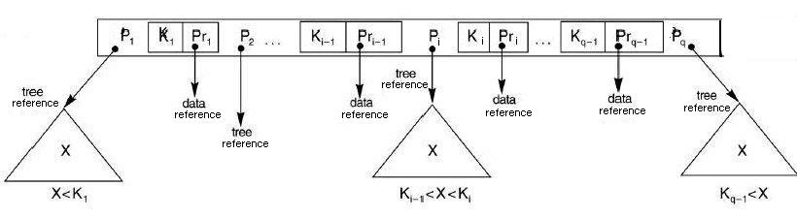
The node structure of a Multi-way tree
Note:
  Corresponding to each key there is a data reference that refers to the data record for that key in secondary memory.
  In our representations we will omit the data references.
  The literature contains other node representations that we will not discuss.

Slide 11
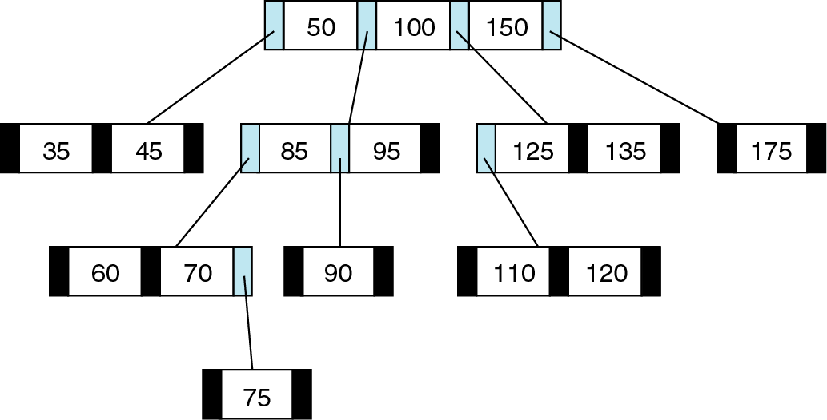
Examples of Multi-way Trees
Note: In a multiway tree:
  The leaf nodes need not be at the same level.
  A non-leaf node with n keys may contain less than n+1 non-empty subtrees.

Slide 12
Multi-way Searching
Similar to binary searching
  If search key s<k₁ search the leftmost child
  If s>k_{d-1} , search the rightmost child
That’s it in a binary tree; what about if d>2?
  Find two keys k_{i-1} and k_{i} between which s falls, and search the child v_{i}.
What would an in-order traversal look like?
Searching
22
for
s
= 8
Searching
for
s
= 12
5
10
25
3 4
27
3
4
6
8
14
23
24
11
13
17
18
19
20
21
Not found!

Slide 13
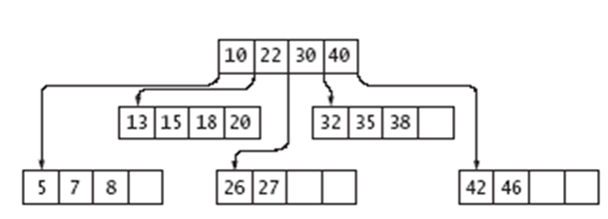
B-Trees
A B-tree of order m is a multi-way tree of order M where each node has at most m children, and a node can hold up to m-1 values
  a more general version of a 2-3 tree / 2-3-4 tree
B-Trees are most commonly used in databases and file systems
  most nodes are stored in secondary storage such as hard drives
It has following structural properties.
  The root is either a leaf or has
  at least 2 subtrees.
  - All nonroot nodes have at least
  m/2 branches.
  - All leaves are at the same level.
The first constraint ensures that the tree branches out at the root.
The second constraint ensures that each node of the tree is at least half full.
The third constraint keeps the tree nearly balanced.

Slide 14
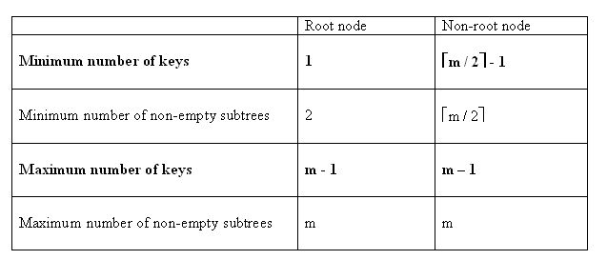
B-Trees (Contd …)
B-tree is a perfectly balanced m-way search tree with the following properties:
  1. The root is not a leaf : It has 2 . . . m subtrees.
  2. All internal nodes have at least (Ceiling |m/2|) non-null subtrees with (Ceiling |m/2|-1) key entries and at most m non-null subtrees with m-1 key entries.
  3. All leaf nodes are at the same level; that is the tree is perfectly balanced.
  4. A leaf node has at least (Ceiling |m/2|-1) and at the most m-1 key entries.
The following table defines the number of subtrees for non-root nodes:
This may be zero, if the node is a leaf as well
Order
No of Subtrees
Min
Max
3
2
3
4
2
4
5
3
5
6
3
6
...
...
...
m
Ceiling |m/2|
m
These will be zero if the node is a leaf as well

Slide 15
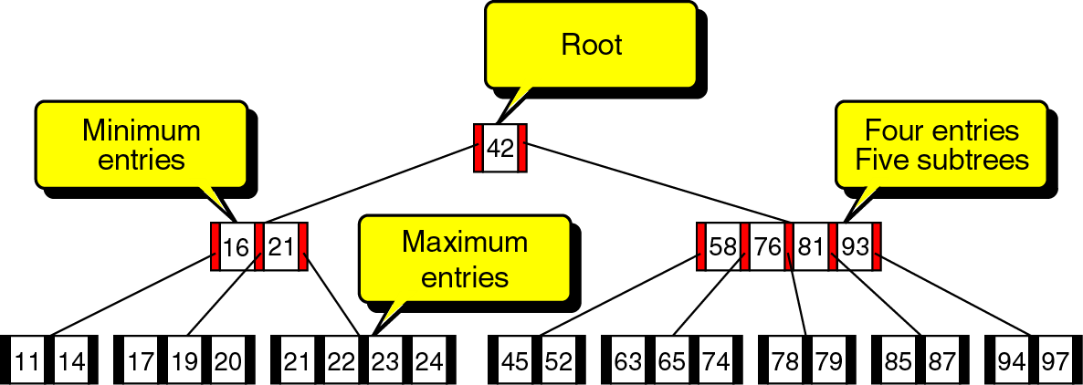
B-Trees
A B-tree of order; m=5.
Min entry : Ceiling|5/2| - 1 = 2 entries.
Max entry: 5 – 1 = 4 entries.
Min subtrees : Ceiling|5/2|=3
Max subtrees: 5

Slide 16
Why B-Trees ?
B-trees are suitable for representing huge tables residing in secondary memory because:
  With a large branching factor m, the height of a B-tree is low resulting in fewer disk accesses. Any nodes that are passed as parameters must already have had a Disk-Read operation performed on them.
  Note: As m increases the amount of computation at each node increases; however this cost is negligible compared to hard-drive accesses. The root of the B-tree is always in main memory, so that a Disk-Read on the root is never required; a Disk-Write of the root is required, however, whenever the root node is changed.
  The branching factor can be chosen such that a node corresponds to a block of secondary memory.
  The most common data structure used for database indices is the B-tree. An index is any data structure that takes as input a property (e.g. a value for a specific field), called the search key, and quickly finds all records with that property.

Slide 17
Comparing B-Trees with AVL Trees
The height h of a B-tree of order m, with a total of n(≥ 1) keys, satisfies the inequality:
        h <= 1 + log _{⎡m / 2⎤} ((n + 1) / 2)
The important thing to notice is that the height of the tree is log base t. So, as t increases, the height, for any number of nodes n, will decrease.
If m = 300 and n = 16,000,000 then h ≈ 4.
Thus, in the worst case finding a key in such a B-tree requires 3 disk accesses (assuming the root node is always in main memory ).
The average number of comparisons for an AVL tree with n keys is log n + 0.25 where n is large.
If n = 16,000,000 the average number of comparisons is 24.
Thus, in the average case, finding a key in such an AVL tree requires 24 disk accesses.

Slide 18
Insertion in B-Trees
OVERFLOW CONDITION:
A root-node or a non-root node of a B-tree of order m overflows if, after a key insertion, it contains m keys.
UNDERFLOW CONDITION
A non-root node of a B-tree of order m underflows if, after a key deletion, it contains ⎡m / 2⎤ - 2 keys
The root node does not underflow. If it contains only one key and this key is deleted, the tree becomes empty.
Insertion algorithm:
If a node overflows, split it into two, propagate the "middle" key to the parent of the node. If the parent overflows the process propagates upward. If the node has no parent, create a new root node.
Note: Insertion of a key always starts at a leaf node.

Slide 19
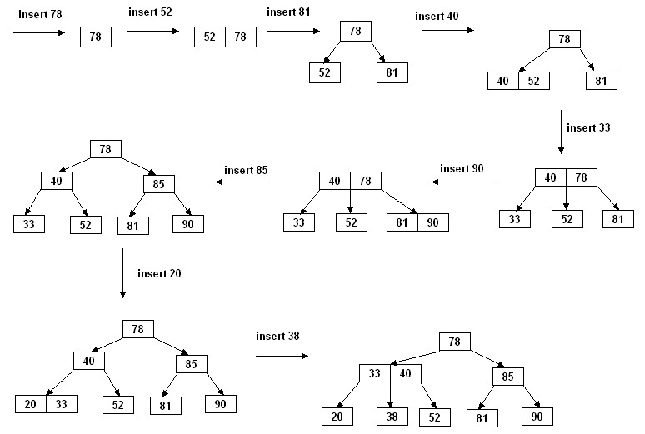
Insertion in B-Trees (Contd …)
Insertion in a B-tree of odd order
Example: Insert the keys 78, 52, 81, 40, 33, 90, 85, 20, and 38 in this order in an initially empty B-tree of order 3

Slide 20
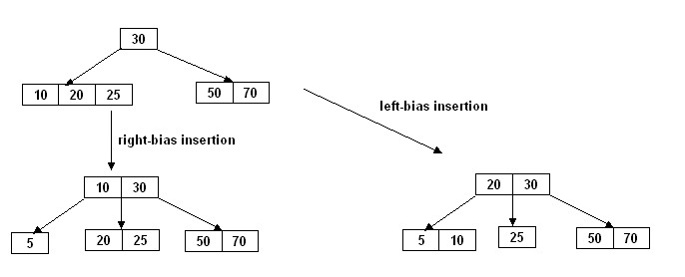
Insertion in B-Trees (Contd …)
Insertion in a B-tree of even order
At each node the insertion can be done in two different ways:
right-bias: The node is split such that its right subtree has more keys than left subtree.
left-bias: The node is split such that its left subtree has more keys than the right subtree.
Example: Insert the key 5 in the following B-tree of order 4:

Slide 21
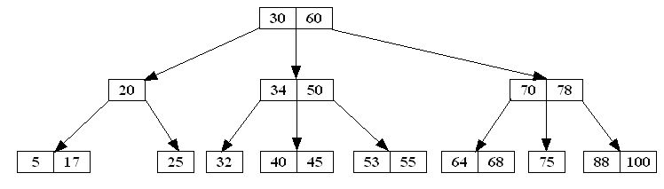
Deletion in B-Tree
Like insertion, deletion must be on a leaf node. If the
key to be deleted is not in a leaf, swap it with either
its successor or predecessor (each will be in a leaf).
The successor of a key k is the smallest key
greater than k.
The predecessor of a key k is the largest key
smaller than k.
In aB-Tree the successor and predecessor, if any, of any key is in a leaf node.
key | predecessor | successor
20 | 17 | 25
30 | 25 | 32
34 | 32 | 40
50 | 45 | 53
60 | 55 | 64
70 | 68 | 75
78 | 75 | 88
Example: Consider the following B-tree of order 3:

Slide 22
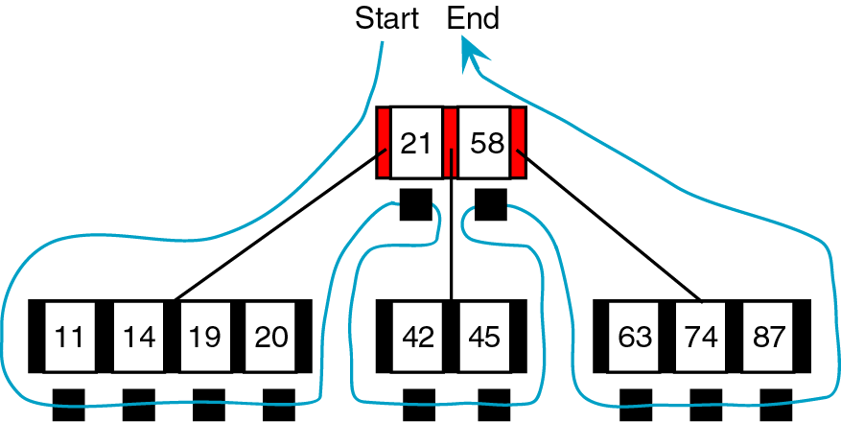
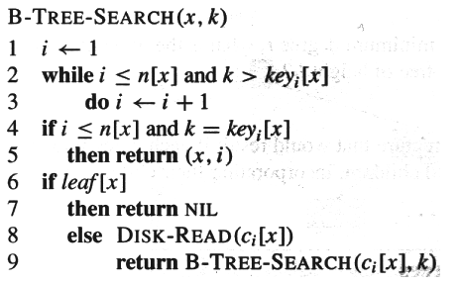
Traversal and Searching in B-Tree
Traversal:
Searching:
Methods:
Start from root, go down left.
Go from left to right of left most leaf
Move upward to 1st parent key
Go down again and traverse next leaf
Repeat the steps above till last leaf.
Move upward up to the root.
Methods:
Start at the leftmost key in the node, and go to the
right until you go too far [Steps 1, 2, 3].
If it is a leaf node, then you are done, as there is
no leaf to inspect [Steps 4, 5, 6, 7].
Otherwise, retrieve the child node from the disk,
and put it into memory [Step 8].

Slide 23
Exercise
Calculate the maximum number of data entries in a:
  3-way tree of heigh 3:
  4-way tree of heigh 5:
  m-way tree of heigh h:
Draw the B-tree of order 3 created by inserting the following data arriving sequence: 92 24 6 7 11 8 22 4 5 16 19 20 78
Write a C program to create a B-tree which has the order 3.
In this program rewrite the B-Tree insertion algorithm using a stack instead of recursion and add a menu as an option to traverse this created B-tree and display the all items of B-Tree.
Ans: 3³ – 1 = 26, 4⁵ – 1 = 1023, m^{h} – 1

Slide 24
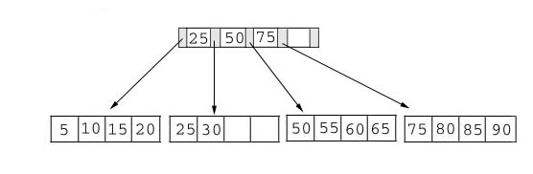
What is a B+ Tree
Definition: A B+ tree is a balanced tree in which every path from the root of the tree to a leaf is of the same length, and each non-leaf node of the tree has between [n/2] and [n] children, where n is fixed for a particular tree. It contains index pages and data pages. The capacity of a leaf has to be 50% or more. For example: if n = 4, then the key for each node is between 2 to 4. The index page will be 4 + 1 = 5. The index pages are in internal nodes and data pages are stored in leaf node.
Example of a B+ tree with four keys (n = 4) looks like this:

Slide 25
B⁺-Trees (Contd …)
Internal nodes of the B⁺-Tree do not store references to data-- only key values to guide the search.
  The order of the B+ tree determines the number of subtrees, which exactly follows the B-Tree definition.
Only Leaf nodes store references to data.
A leaf node may store more or less data records than an internal node stores keys.
  Underflow condition:
    Internal Nodes: Exactly the same rules for B-Trees
    Leaf Nodes: When the number of nodes in a leaf node becomes less than half its maximum capacity.

Slide 26
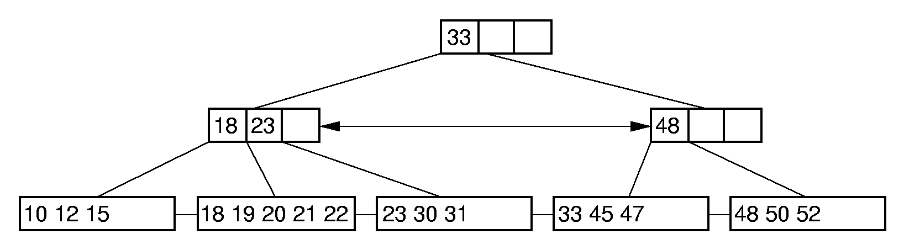
B⁺-Tree Example
Note key replication of guiding index keys at the leaf nodes!

Slide 27
B⁺-Trees (Contd …)
Same structure as B-trees.
Dictionary pairs are in leaves only. Leaves form a doubly-linked list.
Remaining nodes have following structure:
j a₀ k₁ a₁ k₂ a₂ … k_{j} a_{j}
j = number of keys in node.
a_{i} is a pointer to a subtree.
k_{i} <= smallest key in subtree a_{i} and > largest in a_{i-1}.
Example :
➔ index node
➔ leaf/data node
9
5
16 30
1 3
5 6
9
16 17
30 40
Notes:
Non-leaf nodes can now be made smaller than leaf nodes, alternatively, capacity of non-leaf nodes can be made larger. Doubly-linked list useful for serial access in ascending order of key. May be dispensed with. Instead of smallest in right subtree, we may use largest in left or some key in-between. Item keys must still be distinct—I.e., no duplicates.

Slide 28
B+ Tree
The B+ tree is a variant of the B-tree, all records are stored at the leaf level of the tree; only keys are stored in interior nodes.
B-tree can store both keys and records in its interior nodes; in this sense, the B+ tree is a specialization of the B-tree.
Why B+ Trees?
Another potential problem for B-trees is sequential access
B+-trees provide a solution to this problem by requiring that each element appear in a leaf regardless of whether it appears in an internal node
By requiring this and then linking the leaves together, B+-trees provide very efficient sequential access while maintaining many of the benefits of a tree structure

Slide 29
B+ Tree - Benefit
Benefit: Every data structure has it’s benefit to solve a particular problem over other data structures. The two main benefits of B+ tree are:
1. Based on it’s definition, it is easy to maintain it’s balance. For example: Do you have to check your B+ tree’s balance after you edit it?
No, because all B+ trees are inherently balanced, which make it easy for us to manipulate the data.
2. The searching time in a B+ tree is much shorter than most of other kinds of trees. For example: To search a data in one million key- values, a balanced binary requires about 20 block reads, in contrast only 4 block reads is required in B+ Tree.
(The formula to calculate searching time can be found in the book. Page 492-493)

Slide 30
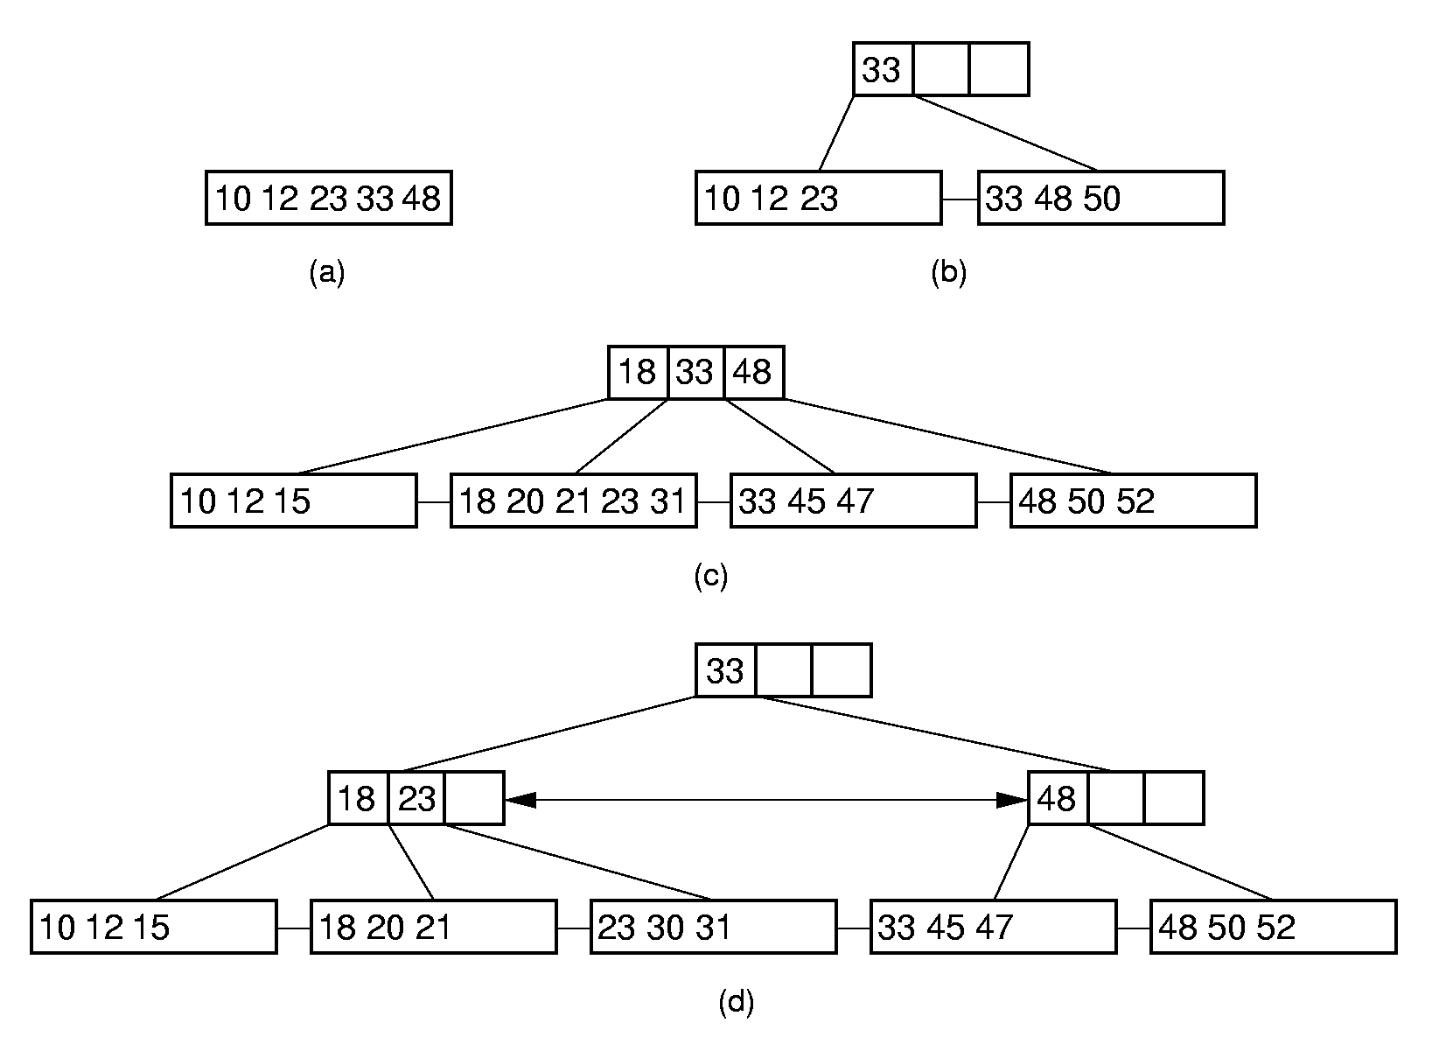
B⁺-Tree Insertion

Slide 31
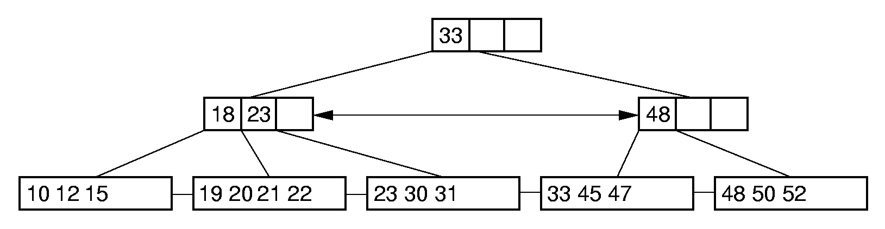
B⁺-Tree Deletion:
Delete 18:

Slide 32
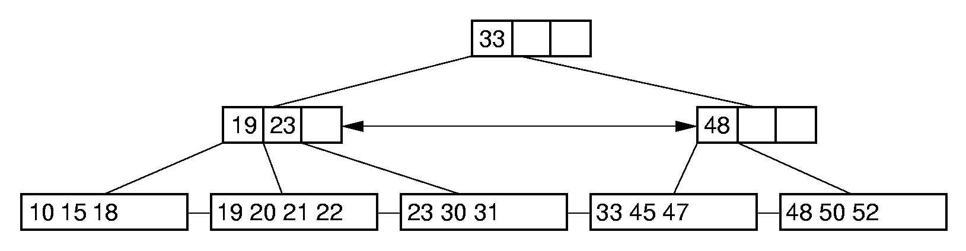
B⁺-Tree Deletion:
Delete 12:

Slide 33
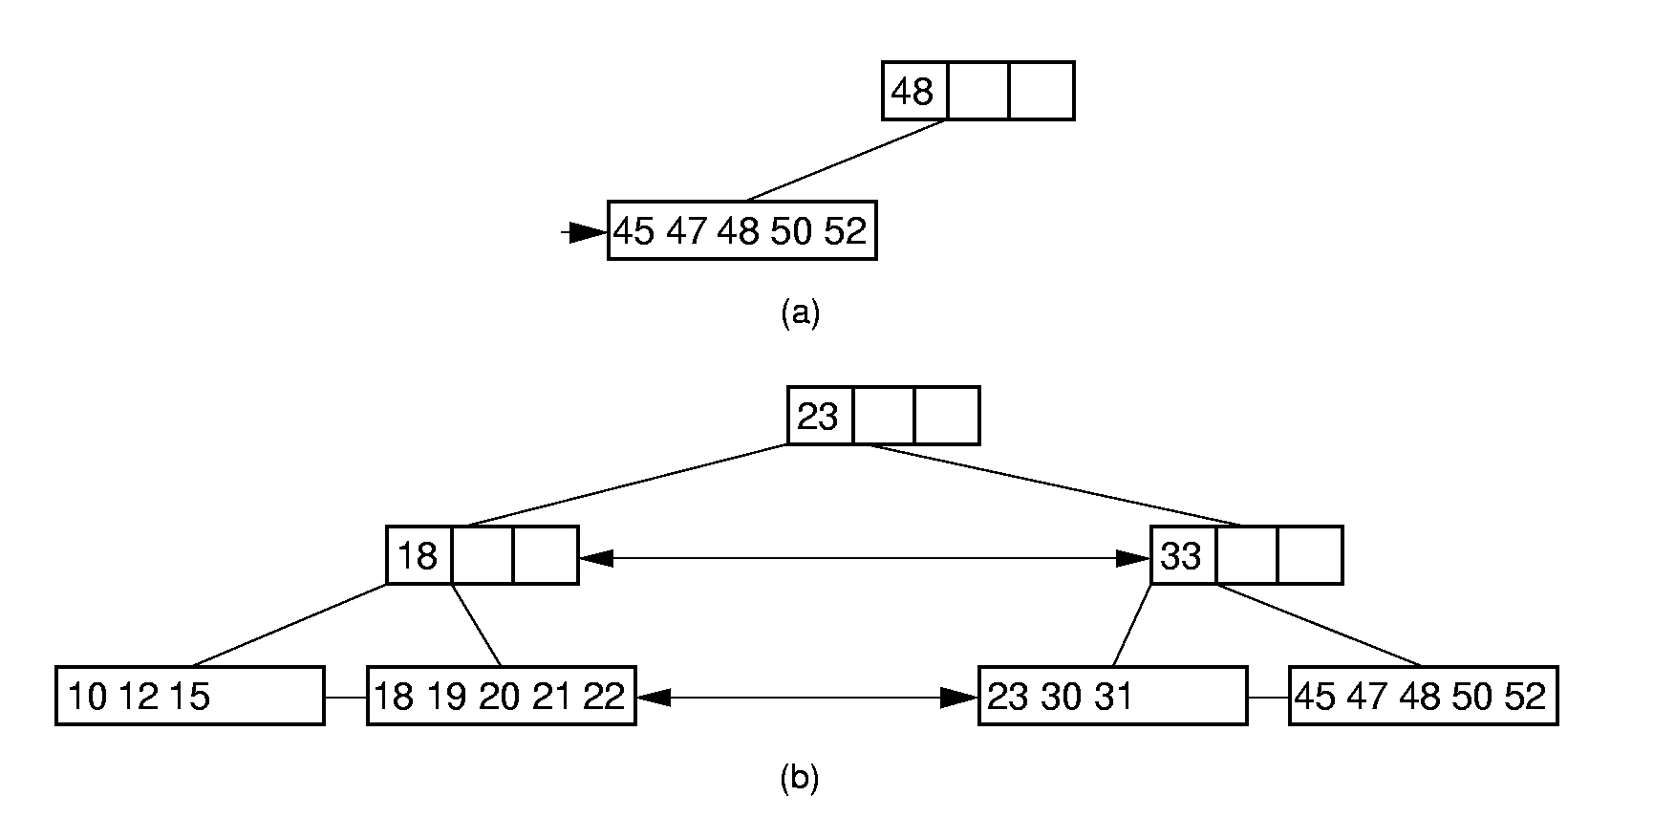
B⁺-Tree Deletion:
Delete 33:

Slide 34
Digital Search Trees & Binary Tries
Analog of radix sort to searching.
Keys are binary bit strings.
  Fixed length – 0110, 0010, 1010, 1011.
  Variable length – 01, 00, 101, 1011.
Application – IP routing, packet classification, firewalls.
  IPv4 – 32 bit IP address.
  IPv6 – 128 bit IP address.
Assume fixed number of bits.
Not empty =>
  Root contains one dictionary pair (any pair).
  All remaining pairs whose key begins with a 0 are in the left subtree.
  All remaining pairs whose key begins with a 1 are in the right subtree.
  Left and right subtrees are digital subtrees on remaining bits.
Notes:
Will discuss IP application in detail later.

Slide 35
Search/Insert/Delete
0110
0010
1001
0000
1011
Complexity of each operation is O(#bits in a key).
#key comparisons = O(height).
Expensive when keys are very long.
Notes:
Delete from nonleaf => replace with key in subtree leaf. Note can’t delete as in binary search tree as that would change levels of nodes and mess up relationship between level and branching bit.

Slide 36
B*-trees
A variation of B-trees called B*-trees were created to solve the problem that the B-tree could be half empty at any given time
B*-trees have all of the same properties as B-trees except that, instead of each node having k children where m/2 ≤ k ≤ m, in a B*-tree, each node has k children where (2m–1)/3 ≤ k ≤ m
This means that each non-root node is at least two-thirds full
1-<number>

Slide 37
Thank You
Tapas Kumar Maiti
Asst. Prof, CSE & IT
CEM, Kolaghat

Slide 38
What is a B+ Tree
Question: Is this a valid B+ Tree?
C E
A B C
D E
F G H
Answer:
1. Ti is valid; how you store data in B+ Tree depend on your algorithm when it is implemented.
2. As long as the number of data in each leaf are balanced, it doesn’t matter how many data you stored in the leaves. For example: in the previous question, the n can be 3 or 4, but can not be 5 or more than 5.

