Slide 1
Overall Earphone Design Flow

Slide 2
Agent-Driven Parametric Earphone Design Pipeline
Fail, send back
INPUT LAYER
Agent Planner
Requirements →
Parametric Design Intent
Parameter Set
Generation
FreeCAD Execution Layer
MCP Toolchain /
Parametric Scripts
3D Model
STL / STEP / FCStd
Automated Geometric
Inspection
Divergence
Point
Requirement Specs
Constraints
Pass
3D Scan Data Sources
Physical Product Scan
Existing Commercial Earphones
Individual Ear Mold Scan
Team Members’ Ear Molds
Li Yuajia
Path 1
Combined Scan: Ear Mold + Product Worn
→ Real Wearing Pose
Expert Selection
Chosen Prototype
Bo Shishi
No, decide next iteration
PRIOR KNOWLEDGE BASE
Path 2
Human Factors / Anatomy
Converged Delivery
Model + Full Generation
Traceability Chain
Agent Interpretation
Compare Against
Design Targets,
Identify Failure Causes
Simulation Results →
Quantitative Metrics
Emulator Layer
Acoustic Simulation
FEM / BEM
(Extensible to Other
Simulation Tools)
Commercial Benchmarks & Patents
Target
Met?
Manufacturability Rules
Yes
Real Wearing Relationship
Pose / Contact Distribution
Two ways out of the Divergence Point
Colour key
Path 1 — human in the loop:
an expert picks a prototype. Ends there.
3D scan evidence
prior knowledge
agent / tooling
Path 2 — simulate and iterate:
metrics computed, agent reads them, loop decides.
decision & feedback
human in the loop
converged output
Both feedback edges — inspection failure and target not met — return to Parameter Set Generation. That is the only re-entry point.
Scan evidence also feeds the priors: product scans → commercial benchmarks; combined ear-mold + worn-product scans → real wearing relationship.

Slide 3
AI-Based Workflow

Slide 4
PROGRESS SUMMARY · 31 AUGUST
Measuring the Ear Does Not Design the Earbud
Knowing someone's exact foot size does not tell you what shoe to make. Our ear scans have the same problem: they measure everything and design nothing.
We scanned ears
sizes, curves, empty space, how ears differ
→
We turned it into rules
space around it, how far it sticks out, room inside
→
We got a shape, not a product
passed every rule, looked nothing like an earbud
Four questions the numbers can never answer — and a designer asks all four before drawing anything
1
2
3
4
Who is it for?
How should it feel?
Why this shape?
Does it look real?
What is this thing, who wears it, and when? A bedtime earbud is not a gym earbud.
Light, soft and almost invisible? Or something people notice and recognise?
Every curve should have a reason. “The maths allowed it” is not a reason.
Would a shopper see it and think “modern earbud”? Or just “lump”?
So what? Pouring in more numbers — battery size, speaker size, wall thickness — only gets us a more complicated lump. Numbers cannot teach taste. Treat the ear scan as a fence, not as the design: it says where the earbud has to fit, never what it should look like.
!
Notes:
The problem, plainly. A scan says how big and what shape an ear is. It cannot say what to build. We already tried designing straight from numbers - space around the ear, how far it sticks out, how much room to leave - and got objects that passed every rule and were not earphones. Adding more numbers makes that worse, not better. The ear data should be a boundary for size, direction and placement only.

Slide 5
PROPOSED DIRECTION
First, Show It a Lot of Real Earbuds
Before a student designs a chair, they look at a hundred chairs. Our system has never looked at a single earbud.
What we write down about each earbud
Where we get it all
What it is, who buys it, and when they wear it
What it looks like: outline, proportions, how it sits in the ear, what photos show
What the maker says it was going for — the story and the clever bit
What owners say: looks, fit, side-sleeping, staying in, forgetting it is there
How sure we are of each line: maker's claim / spec sheet / visible in photos / owner's opinion / our guess / nobody knows
Maker websites — product pages, press releases, interviews, design-award write-ups
Shops — Taobao, JD and Amazon listings, plus the reviews under them
Design press and 3D — magazines, cutaway diagrams, licensed CAD files
Public, cheap, and full of what a scan cannot tell us.
1
Say what we want
2
Sketch a few answers
3
Only then, the shape
Write the wish down in plain words first: what is this thing, who wears it, how should it feel, where is it used, what must it avoid, and what we still do not know.
Pull two or three genuinely different looks out of the collection and put them in front of a person. Pick a direction before anyone models anything. (Fine-tuning, SFT, is on the table here.)
The first CAD is just the outside: one smooth shell, a marker where the eartip and sound hole go, how it sits in the ear, and keep it flat. Battery, speaker and factory questions come later.
The rule we keep: every photo, sales pitch and review gets a label saying where it came from and how much to trust it. We are borrowing ideas, not copying products — and a marketing page is never a fact about physics or ears.
Notes:
The fix, plainly. Build a searchable scrapbook of real earphones so the system knows what it is designing and why before it makes a shape. Every line in an entry carries a label for how much to trust it. The material is public: maker sites, shop listings and reviews, design press and licensed 3D files. Then work in three steps - say what we want in plain words, show a person a few different looks, and only then build a first CAD of the outside. Battery, acoustics, comfort and per-person fit are layered in after the look is agreed.

Slide 6
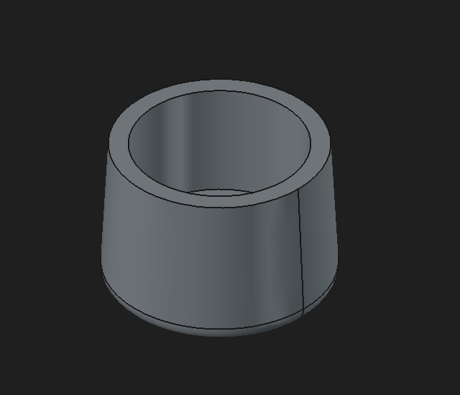
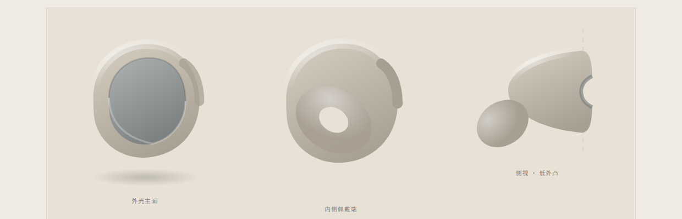
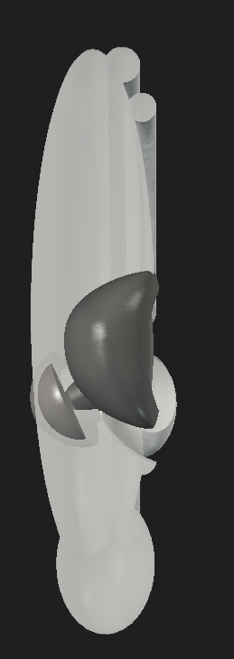
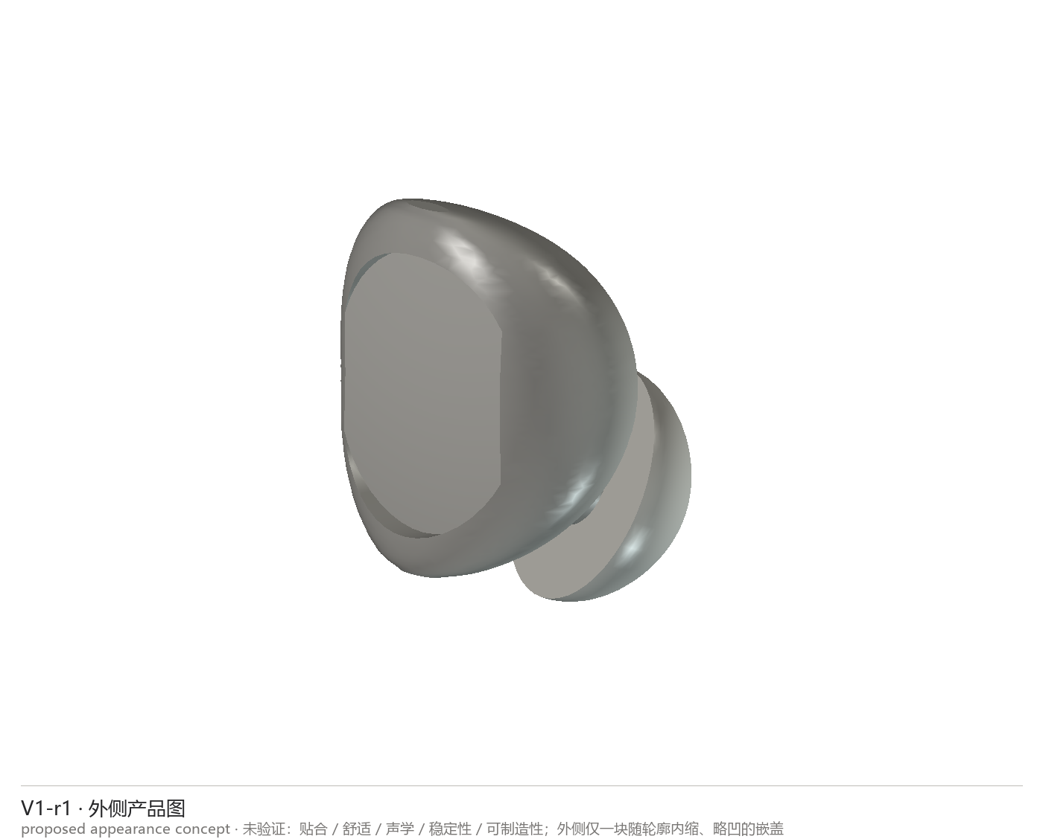
PROGRESS
Point Clouds Can Fit an Ear, but Cannot Design an Earbud.
Geometry optimizes dimensions. Product cases add the design knowledge needed for a credible sleep-earbud concept.
1. GEOMETRY-ONLY GENERATION
2. THE NEW DESIGN KNOWLEDGE
Ear geometry defined a feasible volume.
Build a design-case corpus from real product introductions, innovation and design narratives, public images and available public models; use it before CAD.
Extract concha dimensions and place a low-protrusion body.
Use component size, wall thickness and cavity volume to set dimensions.
Sweep fit, protrusion and coverage to reduce side-sleep pressure.
Use a hollow frustum for calculable volume, walls and fit range.
RESULT
A feasible spatial envelope, not yet a product design.
What was missing?
An ear point cloud describes the ear, not product identity, visual language or design intent.

Slide 7
Sensors · 2026 · 26(11): 3493
An Annotation-Free
Auricular Bowl Atlas Pipeline
How a computer lines up 50 different ears without anyone pointing at them first
It uses ICP to slide each ear into place, then a bidirectional thin-plate spline to bend it onto a shared average shape.
Notes:
Walkthrough of Zhang et al., Sensors 2026, 26(11):3493 - an annotation-free pipeline that builds a 3D atlas and statistical shape model of the auricular bowl from 50 surface scans.

Slide 8

SOURCE
Where This Comes From
Zhang, T., Lee, T.K.W., Huang, J., Leung, K.L., Fu, S.N.
An Annotation-Free Pipeline for 3D Auricular Bowl Atlas Construction and Statistical Shape Modelling from Surface Scans
Sensors, 2026, 26(11): 3493
Field | Value
DOI | 10.3390/s26113493
PMID | 42281011
PMCID | PMC13259287
License | Open Access, CC BY
First published | 2026-06-01
Institution | The Hong Kong Polytechnic University (ethics HSEARS20230705002)
Free to read. It is open access, so you can pull up the whole paper yourself — no paywall, no login.
https://www.mdpi.com/1424-8220/26/11/3493
Notes:
Open access under CC BY, so the full text is freely available via Europe PMC.

Slide 9
OBJECTIVE
What It Is Trying to Do
The computer takes 50 ears, works out which patch of one ear matches which patch of another, and boils that whole family of shapes down to a handful of dials you can turn.
1
It works with no hand-marking
Why anyone cares
No human clicks anything. The computer picks its own reference dots, using farthest point sampling.
Ear shape decides whether an earbud stays put, whether a hearing aid rubs, and where a taVNS electrode should sit. So people build computer models of ears — but nearly all of them need a human to click on landmarks first.
2
The line-up is tight enough
Why clicking by hand is a problem
After five rounds, paired-up points sit 0.30 mm apart on average, and 98% of the surface gets matched.
It is slow — someone has to sit and click every single ear
People disagree — ask two of them to mark the tragus apex and you get two different spots
It cannot grow — fine for 20 ears, hopeless for 2,000
3
The sizes it gives are real
Measure the bowl by hand, then ask the model. They agree almost exactly (Pearson r ≥ 0.98, ICC ≥ 0.98).
The fix: bin the clicking. Instead, squash each ear onto a shared average shape, over and over, until it fits.
Notes:
Merged from the objective and problem-statement pages. The three claims map onto the result blocks later in the deck.

Slide 10
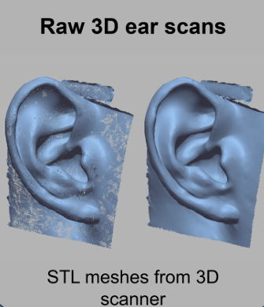
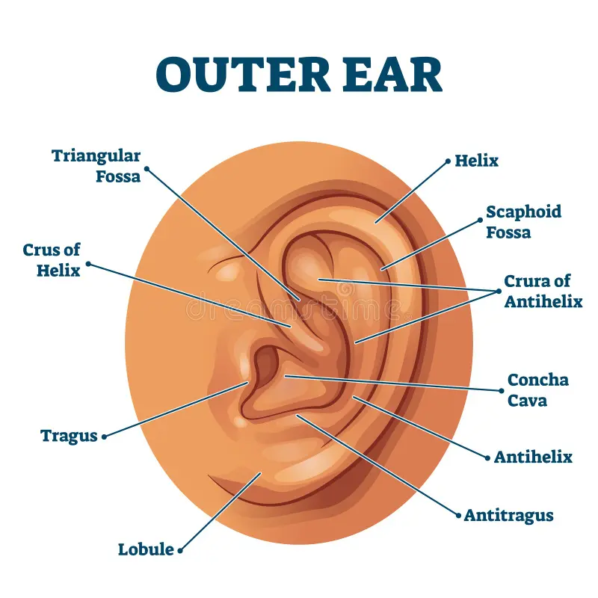
SCOPE
Which Bit of the Ear
The dished-out part in the middle of your ear — the auricular bowl. Earlobe not included.
 | What is in and what is out
In | Cavum conchae, cymba conchae, triangular fossa, antihelix
Out | Lobule (the earlobe), ear canal opening
In plain words: the deep cup, the little scoop above it, the small triangular dip, and the Y-shaped ridge wrapped around them.
"Annotation-free" means no dots, not no people. Someone still traces the outline of the region by hand in Geomagic Design X. But roughly lassoing an area is far easier to repeat than pinpointing an exact anatomical spot — which is why it does not spoil the method.
The region is bigger than "bowl" sounds. The triangular fossa and the antihelix ridge come along too, so the wall around the cup is counted, not just the cup. Check what is included before borrowing any number from this paper.
Notes:
The scope caveat matters for anyone reusing these dimensions: the region is larger than the literal concha bowl.

Slide 11
DATA
Whose Ears, and How They Were Captured
50
Right
13–45
~0.2 mm
ears, one each
ears only
years old
detail the scanner sees
Item | Detail
Who | 25 men, 25 women
How the ear was captured | EinScan Pro HD structured-light scanner (Shining 3D) — it paints stripes of light on the ear and reads the shape from how they bend
Getting it ready | Trace the region by hand in Geomagic Design X → re-tile it into 40,000–60,000 evenly sized triangles → scatter 20,000 dots over it, spread by area so big flat patches get their fair share
Where the ears came from | The team scanned them; no public dataset was used
Two things it does not cover
Right ears only. Nobody checked whether left ears behave the same. You would have to mirror the model, and the paper never tests whether mirroring is fair.
Nobody over 45. Ears keep changing as people get older, and the youngest here is 13. If your users are older, this does not speak for them.
Notes:
The right-ear-only limitation is the one most likely to bite anyone reusing this atlas.

Slide 12
PIPELINE
The Whole Loop, Start to Finish
Start: one ear,
borrowed as a stand-in
Run the five steps. Then ask whether you have done it five times. If not, go round again. If yes, you are finished.
1
2
3
4
5
Rigid ICP alignment
Farthest point sampling
Bidirectional TPS
Nearest-neighbour map
Average all subjects
Slide and spin it into
place. Size stays locked
Pick its own handles,
spread far apart
Bend it until it fits
the average shape
Write down which dot
pairs with which
Blend all 50 into a
new average shape
No — go round again
Done it
five times?
Yes
Final atlas + PCA statistical shape model
Inner loop — ICP repeating itself
Outer loop — the five steps above
Stops on its own, once a round barely shrinks the average gap any further
Always runs exactly 5 times — that is what the diamond decides
Notes:
One pass of the outer loop runs ICP to full convergence internally. Both are "iterative", which is where the confusion comes from.

Slide 13
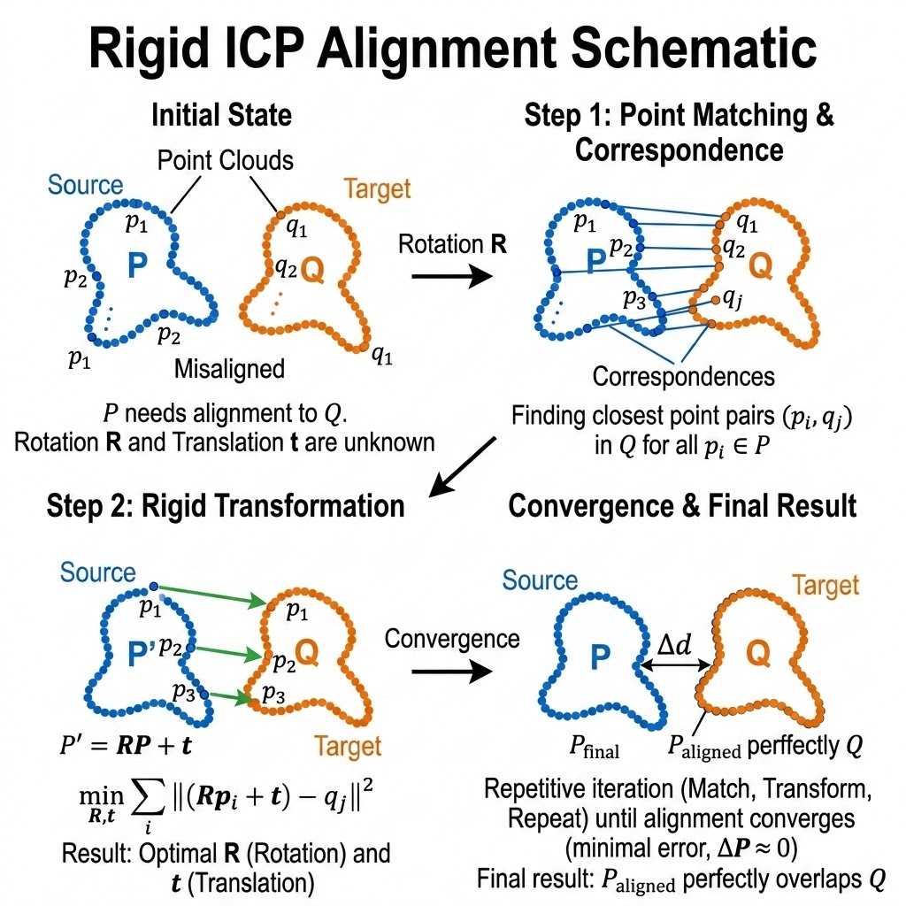
STEP 1
Rigid ICP Alignment — Sliding It Into Place
ICP = iterative closest point. Picture two paper cut-outs of an ear lying crooked on a table. You cannot tell which corner belongs to which. So you guess: whatever is nearest is probably the match. You shove one cut-out so those guessed pairs line up better. Now they sit closer, which makes your next guess a better guess. Repeat until shoving stops helping. The wrong guesses quietly fix themselves as the two shapes drift together.
The point of it: get every ear sitting in the same spot, facing the same way. This step only slides and spins — it never changes the shape.
Setting | Value | What that means
How each shove is solved | Umeyama transform | Hand it a list of which dot pairs with which, and it works out the best slide-and-spin in one go, with no trial and error
Resizing | Locked at s = 1 | No shrinking or stretching. A big ear stays big, so the model remembers real sizes instead of throwing them away
How many dots | 20,000 per mesh | Scattered by area, so a finely tiled patch does not hog more than its fair share
When it stops | When shoving stops helping | Once a round barely shrinks the average gap, it quits
Notes:
The s = 1 decision is what makes the resulting shape model usable for absolute dimensions rather than shape only.

Slide 14
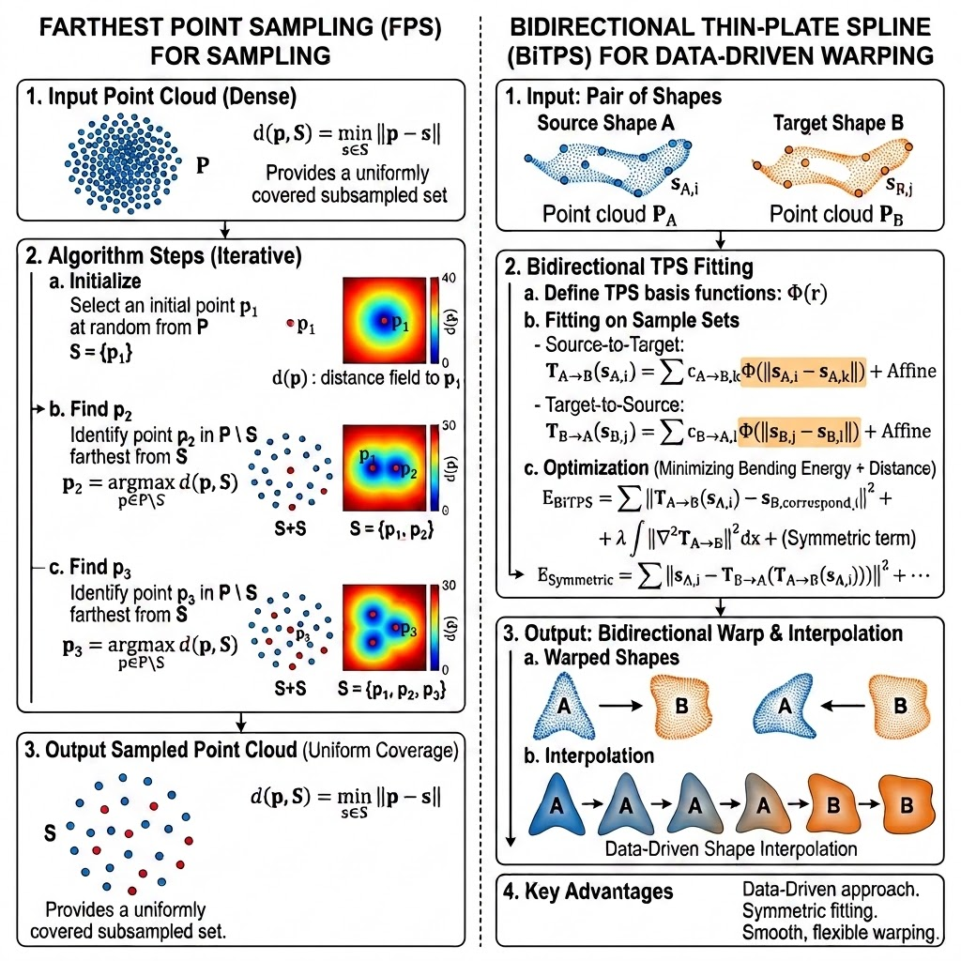
STEPS 2 & 3
Picking Its Own Handles, Then Bending to Fit
2
Farthest point sampling (FPS)
The computer picks its own handles. The rule is simple: keep grabbing whichever spot sits furthest away from everything grabbed so far. You end up with handles spread evenly, never bunched together.
3
Bidirectional thin-plate spline (BiTPS)
Think of a thin sheet of metal. Push a few spots on it and the whole sheet bends smoothly to follow — it will not crease, because bending costs energy and the sheet takes the laziest path it can. That is a thin-plate spline. Move the handles, and the surface between them follows along on its own.
Notes:
FPS is the crux of the annotation-free claim. BiTPS is what actually removes shape difference.

Slide 15
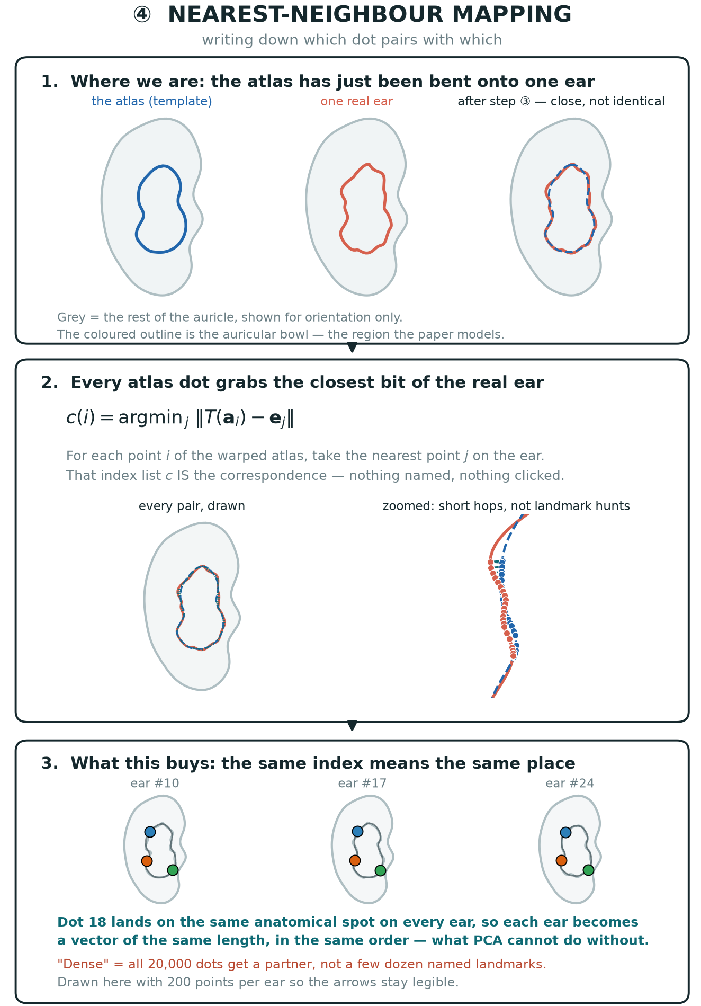
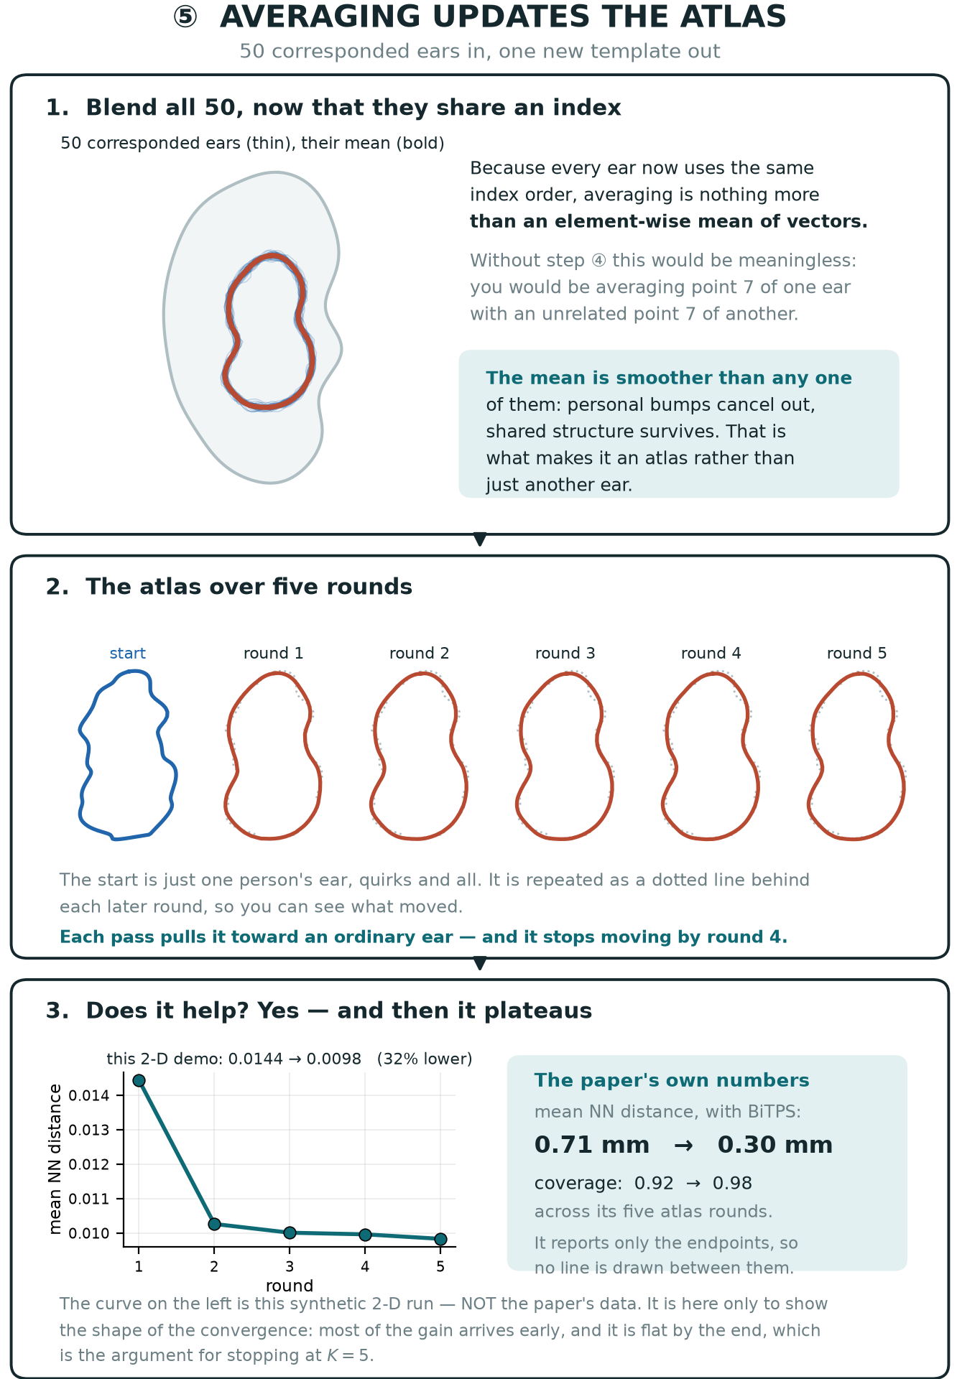
STEPS 4 & 5
Writing Down the Pairs, Then Re-Averaging
Notes:
Correspondence and atlas quality bootstrap each other across the five iterations.

Slide 16
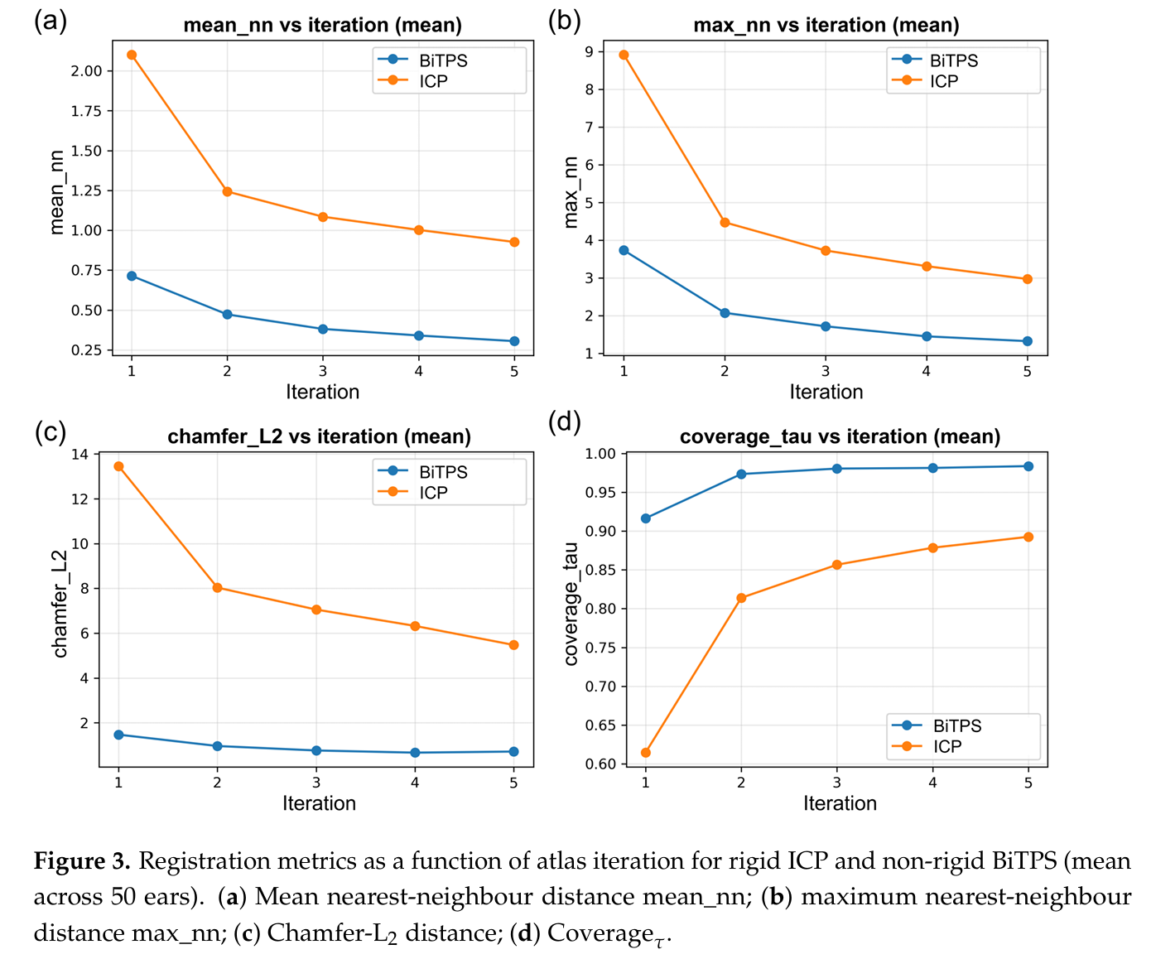
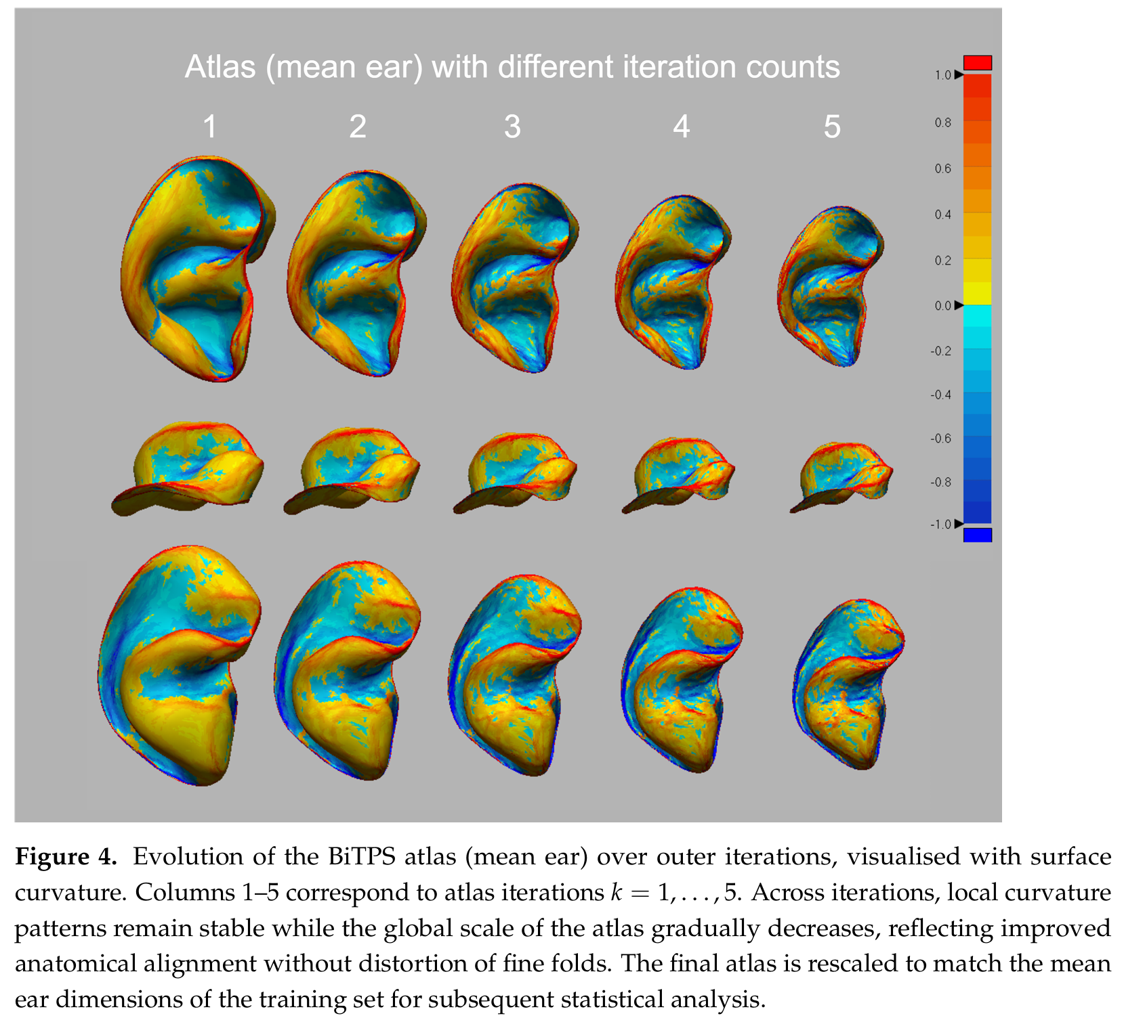
RESULTS
Did It Actually Line Up?
Four ways of measuring the leftover gap, round 1 → round 5. Smaller is better, except the bottom row where bigger is better.
What is measured | ICP alone | + BiTPS
Average gap (mm) | 2.10 → 0.93 | 0.71 → 0.30
Worst single gap (mm) | 8.92 → 2.97 | 3.73 → 1.32
Overall mismatch (Chamfer-L2) | 13.46 → 5.47 | 1.47 → 0.71
Surface actually matched | 0.61 → 0.89 | 0.92 → 0.98
These are not two rival methods. ICP slides the ear into place; BiTPS then bends it. One happens after the other. They sit side by side only to show how much the bending step adds.
1
Going round again helps
Every number improves from round 1 to round 5. No exceptions.
2
The bending does the heavy lifting
One round of BiTPS (0.71 mm) already beats five rounds of ICP on its own (0.93 mm).
3
Is 0.30 mm good?
The scanner itself only sees down to about 0.2 mm, so the leftover error is nearly as small as the measurement can tell.
Notes:
The scanner-resolution comparison is the key takeaway: registration residual is now close to the limit of what the measurement itself can resolve.

