Slide 1
DDSCS Design

Slide 2





DDSCS application’s components
Code generator
DDSCS application
DDSCS library
Code generated

Slide 3
DDSCS library
Client
Server
Encapsulates the DDS participant creation and management.
Encapsulates the DDS entities creation and management that are use to send request and receive reply.
Encapsulates the mechanism of sending the request and waiting the server’s reply.
Encapsulates the DDS participant creation and management.
Encapsulates the DDS entities creation and management that are use to receive the request and send the reply.
Encapsulates the mechanism of receiving the request, procesing it in a separate thread, calling the user implementation of the remote procedure and sending the reply.

Slide 4
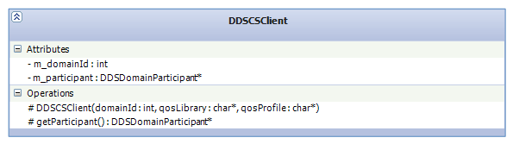
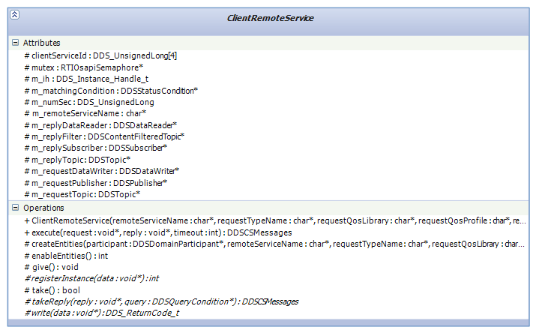
Client
1
*

Slide 5
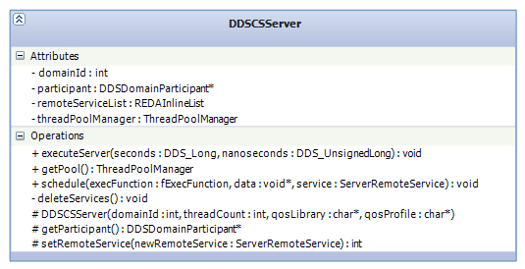
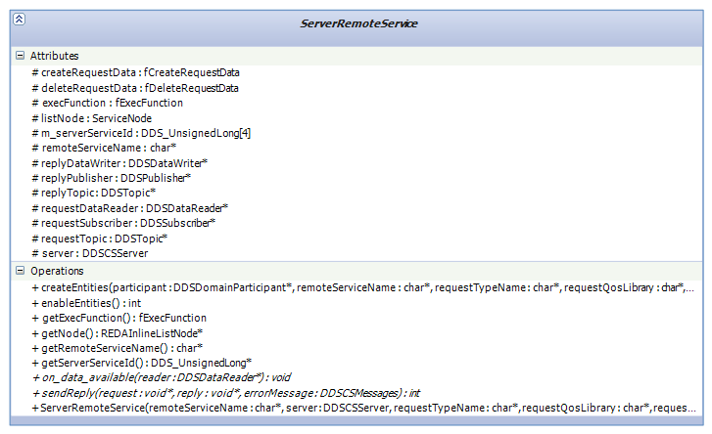
Server
1
*

Slide 6
Generated code
rtiddsgen
Type definitions’ code
rtiddsgen
Request/Reply types’ code
Request/Reply IDL
Code generator
Request/Reply utils’ code
Client’s code
Server’s code

Slide 7
Understanding with an example
interface Example1
{ long function1(in short param1, in long param2, out long param3); };

Slide 8
Request type
struct function1tRequest{
unsigned long clientServiceId[4]; //@key
unsigned long numSec;
short param1;
long param2;
}; //@top-level true

Slide 9
Reply type
struct function1Reply{
unsigned long serverServiceId[4]; //@key
unsigned long clientServiceId[4]; //@key
unsigned long numSec;
long ddscsRetCode;
long param3;
long returnedValue;
}; //@top-level true

Slide 10
Request type utils
function1Request* function1RequestUtils::createTypeData(DDS_Short param1, DDS_Long param2)
{
function1Request* instance = function1RequestTypeSupport::create_data();
instance->param1 = param1;
instance->param2 = param2;
return instance;
}
void function1RequestUtils::extractTypeData(function1Request* data , DDS_Short &param1, DDS_Long & param 2)
{
param1 = data->param1;
param2 = data->param2;
}

Slide 11
Reply type utils
function1Request* function1RequestUtils::createTypeData(DDS_Short param1, DDS_Long param2)
{
function1Request* instance = function1RequestTypeSupport::create_data();
instance->param1 = param1;
instance->param2 = param2;
return instance;
}
void function1RequestUtils::extractTypeData(function1Request* data , DDS_Short &param1, DDS_Long & param 2)
{
param1 = data->param1;
param2 = data->param2;
}

Slide 12
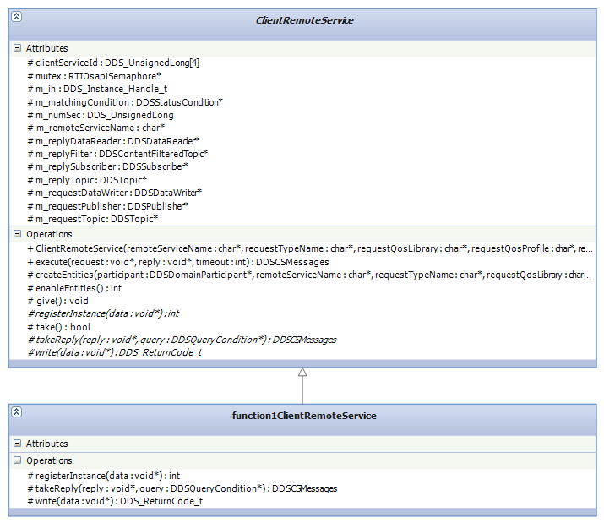
Client side: Remote service

Slide 13
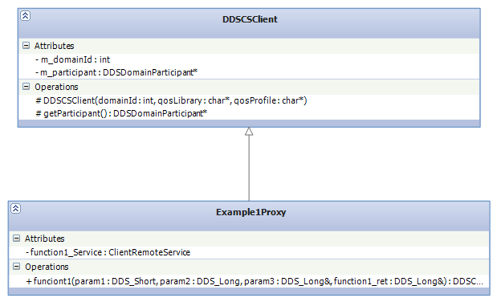
Client side: Proxy

Slide 14
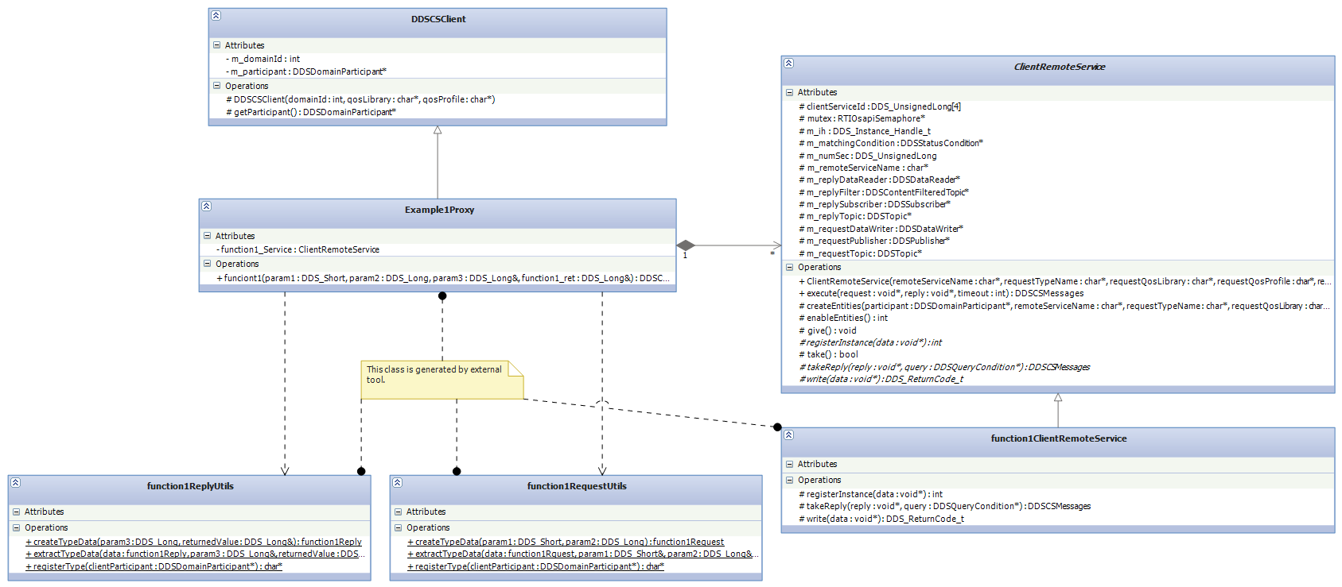
Client side

Slide 15
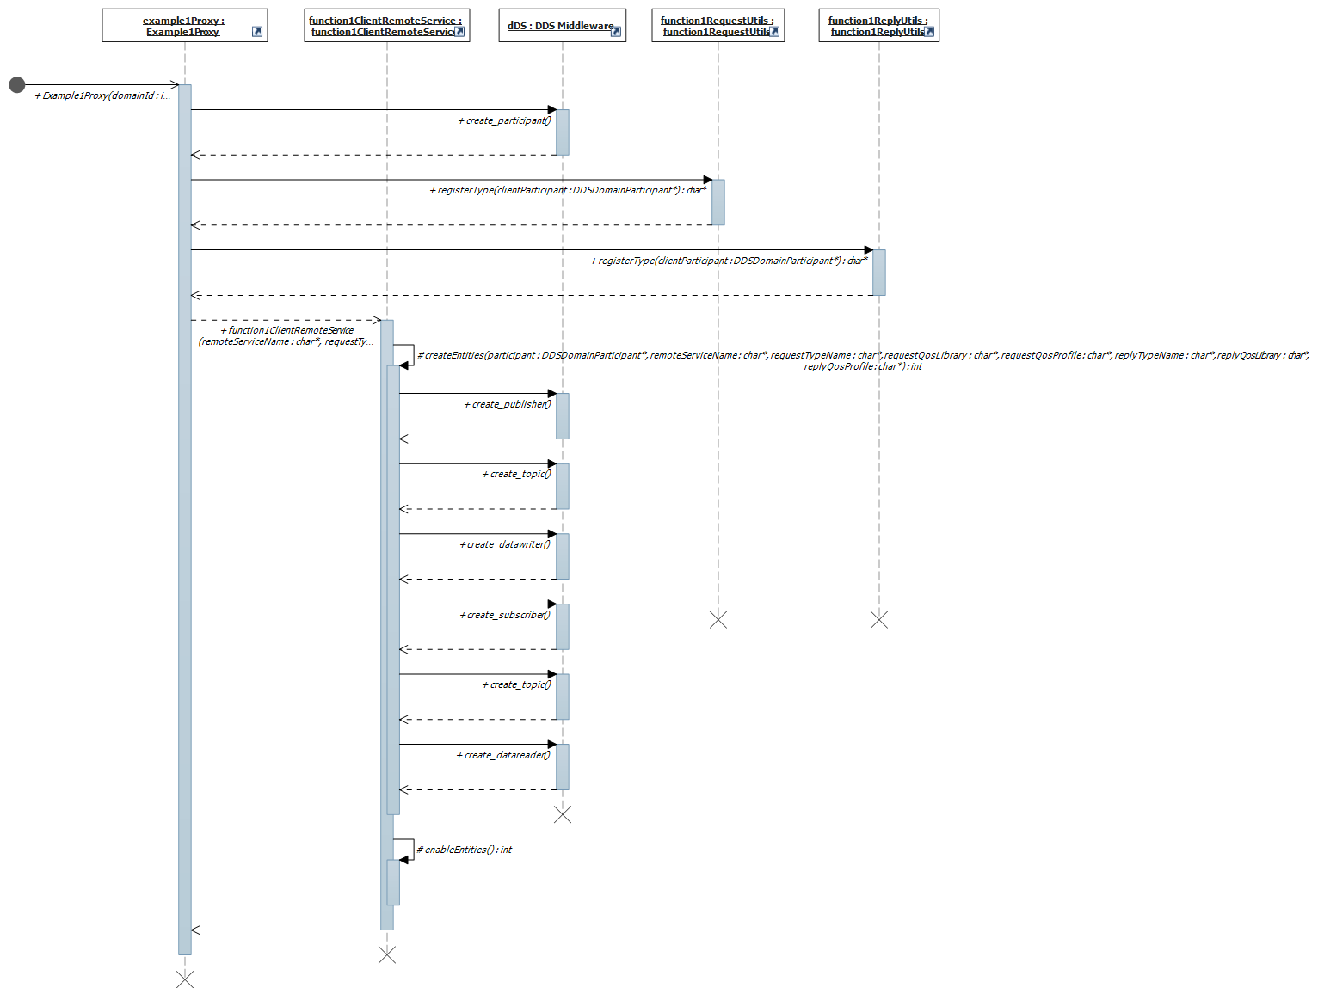
Client side: Client creation

Slide 16
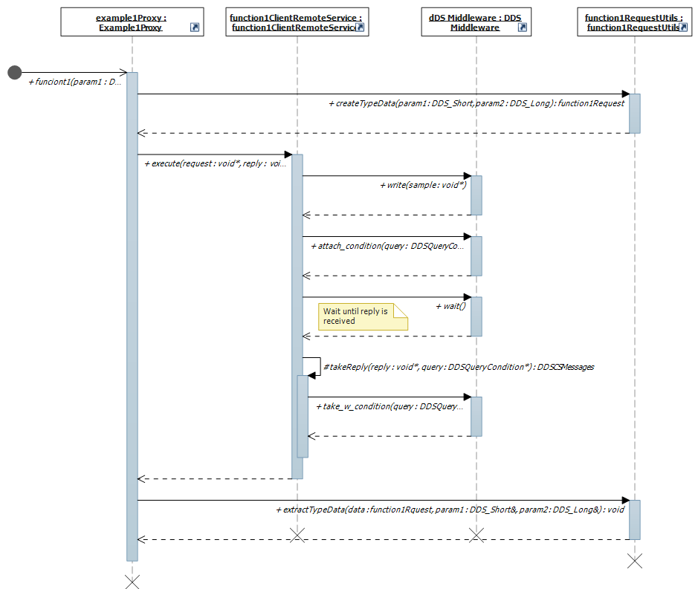
Client side: Calling procedure

Slide 17
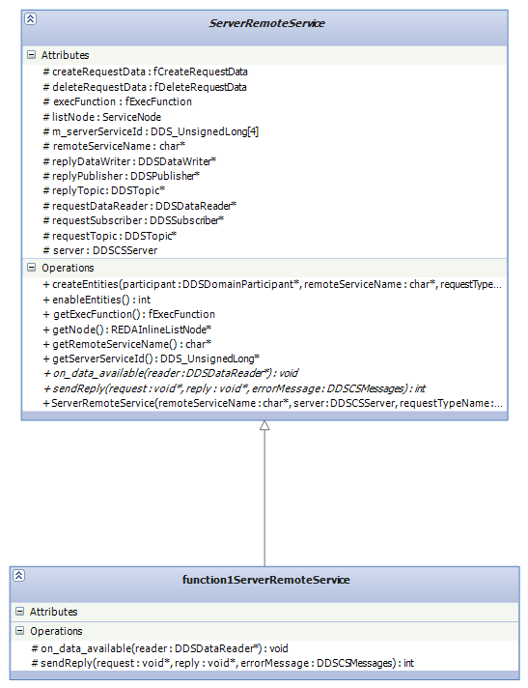
Server side: Remote service

Slide 18
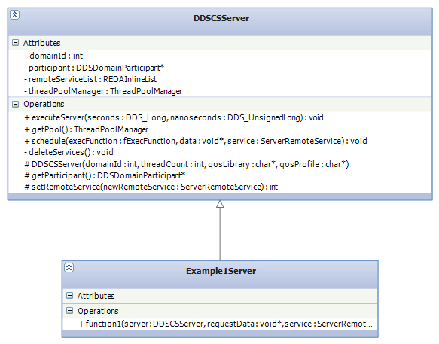
Server side: Server

Slide 19
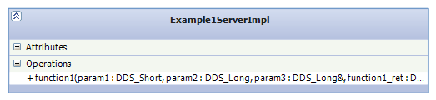
Server side: Skeleton

Slide 20
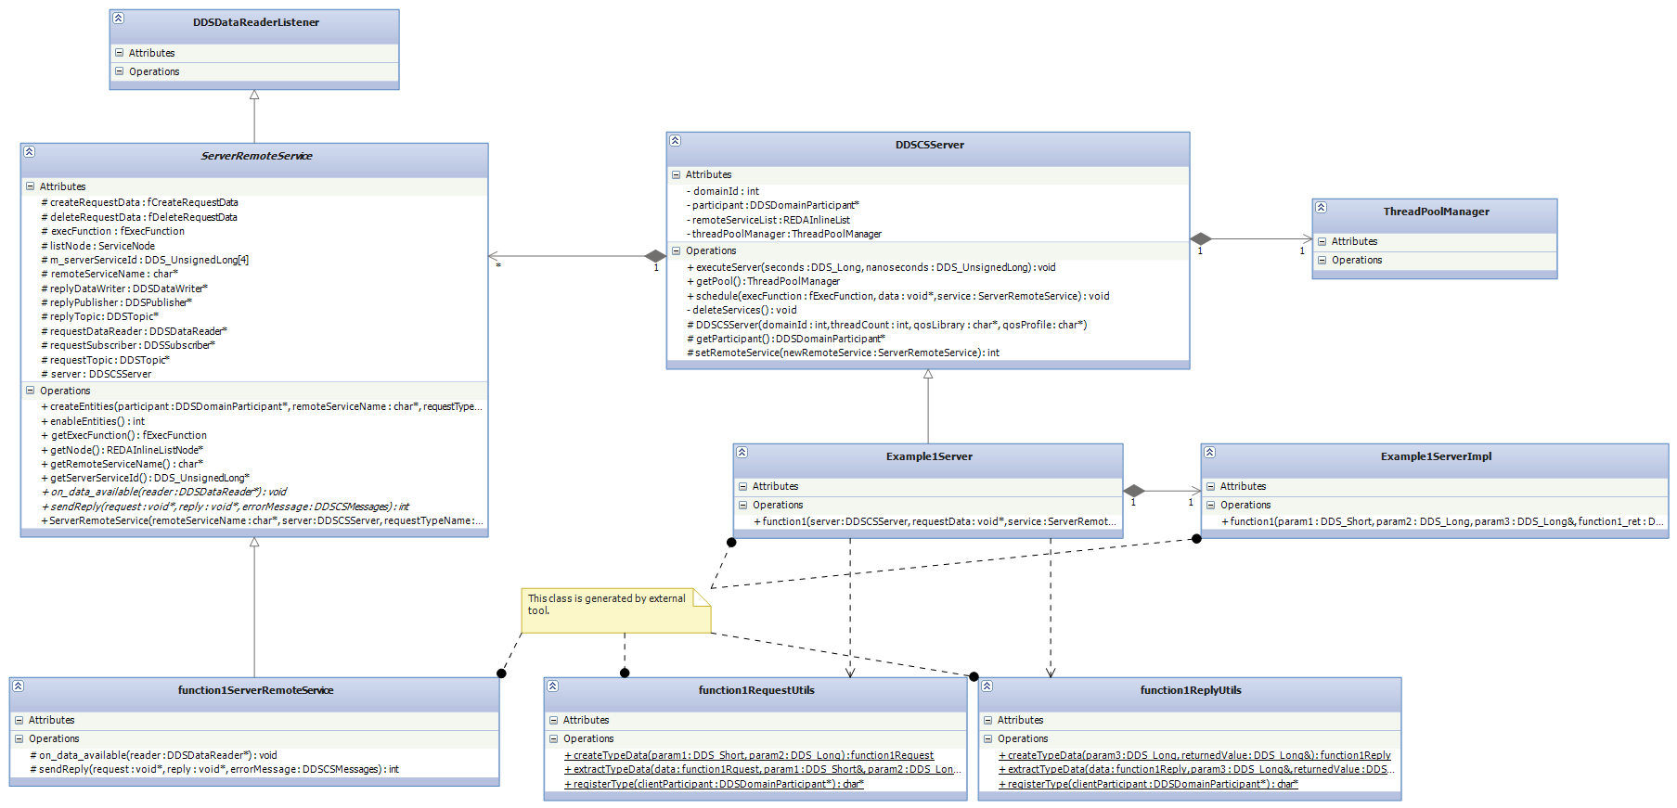
Server side

Slide 21
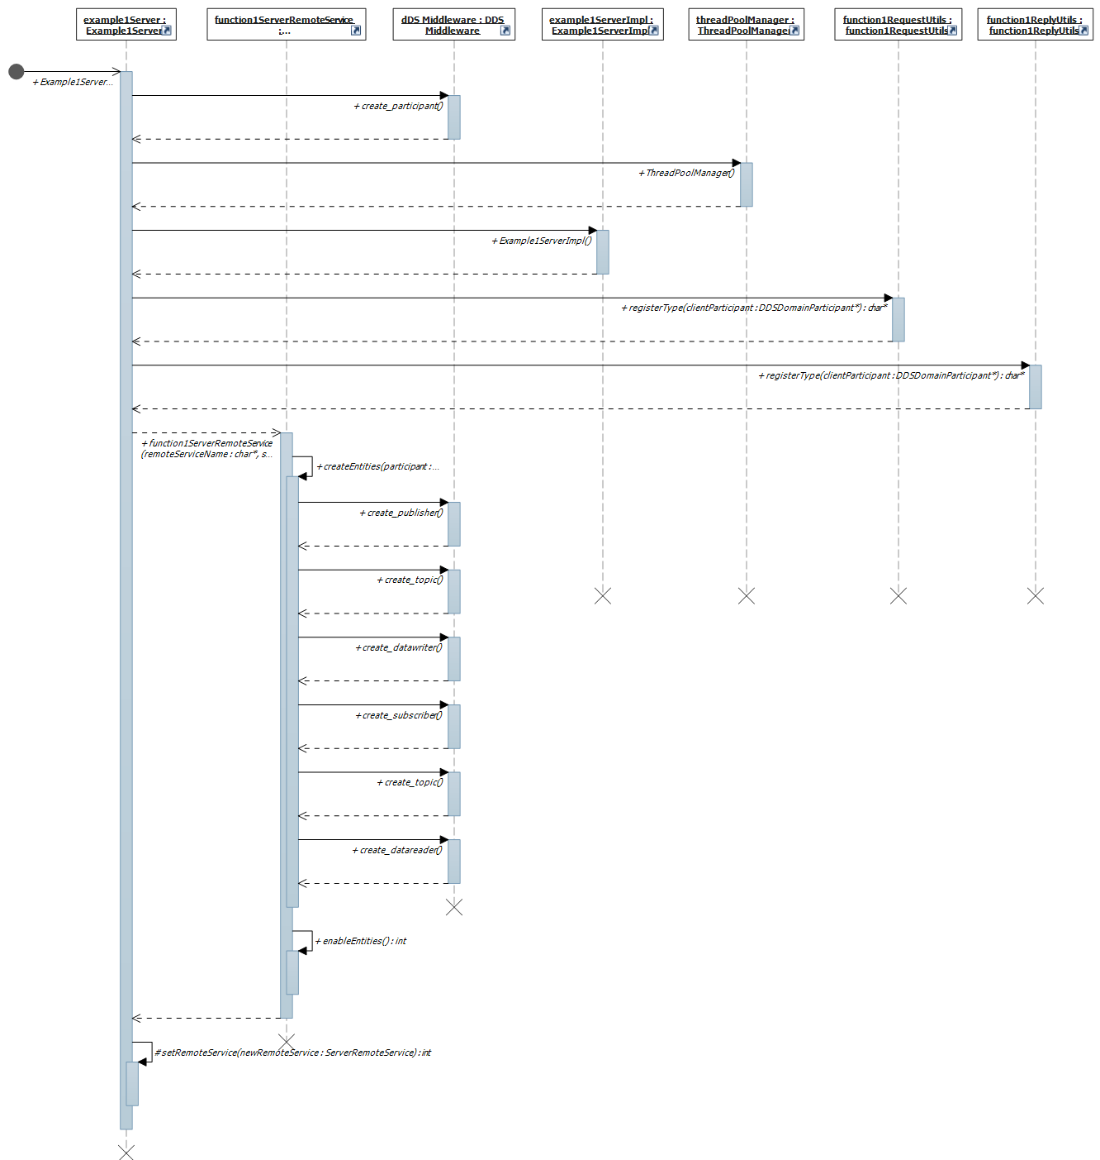
Server side: Server creation

Slide 22
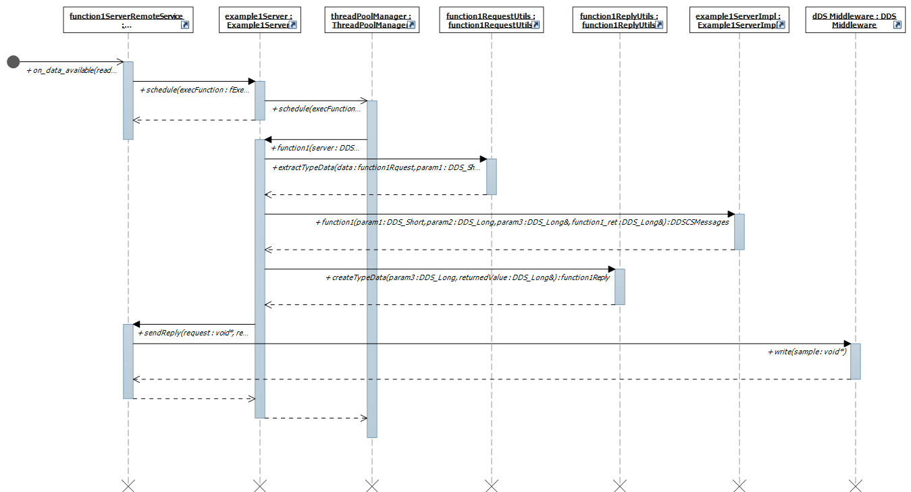
Server side: Receiving request

