Slide 1
Proposal 2: Analyzing and Mitigating Energy Crises

Slide 2
GROUP INFO
Azmaain Noor Miazi
Niloy Ahmed Showrav
Sejuti Najneen

Slide 3
Question Worked On
Why do underdeveloped countries face more frequent and severe energy crises?

Slide 4
PRE-PROCESSING
Filling null values
Feature Engineering
Calculation of development score(DS)
Calculation of energy efficiency score(EES)
Calculation of catastrophe score(CS)
a

Slide 5
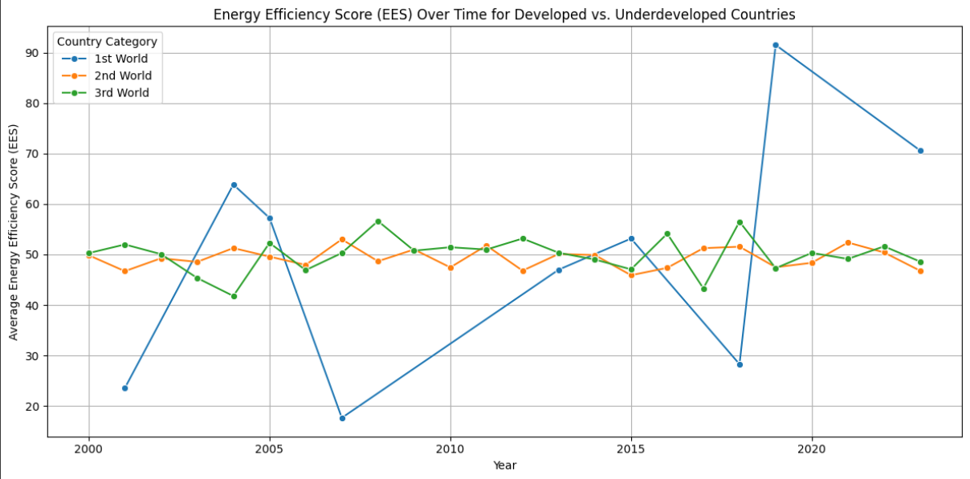

Slide 6
Line Chart: Track Energy Efficiency Over Time
The line chart illustrates the trends in Energy Efficiency Scores (EES) over time for three categories of countries: 1st World (developed), 2nd World (developing), and 3rd World (underdeveloped). It reveals how energy efficiency has fluctuated in different economic contexts. Developed countries initially show significant variability, with dramatic peaks and declines, potentially reflecting shifts in energy policies, technologies, or economic factors. In contrast, underdeveloped and developing countries display more stable trends with gradual changes, indicating slower adoption of energy-efficient practices or limited access to advanced technologies. Comparing these trajectories highlights disparities in energy efficiency progress, which may point to inefficiencies in resource utilization or barriers to sustainable energy transitions. Such analysis is critical for identifying regions needing targeted interventions to improve efficiency and mitigate energy crises.
a

Slide 7
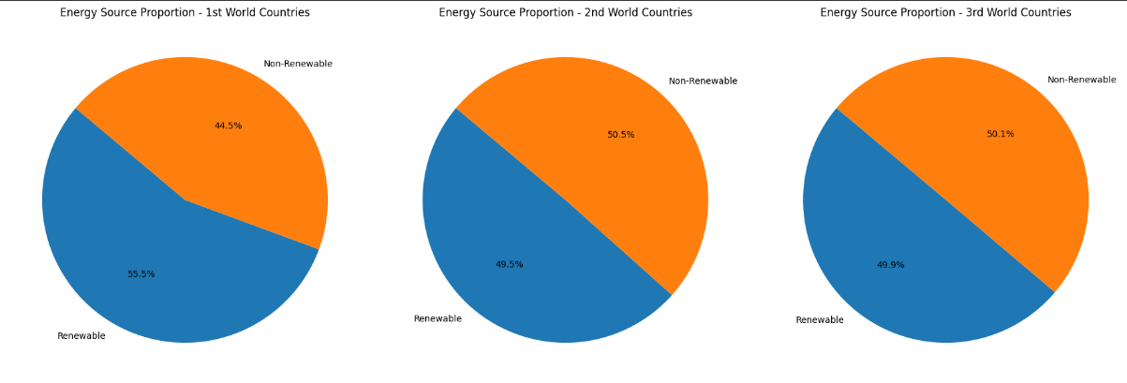

Slide 8
Pie Chart: Proportion of Energy from Renewables
The pie charts depict the proportion of renewable versus non-renewable energy sources for 1st World (developed), 2nd World (developing), and 3rd World (underdeveloped) countries. Developed countries have the highest reliance on renewable energy (55.5%), reflecting greater adoption of sustainable energy technologies and policies aimed at reducing environmental impact. In contrast, developing and underdeveloped countries exhibit a more balanced split, with a slight dominance of non-renewable sources (50.5% and 50.1%, respectively). This higher dependency on non-renewables in less developed regions could contribute to increased vulnerability to energy crises due to resource scarcity, fluctuating prices, and environmental degradation. Understanding these proportions is critical for formulating targeted strategies to enhance energy sustainability and resilience in underdeveloped regions.
a

Slide 9
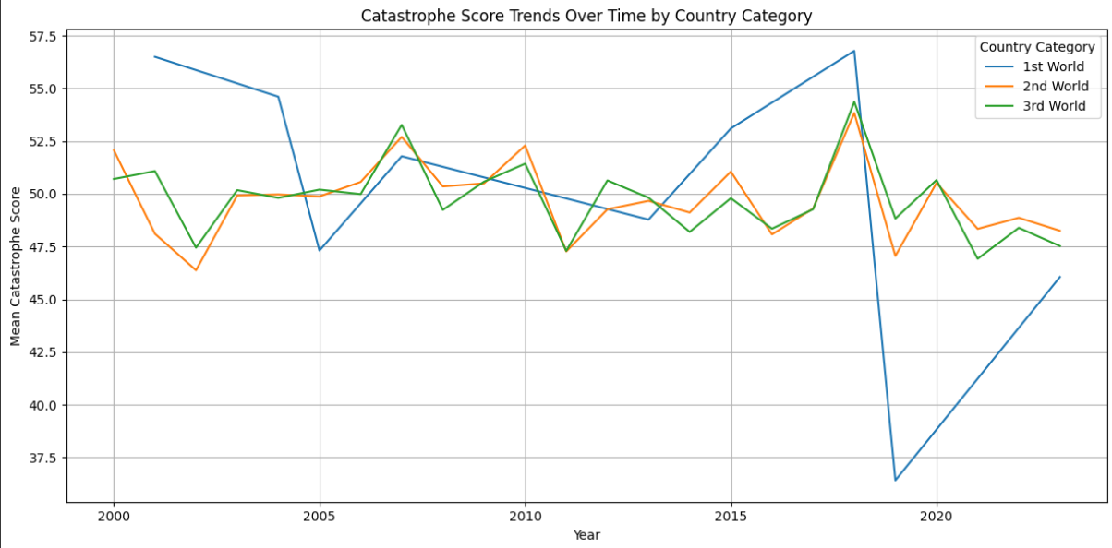

Slide 10
A Line Plot to show the resilience and management differences over time
The line plot illustrates the trends in catastrophe scores over time across three country categories: 1st World, 2nd World, and 3rd World. It highlights distinct differences in resilience and management of catastrophe impacts. The 1st World countries display relatively stable and higher mean scores, indicating consistent capacity to manage and mitigate catastrophe effects. In contrast, 2nd and 3rd World countries show greater fluctuations, suggesting varied levels of preparedness and recovery strategies. The 3rd World category exhibits a narrower range compared to the 2nd World, implying some stabilization over time but still remaining below the performance of 1st World nations. This visualization supports the narrative that developed nations sustain resilience, while developing and underdeveloped regions face growing or inconsistent challenges in catastrophe management.
a

Slide 11
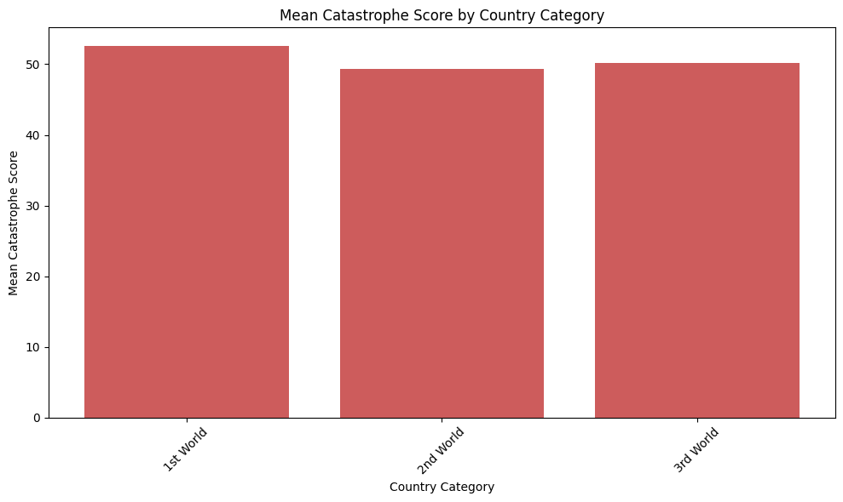

Slide 12
Stacked Bar Chart: Impact of CO₂ Emissions(Catastrophe Score)
The bar chart illustrates the average Catastrophe Score across different country categories—1st World (developed), 2nd World (developing), and 3rd World (underdeveloped). Interestingly, the scores are relatively similar across the groups, with the 1st World countries slightly leading. This finding suggests that developed nations, despite their advanced economies and access to resources, still face significant environmental and societal risks, possibly due to high CO₂ emissions, industrial activities, or population density. For developing and underdeveloped countries, while the risks are slightly lower, they likely stem from vulnerabilities such as natural disasters, resource over-dependence, and limited adaptive capacity. Understanding these scores can help prioritize resilience-building strategies tailored to the specific challenges faced by each group.
a

Slide 13
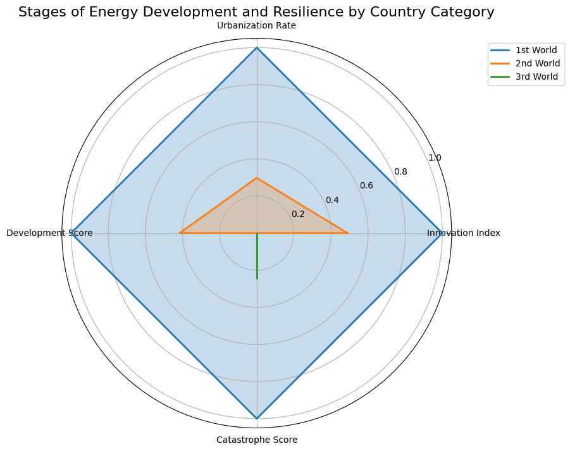

Slide 14
A Radar Chart to compare the stages of energy development and resilience
This radar chart compares the stages of energy development and resilience across three country categories—1st World, 2nd World, and 3rd World—based on metrics such as Urbanization Rate, Innovation Index, Catastrophe Score, and Development Score. The Catastrophe Score highlights a stark difference in preparedness and resilience: 1st World countries, being highly structured and well-resourced, manage adversities effectively with minimal disruption. Their high Development Score and Innovation Index reflect advanced infrastructure and technologies that allow them to mitigate catastrophe impacts efficiently. In contrast, 2nd World countries, with moderate structural development and resources, face challenges in dealing with adversities, but they can manage these moderately due to gradual improvements in urbanization and innovation. However, 3rd World countries, represented by the smallest area in the radar chart, struggle significantly with catastrophes due to poor infrastructure, limited resources, and low innovation capacity. These disparities underscore the need for targeted interventions to improve resilience in less developed regions.
a

Slide 15
Thank you

