Slide 1
Normalization
Shoyab Siddique

Slide 2
Employee Table
EMPLOYEE (EID, NAME, AGE, SALARY, BASIC, HRA, TA, DA, PF, DESIGNATION, DEPARTMENT, HOD)

Slide 3
1NF
There are only Single Valued Attributes.
Attribute Domain does not change.
There is a unique name for every Attribute/Column.
The order in which data is stored does not matter.
The table is already in 1NF

Slide 4
2NF
A relation that is in First Normal Form and every non-prime attribute is fully functionally dependent on the candidate key, then the relation is in Second Normal Form (2NF).
2NF requires that the table is in 1NF and all non-key attributes are fully functionally dependent on the primary key.
1. eid is the primary key
2. designation is dependent on designation
3. department and hod are dependent on department
therefore,
EMPLOYEE (EID, NAME, AGE, SALARY, BASIC, HRA, TA, DA, PF, DESIGNATION_ID, DEPARTMENT_ID)
DEPARTMENT (DEPARTMENT_ID, DEPARTMENT, HOD)
DESIGNATION (DESIGNATION_ID, DESIGNATION)

Slide 5
3NF
3NF requires that the table is in 2NF and all non-key attributes are non-transitively dependent on the primary key.
here, the salary can be derived from the basic, hra, ta, da, pf
therefore,
EMPLOYEE (EID, NAME, AGE, DESIGNATION_ID, DEPARTMENT_ID)
DEPARTMENT (DEPARTMENT_ID, DEPARTMENT, HOD)
DESIGNATION (DESIGNATION_ID, DESIGNATION)
SALARY(EID, BASIC, HRA, TA, DA, PF, SALARY)

Slide 6
Normalized Table Structure
EMPLOYEE (EID, NAME, AGE, DESIGNATION_ID, DEPARTMENT_ID)
DEPARTMENT (DEPARTMENT_ID, DEPARTMENT, HOD)
DESIGNATION (DESIGNATION_ID, DESIGNATION)
SALARY(EID, BASIC, HRA, TA, DA, PF, SALARY)

Slide 7
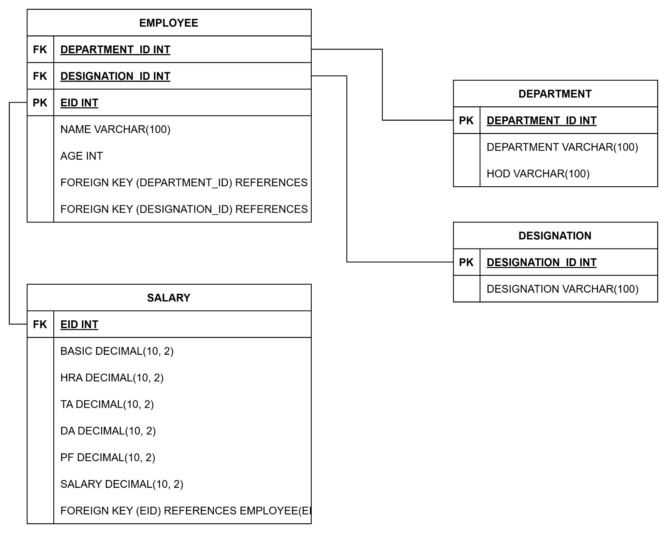
ER Diagram

Slide 8
THANK YOU

