Slide 1

Data Compression and Huffman Coding - Paras Sharma Computer Engineering, Junior
Image: https://www.online-tech-tips.com/software-reviews/7-zip-vs-winzip-vs-winrar/

Slide 2
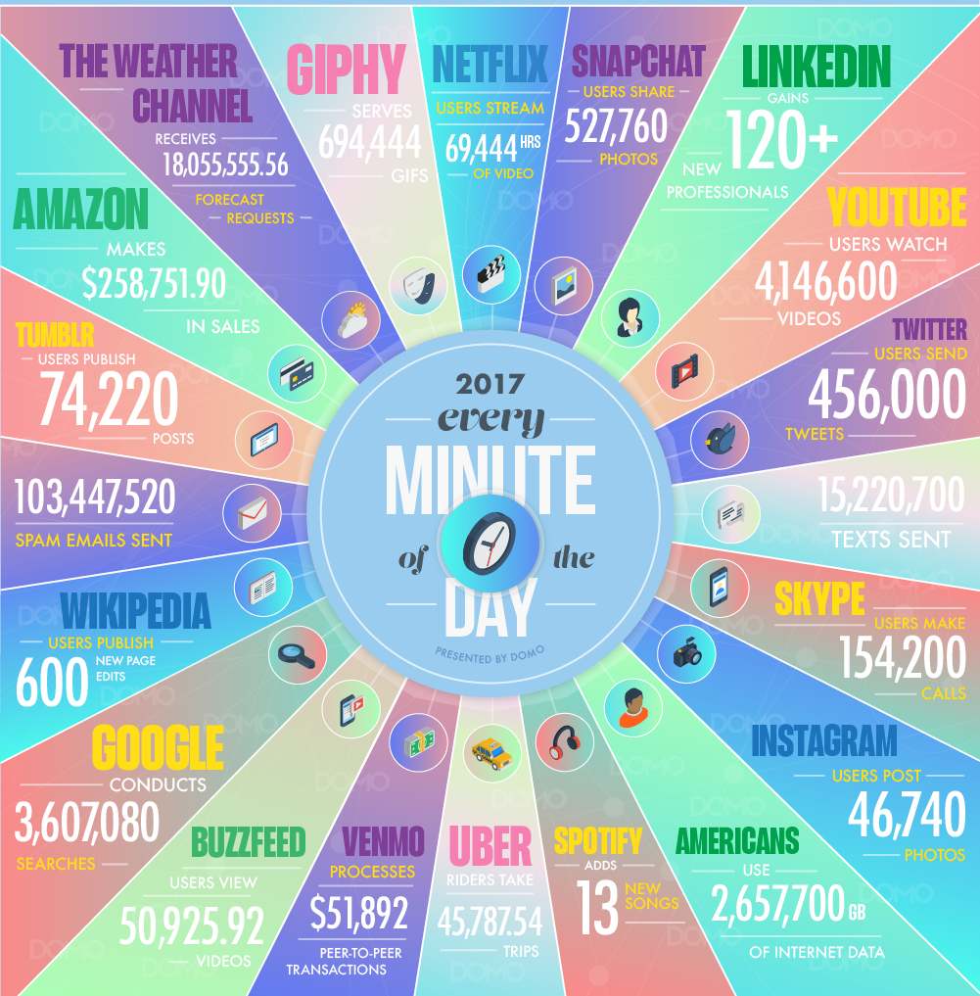
Image: https://web-assets.domo.com/blog/wp-content/uploads/2017/07/17_domo_data-never-sleeps-5-01.png

Slide 3
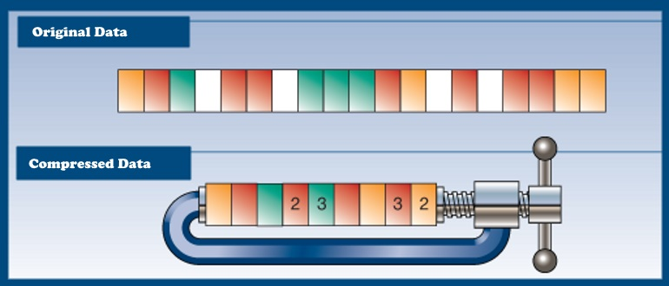
Image: https://docs.faircom.com/doc/v10ace/55874.htm

Slide 4
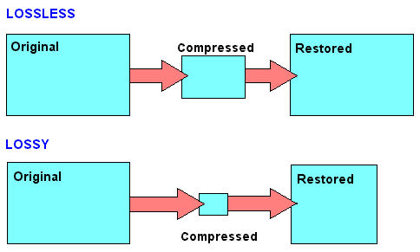
Image: http://cf.ydcdn.net/latest/images/computer/LOSSY.GIF

Slide 5
Apple Apple Apple Apple Apple Ball Cat Cat Cat Dog Dog
The code that we can use, as generated by the algorithm, are 0, 10, 100 and 101.
Apple occurs most frequent, use shortest code i.e. 0 to represent it.
Then Cat occurs often, lets use 10.
Then Dog so use 110
Then Ball so use 111
The compressed data is:
0 0 0 0 0 111 10 10 10 110 110 (Looks very short? It can be made shorter.)

Slide 6
Decompression is as easy as replacing the short code with their respective representation:
0 0 0 0 0 111 10 10 10 110 110
0 => Apple
10 => Cat
110 => Dog
111 => Ball
The decompressed data is:
Apple Apple Apple Apple Apple Ball Cat Cat Cat Dog Dog

Slide 7
That is it!

