Slide 1
Intermediate C#

Slide 2
Polymorphism
In general:
Having many forms
In OOP:
Ability of an object to behave based on its type

Slide 3
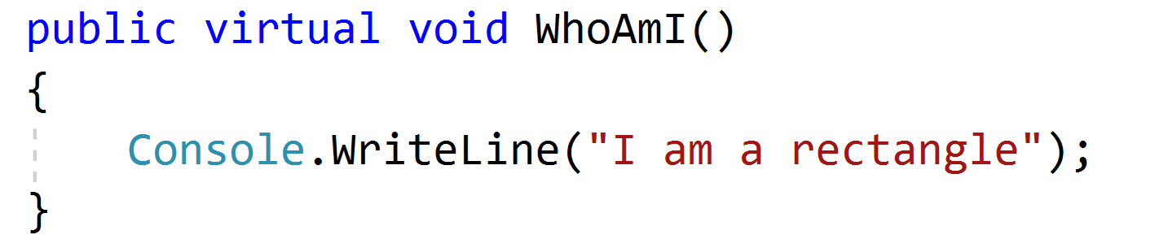
Polymorphism Simple Example
In Rectangle Class

Slide 4
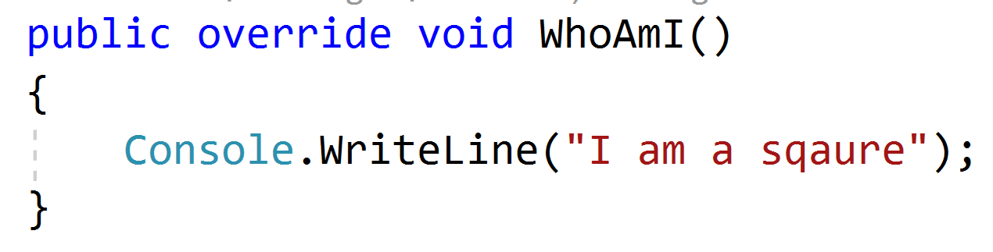
Polymorphism Simple Example
In Square Class

Slide 5
Polymorphism More Complex Example
Example: 3DRectangle, inherit from Rectangle
Add depth property
Override Area() method

Slide 6
System.Object
All classes in C# inherit from System.Object
Provides 8 methods
All details can be found on MSDN
ToString() in Rectangle overrides Object’s ToString()

Slide 7
Abstraction
When designing an object we don’t have to think about concrete implementation
What is the min set of methods an object can have
Abstraction is about handling complexity by hiding unnecessary details from the user.

Slide 8
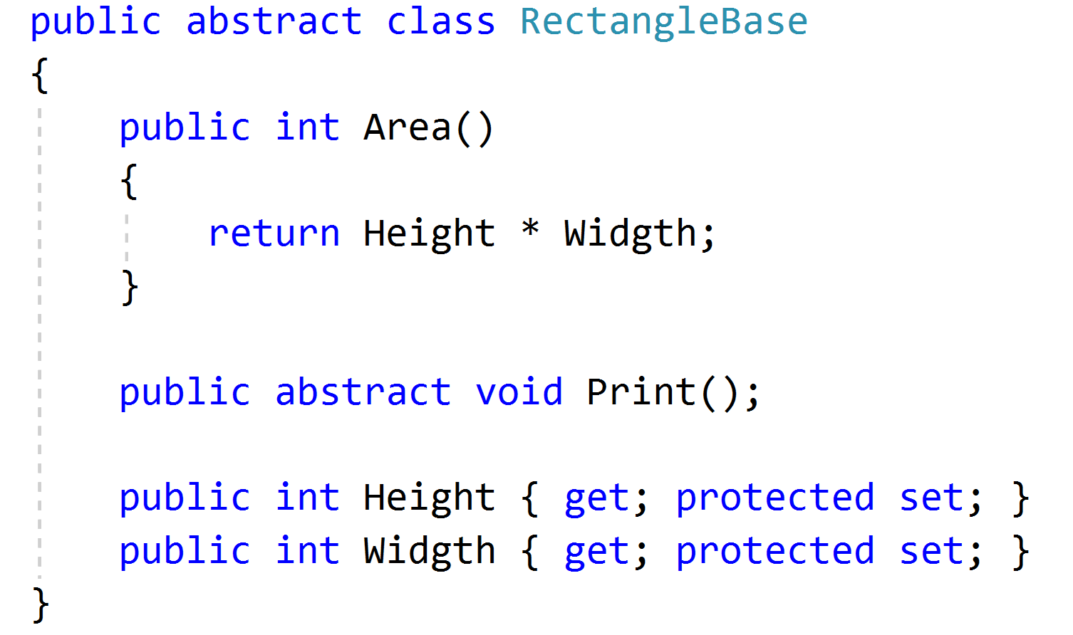
Abstract class - Example
Note
Print() function is defined as abstract and doesn’t have an implementation

Slide 9
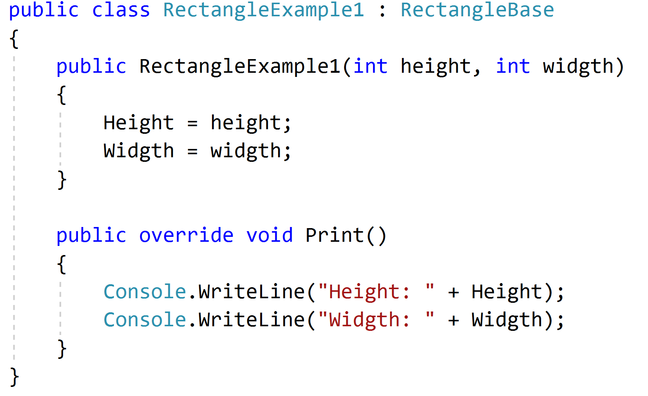
Abstract class - Example
Note
Inheriting Rectangle from RectangleBase forces us to override Print() function that is defined as abstract in RectangleBase class
we no longer need Area() function in Rectangle class because it is implemented in RectangleBase class

Slide 10
Interface
Defines a set of functions that all derived classes need to implement
Serves as a “contract” for child classes
As opposed to Abstract classes, can’t contain any implementation

Slide 11
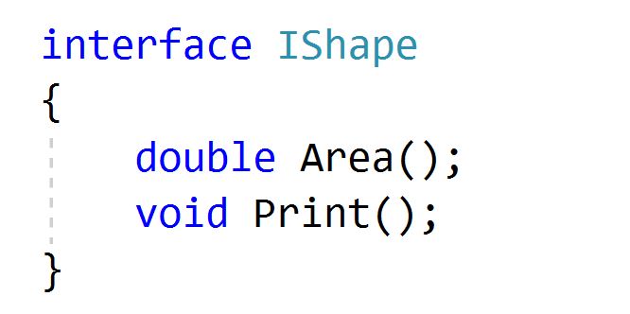
Interface - Example
Note
Double is more generic than int, so we opted to use it for our generic interface

Slide 12
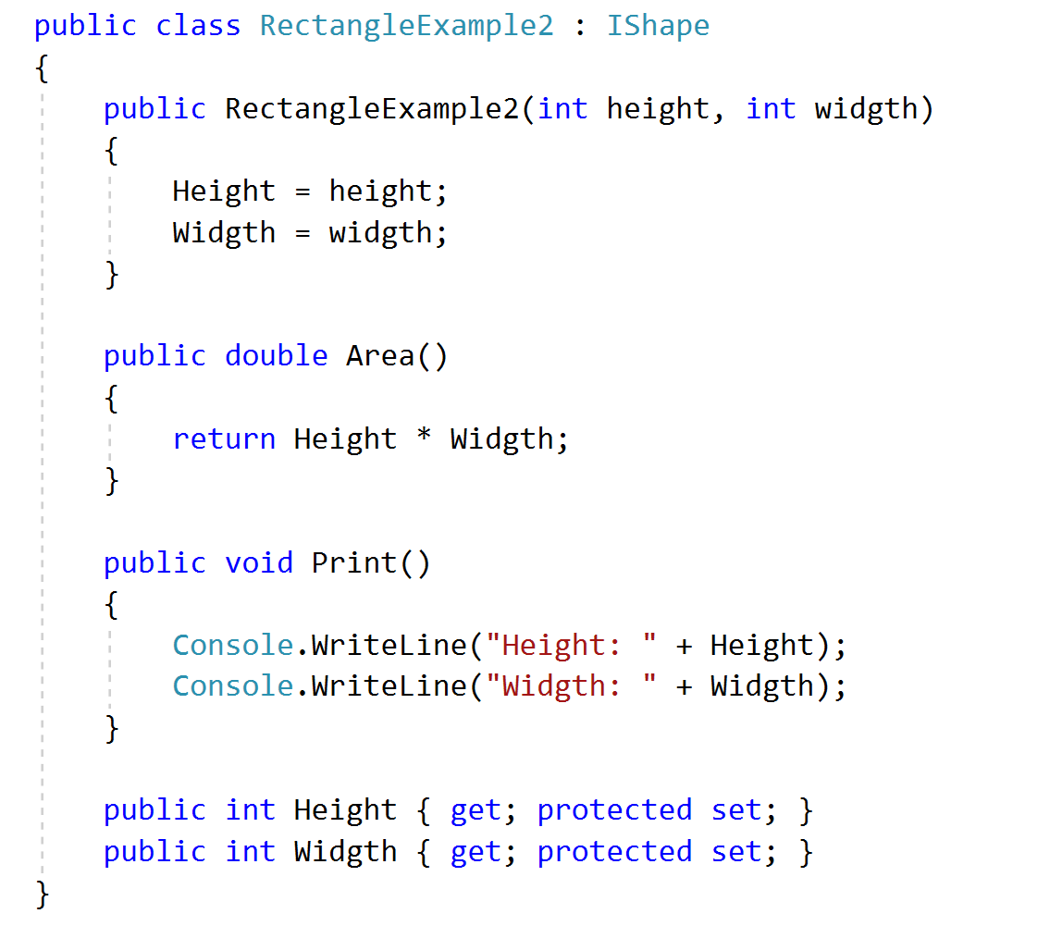
Interface - Example

Slide 13
Exercise
https://github.com/shpolina/CodeLouisville/blob/master/Intermediate/IntermediateExercise.txt

