Slide 1
Objects

Slide 2
Objects and Classes
Primitive types (int, string, bool, double, etc)
Complex types
Defined using classes
Object is an instance of a class
var rectangle = new Rectangle();

Slide 3
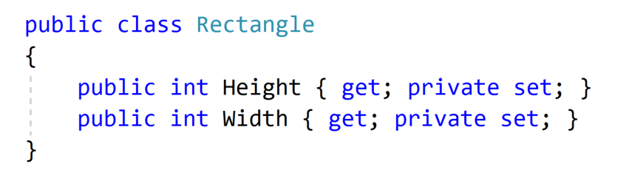
Class Example - Rectangle

Slide 4
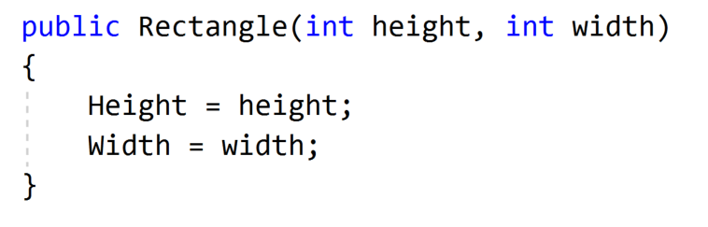
Class Example - Constructor

Slide 5
Class Methods
Object behavior is defined using methods
Methods have access to the instance
Methods use fields
Methods can return values
Static Methods - operate on the entire class rather than class instance

Slide 6
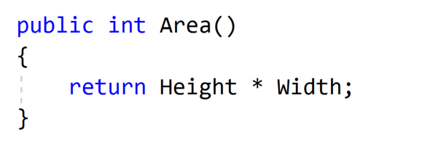
Class Example - Methods

Slide 7
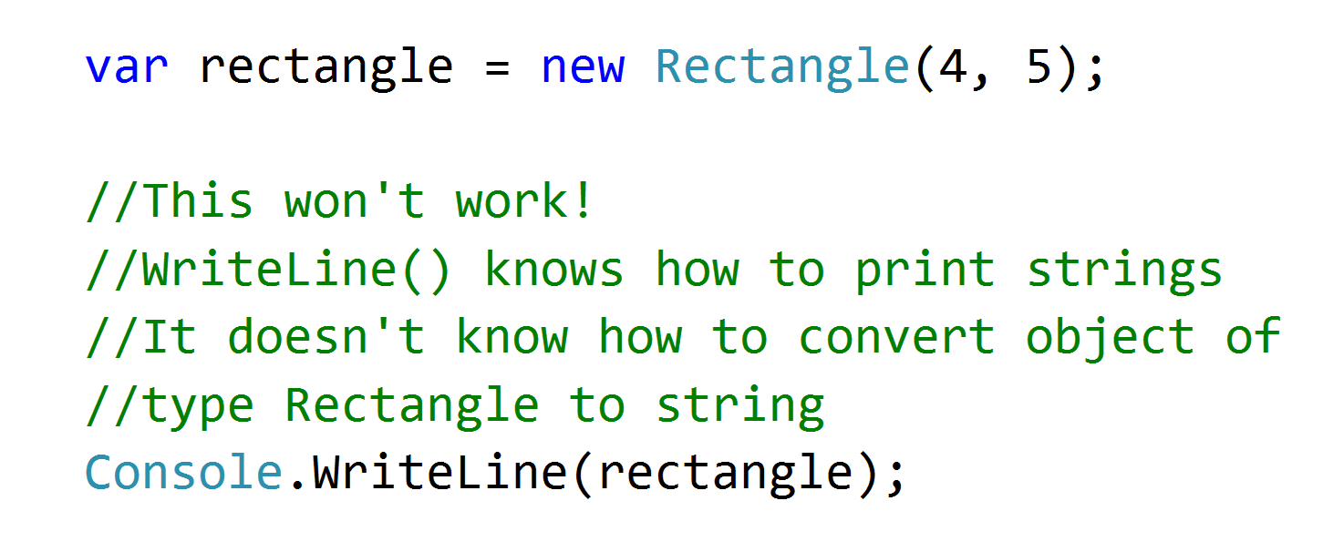
Printing Class Content

Slide 8
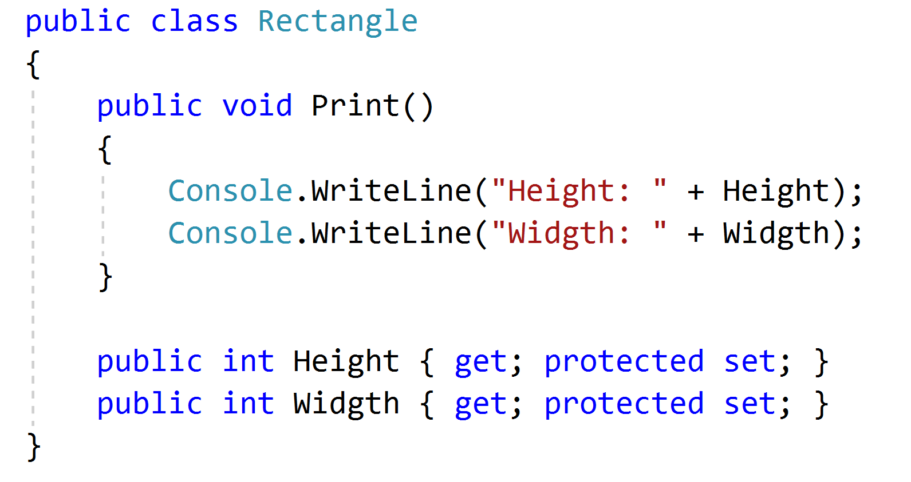
Printing Class Content using Method
Instead, we can define method Print() in class Rectangle

Slide 9
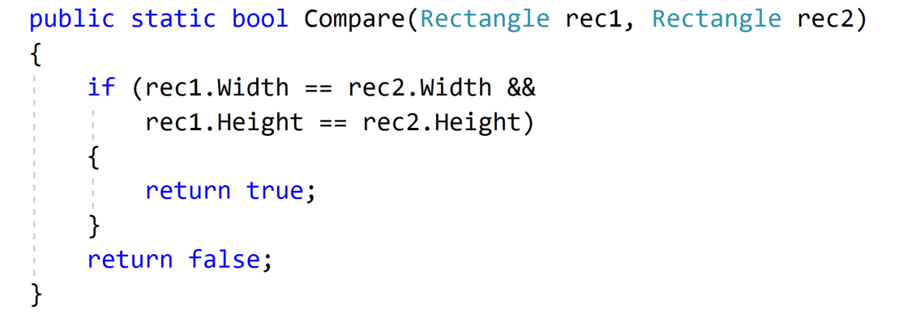
Static Methods
Operate on the entire class rather than class instance
Don’t have access to class non-static members

Slide 10
Inheritance
Many objects share similar logic
But they are not entirely similar
Inheritance allows to reuse similar logic
Parent/Child or Base/Derived class
Is-A relashionship

Slide 11
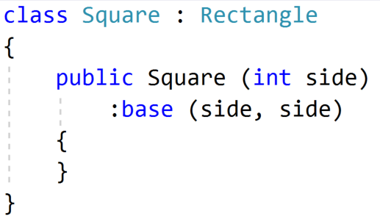
Inheritance Example

Slide 12
Arrays
Simplest way to represent a collection of objects
Constant predefined size
Access by index
0-based indexing

Slide 13
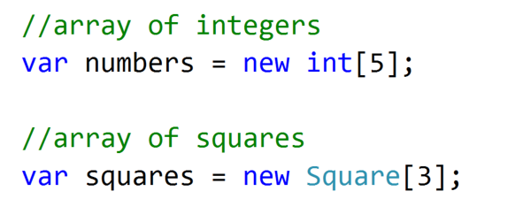
Arrays Example - Declaration

Slide 14
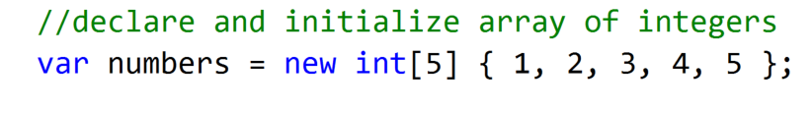
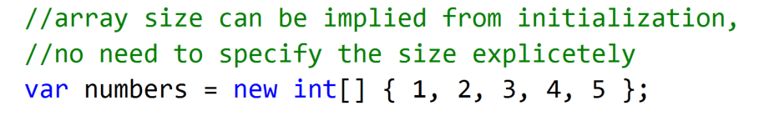
Arrays Example - Initialization
OR

Slide 15
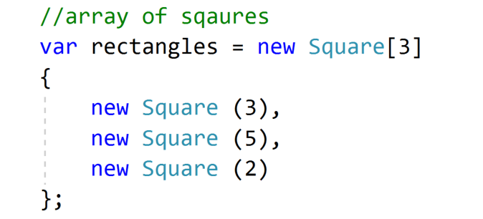
Arrays Example - Initialization with Objects

