Slide 1
COMP 1950
Web Development and Design 2

Slide 2
Day 03

Slide 3
Agenda
Flexbox

Slide 4
What is Flexbox?
The Flexbox Layout (Flexible Box) module aims at providing a more efficient way to lay out, align and distribute space among items in a container, even when their size is unknown and/or dynamic (thus the word "flex")¹
1. https://css-tricks.com/snippets/css/a-guide-to-flexbox/

Slide 5
What is Flexbox?
The main idea behind the flex layout is to give the container the ability to alter its items' width/height (and order) to best fill the available space (mostly to accommodate to all kind of display devices and screen sizes). A flex container expands items to fill available free space, or shrinks them to prevent overflow¹
1. https://css-tricks.com/snippets/css/a-guide-to-flexbox/

Slide 6
What is Flexbox?
The flexbox layout is direction-agnostic as opposed to the regular layouts (block which is vertically-based and inline which is horizontally-based). While those work well for pages, they lack flexibility (no pun intended) to support large or complex applications (especially when it comes to orientation changing, resizing, stretching, shrinking, etc.)¹
1. https://css-tricks.com/snippets/css/a-guide-to-flexbox/

Slide 7
Creating a Flexbox Area?
Set parent element to:
display: flex
To create a flexbox area you simply create a display property on a container element and set its value to "flex"
Once the container has been set to display: flex then its immediate children become flex-items
<div class="container">
<div class="box box1">1</div>
<div class="box box2">2</div>
<div class="box box3">3</div>
</div>
Direct child elements become flex-items

Slide 8
Flex Direction
flex box layout is direction agnostic. It can be set to have flex-items flow horizontally (row (default)) or vertically (column)
The order of flex items can even be reversed by setting the flex-direction property to row-reverse or column-reverse
flex-direction: column
flex-direction: row (default)

Slide 9
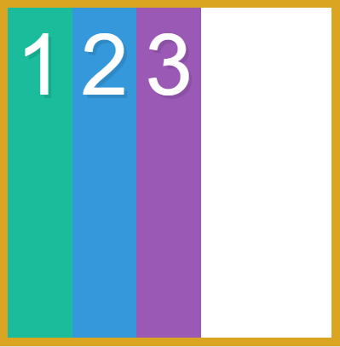
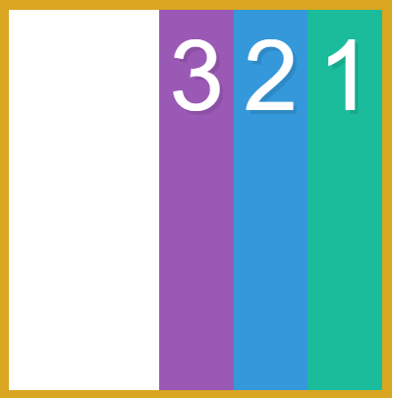
Flex Direction
row (default)
row-reverse

Slide 10
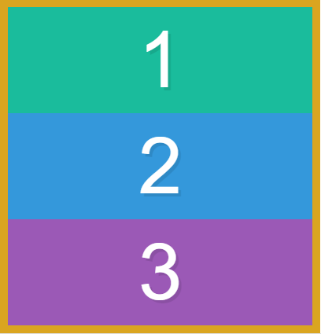
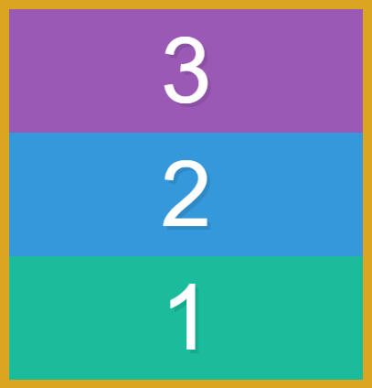
Flex Direction
column
column-reverse

Slide 11
Flex Direction - Main Axis and Cross Axis
Flex Box has some properties which determine how flex-items are laid out on the main axis and some which determine how flex-items are laid out on the cross axis
The Flex Direction property determines which way the main axis and cross axis go
See the next slide for details

Slide 12
Flex Direction - Main Axis and Cross Axis
Cross Axis
Main Axis
Main Axis
Cross Axis
row (default)
column

Slide 13
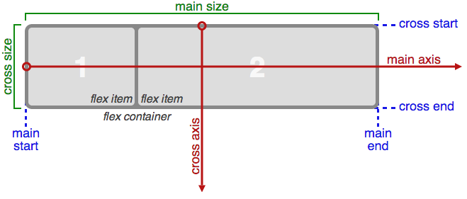
Flexbox Layout
The above image from: https://css-tricks.com/snippets/css/a-guide-to-flexbox/

Slide 14
Flex Wrap
The flex wrap property determines if the flex items will wrap to a new line if they run out of available space. The default is "nowrap" which means the flex items will shrink to fit on a single line
See diagram on next page

Slide 15
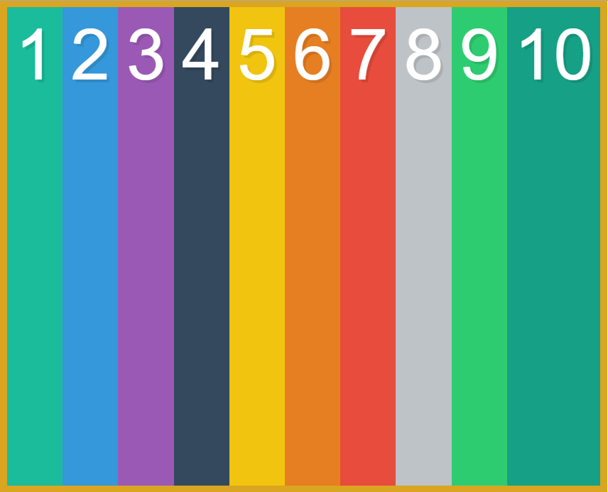
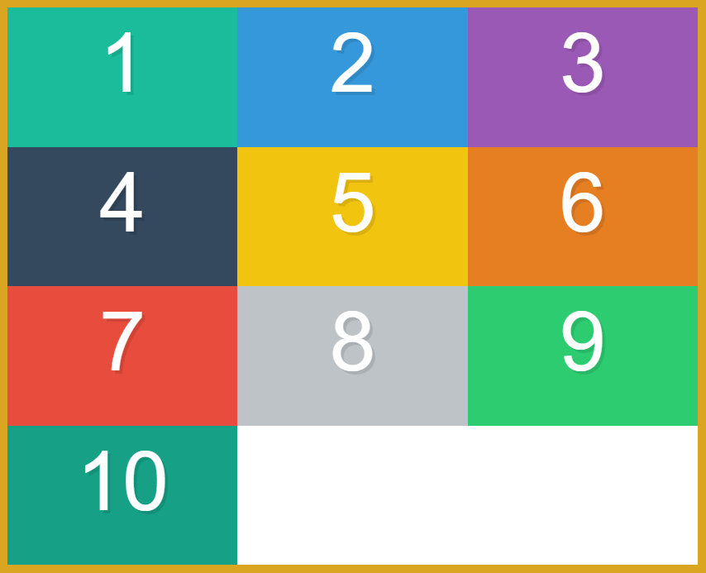
Flex Wrap
Each box has a width set at 33.33%. Notice how with the nowrap (default) version the flexbox layout engine shrinks the items to fit on a single line
flex-wrap: nowrap
flex-wrap: wrap

Slide 16
Order
With flexbox you can change the order that flex-items appear on the page by setting the order property
By default all flex-items have their order property set to "0". So if you set a flex-item to have an order value higher than zero it will appear on the screen after all the other flex-items.
The order property takes a unit less number. Higher numbers get placed last in the layout and lower numbers get displayed first
Negative values are allowed
See next page for a diagram explaining the order property

Slide 17
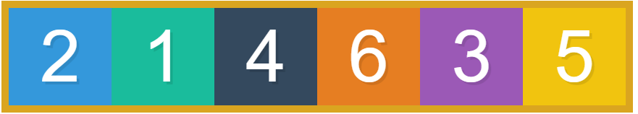
Order
order property set to -1
order property at the default value of "0"
order property set to 1
order property set to 2

Slide 18
Justify Content
The justify-content property handles how flex-items are aligned along the main axis
The justify-content property can have 5 different values
flex-start
Aligns the flex items at the start of the main axis
flex-end
Aligns the flex items at the end of the main axis
center
Aligns the flex items in the center of the main axis
space-between
Places the first item at the start and the last item at the end and divides the space between the other items evenly
space-around
Evenly puts equal space around each item
See diagrams on the next page

Slide 19
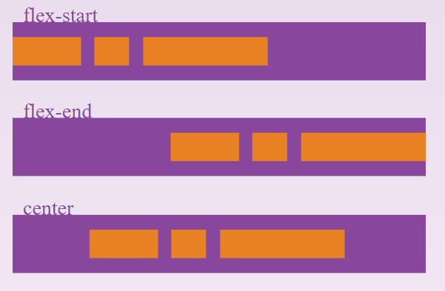
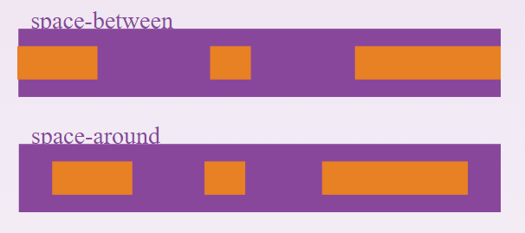
Justify Content
The above images are modified images from: https://css-tricks.com/snippets/css/a-guide-to-flexbox/

Slide 20
Align Items
The align-items property determines how flex-items are aligned along the cross-axis on the current line
The align-items property can have 5 different values
stretch
This is the default. All items are stretched to fill all the available space in the cross axis
flex-start
Flex items start at the start of the cross-axis
flex-end
Flex items are pushed to the end of the cross-axis
center
Flex items are placed in the center of the cross axis
baseline
All the flex items are aligned along the cross axis based on the baseline of their text content
See Diagram on the next page

Slide 21
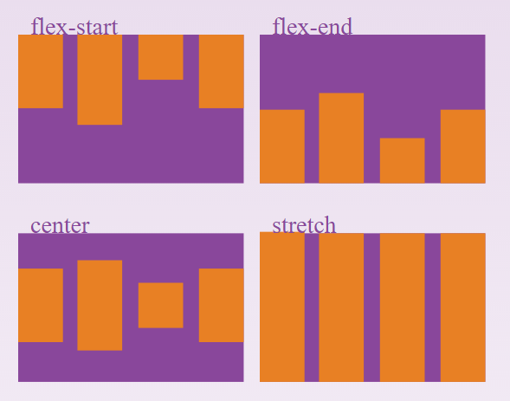
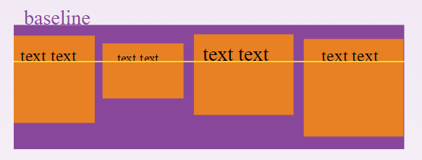
Align Items
The above images are modified images from: https://css-tricks.com/snippets/css/a-guide-to-flexbox/

Slide 22
Align Content
The align-content property works similarly to the justify-content property except that it works along the cross axis
For the align-content property to work the flex-wrap property must be set to wrap
The align content property takes the same values as the justify-content property. The only difference being it applies those values to the cross-axis
See diagram on next page

Slide 23
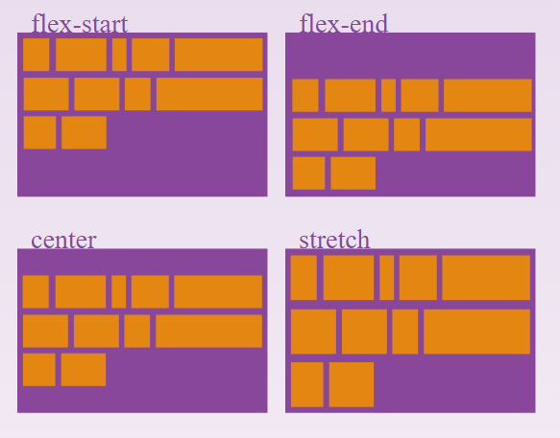
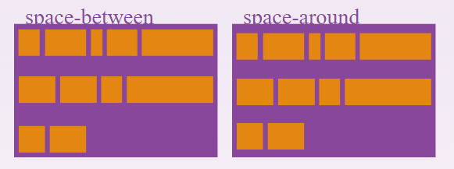
Align Content
The above images are modified images from: https://css-tricks.com/snippets/css/a-guide-to-flexbox/

Slide 24
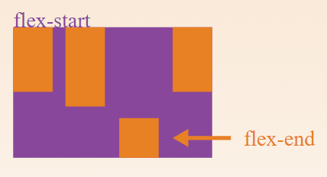
Align Self
The align-self property is set on a flex item and not on a flex container
The align-self property allows you to override the align-items property on individual flex-items
The align-self property takes the same values as align-items
The above image from: https://css-tricks.com/snippets/css/a-guide-to-flexbox/

Slide 25
Flex Property
The flex property is set on flex items
The flex property handles how to divvy up any extra white space between all the flex items or how shrink the items if there is not enough space
The flex property takes a unit-less number (decimal numbers are fine). The numbers are simply proportional
For example
box1, box3, box4, box5 and box6 has a flex property set at 1
box2 has a flex property set at 2
This means that box2 will get twice the amount of space as the other boxes because 2 is twice as large as 1
See diagram on the next page

Slide 26
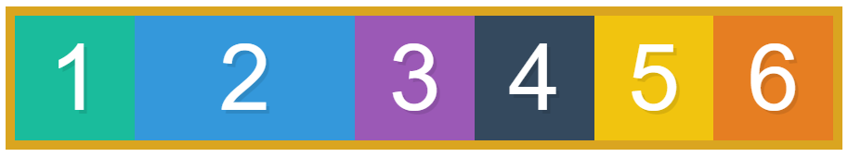
Flex Property
flex: 2
flex: 1

Slide 27
Flex Grow, Shrink and Basis
The flex property can actually take three values
The first value sets the grow value
This is a proportional value and determines how of the available free space a flex item will take up when there is free space available
The second value sets the shrink value
This is the opposite to the grow value and determines how much an item will shrink when there is not enough available space
The third value sets the basis value
The basis determines how space is given to a flex item before any shrinking or growing of a flex item

Slide 28
Flex Grow, Shrink and Basis
.box1 {
flex: 10 10 300px;
}
flex-grow
flex-shrink
flex-basis

Slide 29

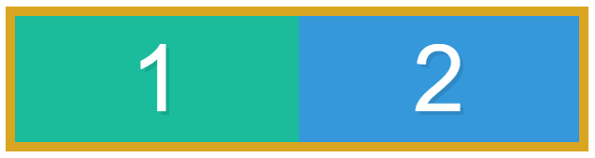
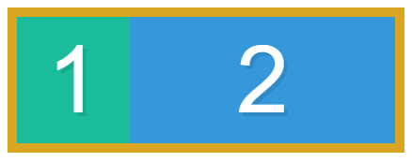
Flex Grow, Shrink and Basis
.box1 {
flex: 10 10 300px;
}
.box2 {
flex: 1 1 300px;
}
Browser width - narrower ->

