Slide 1
COMP 1950
Web Development and Design 2

Slide 2
Day 04

Slide 3
CSS3
Some Advantages to CSS3
Create better layout design using just styles as opposed to images
Create more advanced transitions without the use of JavaScript
Some Dis-Advantages to CSS3
No support in older versions of IE

Slide 4

Text Shadow
Text shadow adds a drop shadow to text
You can have multiple text shadows applied to the same text
Text shadow parameters
Color (optional)
Can be placed at the beginning or end of the style declaration
offset-x (required)
Sets the x axis offset of the drop shadow
offset-y (required)
Sets the y axis offset of the drop shadow
blur-radius (optional)
Sets the blur of the shadow

Slide 5
Text Shadow
.box_main .h_01 {
text-shadow: 10px 10px 10px #363636;
}
offset-x
offset-y
blur-radius
color

Slide 6

Text Shadow - Multiple
shadow 01
.box_main .h_02 {
text-shadow: 5px 5px 0 #09F,
10px 10px 0 #F9F,
15px 15px 0 #09F,
20px 20px 0 #F9F;
}
shadow 02
shadow 03
shadow 04

Slide 7





Text Shadow
Browser compatibility for text shadow:
IE10+
Firefox 3.1+
Chrome 2+
Safari 1.1+
Opera 9.5+

Slide 8

Box Shadow
Box Shadow adds a drop shadow to HTML elements
You can set inset box shadow styles
Box Shadow parameters
Inset (optional)
Determines whether the shadow is inset or not
If omitted the browser will assume that the box shadow is a regular drop shadow
offset-x (required)
Sets the x axis offset of the drop shadow
offset-y (required)
Sets the y axis offset of the drop shadow
blur-radius (optional)
Sets the blur of the shadow
spread-radius (optional)
Sets how much the shadow will expand or shrink
Positive values will cause the shadow to expand
Negative values will cause the shadow to shrink

Slide 9
Box Shadow
.box_01 {
box-shadow: 10px 10px 19px 2px #000000;
}
offset-x
offset-y
blur-radius
spread-radius
color

Slide 10

Box Shadow - Inset
.box_02 {
box-shadow: inset -1px -2px 41px 5px #000000;
}
inset
offset-x
offset-y
blur-radius
spread-radius
color

Slide 11
Box Shadow
Browser compatibility for box shadow:
IE9+
Firefox 3.5+
Chrome 3+
Safari 3+
Opera 10.5+

Slide 12

Border Radius
Border radius adds rounded corners to elements
You can have different values set for each corner
You can have different values for the horizontal and vertical radii of a quarter ellipse which can create a more elliptical appearance in the corners as opposed to more a more circular appearance when the horizontal and vertical radii are of the same value
Border radius can use a shorthand or long hand syntax
Border radius parameters
length
Determines the size of the rounded corner based on a CSS unit (px, ems etc)
percentage
Determines the size of the rounder corner based on a percentage of the size of the HTML element

Slide 13

Border Radius
Shorthand syntax where all the corners have the same value
.box_04 {
border-radius: 50px;
}
length

Slide 14

Border Radius
Shorthand syntax where the adjacent corners have different values
.box_05 {
border-radius: 50px 100px;
}
top left and bottom right length
top right and bottom left length

Slide 15

Border Radius
Shorthand syntax where all corners have different values
.box_06 {
border-radius: 30px 45px 180px 100px;
}
top left
top right
bottom right
bottom left

Slide 16

Border Radius
Shorthand syntax for elliptical corners where all corners have the same values
.box_07 {
border-radius: 100px / 50px;
}
horizontal radii
vertical radii

Slide 17
Border Radius
Browser compatibility for border radius:
IE9+
Firefox 1+
Chrome 3+
Safari 3+
Opera 10.5+

Slide 18

Opacity
Sets the opacity level of an element
The opacity style applies to the element and all its descendant elements
Child elements can not override an opacity level if an opacity level is set on any of its ascendant elements (parents, grandparents, great grandparents, etc)
Opacity parameters
Alpha value
Takes a value between 0 and 1
0 = fully transparent
1 = fully opaque

Slide 19
Opacity
.box_09 {
opacity: 0.5;
}
alpha value

Slide 20
Opacity
Browser compatibility for opacity:
IE9+
Firefox 1.5+
Chrome 1+
Safari 1.2+
Opera 9+

Slide 21

RGBA
RGBA adds an alpha channel to the RGB color format for setting color in CSS
The alpha channel controls the transparency of the color
The alpha channel value takes a value between 0 and 1
0 = transparent
1 = opaque

Slide 22
RGBA
.box_11 {
background-color: rgba(204,51,153,0.5);
}
color model
red value
green value
blue value
alpha value

Slide 23
RGBA
Browser compatibility for rgba:
IE9+
Firefox 3+
Chrome 3+
Safari 3.2+
Opera 10+

Slide 24

CSS3 Gradients
CSS3 Gradients allow you to create gradient backgrounds using CSS and without images
You can create linear or radial backgrounds using the CSS3 gradient style
CSS gradients are considered backgrounds so they are actually written as a value of the background property
You can create multiple gradients for the same background property by separating each gradient with a comma
This is the same method as adding multiple background images to an element which we will cover in the next HTML course
The syntax for CSS gradients can be quite complex so below is a link to a CSS gradient generator that will help you generate the CSS code for creating CSS3 gradients
http://www.colorzilla.com/gradient-editor

Slide 25
CSS3 Gradients
Browser compatibility for CSS3 gradients:
IE10+
Firefox 3.6+
Chrome 10+
Safari 5.1+
Opera 11.6+

Slide 26
Advanced CSS Selectors
CSS 2.1 and CSS3 contain many advanced selectors that allow web designers to select elements on the page using fewer custom classes or ID’s
Some more advanced CSS selectors include:
Attribute selectors
Child selectors
Adjacent Selectors
Sibling selectors
Pseudo Selectors

Slide 27
Attribute Selectors
The attribute selector allows you to select certain HTML elements based on whether or not the element contains a certain attribute
The attribute selector also allows you to select elements based on what the value of an attribute is
7 main types of attribute selectors
[attribute] = matches all elements with have a certain attribute
^ = matches items that start with a value
$ = matches items that end with a value
* = matches items that contain a certain value
~= matches space separated value of some kind
|= matches dash separated value
“some text” = matches items that contain exactly the text in the quotes
You can combine multiple attribute selectors to make a more specific selection

Slide 28
Attribute Selectors
Examples of attribute selectors:
The selector below will select all “a” elements that have an “href” attribute with a value that ends with “pdf”
a[href$="pdf"]{
background-image: url(images/pdficon_small.png);
background-repeat: no-repeat;
background-position: 0px 2px;
}

Slide 29
Child Selectors
Selects “direct” decedents of on an element
This is different from the related common descendant selector which will select all decedents of an element
The “>” means this is a child selector
div > h1 {
color: red;
}

Slide 30
Child Selectors
Child Selector
Descendent Selector
div > h1 {
color: red;
}
div h1 {
color: red;
}
<div>
<div>
h1 heading
h1 heading
<section>
<section>
h1 heading
h1 heading
<section>
<section>
h1 heading
h1 heading

Slide 31
Adjacent Sibling Selector
Selects elements directly “adjacent to the element in the dom
The “+” means this is an adjacent selector
p + p {
color: red;
}

Slide 32
Adjacent Sibling Selector
Example of an Adjacent selector
Pellentesque habitant morbi tristique senectus et netus et malesuada fames ac turpis egestas.
Pellentesque habitant morbi tristique senectus et netus et malesuada fames ac turpis egestas.
Pellentesque habitant morbi tristique senectus et netus et malesuada fames ac turpis egestas
p + p {
color: red;
}

Slide 33
General Sibling Selector
Selects any “sibling” element that follows the element
Different from the adjacent selector in that the element does not have to directly follow the element, it merely has to be after the element
The element does have to be a sibling element and share the same parent element
The “~” means this is a general sibling selector
p ~ p {
color: red;
}

Slide 34
General Sibling Selector
Example of a general sibling selector
Heading 01
Pellentesque habitant morbi tristique senectus et netus et malesuada fames ac turpis egestas.
Heading 02
Pellentesque habitant morbi tristique senectus et netus et malesuada fames ac turpis egestas.
Pellentesque habitant morbi tristique senectus et netus et malesuada fames ac turpis egestas
p ~ p {
color: red;
}

Slide 35
Pseudo Classes
CSS3 has several new types pseudo class selectors
Some of the more useful are:
:first-child (CSS 2.1)
:last-child (CSS 2.1)
:nth-child(N)
:nth-last-child(N)
:nth-of-type(N)
:nth-last-of-type(N)
Go to this web site for more information on Pseudo-classes
http://reference.sitepoint.com/css/css3psuedoclasses

Slide 36
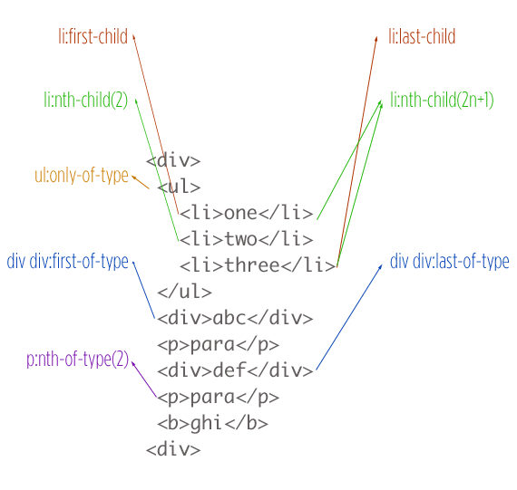
Pseudo Classes
Above image from: http://css-tricks.com/pseudo-class-selectors

Slide 37
CSS3 Transforms
Transform size rotation, skew and position of html elements
Transforms can be combined with transitions to create interesting effects
Partial support in IE9

Slide 38
CSS Transforms
Browser compatibility for CSS Transforms:
IE9+
Firefox 3.5+
Chrome 4+
Safari 3.1+
Opera 10.5+

Slide 39
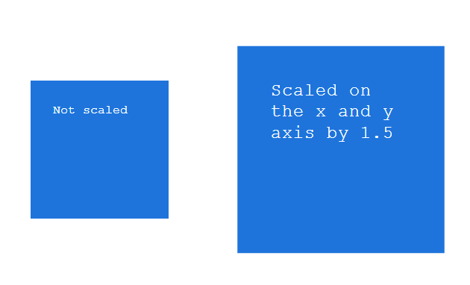
CSS3 Transforms - Scale
The scale transform adjusts the size of an element
A scale of “1” is the equivalent of not scaling the element
A scale of “2” will make the element twice as big
A scale of “0.5” will make the element half as big
The scale can be set to any value
The scale is a unitless value, it does NOT take units such as px or ems

Slide 40
CSS3 Transforms – Scale
.box_17 {
transform: scale(1.5);
}

Slide 41
CSS3 Transforms – Scale – X and Y
You can scale the x axis and y axis values independently
You have two syntax options
Option 01:
.box_19 {
transform: scale(0.5, 0.9);
}
Option 02:
.box_19 {
transform: scaleX(0.5) scaleY(0.9);
}

Slide 42
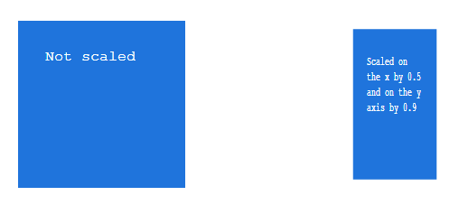
CSS3 Transforms – Scale – X and Y
Option 01:
.box_19 {
transform: scale(0.5, 0.9);
}

Slide 43
CSS3 Transforms – Scale – X and Y
Option 02:
.box_19 {
transform: scaleX(0.5) scaleY(0.9);
}

Slide 44
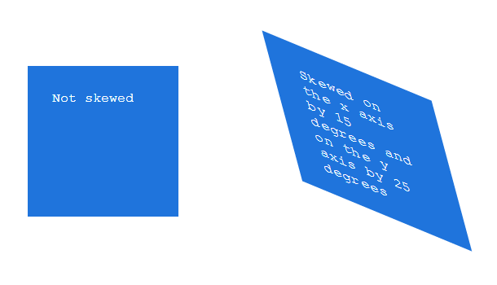
CSS3 Transforms - Skew
The skew skews an element along the x and or y axis

Slide 45
CSS3 Transforms - Skew
.box_21 {
transform: skewX(15deg) skewY(25deg);
}

Slide 46
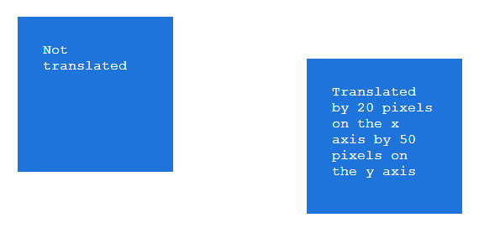
CSS3 Transforms - Translate
Translate alters the position of the element relative to where it would naturally sit
You can move an element along the x and or y axis
element naturally sits here
translate 50px on the y axis
translate 20px on the x axis

Slide 47
CSS3 Transforms - Translate
.box_23 {
transform: translate(20px, 50px);
}

Slide 48

CSS3 Transforms - Rotate
Rotate transforms the element in a clockwise (positive values) or a counter-clockwise) direction
Values are set in degrees (deg)

Slide 49
CSS3 Transforms - Rotate
.box_25 {
transform: rotate(60deg);
}

Slide 50
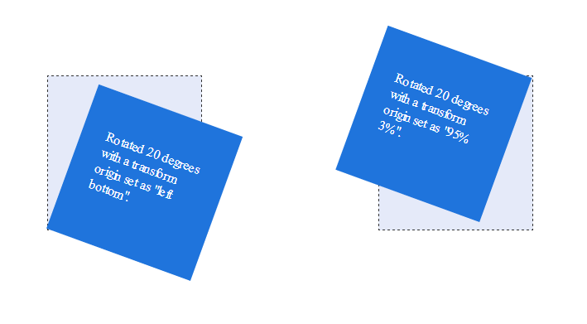
CSS3 Transforms - Origin
Transform origin sets the transform point on the x and y axis.
Possible values for the x axis and y axis are
left
center
right
Percentage (%).

Slide 51
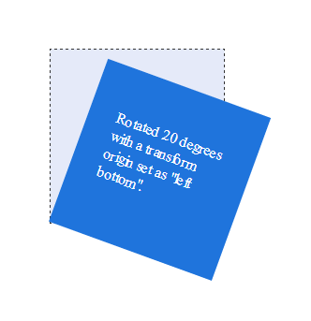
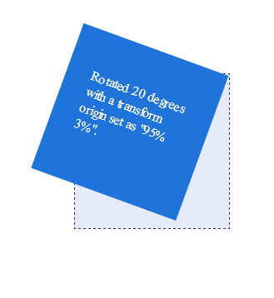
CSS3 Transforms - Origin
.box_26 {
transform-origin: left bottom;
}
.box_27 {
transform-origin: 95% 3%;
}

Slide 52
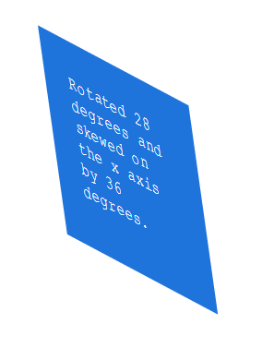
CSS3 Transforms - Multiple
You can set multiple transform types on a single line by separating the transforms with a space
.box_28 {
transform: rotate(28deg) skewX(36deg);
}

Slide 53
CSS 3 – Transitions (introduction)
Transitions smooth out the “transition” from various states
Example: regular state to hover
.box_28 {
transition: all 2s ease;
}
.box_28:hover {
transform: translateY(100px);
}

Slide 54
CSS Transistions
Browser compatibility for CSS Transforms:
IE10
Firefox 4+
Chrome 4+
Safari 3.1+
Opera 10.5+

Slide 55
CSS 3 – Transitions Multiple
You can transition a single property, all properties (that change) or multiple properties
If you transform multiple specific properties you can have the transitions run one after the other by setting the delay property of the second, third, fourth, etc. transitioned elements to be equal to the total transition time of the elements that ran before it
.box_28 {
transition: height 1s ease, width 1s ease 1s;
}
.box_28:hover {
width: 30px;
height: 30px;
}
Notice the second time of “1s” after the easing. This is the delay parameter and sets the delay. Here we have set the delay to be equal to the time of the transition of the height. This will cause the width transition to run after the height transition

