Slide 1
COMP 1950
Web Development and Design 2

Slide 2
Day 08

Slide 3
Agenda
Sass

Slide 4
About Sass
Sass stands for:
S
yntactically
A
wesome
S
tyle
S
heets

Slide 5
About Sass
Sass is a CSS preprocessor and scripting language
Developers write CSS like syntax that is then interpreted by the Sass complier and converted into regular CSS
Sass is open sourced and coded in Ruby; however other implementations exist.
Developers can have script like abilities for their CSS development. The following are available to CSS developers that use Sass:
Variables
Mixins (sort of like functions)
Functions
If/else statements
Loops
@extend
Importing and concatenation of several files into a single file
Compression
“//” single line comments

Slide 6
Why Use Sass
It adds programmability to CSS
It allows less repeated code in your CSS development (before compiling)
You can use variables, mixins, functions and extends to write a set of rules once and apply them in multiple locations
It allows you to break up your CSS into smaller modular files and concatenate them into a single CSS file, making development easier
Promotes DRY (Do not repeat yourself) principals in writing your CSS
We can use the quick and easy “//” for single line comments

Slide 7


How Sass Works
SCSS
Compilier
CSS

Slide 8
Installing Sass
Many options to get Sass up and running on your computer
Use a build system such as Gulp
Use a GUI tool such as CodeKit or Prepros
Install Ruby, install Sass and run from the Terminal (Mac) or Command Prompt (Windows)
For this class we will run Sass from Terminal (Mac) or the Command Prompt (Windows)

Slide 9
Installing Sass
To get Sass up running using the Ruby version of Sass you will need to install Ruby on your system
Mac’s already have Ruby installed
Linux and Windows users will need to install Ruby on their systems
Windows users can visit the link below for an easy Ruby installer that installs Ruby and gives you a Ruby command prompt program
http://www.rubyinstaller.org
Once Ruby is installed you can open the terminal on a Mac or Linux machine or the Ruby command prompt on Windows and type:
$ gem install sass
Mac users may have to type "sudo gem install sass"
Don't want to use "sudo"?
Follow the instructions laid out in the "mac-os-sass-install-instructions.pdf" file located in the day's folder
Sass will download and install
To double check if Sass has installed correctly type:
$ sass –v
You should see something similar displayed in the terminal:
Sass 3.3.4 (Maptastic Maple)

Slide 10
Watch Files With Sass
In order for Sass to compile files you need to tell Sass what folder to watch
To tell Sass to watch a file or folder of files first navigate to your project folder in the terminal and then type the following:
The folder where the compiled CSS will go
The folder containing the .scss files that we want to watch
$ sass --watch scss:styles
Initiates the watch function

Slide 11
Your Browser only understands CSS
A key point to remember is that your browser only reads CSS files, so the link to your stylesheet should be to your compiled CSS file, not to your Sass files
The Sass compiler will create a ".map" file which some browser's developer tools can read. The ".map" file will tell the browser which Sass file and line number a particular CSS rule was compiled from
That information is displayed in the browser's developer tools to aid in CSS/Sass development

Slide 12
Determining CSS Output Format
Sass can output the CSS in a variety of ways, the default is using the nested syntax where nested rules are indented
Other options include:
expanded
Each selector written on a new line with each property and value also written on its own line (this is my personal preference as it is how I write my CSS)
compact
Each selector on its own line and all properties and values written on the same line as the selector
compressed
All non-required white space between selectors, properties and values are removed
This outputs the smallest file size

Slide 13
Determining CSS Output Format
To output CSS with the expanded output type the following into the terminal:
Tells Sass to output CSS using expanded CSS syntax
$ sass --watch –-style expanded scss:styles

Slide 14
Don't Edit the Compiled CSS File
Do not edit the compiled CSS
If you need to change the CSS, write your changes in Sass and re-compile
Feel free to look at the compiled CSS to see what Sass is outputting and for troubleshooting purposes

Slide 15
Writing Sass
Sass Syntax
Sass can be written in two ways
Sass syntax
Uses indenting to format rules
SCSS syntax
Written using a syntax that is similar to the syntax used for writing standard CSS
For this course we will be using SCSS syntax but your choice of syntax comes down to either personal preference or what your development team is using
$brand-color: #eee;
p
font-size: 24px
color: $brand-color
line-height: 1.5
SCSS Syntax
$brand-color: #eee;
p {
font-size: 24px;
color: $brand-color;
line-height: 1.5;
}

Slide 16
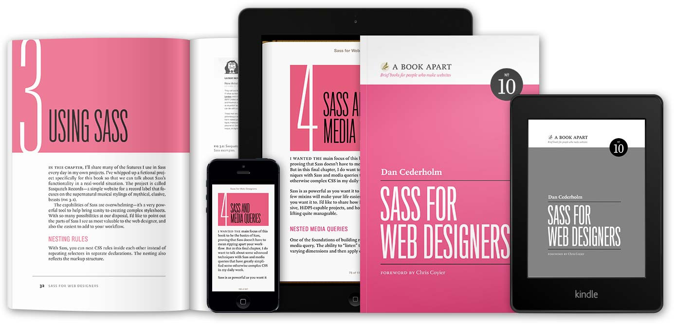
Sass Resources
Sass web site
http://sass-lang.com
Sass book
Sass for Web Designers
http://www.abookapart.com/products/sass-for-web-designers
Image credit: http://www.abookapart.com/products/sass-for-web-designers

Slide 17
VS Code – Sass Extension
Useful extension for Sass in Visual Studio Code
SCSS IntelliSense
https://marketplace.visualstudio.com/items?itemName=mrmlnc.vscode-scss
This extension will auto-complete variables, mixins, functions and extends for a values located across the project
Especially useful when using partials

