Slide 1
COMP 1950
Web Development and Design 2

Slide 2
Day 07

Slide 3
Agenda
CSS Grid
Assignment 06

Slide 4
What is CSS Grid Layout?
CSS Grid Layout (aka "Grid"), is a two-dimensional grid-based layout system¹
CSS Grid Layout is the most powerful layout system available in CSS. It is a 2-dimensional system, meaning it can handle both columns and rows, unlike flexbox which is largely a 1-dimensional system. You work with Grid Layout by applying CSS rules both to a parent element (which becomes the Grid Container) and to that elements children (which become Grid Items)¹
1. https://css-tricks.com/snippets/css/complete-guide-grid/

Slide 5
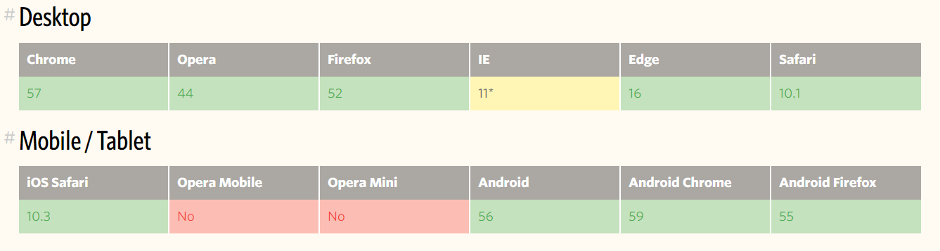
Browser Support for Grid
*** Support is for an older outdated syntax.

Slide 6
Grid Terminology
Grid Area
Grid Line
Grid Container
Grid Item
Grid Cell
Grid Track

Slide 7
Grid Container
The element that surrounds the grid items.
This is the element that you apply "display: grid" to
Once you apply "display: grid" to an element all its direct children become grid items
Grid container

Slide 8
Grid Item
The HTML elements that are direct children of a parent element that has a display property set to grid
Grid Item
Grid Item
Grid Item
Grid Item
Grid Item
Grid Item

Slide 9
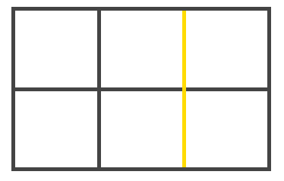
Grid Line
The dividing lines that make up the structure of the grid. They can be either vertical ("column grid lines") or horizontal ("row grid lines") and reside on either side of a row or column
Here the yellow line is an example of a column grid line
1. Information on this slide from: https://css-tricks.com/snippets/css/complete-guide-grid/

Slide 10
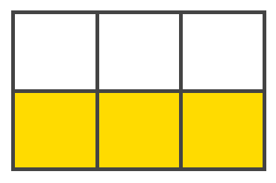
Grid Track
The space between two adjacent grid lines. You can think of them like the columns or rows of the grid
Here's the grid track between the second and third row grid lines
1. Information on this slide from: https://css-tricks.com/snippets/css/complete-guide-grid/

Slide 11
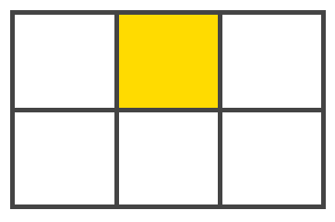
Grid Cell
The space between two adjacent row and two adjacent column grid lines. It's a single "unit" of the grid
Here's the grid cell between row grid lines 1 and 2, and column grid lines 2 and 3
1. Information on this slide from: https://css-tricks.com/snippets/css/complete-guide-grid/

Slide 12
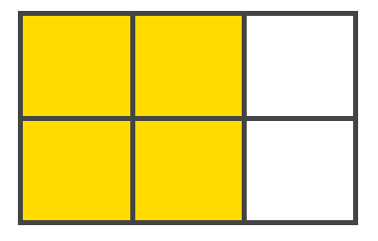
Grid Area
The total space surrounded by four grid lines. A grid area may be comprised of any number of grid cells
Here's the grid area between row grid lines 1 and 3, and column grid lines 1 and 3
1. Information on this slide from: https://css-tricks.com/snippets/css/complete-guide-grid/

Slide 13
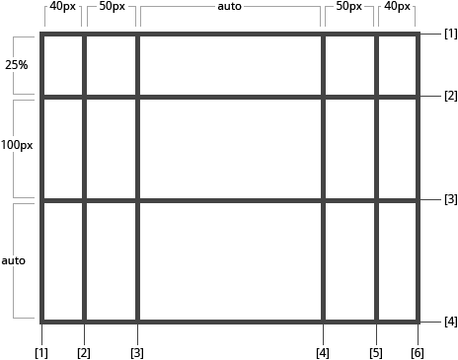
Defining the Grid
1. Image from: https://css-tricks.com/snippets/css/complete-guide-grid/

Slide 14
Defining the Grid
CSS Grid will default to the default CSS layout unless you define the grid
You can layout your grid using the following two CSS properties set on the parent element
"grid-template-columns"
"grid-template-rows"

Slide 15
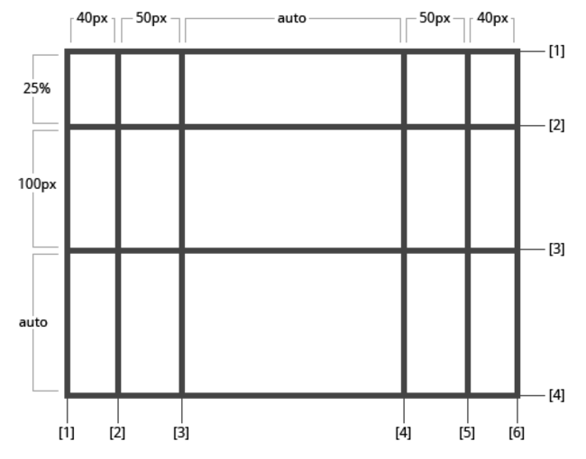
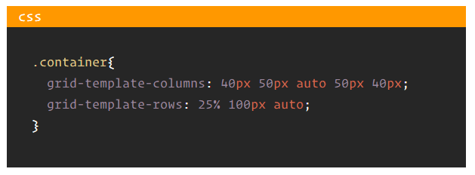
Defining the Grid
The syntax below lays out a two dimensional grid with columns that are 40px, 50px, [auto-width], 50px and 40px wide. The rows have heights of 25%, 100px and [auto-height]
1. Information on this slide from: https://css-tricks.com/snippets/css/complete-guide-grid/

Slide 16
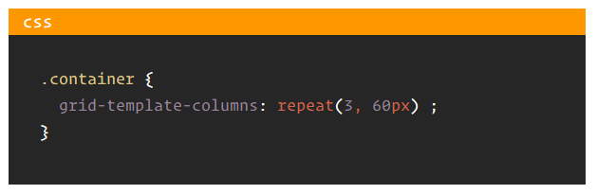
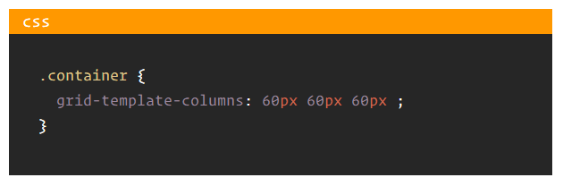
Defining the Grid – repeating items
If your grid contains several grid items of equivalent size than you can use the repeat() function instead of writing them out individually
Which is equivalent to:
1. Information on this slide from: https://css-tricks.com/snippets/css/complete-guide-grid/

Slide 17

fr Units
The fr unit allows you to set the size of a track as a fraction of the free space of the grid container
For example, this will set each item to one half the width of the remaining space in the grid container (100px – (remaining space / 2) )
100px
1fr
1fr
1. Information on this slide from: https://css-tricks.com/snippets/css/complete-guide-grid/

Slide 18
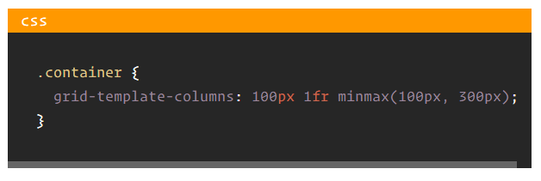
minmax() value
The minmax() method allows you set width or height of a grid track that can vary between a minimum value and a maximum value
100px
1fr
minmax(100px, 300px)

Slide 19
Grid Template Areas
Defines a grid template by referencing the names of the grid areas which are specified with the grid-area property
Repeating the name of a grid area causes the content to span those cells
A period signifies an empty cell
The syntax itself provides a visualization of the structure of the grid
1. Information on this slide from: https://css-tricks.com/snippets/css/complete-guide-grid/

Slide 20
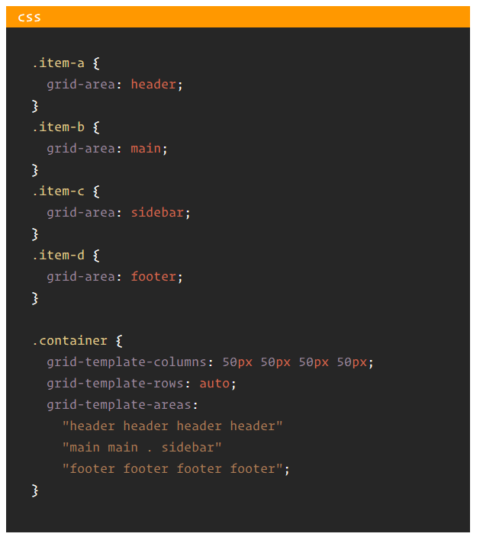
Grid Template Areas
Notice the dot. It represents an empty cell or placeholder
Grid items must have the grid-area property set to a value that matches the name in the grid-template-areas property
.
header
header
header
header
main
main
sidebar
footer
footer
footer
footer
1. Information on this slide from: https://css-tricks.com/snippets/css/complete-guide-grid/

Slide 21
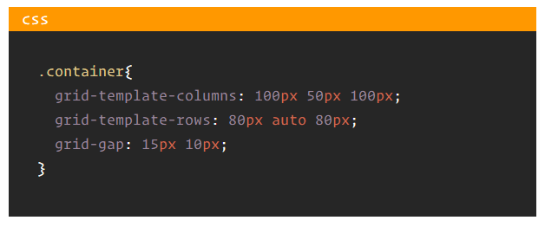
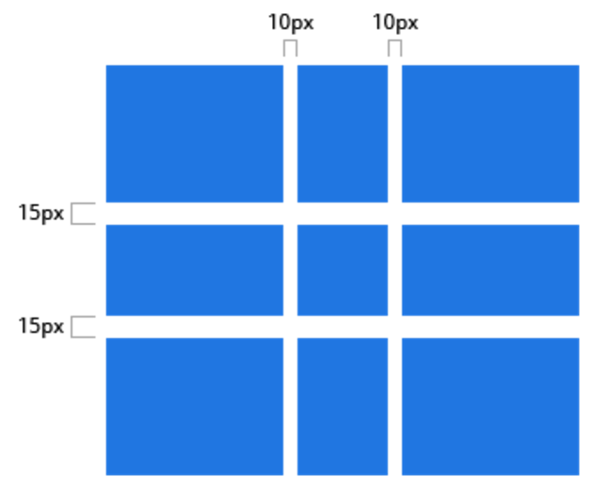
Grid Gap
Specifies the size of the grid lines
You can think of it like setting the width of the gutters between the columns/rows
The first value sets the row gap, the second value sets the column gap
1. Information on this slide from: https://css-tricks.com/snippets/css/complete-guide-grid/

Slide 22
Box Alignment Properties
Grid uses similar box alignment properties as flex-box
The following are box alignment properties used by grid
Set on the grid container element
justify-items
justify-content
align-items
align-content
Set on a grid item
justify-self
align-self

Slide 23
Justify Items
Aligns the content inside a grid item along the row axis (as opposed to align-items which aligns along the column axis). This value applies to all grid items inside the container
Values:
start - aligns the content to the left end of the grid area
end - aligns the content to the right end of the grid area
center - aligns the content in the center of the grid area
stretch - fills the whole width of the grid area (this is the default)
1. Information on this slide from: https://css-tricks.com/snippets/css/complete-guide-grid/

Slide 24
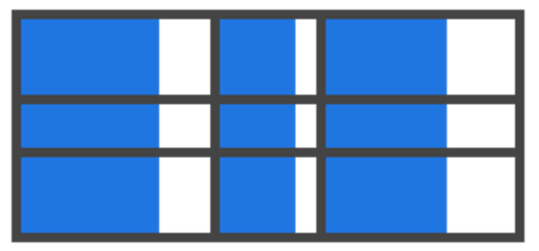
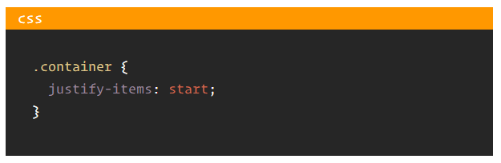
Justify Items - start
1. Information on this slide from: https://css-tricks.com/snippets/css/complete-guide-grid/

Slide 25
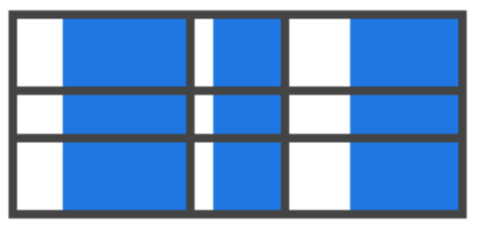
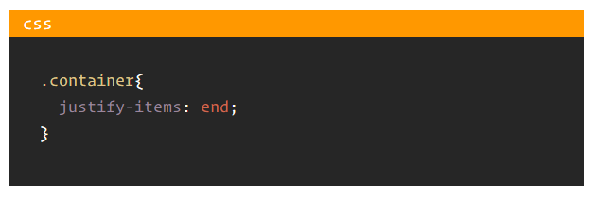
Justify Items - end
1. Information on this slide from: https://css-tricks.com/snippets/css/complete-guide-grid/

Slide 26
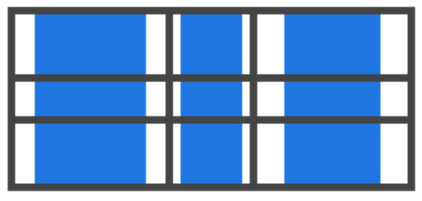
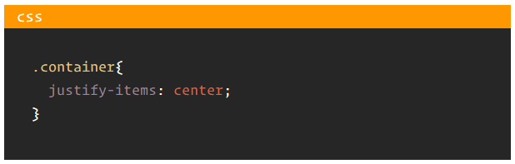
Justify Items - center
1. Information on this slide from: https://css-tricks.com/snippets/css/complete-guide-grid/

Slide 27
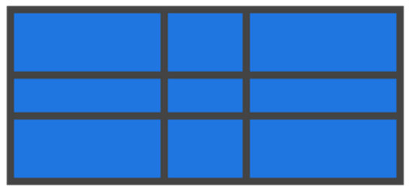
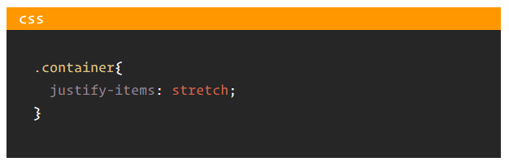
Justify Items - stretch
1. Information on this slide from: https://css-tricks.com/snippets/css/complete-guide-grid/

Slide 28
Align Items
Aligns the content inside a grid item along the column axis (as opposed to justify-items which aligns along the row axis). This value applies to all grid items inside the container
Values:
start - aligns the content to the top of the grid area
end - aligns the content to the bottom of the grid area
center - aligns the content in the center of the grid area
stretch - fills the whole height of the grid area (this is the default)
1. Information on this slide from: https://css-tricks.com/snippets/css/complete-guide-grid/

Slide 29
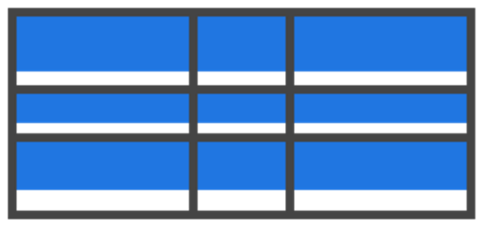
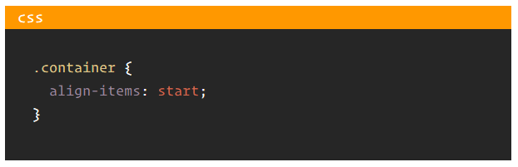
Align Items - start
1. Information on this slide from: https://css-tricks.com/snippets/css/complete-guide-grid/

Slide 30
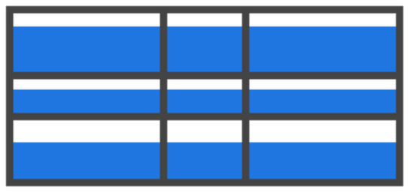
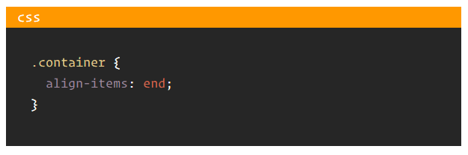
Align Items - end
1. Information on this slide from: https://css-tricks.com/snippets/css/complete-guide-grid/

Slide 31
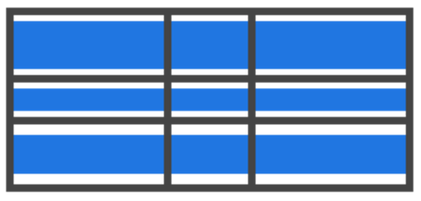
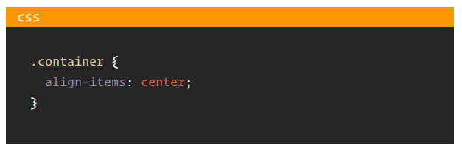
Align Items - center
1. Information on this slide from: https://css-tricks.com/snippets/css/complete-guide-grid/

Slide 32
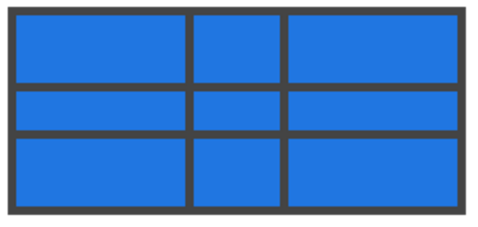
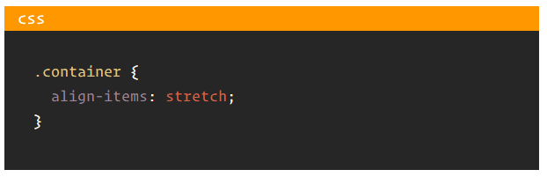
Align Items - stretch
1. Information on this slide from: https://css-tricks.com/snippets/css/complete-guide-grid/

Slide 33
Justify Content
Sometimes the total size of your grid might be less than the size of its grid container. This could happen if all of your grid items are sized with non-flexible units like px. In this case you can set the alignment of the grid within the grid container
This property aligns the grid along the row axis (as opposed to align-content which aligns the grid along the column axis)
Values:
start - aligns the grid to the left end of the grid container
end - aligns the grid to the right end of the grid container
center - aligns the grid in the center of the grid container
stretch - resizes the grid items to allow the grid to fill the full width of the grid container
space-around - places an even amount of space between each grid item, with half-sized spaces on the far ends
space-between - places an even amount of space between each grid item, with no space at the far ends
space-evenly - places an even amount of space between each grid item, including the far ends
1. Information on this slide from: https://css-tricks.com/snippets/css/complete-guide-grid/

Slide 34
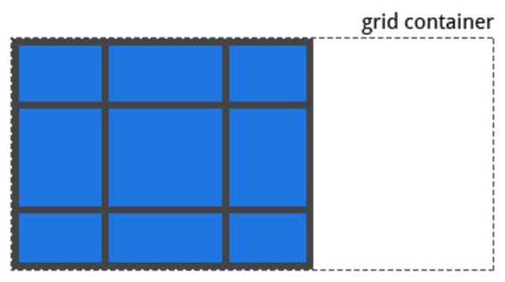
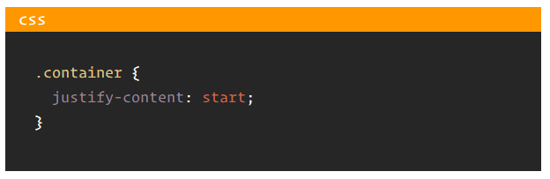
Justify Content - start
1. Information on this slide from: https://css-tricks.com/snippets/css/complete-guide-grid/

Slide 35
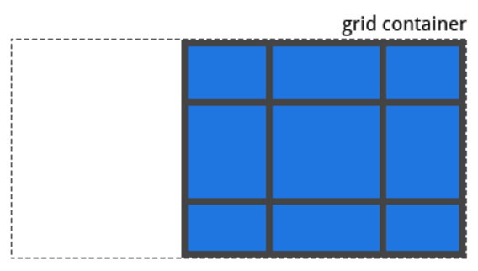
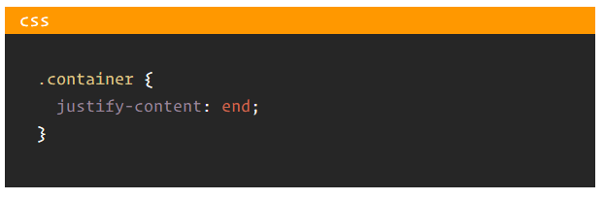
Justify Content - end
1. Information on this slide from: https://css-tricks.com/snippets/css/complete-guide-grid/

Slide 36
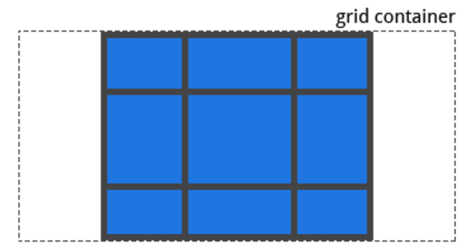
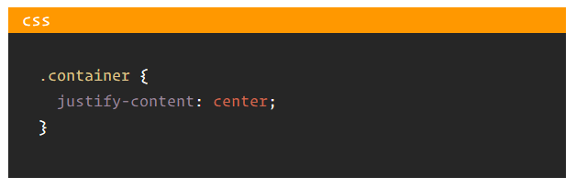
Justify Content - center
1. Information on this slide from: https://css-tricks.com/snippets/css/complete-guide-grid/

Slide 37
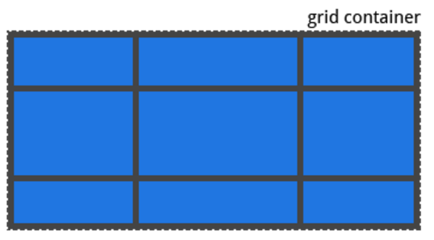
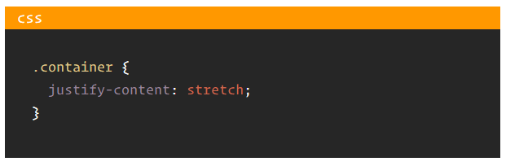
Justify Content - stretch
1. Information on this slide from: https://css-tricks.com/snippets/css/complete-guide-grid/

Slide 38
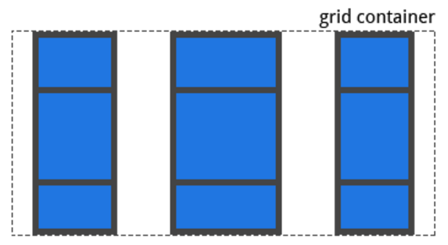
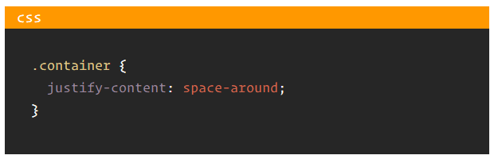
Justify Content – space-around
1. Information on this slide from: https://css-tricks.com/snippets/css/complete-guide-grid/

Slide 39
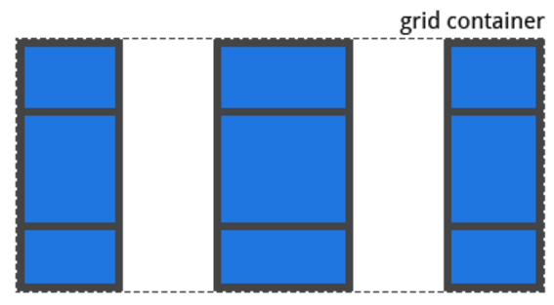
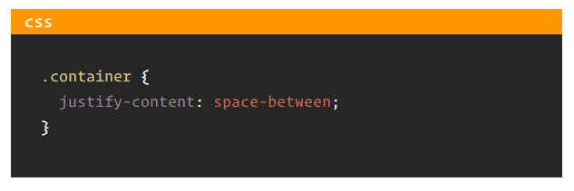
Justify Content – space-between
1. Information on this slide from: https://css-tricks.com/snippets/css/complete-guide-grid/

Slide 40
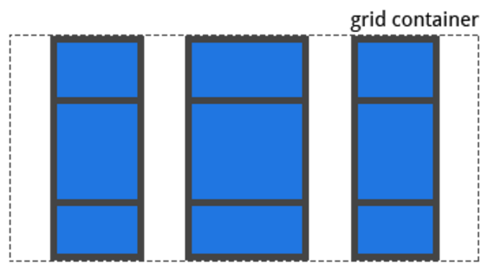

Justify Content – space-evenly
1. Information on this slide from: https://css-tricks.com/snippets/css/complete-guide-grid/

Slide 41
Align Content
Values:
start - aligns the grid to the top of the grid container
end - aligns the grid to the bottom of the grid container
center - aligns the grid in the center of the grid container
stretch - resizes the grid items to allow the grid to fill the full height of the grid container
space-around - places an even amount of space between each grid item, with half-sized spaces on the far ends
space-between - places an even amount of space between each grid item, with no space at the far ends
space-evenly - places an even amount of space between each grid item, including the far ends
Sometimes the total size of your grid might be less than the size of its grid container. This could happen if all of your grid items are sized with non-flexible units like px. In this case you can set the alignment of the grid within the grid container
This property aligns the grid along the column axis (as opposed to justify-content which aligns the grid along the row axis)
1. Information on this slide from: https://css-tricks.com/snippets/css/complete-guide-grid/

Slide 42
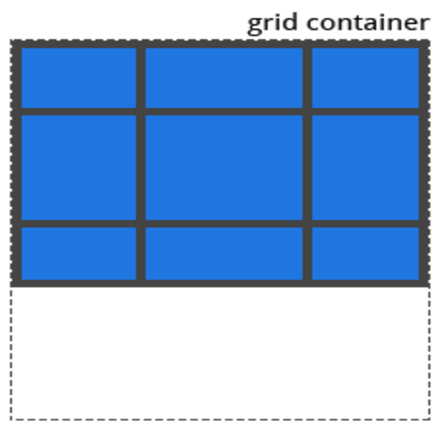
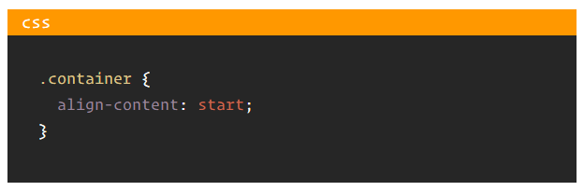
Align Content - start
1. Information on this slide from: https://css-tricks.com/snippets/css/complete-guide-grid/

Slide 43
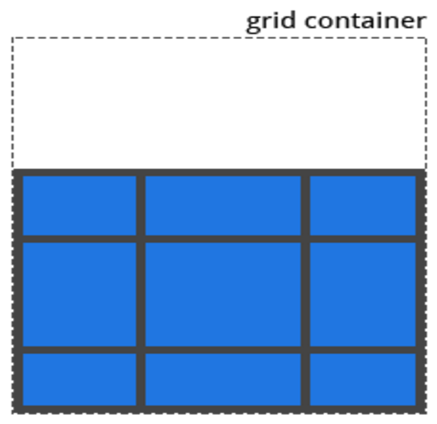

Align Content - end
1. Information on this slide from: https://css-tricks.com/snippets/css/complete-guide-grid/

Slide 44
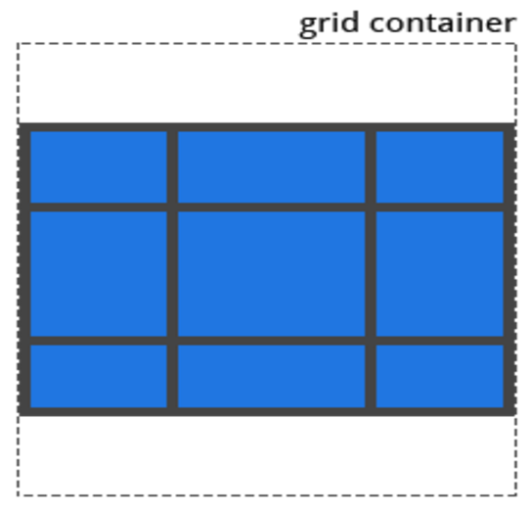

Align Content - center
1. Information on this slide from: https://css-tricks.com/snippets/css/complete-guide-grid/

Slide 45
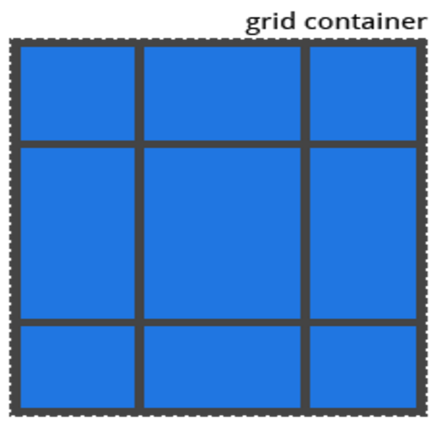

Align Content - stretch
1. Information on this slide from: https://css-tricks.com/snippets/css/complete-guide-grid/

Slide 46
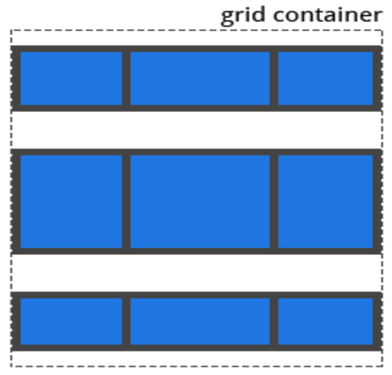
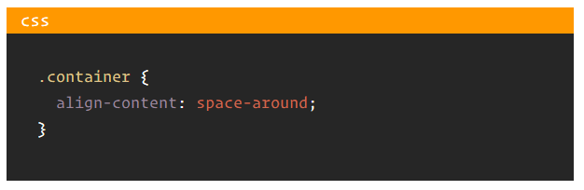
Align Content – space-around
1. Information on this slide from: https://css-tricks.com/snippets/css/complete-guide-grid/

Slide 47


Align Content – space-between
1. Information on this slide from: https://css-tricks.com/snippets/css/complete-guide-grid/

Slide 48


Align Content – space-evenly
1. Information on this slide from: https://css-tricks.com/snippets/css/complete-guide-grid/

Slide 49
Justify Self
Works similarly to justify-items except it is applied to a single grid item
Aligns the content inside a grid item along the row axis (as opposed to align-self which aligns along the column axis)
This value applies to the content inside a single grid item
Values:
start - aligns the content to the left end of the grid area
end - aligns the content to the right end of the grid area
center - aligns the content in the center of the grid area
stretch - fills the whole width of the grid area (this is the default)
1. Information on this slide from: https://css-tricks.com/snippets/css/complete-guide-grid/

Slide 50




Justify Self
start
end
center
stretch
1. Information on this slide from: https://css-tricks.com/snippets/css/complete-guide-grid/

Slide 51
Align Self
Works similarly to align-items except it is applied to a single grid item
Aligns the content inside a grid item along the column axis (as opposed to justify-self which aligns along the row axis)
This value applies to the content inside a single grid item
Values:
start - aligns the content to the top of the grid area
end - aligns the content to the bottom of the grid area
center - aligns the content in the center of the grid area
stretch - fills the whole height of the grid area (this is the default)
1. Information on this slide from: https://css-tricks.com/snippets/css/complete-guide-grid/

Slide 52




Align Self
start
end
center
stretch
1. Information on this slide from: https://css-tricks.com/snippets/css/complete-guide-grid/

Slide 53
Grid Auto Columns and Grid Auto Rows
Specifies the size of any auto-generated grid tracks (aka implicit grid tracks)
Implicit grid tracks get created when you explicitly position rows or columns (via grid-template-rows/grid-template-columns) that are out of range of the defined grid
We can use grid-auto-columns and grid-auto-rows to specify the widths of these implicit tracks
1. Information on this slide from: https://css-tricks.com/snippets/css/complete-guide-grid/

Slide 54


Grid Auto Columns and Grid Auto Rows
1. Information on this slide from: https://css-tricks.com/snippets/css/complete-guide-grid/

Slide 55
Grid Auto Flow
If you have grid items that you don't explicitly place on the grid, the auto-placement algorithm kicks in to automatically place the items
This property controls how the auto-placement algorithm works
Values:
row - tells the auto-placement algorithm to fill in each row in turn, adding new rows as necessary
column - tells the auto-placement algorithm to fill in each column in turn, adding new columns as necessary
dense - tells the auto-placement algorithm to attempt to fill in holes earlier in the grid if smaller items come up later
1. Information on this slide from: https://css-tricks.com/snippets/css/complete-guide-grid/

Slide 56

Grid Auto Flow - row
item-b, item-c and item-d are not set explicitly on the grid, so they are placed automatically along the first available row
item-a and item-e are set explicitly on the grid
1. Information on this slide from: https://css-tricks.com/snippets/css/complete-guide-grid/

Slide 57

Grid Auto Flow - column
item-b, item-c and item-d are not set explicitly on the grid, so they are placed automatically along the first available column
item-a and item-e are set explicitly on the grid
1. Information on this slide from: https://css-tricks.com/snippets/css/complete-guide-grid/

Slide 58
Grid Column and Grid Row
The "grid-column" and "grid-row" property are set on a grid item
They determine where on the grid a grid item will go
The first value is the starting line followed by a " / " (the space is important)" and then a second value which is the ending line
You can tell a grid item to span a number of lines by using the "span" keyword

Slide 59


Grid Column and Grid Row
1
2
3
4
1
2
3
4
5
6
1. Information on this slide from: https://css-tricks.com/snippets/css/complete-guide-grid/

Slide 60
Grid Order
Similar to flex box's order property. This is set on the grid items
Any numerical value is valid. Grid items order values with larger numbers go to the end of the grid

Slide 61

Grid Order
order property set to 1
order property set to 2

