Slide 1

March 8th 2022
Master Class: 5 Rancher Tricks
Tips to optimize common Rancher/Kubernetes workflows
--Jason Skrzypek

Slide 2





Agenda
CLI
<Disclaimer> Use at your own risk. These are examples, not “plug and play” solutions. </Disclaimer>
CI/CD
GUI
API
K8S

Slide 3
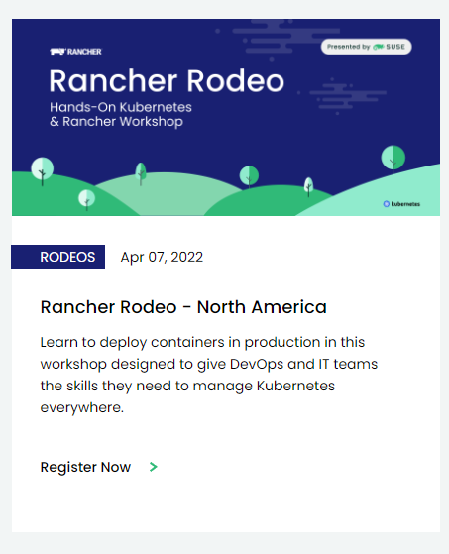
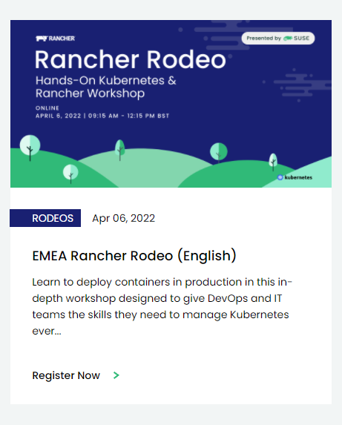
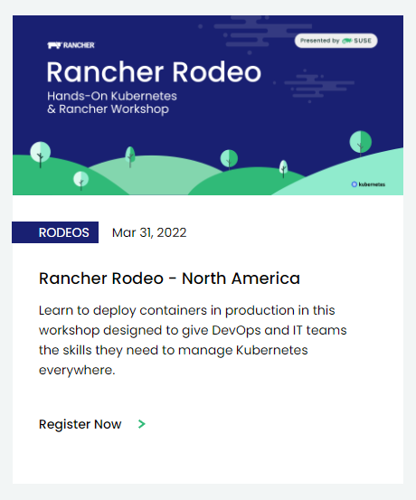
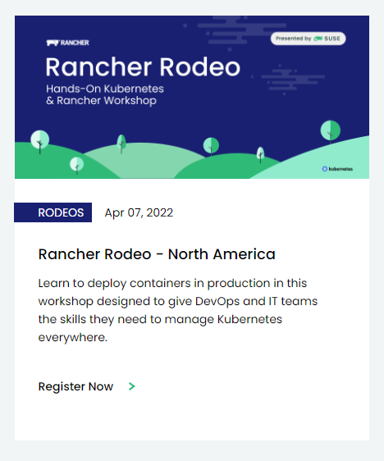
Rodeo Level 2?
What to do after you have mastered the Rancher Rodeo.

Slide 4
Reduce the complexity of your console

Slide 5

How many tools do you use?
Cloud Provioning (AWS,Azure,GCP)
Generic Provisioning (Terraform,Pulumi)
Containers (Docker,Nerdctl)
Kubernetes (helm,kubectl,krew)
Rancher (rancher,istioctl,helm)

Slide 6
Solutions
In no particular order
HUBER
github.com/ innobead/huber
80 Stars
Written in Rust
ASDF
github.com/ asdf-vm/asdf
13.4k Stars
Written in Shell
ARKADE
github.com/ allexellis/arcade
2.5k Stars
Written in Golang
NIX
github.com/ nixos/nix
5.7k Stars
Written in C++

Slide 7
General Tips for Kubernetes
If you’re not using aliases, then you’re typing too much. https://github.com/ahmetb/kubectl-aliases
Running `kubie` or `kubectx & kubens` will be much easier than managing disparate kubeconfigs. https://github.com/ahmetb/kubectx https://github.com/sbstp/kubie
Make your prompt Kubernetes aware. https://github.com/starship/starship
Easily pull down kubeconfigs from Rancher. https://gist.github.com/shpwrck/845722d408884be2c762ee1b47a82e3d

Slide 8
Testing Rancher Configurations Automatically

Slide 9
Deploying Rancher in your CI/CD workflow
The “Manual Quick Start” (standalone container installation) works in a pinch, but we can do better. https://rancher.com/docs/rancher/v2.6/en/quick-start-guide/deployment/quickstart-manual-setup/
What do we need?
Multiple nodes
What do we have?
Container runtimes in most CI/CD platforms
What distribution should it run on?
Either a generic upstream distribution, or the same distribution
What limitations do we have?
There will be no manual intervention or pre/post setup available

Slide 10
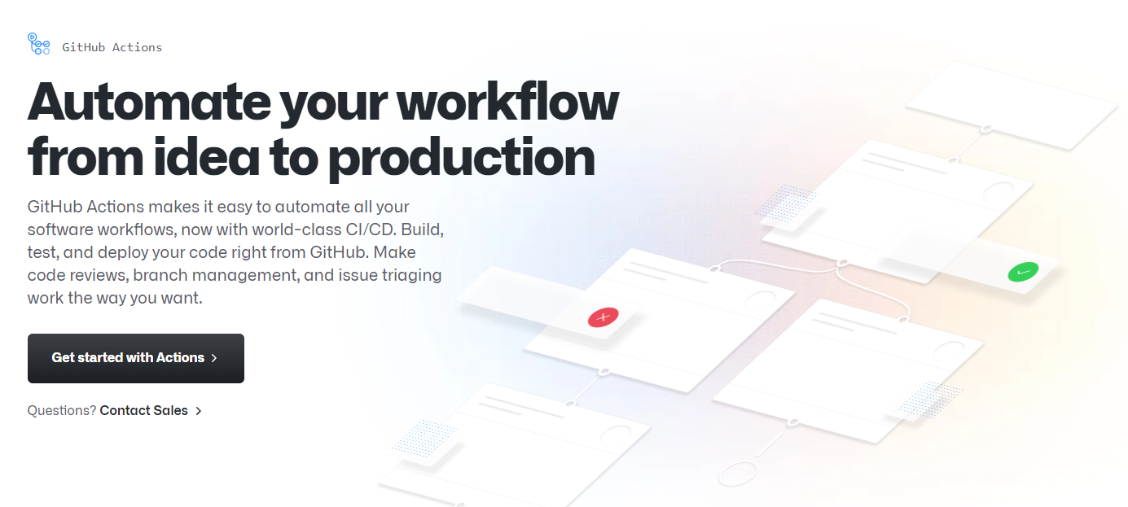
Example Implementation

Slide 11
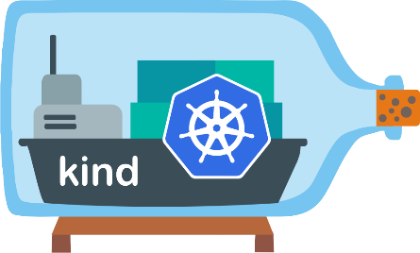


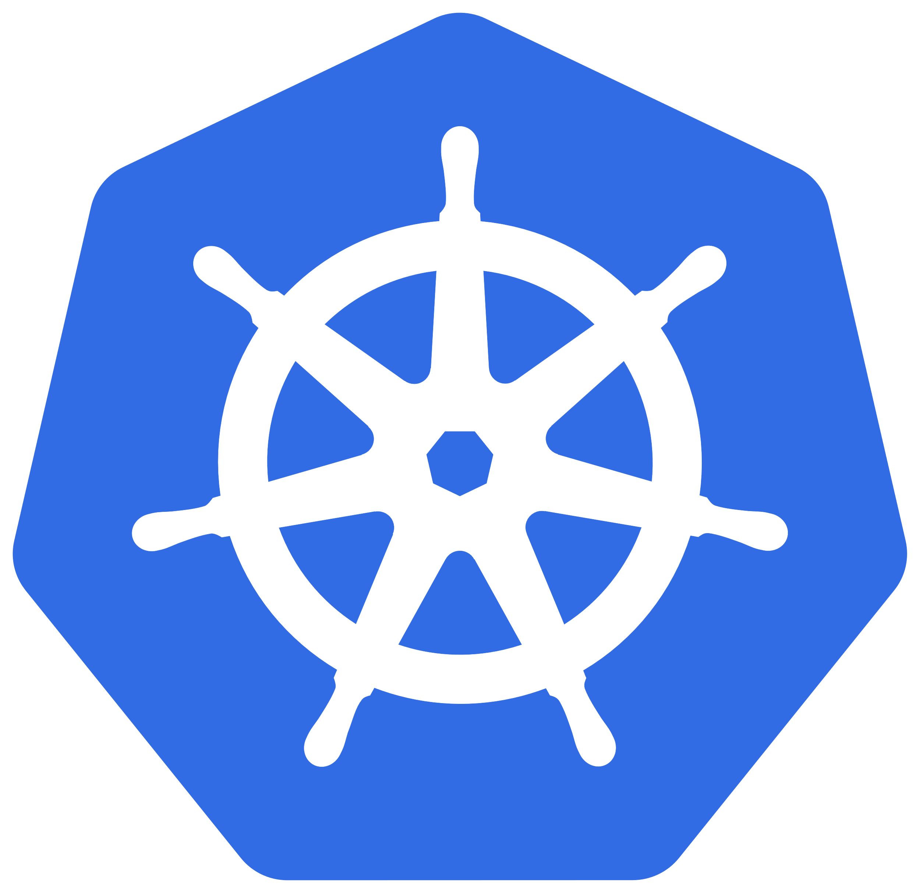
Key Ingredients: https://gist.github.com/shpwrck/ccd495a4943e8b677086342ca6060abc
KinD: Other solutions could work, but KinD has an action.
Ingress Controller: I chose NGINX for parity reasons.
Rancher Settings: Bypassing the bootstrap screen & credentials is tricky.
CLI Tooling: You ultimately need to run/test something.

Slide 12
There’s some magic in the UI to reduce actions.

Slide 13
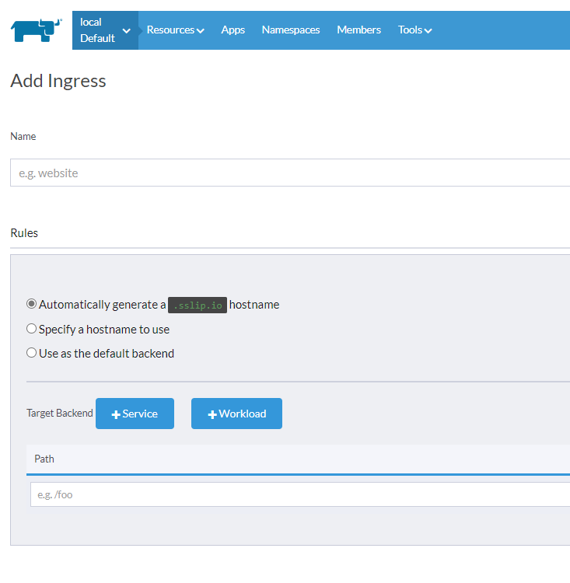
How do you automatically generate a hostname in the new UI?

Slide 14
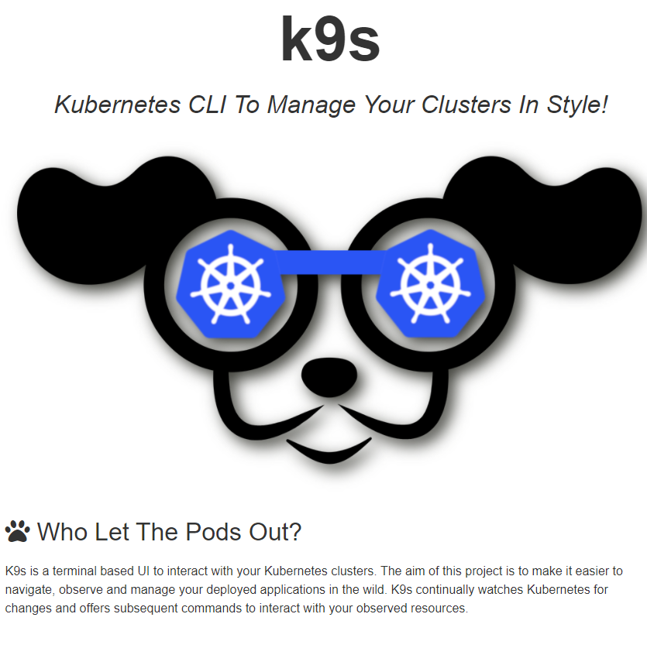
For those who want both a GUI and a TUI

Slide 15
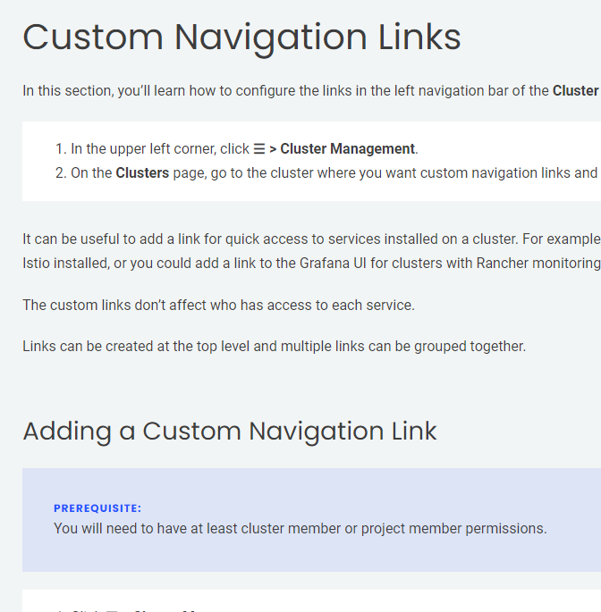
Taking advantage of Rancher 2.6’s UI flexibility

Slide 16
Easily access services using known configurations

Slide 17
Proxy Services Through Rancher
Have you ever looked at the included Grafana dashboard?
It’s a hint to how to access cluster services through Rancher!
https://demo.fremont.rancherlabs.com/k8s/clusters/c-sjfvh/api/v1/namespaces/default/services/http:frontend:80/proxy/
https://demo.fremont.rancherlabs.com – Rancher Server URL
/k8s/clusters/c-sjfvh – Cluster Identifier
/api/v1/namespaces/default – Namespace Identifier (default is the namespace)
/services/http:frontend:80 – Service Identifier (protocol, name, port)
/proxy
Try it with a service of your own!

Slide 18
Kubernetes

Slide 19

Rancher can Helm, and Helm can Rancher, so can Rancher Rancher?

Slide 20
Concept
Use Rancher to manage it’s own helm chart installation.
Process:
Install Rancher
Add Rancher Repository
Modify Bootstrap Secret with required keys
Modify installation as necessary
Precautions:
Don’t lose track of the original Rancher/Helm configuration.
Be aware of the access implications.

Slide 21

Rancher can Fleet, and Fleet can Rancher, so can Rancher Rancher?

Slide 22
Concept
Use a Rancher instance to manage several Rancher instances using fleet.
Process:
Provision Rancher normally.
Create some number of additional clusters.
Install Fleet on each cluster.
Create ‘GitRepo’ object with Rancher configuration.
Maintain ‘Leaf’ Rancher through GitOps
Precautions:
Fleet is leveraged internally for Rancher as well, be aware that deployment changes in subsequent releases may require additional configuration.

Slide 23
Fleet can do more outside of Rancher
Image Scan https://fleet.rancher.io/imagescan/
Webhook (Push Model) https://fleet.rancher.io/webhook/
Bundle diffs are hard to generate.
There’s JSON Patch Builder Online (json-patch-builder-online.github.io)
As well as some CLI solutions.

