Slide 1


Childcare Affordability Across U.S. Counties
A Data Storytelling Project
Shaghayegh Malekshahi Bellevue University DSC640-T301 Data Presentation & Visualization

Slide 2

Problem Statement
Childcare costs have increased significantly across the United States.
High childcare prices affect workforce participation and family financial stability.
Infant childcare often represents one of the largest household expenses for families.
Policymakers and workforce development leaders need reliable data to identify where affordability burdens are most severe.
This project analyzes childcare affordability across U.S. counties to highlight geographic disparities.

Slide 3

Dataset
This analysis uses the National Database of Childcare Prices, a county-level dataset published by the U.S. Department of Labor Women’s Bureau. The dataset provides childcare price estimates across the United States and includes multiple childcare types and age groups.
Key variables used in this analysis include:
Weekly childcare prices for infants, toddlers, and preschool children
Costs for center-based childcare and family childcare providers
Median household income for each county
To maintain consistency and interpretability, the analysis focuses on 2018, the most recent year available in the original dataset used for the project.

Slide 4

Analytical Approach
To evaluate childcare affordability, weekly infant childcare prices were converted into annual cost estimates. These values were then compared with county-level median household income to calculate an affordability ratio, representing the share of household income required to pay for infant childcare.
Additional comparisons were conducted across:
childcare age groups
center-based vs family childcare providers
geographic differences across counties and states
The goal of this analysis is not only to measure childcare prices but also to highlight how affordability burdens vary across regions.

Slide 5

Medium 1: Policy Presentation
The first communication medium is a policy-focused presentation designed for policymakers and workforce development stakeholders. The objective of this medium is to present the most important affordability patterns clearly and concisely so decision-makers can identify where childcare costs place the greatest financial burden on families.
The following visualizations highlight major affordability patterns and geographic differences in childcare pricing across the United States.

Slide 6
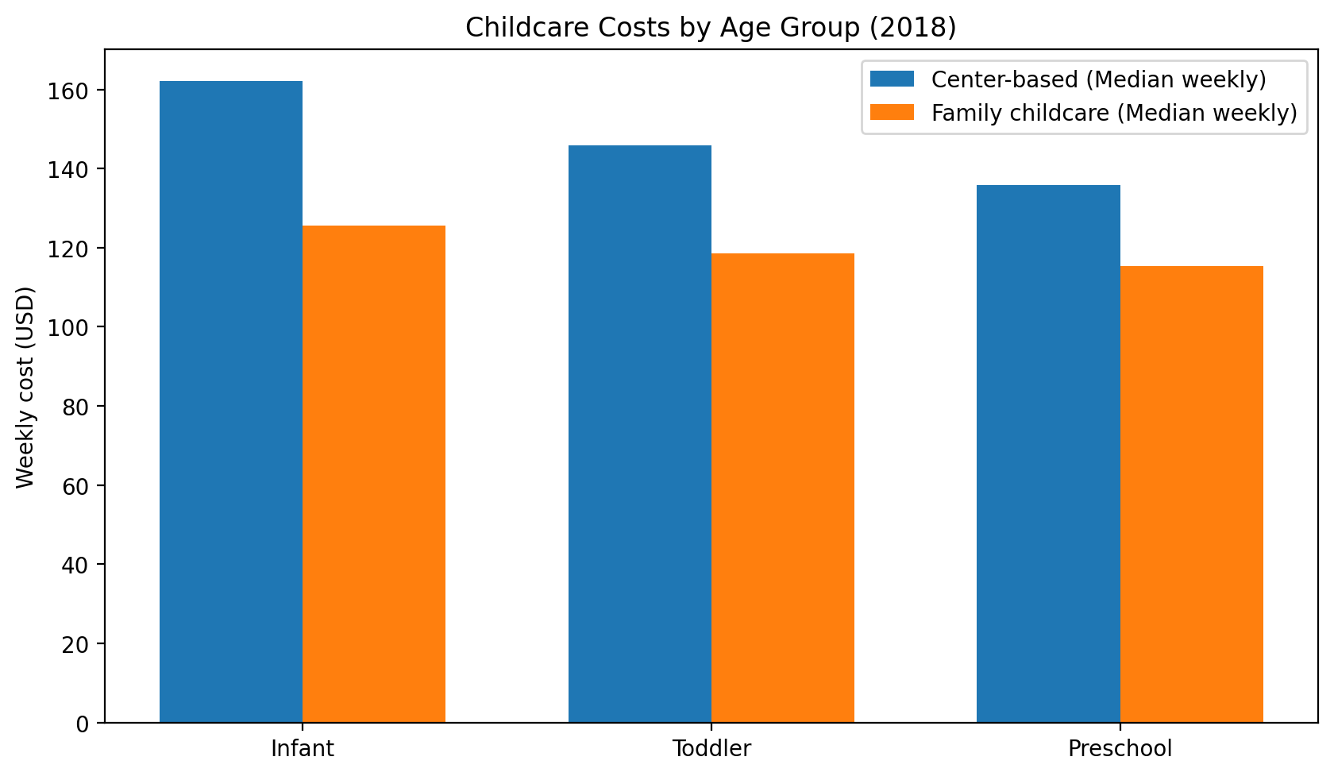
Childcare Costs by Age Group
Infant childcare consistently represents the highest average weekly cost across both center-based and family childcare settings. Costs decline slightly for toddlers and preschool children, but infant care remains the most financially demanding stage for families requiring full-time childcare.
Additionally, center-based childcare is consistently more expensive than family childcare across all age groups, demonstrating structural differences in pricing between childcare provider types.

Slide 7
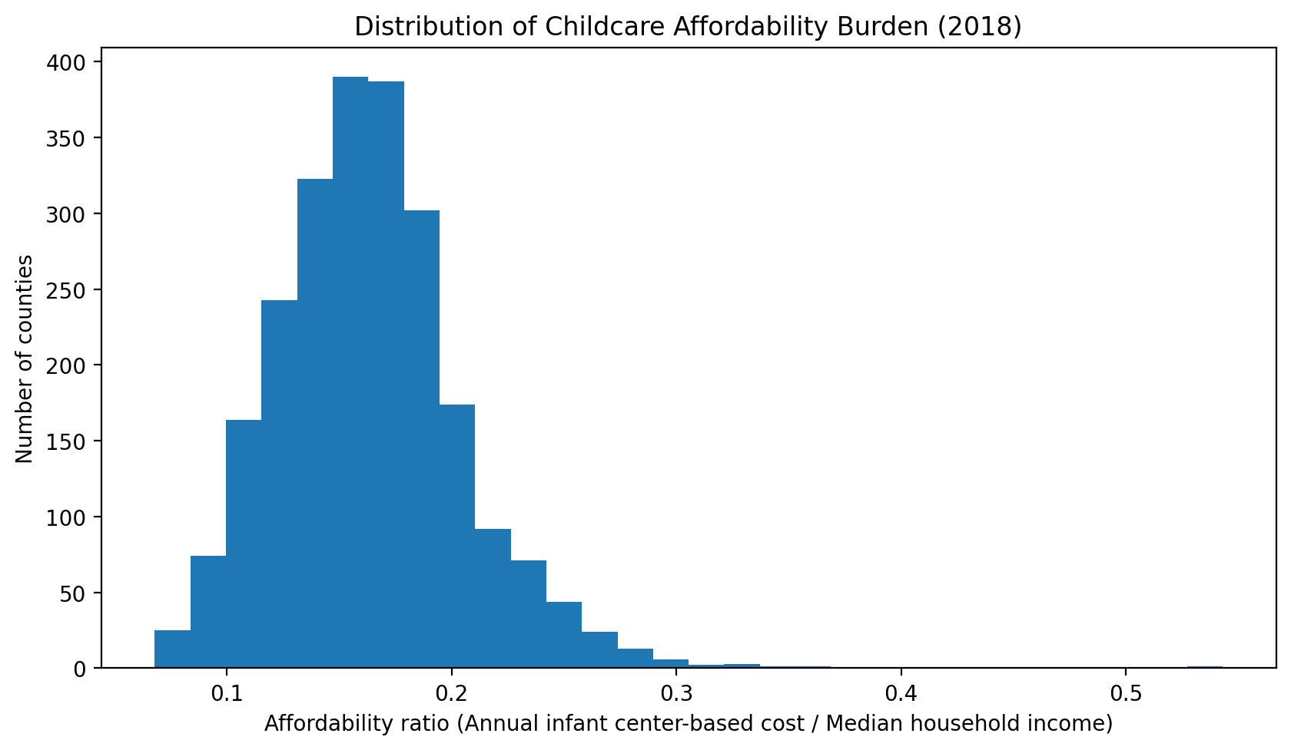
Affordability Burden Across Counties
Affordability was calculated as the ratio of annual infant childcare cost to median household income. The distribution across counties shows substantial variation, indicating that childcare affordability challenges are not experienced uniformly across the United States.
While some counties experience moderate affordability burdens, others face significantly higher cost pressures relative to income levels.

Slide 8
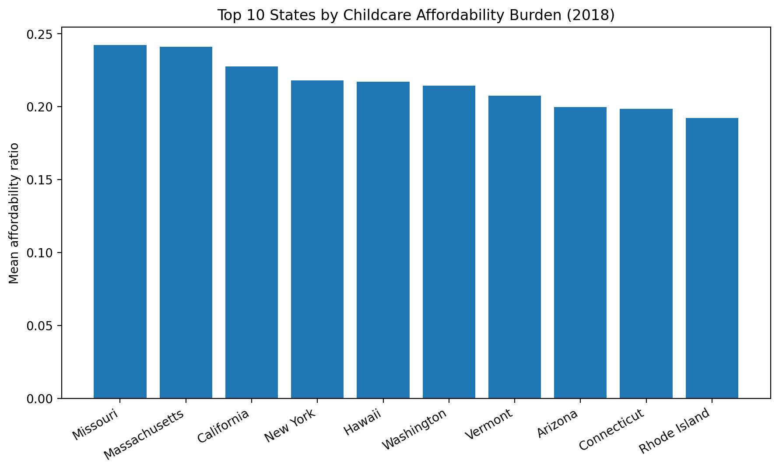
States with the Highest Affordability Burden
When county data is aggregated at the state level, several states demonstrate substantially higher affordability burdens compared to others. These patterns suggest that childcare affordability challenges are geographically concentrated and that policy responses may need to be tailored to regional economic conditions rather than applied uniformly nationwide.

Slide 9
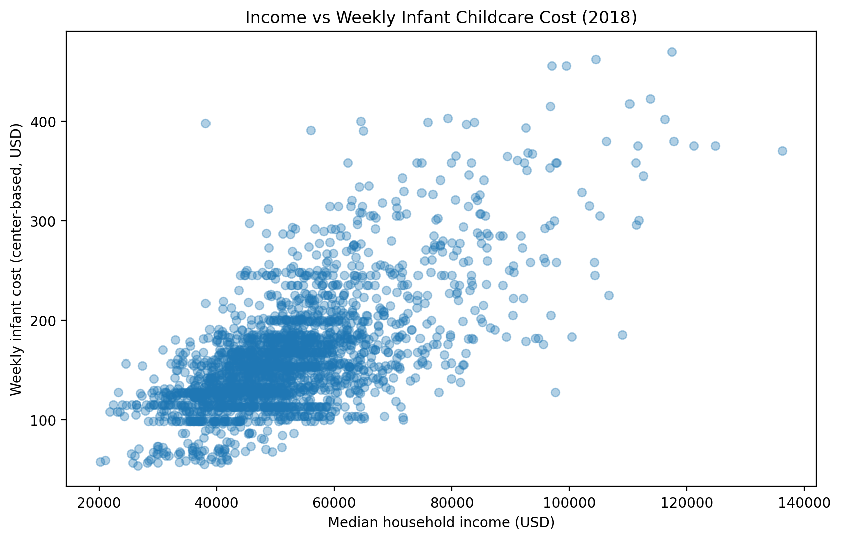
Income and Childcare Cost Relationship
Although higher household income can reduce financial strain in some areas, the relationship between income and childcare cost is not perfectly aligned. Some higher-income counties still experience high childcare prices, suggesting that structural pricing differences across regions play a significant role in affordability challenges.
This indicates that childcare affordability cannot be explained by income alone.

Slide 10
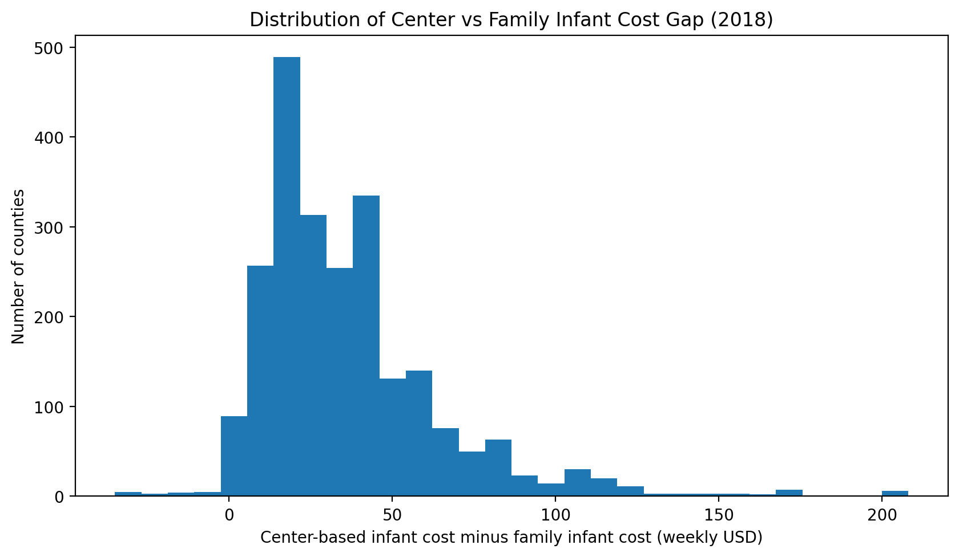
Center vs Family Infant Care Cost Gap
The difference between center-based infant care and family childcare varies widely across counties. In many regions, family childcare provides a lower-cost alternative to center-based care. This gap highlights potential opportunities for reducing childcare costs if families have access to family childcare providers and if policies support their availability.

Slide 11
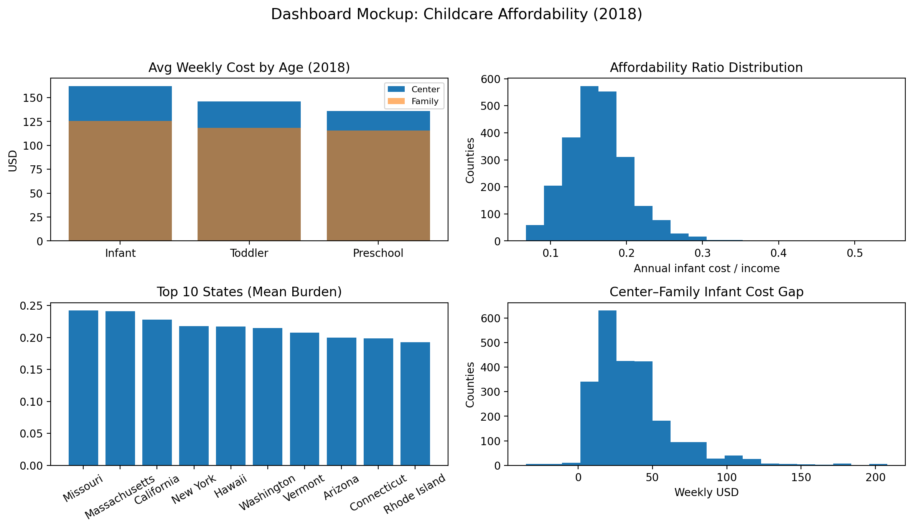
Medium 2: Dashboard Concept
The second communication medium is an interactive dashboard intended for analysts and program managers who require deeper exploration of childcare affordability patterns.
A dashboard would allow users to interact with the data and explore affordability patterns through filters such as:
state or county
childcare type
age group
affordability threshold
This medium enables users to identify high-burden regions and prioritize policy responses based on localized data.

Slide 12
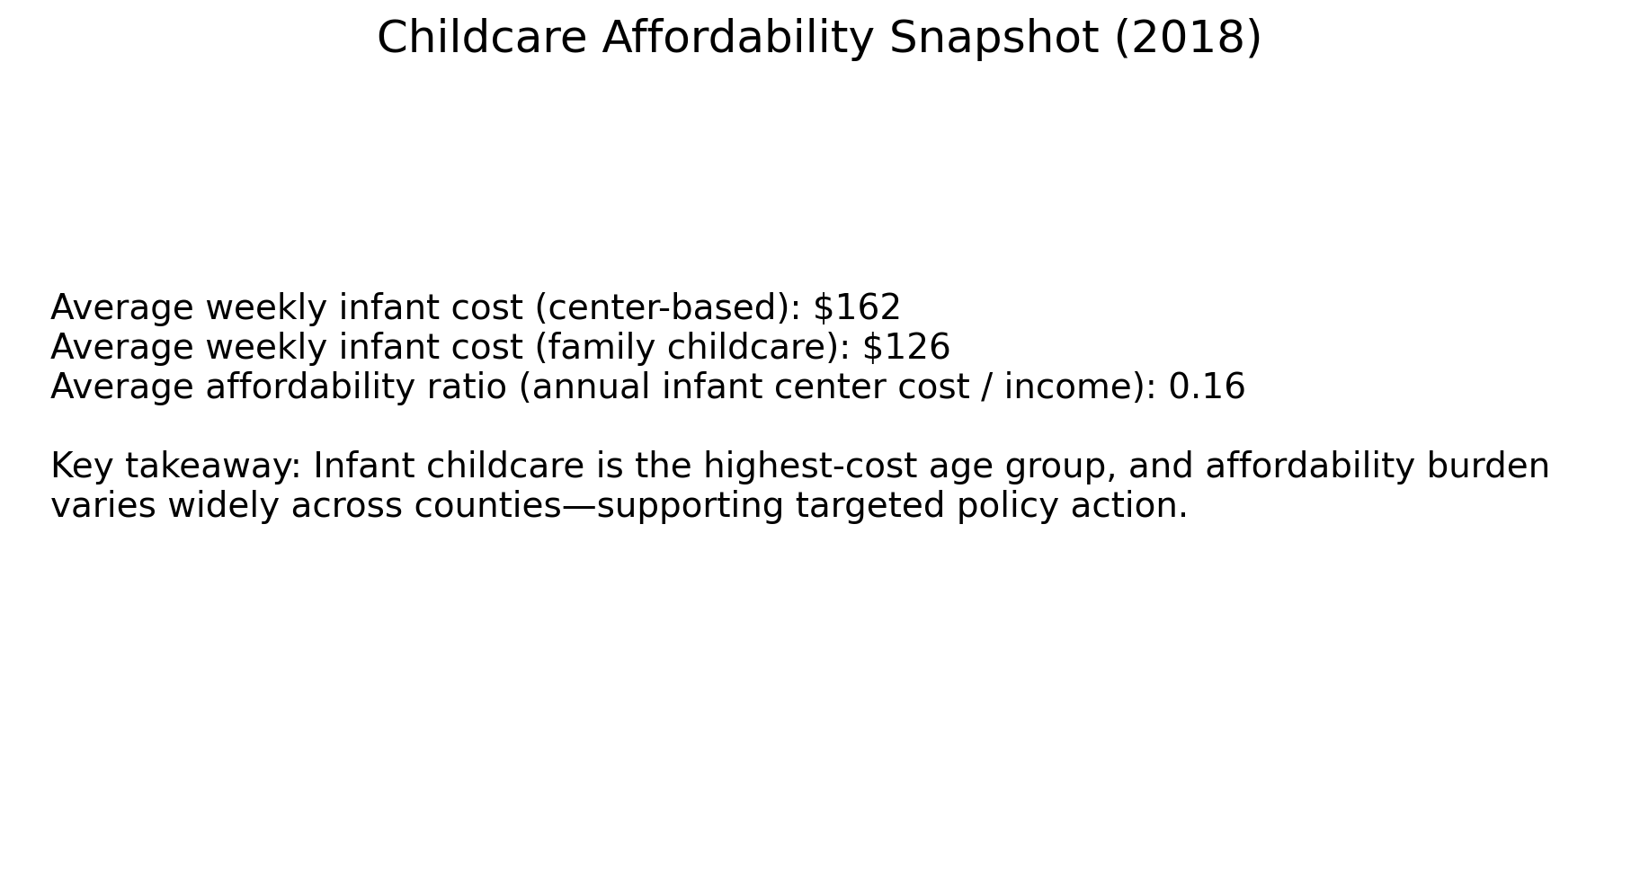
Medium 3: Public Infographic
The third communication medium is a public-facing infographic designed for parents, advocacy groups, and the general public.
Unlike the policy presentation or dashboard, the infographic focuses on accessibility and quick understanding. Simplified visuals highlight key insights about childcare affordability and communicate the financial burden faced by families with young children.
The goal of this medium is to increase awareness and encourage public engagement around childcare affordability challenges.

Slide 13

Key Insights
The analysis highlights several important patterns:
Infant childcare represents the largest affordability challenge for families.
Center-based childcare is consistently more expensive than family childcare.
Childcare affordability varies significantly across counties and states.
Higher household income does not always eliminate affordability challenges.
Geographic differences suggest the need for targeted policy interventions.
These insights demonstrate that childcare affordability is not only expensive, but also unevenly distributed across the United States.

Slide 14

Design Decisions
The visual design of this project emphasizes clarity and accessibility for non-technical audiences. Bar charts were used to compare childcare prices across age groups and childcare types because they provide straightforward comparisons. Histograms were used to display affordability distributions and cost gaps in order to highlight variability and inequality rather than focusing only on averages.
A scatter plot was used to examine the relationship between income and childcare cost, demonstrating that affordability challenges extend beyond low-income regions. Consistent colors, clear labeling, and balanced spacing were used throughout the visuals to minimize cognitive load and improve readability for policymakers and stakeholders.

Slide 15

Conclusion
Childcare affordability represents a significant financial challenge for families across the United States, particularly for households with infants requiring full-time care. The analysis demonstrates that affordability burdens vary widely across counties and states, indicating that childcare challenges are not evenly distributed nationwide.
By translating complex data into clear visual narratives, this project illustrates how data storytelling can inform targeted policy responses aimed at improving childcare accessibility, strengthening workforce participation, and supporting family financial stability.

