Slide 1
STAY
Roomfinder Web Application
Prepared by:
Samir Shrestha
Bijesh Limbu
Veshraj Neupane
Prashant KC

Slide 2
Problem Statement
Room-finding have been a challenge in urban areas of Nepal.
Especially, in desired locations for families and students.

Slide 3
Problem Solution
This project helps tenant to find rooms easily in their desired locations.
This project makes room finding process easy, fast, reliable and time-saving.

Slide 4
Objectives
To help tenant to find rooms easily in their desired locations.
To make room finding process easy, fast, reliable and time-saving.
To have good knowledge in web development.
To have interactive and responsive web design.

Slide 5
FlowChart
Does the tenant find interesting room?
Is the house owner ok to arrange a
viewing?
Current tenant in charge of search
Looks ad online
Yes
Send a bio to the ad poster and arrange a viewing
Yes
Go visit the place
No
No
Do the
tenant like the place ?
No
No
Do house owner like the tenant?
New Tenant gets the room
Discuss & fix rent
Yes

Slide 6
Tools Used
HTML
CSS
Bootstrap
Django
Python

Slide 7
Open Street Map
It is a free and editable world map.
It also includes individual buildings which makes it even more suitable for our project.

Slide 8
Anaconda
Anaconda is a free and open-source distribution of Python.
It simplifies package management and deployment.
Easy virtual environment creation for django projects.
Easy integration of open street map with django projects.

Slide 9
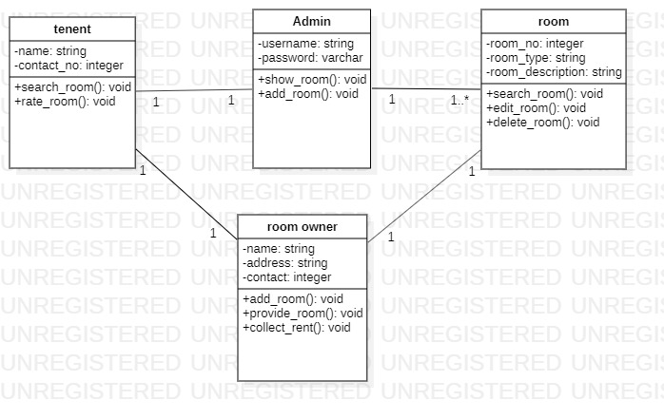

Slide 10
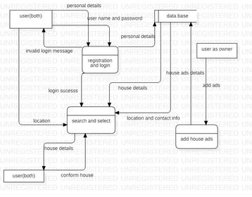

Slide 11
Features
Hide an AD:
Hide room ads you are not interested in to avoid losing time. Check ads only on those areas of your search.
Ads are shown only when you click the location of that ad.

Slide 12
Features
Are you Pet Friendly?
Users will be able to know before moving in if tenant/house owner have any pets or not.
Helps to minimize the issues between house owner and tenant regarding pets.

Slide 13
Features
Amenities
Different amenities are mentioned in the form of check-box that are found in Nepalese Society.
Eg: 24-hr water,furnished or not, wifi available, etc.

Slide 14
Features
House Rules
Different house rules are mentioned in the form of check-box that are found in Nepalese Society.
Eg: late night arrival,access rooftop, no smoking/drinking, guests frequency, etc.

Slide 15
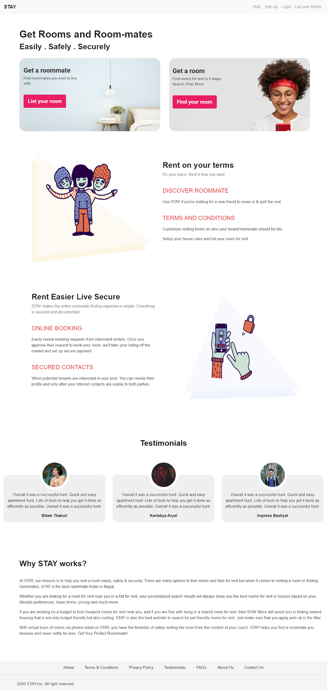

Slide 16
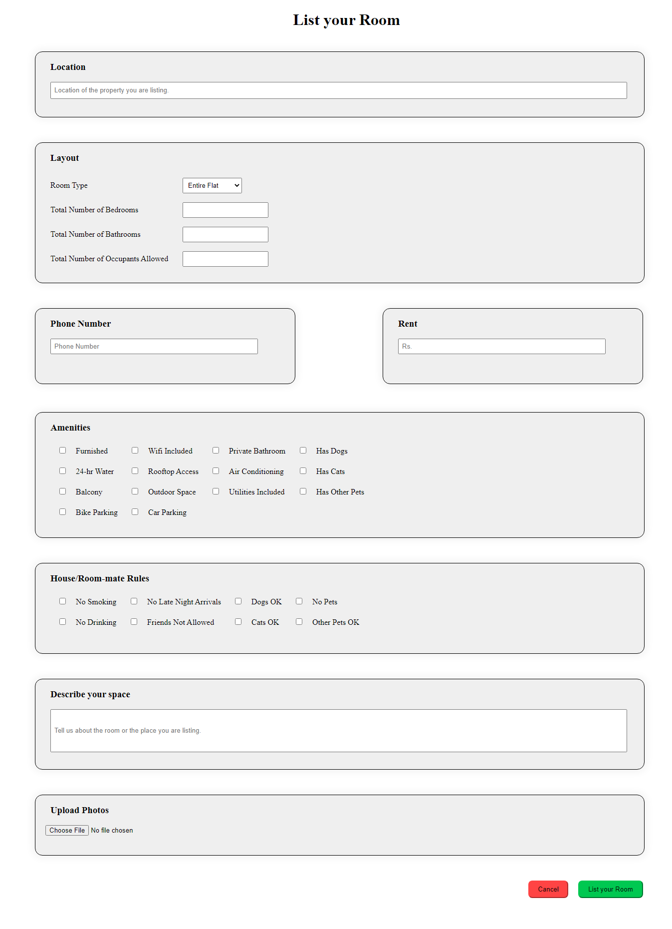

Slide 17
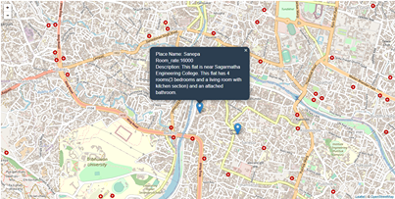

Slide 18
Thank You

